Slide 1




Where you are Loved, Included and Respected
St Charles’ Primary School
& Early Learning Childcare Class
School Improvement Plan Summary
2024/25

Slide 2

Our Vision
The vision of St Charles' Primary School is for all to be safe, happy, and confidently engaged as learners in an environment where all individuals are respected; where the message of Christ is central in all that we do; where parents and carers are highly valued as partners and where everyone is motivated and encouraged to do their very best.

Slide 3



Our Values

Slide 4
Our Aims
In St Charles' Primary School we aim to:
Provide a broad general education that meets the needs, expectations and aspirations of pupils and parents supported by well-trained motivated staff and well organised modern education resources.
Create a welcoming atmosphere and a positive ethos, allowing all children to be educated according to their needs in a safe, secure, happy and health-promoting environment based on Christ’s Gospel values
Enable learners to realise their full potential through the provision of high-quality learning opportunities which encourage independence & co-operation in learning.
Support children’s growth in all aspects of their intellectual, physical, spiritual, social and emotional development affording all children equality of opportunity.
Ensure all pupils value learning & achievement and are motivated to participate in the wider life of the school community.
Provide highly effective personalised support for learners to minimise the impact of potential barriers to learning.
Develop a genuine partnership with parents & other service users where every member of the community holds a deep respect for all others and their personal wellbeing and happiness.
Ensure the school’s approach & commitment to improvement through self-evaluation, and high-quality leadership at all levels, maximises pupil attainment & achievement.

Slide 5


SCHOOL IMPROVEMENT PROGRESS Session 2023/24
Click HERE to read
Standards & Quality Report 2023/24

Slide 6
School Improvement Plan Priorities 24/25
Improvement Priority 1
Develop high quality learning, teaching and assessment leading to improved attainment and achievement in numeracy & reading
Improvement Priority 2
Ensure that children will experience inclusive learning & supportive relationships which lead to positive life outcomes.

Slide 7


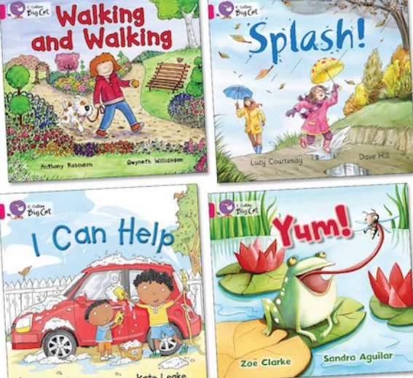
Improvement Priority 1 Develop high quality learning, teaching and assessment leading to improved attainment and achievement in numeracy & reading
Develop a new policy for staff on “Highly Effective Learning & Teaching” to ensure consistency of practice across the school.
Refocus on Number Talks in all classes across the school.
Adopt a Modelling & Coaching model to support staff understanding of & increase confidence in using Concrete, Pictorial & Abstract in teaching to secure improved numeracy outcomes for learners.
Introduce Big Cat reading resource supported by training to improve engagement motivation & reading skills.
Achieve Reading Schools GOLD accreditation to ensure the profile of reading continues to be central in our school.

Slide 8
Improvement Priority 1 (in the ELCC) Develop high quality learning, teaching and assessment leading to improved attainment and achievement in numeracy & reading
Raise attainment in numeracy & literacy performance for pre-school learners.
Extend learning opportunities relating to specific numeracy milestones: shape, money and position both indoors & outdoors.
Extend learning opportunities relating to specific literacy milestones (syllables, rhyme & letters) both indoors & outdoors.
Close the gender related performance gap.
Talk for Writing approach will be extended to include ELCC learners.
Monitor progress closely to ensure consistency of approach is adopted.

Slide 9


Improvement Priority 2 Ensure that children will experience inclusive learning & supportive relationships which lead to positive life outcomes.
Improve Citizenship Groups- every child P5-7 will be a member & every child P1-4 given opportunities to influence change and be involved in decision-making through Stage Reps & school assemblies.
Increase pupil voice and the involvement of learners in evaluation processes using HGIOURS. The Young Leaders of Learning (YLL) Programme will provide opportunities for learner involvement in reciprocal visits to a partner school (West PS).
Raise the profile of “Laudato Si” & ensure the wider community know about Our Pledge & showcasing the work we undertake as a community of faith & learning through “Best Seat in the House” events.
Achieve Rights Respecting Schools (RRS) Bronze Award Accreditation from UNICEF UK, ensuring all children and staff will have an understanding of the UNCRC and how this affects their own lives in school, home and the wider community.

Slide 10
Improvement Priority 2 (in the ELCC) Ensure that children will experience inclusive learning & supportive relationships which lead to positive life outcomes.
All staff will to undertake professional enquiry focussed on the outdoor environment.
Refresh learning in & beyond the playroom using the outdoors & local community as “the third teacher.”
Explore the concepts of reusing, recycling, rethinking, and repurposing of resources, furniture and equipment to promote an awareness of sustainable practices.
Provide opportunities for children to problem solve and be creative, in ways that develop their respect for the environment and thoughtful use of limited natural resources,
Provide opportunities for learning to take place in the wider local community.

Slide 11




Slide 12

HAVE YOUR SAY!
Please take the opportunity to share your thoughts with us as we use feedback to help us make improvements to our school.
It you have any comments, please email the school at
stcharlesenquiries@renfrewshire.gov.uk

