Slide 1
Returning to school - August 2020 A guide for parents/carers
St Catherine’s Primary School
&
ELCC

Slide 2
We will be returning to school in August 2020 and we have been working very hard to create a safe and nurturing environment for all our children.
Although our school will look and feel different, we still have our school values at the centre of everything we do and we will continue to ensure that we meet the needs of all our children and families.
St Catherine’s Vision
Attain
Achieve
Aspire

Slide 3
This book will be split into 5 sections. Each section will outline how we plan to keep our children and our staff safe -
Section 1- Our School & Class Environment
In this section we will let you know how our classrooms and classes will be run
Section 2- External Environment
In this section we will let you know how we plan to use our playground
Section 3- Medical Support
In this section we will let you know our plans for First Aid and personal care
Section 4- Communication
In this section we will let you know how we plan to report to, and communicate with, parents/carers while current physical distancing restrictions remain in place
Section 5- Curriculum
In this section we will let you know the ways in which we plan to deliver the curriculum

Slide 4
Section 1- Internal Environment
Each class will be split into different and smaller groups of children (Group A and Group B). This is to ensure that our children are able to maintain a safe 2m distance in classes.
We have taken every care to make sure that children are in groups with friends and that siblings are in on the same days.
You will receive a letter on Monday 22nd June which will include your child’s new class, new class teacher and what days your child is to attend (either Monday and Tuesday or Thursday and Friday).
On a Wednesday, no children will attend school, this will allow teachers to focus on planning and implementing home learning and for the school to be deep cleaned.
Day cleaners will support the cleaning of the school environment on a continual basis each day.
A full Risk Assessment has been carried out and all staff are fully aware of Safety Guidance.
Resources within classes will be cleaned regularly and children will be encouraged and supported to keep their own ‘work space’ clean and tidy.
Each class will have a cleaning station with equipment that can be used by staff to support cleaning of resources, e.g. ICT equipment.

Slide 5
Children will be seated within a group maintaining 2m physical distancing. We have set out our classes in the most nurturing way possible to ensure that there can continue to be an element of social interaction which we believe is really important. Children will not move between groups and will stay at their group ‘work station’ or ‘learning zone’.
In our P1 and P2 classes, children will work in small ‘bubbles’ at their own learning zone and will only share resources with children in this ‘bubble’. The ‘bubble’ approach has been suggested and encouraged by the Scottish Government. It will allow the children to interact with small groups of friends.
For children with specific Additional Support Needs who have allocated ASNA support, this will continue to take place in a safe way.
Children will be supported to move around the school in a safe way. We will have many posters and visuals and teachers will remind children of our safety rules in a kind and encouraging way.
Only two children at a time will use the toilets and we will have systems in place to support the safe use of toilets that we will explain to the children in August. Classes will have specific toilets to use to minimise numbers of pupils using facilities.

Slide 6
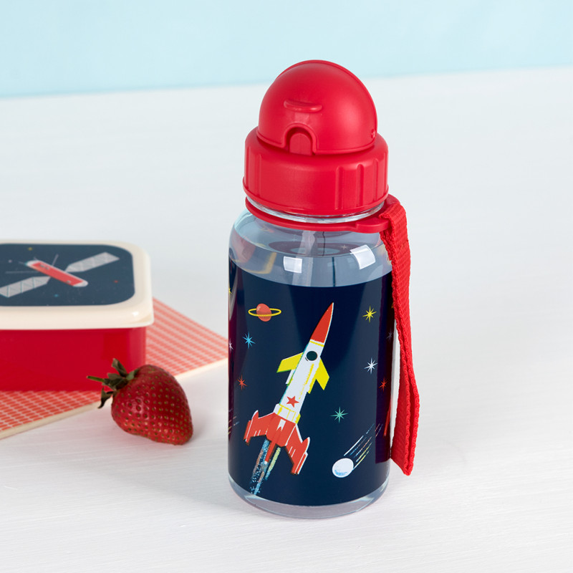
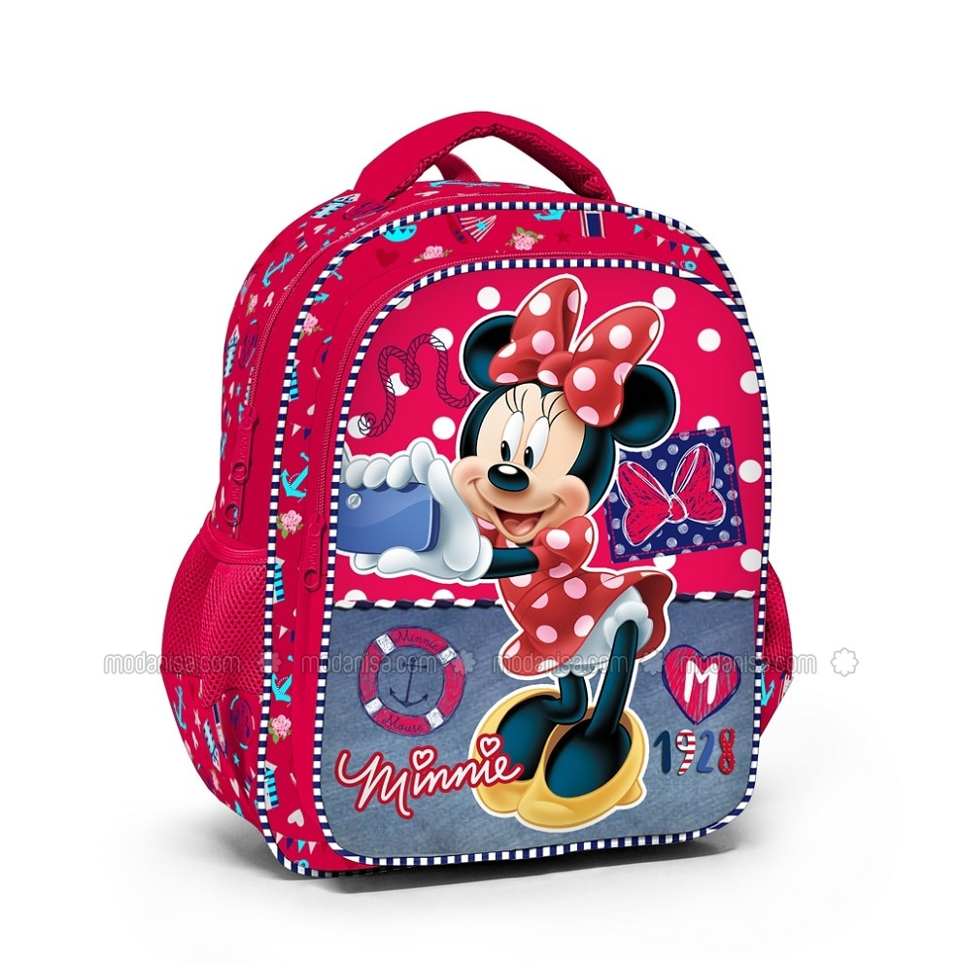
We have cleared our classroom areas for of any unnecessary furniture or equipment to help with cleaning but we will ensure that our classes continue to be bright, welcoming and child friendly and that children’s work and achievements continue to be reflected in our wall displays.
Children will be asked to wash their hands with soap and water for 20 seconds at key times and throughout the day.
All children will have their own A3 plastic wallet which will contain all the necessary resources that they need, e.g. jotters & stationery. Children can bring their own pencil cases to school but must not share any resources with their friends. Children can also bring in a filled water bottle as usual but this will not be able to be filled again so no gulping!! Water bottles need to be taken home each day to be cleaned.
Children will not use the cloakroom areas but will bring school bags and jackets into class where they will be kept at their own work area.

Slide 7
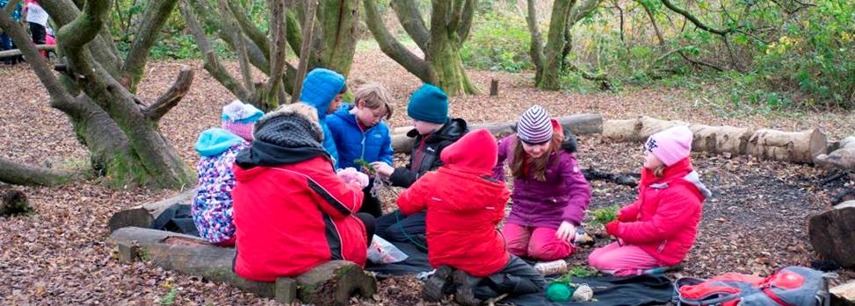
School Uniform
We have suggested a ‘relaxed’ uniform for ease:
Children can wear a school polo shirt and/or sweatshirt (with or without the school logo) and jogging bottoms, leggings or other comfortable clothing. This would allow us to have a sense of ‘uniform’ but would also help children to be comfortable for the range of learning they will be taking part in, including PE.
Please remember to provide outdoor jackets and shoes/wellies
as appropriate for Outdoor Learning.
When we resort back to school uniform this will still be part of your child’s PE kit.

Slide 8
Children who receive free school meals will continue to do so. Please see links below for Free School Meals & Clothing Grants. Please note that new links will be sent to parents for session 20/21 and we will get these to you as soon as possible.
Online application for free school meals: http://www.renfrewshire.gov.uk/Freeschoolmealsandclothinggrants (Visit the page and then click on ‘Apply for Free School Meals’ under Related Links on the right hand side of the page)
Online application for clothing grants: this should reopen on 1 June 2020 or shortly thereafter and information is on the same page as for meals. http://www.renfrewshire.gov.uk/Freeschoolmealsandclothinggrants

Slide 9
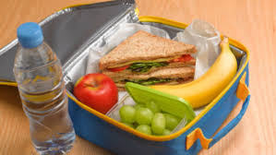
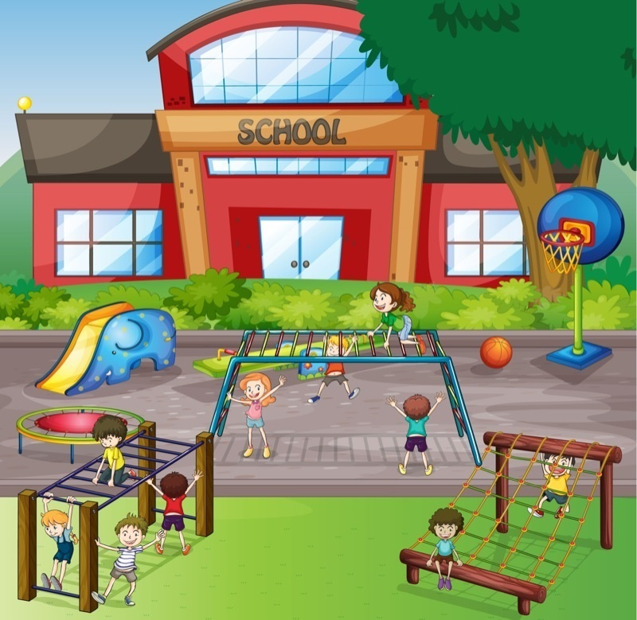
Section 2- External Environment –
Our playground – intervals, lunches & Outdoor Learning
Playtimes and lunchtimes will be staggered to ensure that we minimise numbers of children sharing the outdoor space. Children and adults will wash hands thoroughly before and after using the playground and all playtimes will be supervised by teaching and/or support staff at different times through the day.
Children will eat their lunches in the classroom, supervised by staff and will then get out to play.
Lunches provided by the school kitchen will be a Grab’n’ Go option.
The playground will be split into different areas/zones. Each group will have their own area of the playground and will have resources to use for their zone. Play resources will be organised per group to minimise sharing.
Playground games which promote teamwork and social interaction whilst keeping a safe distance will be facilitated by staff.
All classes will be given staggered Outdoor Learning times where teachers can lead a range of outdoor learning activities to promote literacy, numeracy and Health & Wellbeing.

Slide 10
Section 2- External Environment –
Drop offs and Pick Ups
We will have staggered start and finish times to the day to ensure that children can enter and leave the building safely, minimising congestion.
Children should come to school between 8.30am-9.00am and leave from 2.30pm-3.00pm. Classroom fire doors are the entry/exit points for parents and will be clearly labelled.
Children will be dismissed by staff who will ensure all children have been collected by an adult.
Please do not drop your child off prior to their start time as children will not be able to play in the playground prior to entering the school. They must report directly to their class.
Only one adult should accompany children to school.
There will be no class lines and no bells as school will start at different times.
If your child arrives late to school, they should enter via the main entrance.

Slide 11
Section 3- Medical Support
If your child has a specific condition that requires specific medical or personal care, we will contact you directly about this or you can contact us at any time to discuss.
First Aid
Our trained First Aider, Mrs Murphy will administer First Aid as normal.
PPE equipment is available for staff to wear if required.
We will follow national and local guidelines in relation to keeping children and adults safe.
On some occasions, it may be necessary to contact parents to support with injuries. As per our policy, all head injuries will be reported to parents by our office staff.
Toileting
If your child has a toileting accident, they will be encouraged to change themselves.
As above if this is not possible, staff will support children adhering to safety guidelines.
Please send in a change of clothing for children to keep in bags to help with accidents as we cannot provide changes of clothing. This would be helpful for all children if possible.

Slide 12
Covid-19 Symptoms
Should your child develop Covid-19 symptoms while in school, they will be asked to wait in our nurture room, where they will be supervised by an adult. You will be contacted immediately to collect your child. We also have a separate toilet area for use in these instances.
The nurture room, child’s classroom and toilet will then be deep cleaned.
We will be following the Government advice in relation to reporting incidents or suspected incidents of Covid-19.
If your child develops symptoms at home, it is very important that you do not send them into school and that you contact the school office as soon as possible. Parents are advised to follow national guidelines on reporting as above.
We are very mindful that it is important to continue to provide care and nurture to children when they are unwell or hurt and although we may not be able to provide our usual cuddles, we will do all we can to reassure and support our children with your blessing!

Slide 13
Section 4- Communication – Staying in Touch
As Government advice changes over time, you will receive lots of important information from us. We will try to ensure that all parents can access this information, however, we strongly urge you to ensure that you can access Twitter (@stcatherinespsy) and our school website as this will be one of our main means of communication along with - text messages, newsletters and phone calls.
Please contact the school (0300 300 0180) if you have any issues with any of the above and we will do all we can to support. Please also ensure your contact details are up to date including emergency contacts and your email address.
If you wish to speak to your child’s teacher or a member of the SMT, please contact the school by phone and we will arrange a time and a safe area in the school to meet. Meetings will be by appointment only and we appreciate your support with this. As always, Mrs Henry and Ms McLaughlin will be happy to talk to parents on the phone at any time.
Ms McLaughlin will continue to lead our Pupil Support and we will discuss how meetings for individual pupils will take place with our families in the new session.
Please get in touch if you have any issues related to digital learning, for example, lack of devices at home. We’ll see if we an help you out with this.

Slide 14
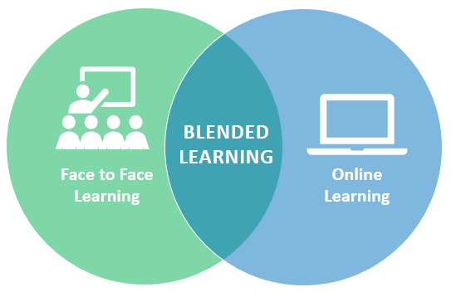
Section 5- Curriculum - What and how we will learn
The main focus of our curriculum when we return in August will be Health & Wellbeing, Literacy and Numeracy. The emotional, social and mental wellbeing of our children and families will be so important and we will do all we can to support this.
We will continue to have a very strong focus on raising attainment and are mindful of learning that may have been affected over the past months, especially in literacy & numeracy. We are confident that our smaller groups structure will lend itself very well to focused sessions in these areas.
Of course, we will continue to make our learning and teaching as motivating as possible for the children and will ensure that they have opportunities to develop and apply their knowledge and skills across other areas of the curriculum, for example, through topic work. The way we learn in class may be different but that shouldn’t prevent it from being fun and rewarding!
Children will be given home learning tasks which reinforce learning that has taken place in class each week (Blended Learning). We will be very mindful of work load but ask that you do your best to support your child to complete any tasks that are given home and contact the school if you need any help with this. Further information will be issued in August.

Slide 15
If you need any support at any time please contact the school -
stcatherinesenquiries@renfrewshire.gov.uk
For parents of key workers, it is important to know that you will be able to apply for continued child care within one of the Renfrewshire Hubs when schools return in August for those days that your child is not attending school. Although we do not have specific information on where these will be located at this time, this service will continue and further information will be issued by the authority in due course.
There will also be summer child care for key workers. Please see the authority info below -
We will continue to offer a critical childcare service for the children of single parents who are key workers or for children with two parents if they are both key workers. We are also supporting children and young people from vulnerable families.
We have already contacted key workers and families who are currently using our service. If you think you meet the criteria for this support, you can find out more and how to apply on the council’s website.
http://www.renfrewshire.gov.uk/coronavirus-childcare
I hope this has been useful information for you and am very much looking forward to our children and staff returning in August. Thank you for your continued support.
Emma Henry
Head Teacher

