Slide 1
KIDS CHURCH
Welcome to Ordinary Time – Christmas time is over- the decorations are all away – and this is a special time to come closer to Jesus, to learn more about his life.
Are you ready to sing?
Ready to clap your hands?
Ready to listen?

Slide 2
We are going to meet Jesus at a wedding feast and something special happens.

Slide 3

In the name of the Father and of the Son and of the Holy Spirit. Amen.
In today’s gospel we hear how Jesus did something very special at a wedding in Cana, changing water into wine. Let’s think about the changes we can make in our lives and in our world.

Slide 4

Let there be love shared among us
Let there be love in our eyes
May now your love sweep this nation
Cause us O Lord to arise
Bring us a fresh understanding
Family love that is real
Let there be love shared among us, let there be love.

Slide 5
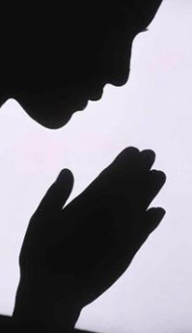
Have mercy on us
Have mercy on us
Have mercy because we have sinned.

Slide 6
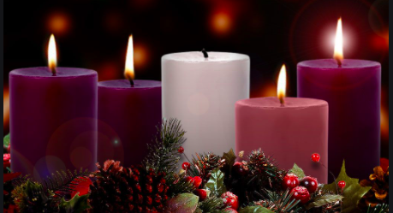
Alleluia
Alleluia
Alleluia
Alleluia

Slide 7
Gospel: John 2:1-11
Two days later there was a wedding in the town of Cana in Galilee. Jesus' mother was there, and Jesus and his disciples had also been invited to the wedding. When the wine had given out, Jesus' mother said to him, “They have no wine left.”
“You must not tell me what to do,” Jesus replied. “My time has not yet come.”
Jesus' mother then told the servants, “Do whatever he tells you.”
The Jews have rules about ritual washing, and for this purpose six stone water jars were there, each one large enough to hold about a hundred litres. Jesus said to the servants, “Fill these jars with water.” They filled them to the brim, and then he told them, “Now draw some water out and take it to the man in charge of the feast.” They took him the water, which now had turned into wine, and he tasted it. He did not know where this wine had come from (but, of course, the servants who had drawn out the water knew); so he called the bridegroom and said to him, “Everyone else serves the best wine first, and after the guests have had plenty to drink, he serves the ordinary wine. But you have kept the best wine until now!”
Jesus performed this first miracle in Cana in Galilee; there he revealed his glory, and his disciples believed in him

Slide 8
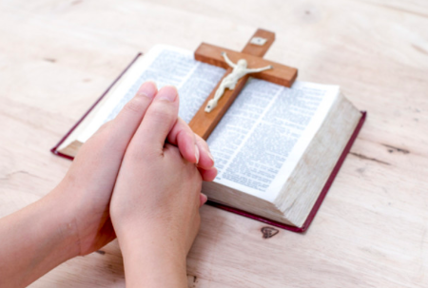
The Gospel of the Lord
Praise to you Lord Jesus Christ

Slide 10
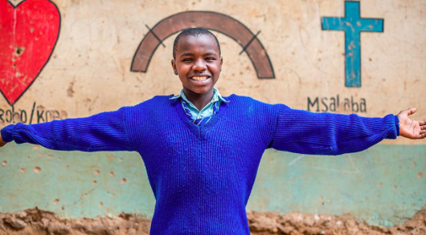
Do you believe in God the Father, Son and Holy Spirit?
We believe
We do
believe.

Slide 11
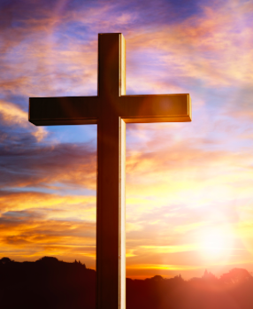
.
We pray for world leaders: that they may use their power wisely so all of their people can live free from poverty. Lord, in your mercy…hear our prayer.
We pray for people who are living in poverty throughout the world: that together with them we may never stop working for a fairer world and a future filled with hope. Lord, in your mercy…hear our prayer.
We pray for our parish, families and friends: that we may be inspired to make a difference, to change our own lives and reach out to help others who are trying to change their lives too. Lord, in your mercy… hear our prayer.

Slide 12
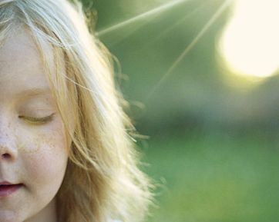
Our Father who art in heaven hallowed be thy name.
Thy kingdom come thy will be done
On earth as it is in heaven.
Give us this day our daily bread
And forgive us our trespasses.
As we forgive those who trespass against us.
And lead us not into temptation but deliver us from evil.
Amen.

Slide 13

May the peace of Christ be with you today
May the love of Christ the hope of Christ, may the Peace of Christ be yours.

Slide 14

Let there be peace shared among us
Let there be peace in our eyes
May now your peace sweep this nation
Cause us O Lord to arise
Bring us a fresh understanding
Family peace that is real
Let there be peace shared among us, let there be peace.

Slide 15

You could play a game where you set up an obstacle course in the house and one of you has a blindfold. Will you trust the other person to lead you round?
www.catholicerskine.website
Let us know if you have completed the work.
Send a picture
Send an email
kids@catholicerskine.info
You have your own page on the parish website.

Slide 16
Enjoy your activity and ;let your friends know that they can do it too. Go to the website to download the file.

Slide 17
Can you come to church on Saturday or Sunday?
Can you bring your friends to church?
Every Sunday you can come to mass. Let your family know.
Meet your friends. Talk about how you are going to follow God this week.
Tell your parents and their friends that on the 19th January
Alpha begins……..time to sign up on the website.

Slide 18
We should try to bring great joy to everyone – especially those who need clean water and good land to grown their crops.
Laudato Si

