Slide 1

KIDS CHURCH
Welcome to the Third Sunday in Advent.
Are you ready to sing?
Ready to clap your hands?
Ready to listen?
Have you enjoyed the SECOND week in Advent?

Slide 2
This is Gaudete Sunday
Joyful Sunday
Christmas Jumper day?????
If you go to St John Bosco church or St. Bernadette’s you will see lots of people wearing Christmas jumpers.
Have you got one
Why not put it on and come to Church for mass. Let everyone see that you are wearing something joyful

Slide 3
The Advent Candles
This is the Third week in Advent. There will be two purple candles lit and the Rose coloured candle.

Slide 4

We pray
Today we hear John the Baptist preparing people for the coming of Jesus. The people were very excited. John told them they had to change their lives for the better and share what they had with others. Let’s think a bit more about that today.

Slide 5
Make Advent a really special time this year.
Have a quiet spot where you can sit and listen to the Gospel.

Slide 6

In the name of the Father and of the Son and of the Holy Spirit. Amen.

Slide 7
Rejoice in the Lord always and again I say rejoice
Rejoice in the Lord always and again I say rejoice.
Rejoice, rejoice and again I say rejoice.
Rejoice, rejoice and again I say rejoice.

Slide 8

Have mercy on us
Have mercy on us
Have mercy because we have sinned.

Slide 9
Alleluia
Alleluia
Alleluia
Alleluia

Slide 10
Gospel: Luke 3:10-18
The people asked [John the Baptist], “What are we to do, then?”
He answered, “Whoever has two shirts must give one to the man who has none, and whoever has food must share it.”
Some tax collectors came to be baptized, and they asked him, “Teacher, what are we to do?”
“Don't collect more than is legal,” he told them.
Some soldiers also asked him, “What about us? What are we to do?”

Slide 11
“
He said to them, “Don't take money from anyone by force or accuse anyone falsely. Be content with your pay.”
People's hopes began to rise, and they began to wonder whether John perhaps might be the Messiah. So John said to all of them, “I baptize you with water, but someone is coming who is much greater than I am. I am not good enough even to untie his sandals. He will baptize you with the Holy Spirit and fire. He has his winnowing shovel with him, to thresh out all the grain and gather the wheat into his barn; but he will burn the chaff in a fire that never goes out.”
In many different ways John preached the Good News to the people and urged them to change their ways.

Slide 12
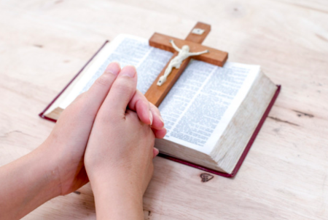
The Gospel of the Lord
Praise to you Lord Jesus Christ

Slide 14
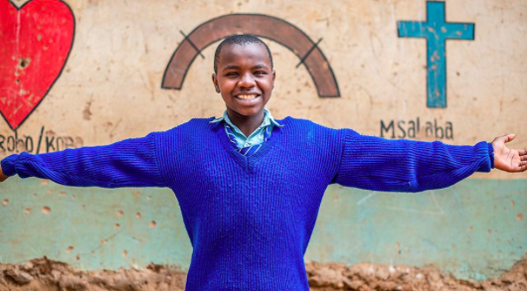
Do you believe in God the Father, Son and Holy Spirit?
We believe
We do
believe.

Slide 15

We pray for the Church throughout the world: that it may be a shining example of joy and God’s love, welcoming everyone and spreading the message of sharing to all people. Lord, in your mercy…
We pray for all members of our global family: that we may all recognise the importance of our brothers and sisters and share what we can for the good of all people. Lord, in your mercy…
We pray for our communities, families and friends: that we may be moved to care for one another and share what we have so all people can live full and happy lives. Lord, in your mercy…
Closing prayer: Christ Jesus, as Christmas approaches, we look forward joyfully to your coming. Help us to share what we can so all people may have what they need. Amen.
.

Slide 16
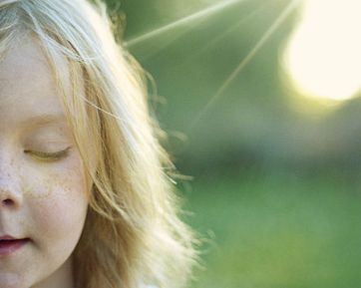
Our Father who art in heaven hallowed be thy name.
Thy kingdom come thy will be done
On earth as it is in heaven.
Give us this day our daily bread
And forgive us our trespasses.
As we forgive those who trespass against us.
And lead us not into temptation but deliver us from evil.
Amen.

Slide 17

May the peace of Christ be with you today
May the love of Christ the hope of Christ, may the Peace of Christ be yours.

Slide 18

Rejoice in the Lord always and again I say rejoice
Rejoice in the Lord always and again I say rejoice.
Rejoice, rejoice and again I say rejoice.
Rejoice, rejoice and again I say rejoice.

Slide 19

You could play a game where you set up an obstacle course in the house and one of you has a blindfold. Will you trust the other person to lead you round?
www.catholicerskine.website
Let us know if you have completed the work.
Send a picture
Send an email
kids@catholicerskine.info
You have your own page on the parish website.

Slide 20
Enjoy your activity and ;let your friends know that they can do it too.

Slide 21
Can you come to church on Saturday or Sunday?
Can you bring your friends to church?
Looking forward to seeing you. XXXXXX

Slide 22
Laudato Si

