Slide 1

KIDS CHURCH
Welcome to the 33rd Sunday of the year.
Are you ready to sing?
Ready to clap your hands?
Ready to listen?
Who will you pray for today?
Will you pray for family and friends today?

Slide 2
Today we hear about the time when Jesus will come again. We do not know when this will be, but we must try to be ready. Let’s think a bit about how we get ready for other special events in our lives today…

Slide 3

We pray
Today we hear about the time when Jesus will come again. We do not know when this will be, but we must try to be ready. Let’s think a bit about how we get ready for other special events in our lives today…

Slide 4
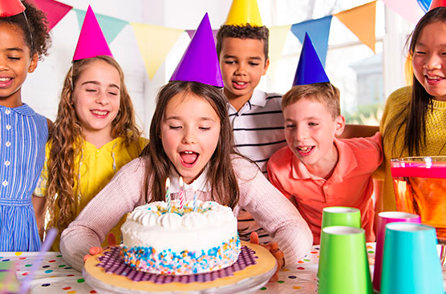

Slide 5
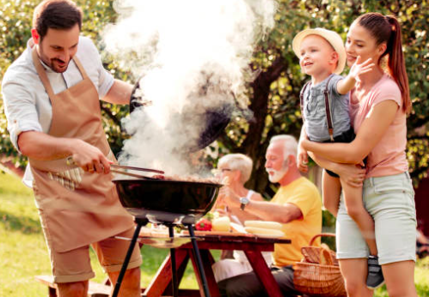

Slide 6
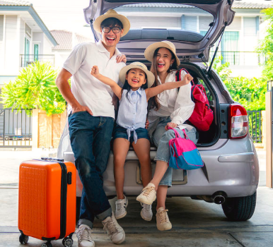

Slide 7
Is it really quiet?
Have you got a quiet spot in your house?
Have you thought about what you want to pray for today?

Slide 8

In the name of the Father and of the Son and of the Holy Spirit. Amen.

Slide 9
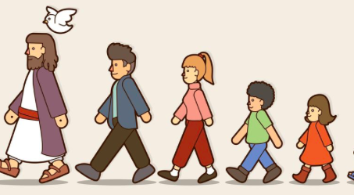
Laudato Si O mi Signore
Laudato Si O mi Signore
Laudato Si O mi Signore
Laudato Si O mi Signore

Slide 10
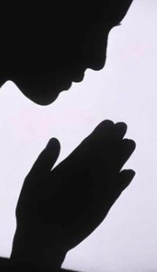
Have mercy on us
Have mercy on us
Have mercy because we have sinned.

Slide 11

Gloria Gloria in the highest heavens
Gloria Gloria in the highest heavens

Slide 12

Allelu, allelu, allelu, allleluia Praise ye the Lord.
Praise ye the Lord Alleluia Praise ye the Lord Alleluia
Praise ye the Lord Alleluia, Praise ye the Lord.

Slide 13
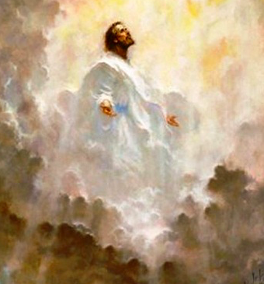
Gospel: Mark 13:24-32
“In the days after that time of trouble the sun will grow dark, the moon will no longer shine, the stars will fall from heaven, and the powers in space will be driven from their courses. Then the Son of Man will appear, coming in the clouds with great power and glory. He will send the angels out to the four corners of the earth to gather God's chosen people from one end of the world to the other.

Slide 14
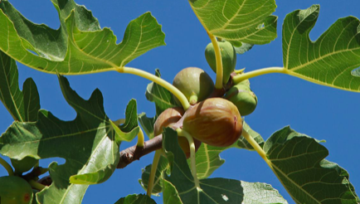
“Let the fig tree teach you a lesson. When its branches become green and tender and it starts putting out leaves, you know that summer is near. In the same way, when you see these things happening, you will know that the time is near, ready to begin. Remember that all these things will happen before the people now living have all died. Heaven and earth will pass away, but my words will never pass away.
“No one knows, however, when that day or hour will come—neither the angels in heaven, nor the Son; only the Father knows.”

Slide 15

The Gospel of the Lord
Praise to you Lord Jesus Christ.

Slide 16
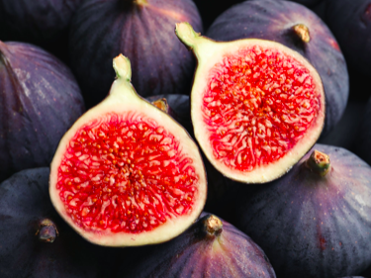

Slide 17
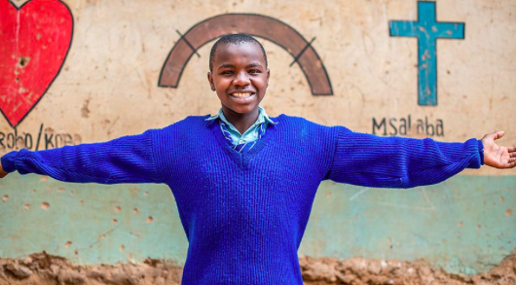
Do you believe in God the Father, Son and Holy Spirit?
We believe
We do
believe.

Slide 18
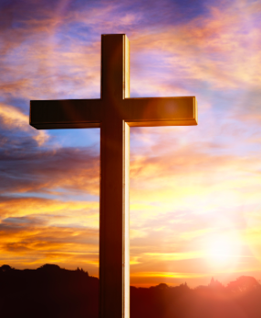
.
We do not know when Jesus will come again and so we pray together:
We pray for the Church throughout the world: that it may be an example of generous and welcoming love for all people, leading the way for when Jesus comes again. Lord, in your mercy…
We pray for all children around the world: that they may have the chance to go to school, to learn and prepare for the future. Lord, in your mercy…
We pray for our parish, family and friends: that we may always try to be kind, loving and generous to others, so that we may be ready when Jesus comes again. Lord, in your mercy…

Slide 19

Church
World
Parish
Friends

Slide 20
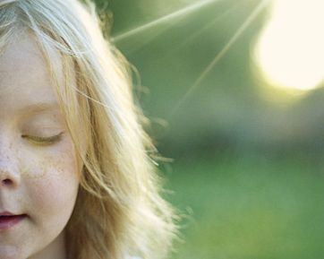
Our Father who art in heaven hallowed be thy name.
Thy kingdom come thy will be done
On earth as it is in heaven.
Give us this day our daily bread
And forgive us our trespasses.
As we forgive those who trespass against us.
And lead us not into temptation but deliver us from evil.
Amen.

Slide 21
Peace, peace will
Peace will come and let it begin with me.

Slide 22
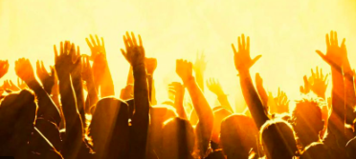
Laudato Si O mi Signore
Laudato Si O mi Signore
Laudato Si O mi Signore
Laudato Si O mi Signore

Slide 23

You could play a game where you set up an obstacle course in the house and one of you has a blindfold. Will you trust the other person to lead you round?
www.catholicerskine.website
Let us know if you have completed the work.
Send a picture
Send an email
kids@catholicerskine.info
You have your own page on the parish website.

Slide 24
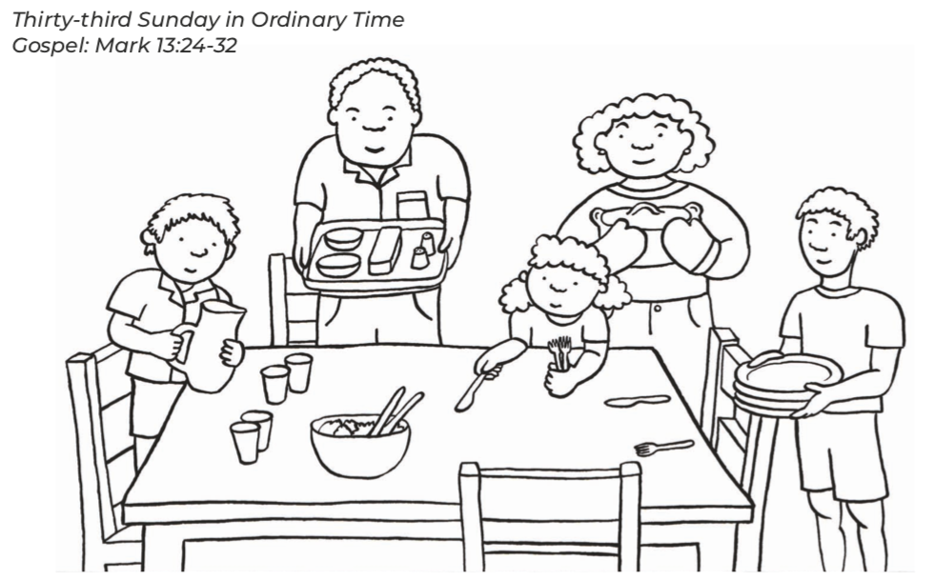
Can you colour this in and send it in by e:mail?
This would help us stay green .
Looking forward to seeing your pictures.

Slide 25
Can you come to church on Saturday or Sunday?
Can you bring your friends to church?
Looking forward to seeing you. XXXXXX

Slide 26
Laudato Si

