Slide 1
SEAL In The Story Corner

Slide 2
Suggested SEAL Strands and Es & Os:
SEAL Strands
Numerals to 20
Finger patterns for numbers to 10
Information handling and data analysis
Es and Os
MNU 0-02a Explore numbers understanding they represent quantities, and can use them to count, create sequences and describe order.
MNU 0-03a I use practical materials “count on and back” to help me understand addition, subtraction and record my ideas and solutions in different ways.
MNU 0-20a I can use the signs and charts around me for information, helping me plan and make choices and decisions in my daily life.

Slide 3
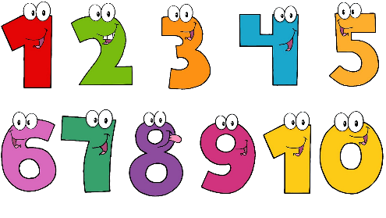
Starter Questions for Children:
What is the number on this page?
How many…. In the story?
Can you find the numbers in the book?
Can you tell me 3 things about this story?
If 5 children choose 1 book to read, how many books will we have?

Slide 4
Key Vocabulary for Children:
Before
After
Same
How many?
012345…
Next
Guess
Estimate
Continue

Slide 5
Suggested activities for the Story Corner:
Numbered teddy bears in the story corner for children to read to. They can read them stories and look at the numbers, counting them and putting them in order.
Finger songs e.g 1,2,3,4,5 once I caught a fish alive etc… and various number songs, rhymes and stories to have in and around the story corner.
Favourite book vote. Children can see a choice of 2 books out on display and can vote in a variety of ways to choose which book they would like to read that day.

Slide 6
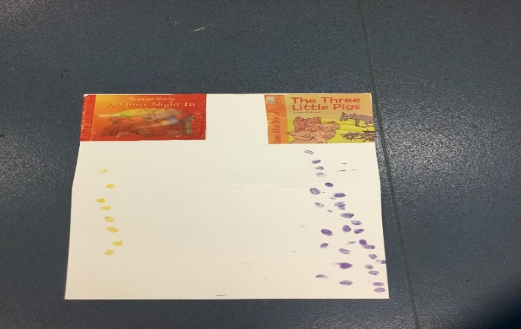
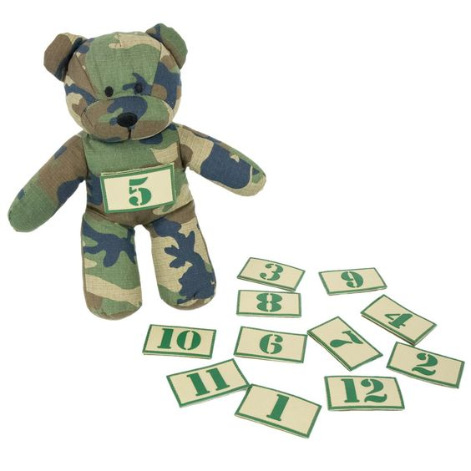
Suggested Resources:
Songs - 1,2,3,4,5 once I caught a fish alive, one little finger, Tommy Thumb.
Stories - Goldielocks and the 3 bears, Ten in the bed, Ten little pirates.
Story votes and Numbered bears - Can source old teddies from families and make numbered badges to stick on them. Use a board with stampers or finger paints for children to vote for their favourite story or bowls with pebbles.

Slide 7
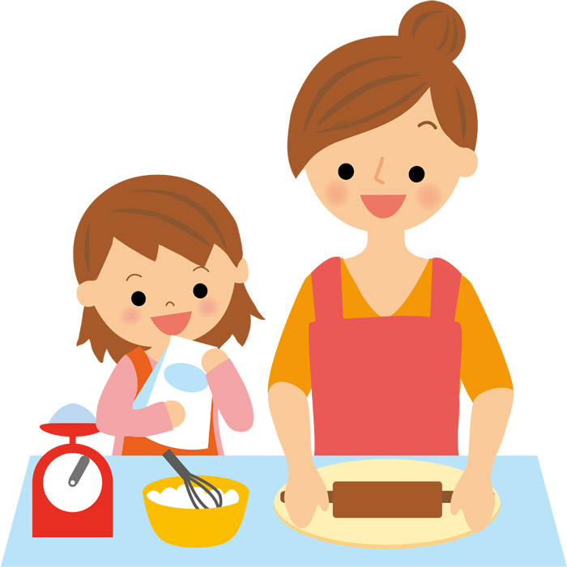
SEAL in the snack area

Slide 8
Suggested SEAL Strands and Es & Os:
SEAL Strands
Perceptual counting strategies (concrete items)
Ideas of equal groups and sharing
Ascribe number to spatial patterns
Es and Os
MNU 0-03a I use practical materials “count on and back” to help me understand addition, subtraction and record my ideas and solutions in different ways.
MNU 0-01a I am developing a sense of size and amount by observing, exploring, using and communicating to others about things in the world around me.

Slide 9
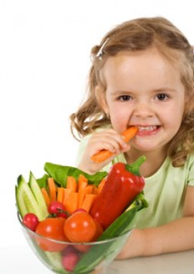
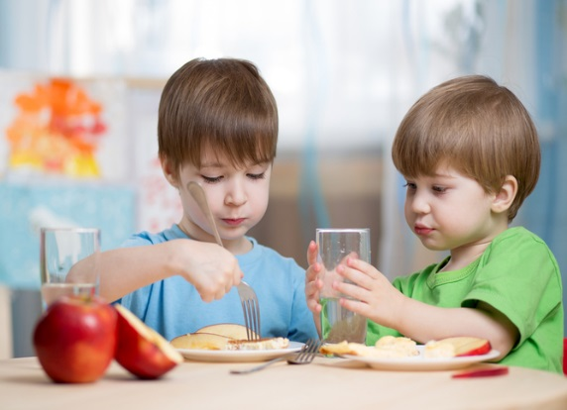
Starter Questions for Children:
How many children are here?
Can you show me with your fingers?
Can you give me….of milk cartons/pieces of fruit please.
Have we got enough?
How many are there altogether?

Slide 10
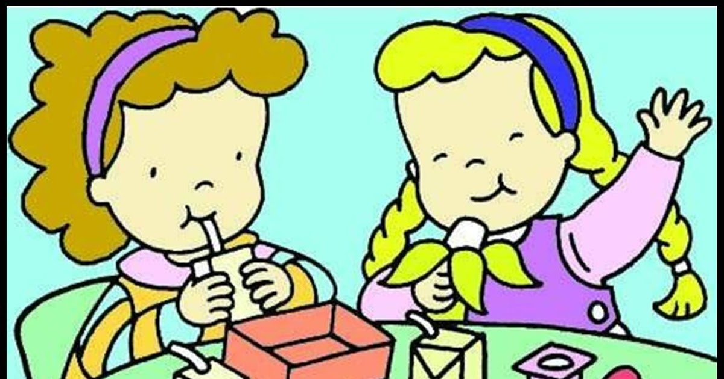
Key Vocabulary for Children:
Enough
More
Less
Altogether
Share
Same
012345…
Match
Guess/Estimate
Subitise

Slide 11
Suggested activities for the Snack Area:
Sharing – Asking children to count how many boys and girls are at the table and count out amounts of fruit etc for the children.
Five Frames – Children can use five frames to estimate amounts given to each child at snack. Can also be used to help them cut fruit etc into different amounts.
Using domino dots and random array dot patterns with flash cards to represent how many items children have to put on the table. E.g cups, plates etc…

Slide 12
Suggested Resources:
Small chopping boards and child friendly cutlery to allow children to cut different amounts of foods.
Five Frames (laminated) to allow children to count out different amounts at snack.
Domino number flash cards and random array dot cards for counting at snack.

Slide 13
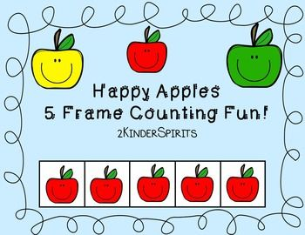
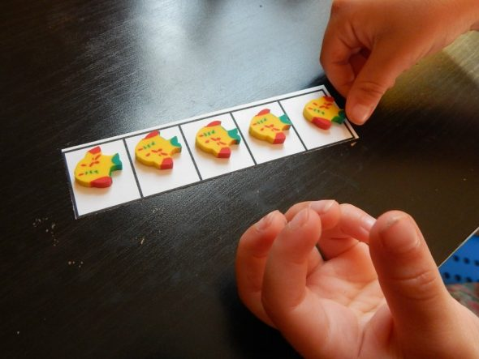
Example Five Frame:

Slide 14
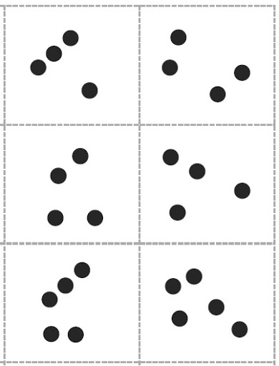
Example Dice Pattern and Random Array Dot Pattern:
Dice pattern number dots Random array number dots

Slide 15
SEAL In The Creative Area

Slide 16
Suggested SEAL Strands and Es & Os:
SEAL Strands
Numerals to 30
Perceptual and Figurative counting strategies
Time
Shape, Position and Movement
Patterns and Relationships
Es and Os:
MNU 0-02a Explore numbers understanding they represent quantities, and can use them to count, create sequences and describe order.
MNU 0-03a I use practical materials “count on and back” to help me understand addition, subtraction and record my ideas and solutions in different ways.
MNU 0-10a I am aware of how routines and events in my world link with times and season and have explored ways to record and display these using clocks, calendars and other methods.
MTH 0-17a In movement games and using technology I can use simple directions and describe position.
MTH 0-13a I have spotted and explored patterns in my own and the wider environment and can copy and continue these and create my own.

Slide 17
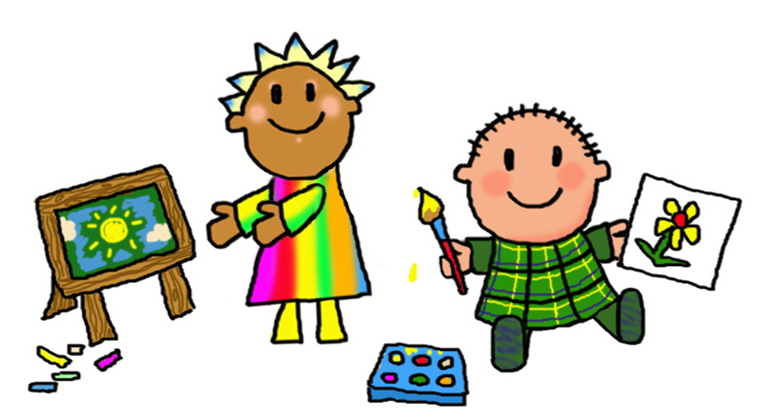
Starter Questions for Children:
Do you need more?
Do you have enough?
How many do you need?
Can you see the pattern?
Can you copy the pattern?
What will come next?
How many buttons, feathers etc… do you have?

Slide 18
Key Vocabulary for Children:
Copy
Match
Pattern
More
Less
Same
Next
Continue

Slide 19
Suggested activities for the Creative Area:
Collage creations – Making collage pictures using a variety of media and talking about colour, shape, sizes and patterns.
Drawing around hands – Draw around hands and count the number of fingers and measure the size of the hands.
Junk modelling – Make junk models with a variety of media and talk about size, weight, empty, full etc…
Making patterns – Make various patterns using collage materials, stampers, different shapes and coloured paints.
Putting dates on art work – Talking about days of the week, months and seasons when dating pieces of art.

Slide 20
Suggested Resources:
A variety of paints
Different types of collage materials
10 frame for making patterns
Different sized rulers, measuring tapes for children to use.

Slide 21
Example 10 Frame:

Slide 22
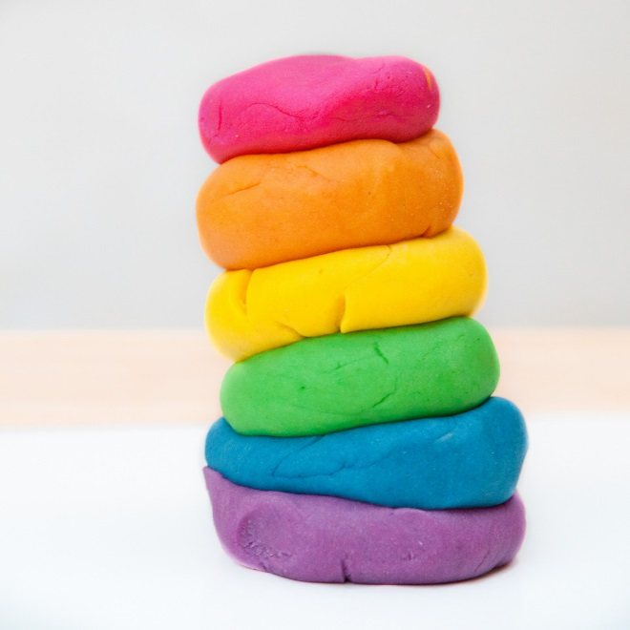
SEAL in The Playdough Area

Slide 23
Suggested SEAL Strands and Es & Os:
SEAL Strands
Perceptual and Figurative counting strategies
Number word sequencing
Numeral recognition
Finger patterns for numbers to 10
Ideas of equal groups and sharing
Shape, position and movement
Es and Os
MNU 0-03a I use practical materials “count on and back” to help me understand addition, subtraction and record my ideas and solutions in different ways.
MNU 0-02a Explore numbers understanding they represent quantities, and can use them to count, create sequences and describe order.
MTH 0-13a I have spotted and explored patterns in my own and the wider environment and can copy and continue these and create my own.
MTH 0-16a I enjoy investigating objects and shapes and can sort, describe and be creative with them.

Slide 24
Starter Questions for Children:
How many dots can you make in the playdough?
Do we all have the same number of….?
Share the cakes between you and your…friends
How many candles do we need?
How many do we have?
Can you count the…
Can you make a pattern with 3 dots?

Slide 25
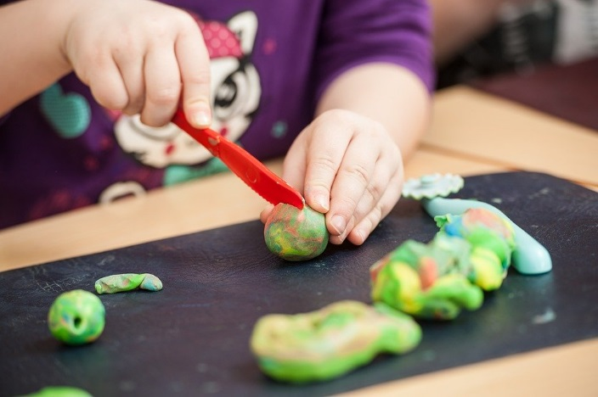
Key Vocabulary for Children:
Enough
Pattern
Share
Altogether
Copy
Match
Same
Next
Continue

Slide 26
Suggested activities for the Playdough Area:
Making the dough – Allow the children to make the dough, allowing them to measure out amounts, mix and colour the dough.
Sharing, cutting and counting out amounts – Children can use a variety of materials to cut and share the playdough between them. Can use dice to roll and then make different numbers of balls to match the dice pattern and count them out.
Loose parts and dough – Have lots of loose parts available for children to access in the area (shells, stones, sticks etc…) to allow them to make different creations and count the number of sticks, stones etc… they have used.
Cake cases and candles – Children can make cupcakes with the playdough and can count the number of candles they put on to each cake.

Slide 27
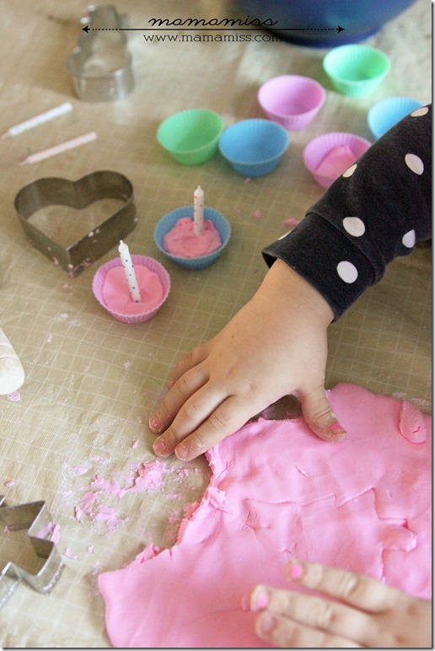
Suggested Resources:
Ingredients to make playdough
Other materials for children to explore e.g shaving foam and/or clay.
Loose parts – sticks, stones, shells, feathers etc…
A variety of dice
Plastic cake cases and candles

Slide 28
Example dice activity with playdough:

Slide 29
SEAL in the Construction Area

Slide 30
Suggested SEAL Strands and Es and Os:
SEAL Strands
Number word sequences 0-20
Numerals to 20
Perceptual counting strategies (concrete items)
Es and Os
MNU 0-02a I have explored numbers understanding that they represent quantities, and can use them to count, create sequences and describe order.
MNU 0-03a I use practical materials to “count on and back” to help me understand addition, subtraction recording my ideas and solutions in different ways.
MTH 0-16a I enjoy investigating objects and shapes and can sort, describe and be creative with them.

Slide 31
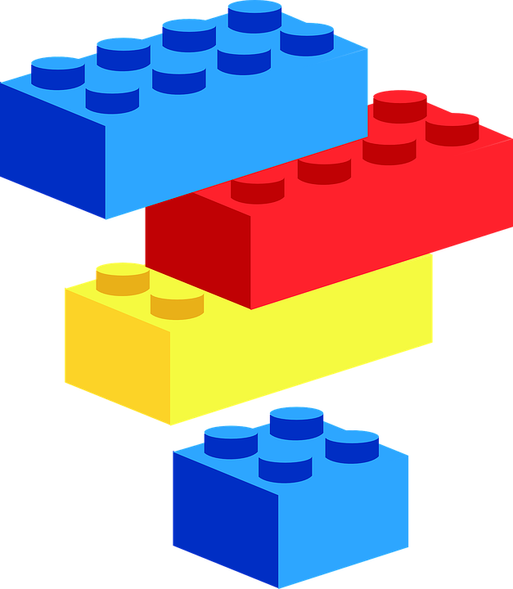
Starter Questions for Children:
How many?
Do you have enough?
Do you have more than…?
How many more do you need?
How many altogether?

Slide 32
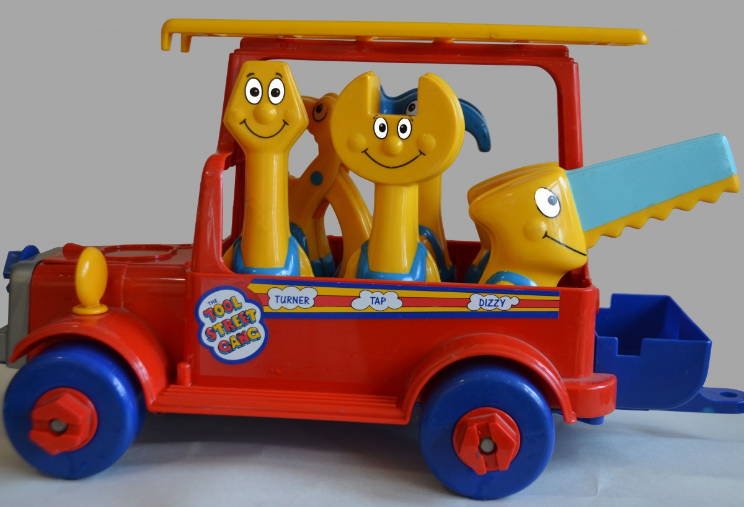
Key Vocabulary for Children:
Match
How many
More
Less
Before
After
Guess
Estimate

Slide 33
Suggested activities for the Construction Area:
Car park and road shaped numerals – Matching cars to spaces using numerals. Finding the road numeral to match numbered car and drive the car around the number shaped road.
Counting trains – Counting the number of carriages on trains when playing with the trains and track.
Building bridges – Using blocks to build bridges etc… how high? How many blocks have we used? Problem solving.
Ten frames and nuts and bolts – Have a numeral and dot pattern of the number at the top and then count out the correct number of nuts/bolts onto the ten frame.

Slide 34
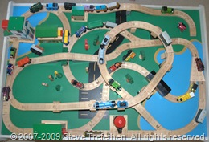
Suggested Resources:
Nuts and bolts/loose parts
Trains, cars and blocks
Numerals and dice patterns
Numeral road tracks

Slide 35
Example Ten Frame for nuts and bolts
Build 7

Slide 36
Example Road Numeral:

Slide 37
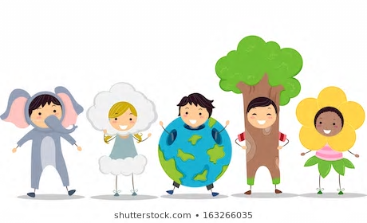
SEAL in The Role Play Area

Slide 38
Suggested SEAL Strands and Es and Os:
SEAL Strands
Numerals to 20
Ascribe number to spatial pattern
Patterns and Relationship
Es and Os
MNU 0-02a I have explored numbers understanding that they represent quantities, and can use them to count, create sequences and describe order.
MNU 0-01a I am developing a sense of size and amount by observing, exploring, using and communicating to others about things in the world around me.
MTH 0-13a I have spotted and explored patterns in my own and the wider environment and can copy and continue these and create my own patterns.

Slide 39
Starter Questions for Children:
Which numeral comes first on the washing line?
Which numeral comes last?
Which numeral comes before?
Which numeral goes in between?
Do we have enough?
Do we need more?
How many do we need?

Slide 40
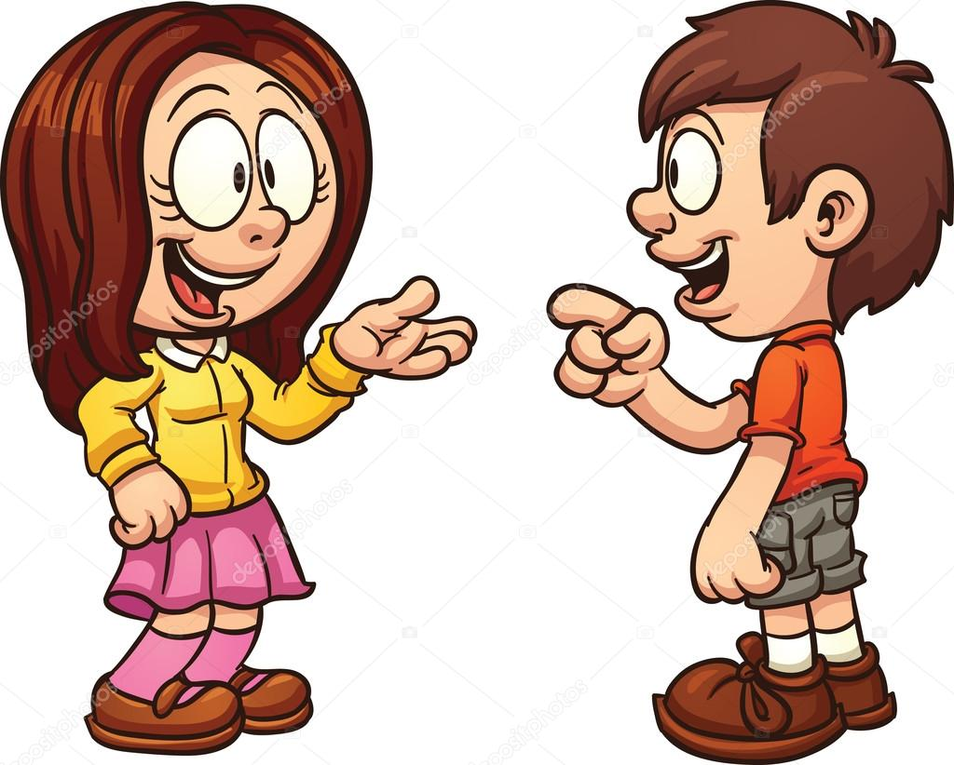
Key Vocabulary for Children:
Before
After
How many?
Missing
Enough
How do you know?
Match
Share
Pattern
Between

Slide 41
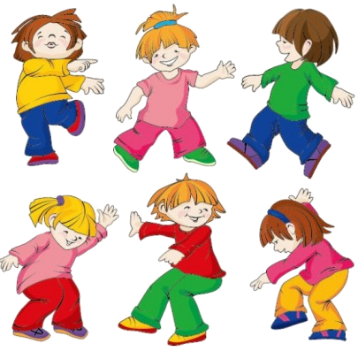
Suggested activities for the Role Play Area:
Washing line – Hanging up socks to make pairs.
Plates etc… with numbers/dice pattern on. Having the plates numbered or with domino patterns will help children to recognise numerals and number dot patterns.
Cookies – Make cookies to have in and around the role play area with dice patterns and random array dot patterns.
Role play costumes – Ask children to count out costumes as they put them on and take them off. 5 pegs/5 costumes.

Slide 42
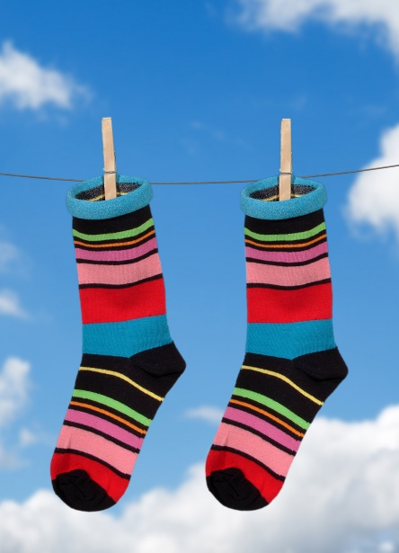
Suggested Resources:
Washing line
Socks – different colours and patterns
Phone
Calculator
Coins
Plates
Numerals
Costumes/T-shirts
Old bus/train tickets

Slide 43
Example Cookies with Dot Pattern and Numerals:

