Slide 2
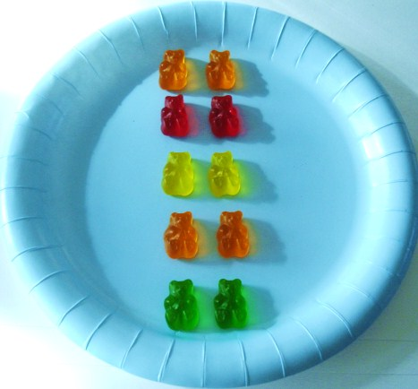
Arrays
2 x 5 = 5 x 2
Commutativity
Describe
Build
Determine how many
Row then column
Row x column
5 x 2
Row then column
Row x column
2 x 5
P2 Green SEAL Planner
Notes:
Driving understanding of commutativity from early age, making links later on for area model/formal layout for division
Building conceptual understanding of multiplication and division

Slide 3
Describing Arrays
rows
How many rows?
How many in each row?
How many columns?
How many in each column?
4 rows of 6
columns
P2 Green SEAL Planner

Slide 4
Building Arrays
Here are 12 counters,
can you make an array?
How many rows?
How many columns?
= Factor Pairs
P2 Green SEAL Planner

Slide 5
Building Arrays
Here are 12 counters,
can you make an array?
How many rows?
How many columns?
= Factor Pairs
P2 Green SEAL Planner

Slide 6
Primes, Squares and Factors
3
4
12

Slide 7
Primes, Squares and Factors
3
Only factors are itself and 1 = PRIME NUMBER

Slide 8
Primes, Squares and Factors
4
Factors = 1, 2, 4
Makes a square = square number

Slide 9
Primes, Squares and Factors
6
Factors = 1, 2, 3, 6

Slide 10
How Many
1x3 = 3
Building up your array step by step using known number facts
2x3 = 6
What is 3 x 18 ?
How many different ways can you show me?
3x3 = 9
4x3 = 12
5x3 = 15
By partitioning:
3 x (10 + 8)
30+24 = 54
6x3 = 18
By factorising:
3 x 9 x 2 (doubling)
27 x 2 = 54
7x3 = 21
8x3 = 24
9x3 = 27
Rounding and compensating
3 x 20 = 60
Subtract 3 x 2 = 6
10x3 = 30
11x3 = 33
12x3 = 36
P2 Green SEAL Planner

