Slide 1
Mental Health and Wellbeing Award
Gryffe High School
Renfrewshire

Slide 2
Background to Introduction
Looking to investigate accreditation possibilities within PSE
Keen to raise profile of PSE as a subject
Recognition of Mental Health as a key area to focus on with pupils
Part of full S1 – S6 PSE revision and move to a vertical structure
Incorporating advice from Scottish Government Review of PSE (January 2019)

Slide 3
Course Aims SQA
Reduce
reduce stigma surrounding mental health
Arm
arm young people with healthy coping strategies
Promote
promote knowledge of the impact of mental health on behaviour
Dispel
dispel myths surrounding mental health
Promote
promote understanding of positive and negative impacts on mental health
Help
help individuals to make the right choices
Promote
promote understanding of the potential uses and impact of social media and the internet
Create
create resilience

Slide 4
Three Units in Award
Understanding Mental Health Issues
Influences on Mental Health and Wellbeing
Coping Strategies and Building Resilience
CONSIDER TEACHING UNITS RATHER THAN FULL AWARD

Slide 5
Planning and Implementation
Began research into courses in session 2018- 2019
Attended SQA course launch in October 2018
Agreed to deliver Award to one cohort – started with S3 in 2018
Pupils in original cohort gained qualification in S4 (2020)

Slide 6
Development and Implementation
Full course materials were developed from scratch
Assessments created
Wellbeing period in S3 in addition to PSE
PDA period in S4 to complete materials (in addition to PDA units)

Slide 7
Delivery
Full year cohort
Working originally with level 5 materials only
Delivering a full course award in one period a week
Short implementation timescale

Slide 8
Delivery
Launch assembly with SMT support
Raising profile with stakeholders
Workshop delivery in conjunction with local GP
Half day and full day workshops
Utilising S6 as support in class and at workshops
Involving other subject specialists

Slide 9
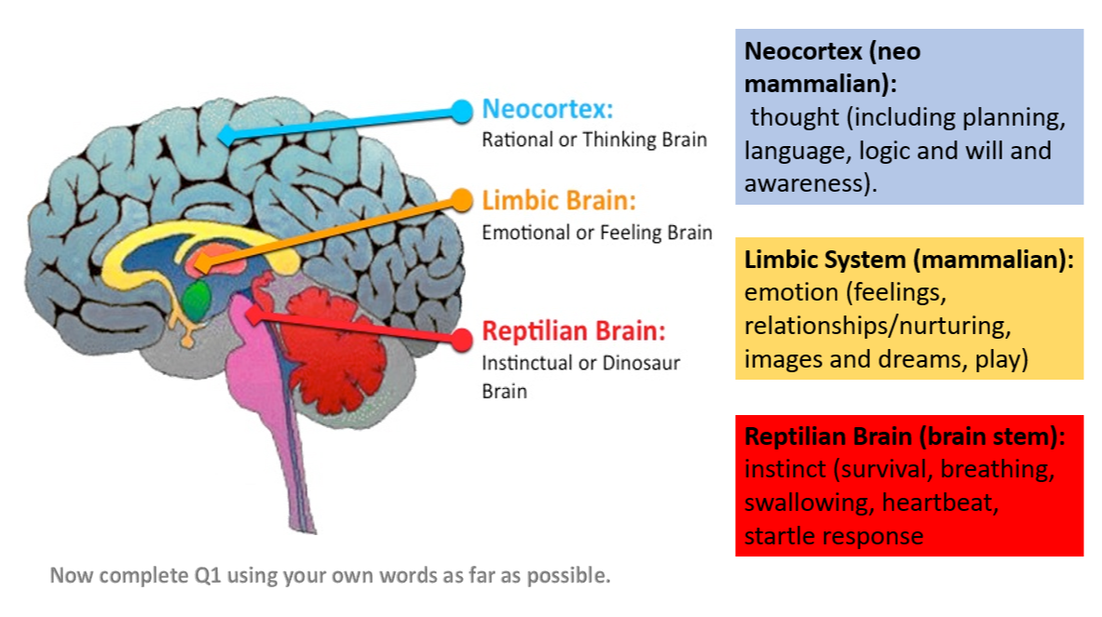
Interdisciplinary Learning Potential
Science Links

Slide 10
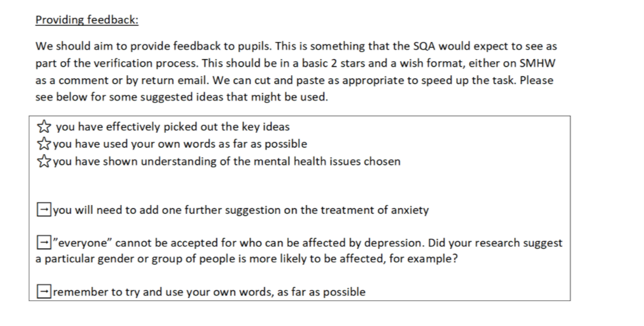
Interdisciplinary Learning Potential
Literacy and English Links

Slide 11
Amendments
More focused teaching
Evidence collection – booklet/folio
Split into units across years
Level 5 not suitable for all pupils

Slide 12
Changed Plans
Classroom based
No external agencies
Assessment during lockdown
Evidence collection

Slide 13
Implementation Advice
Cohort size
Time available – teaching focused on assessments
Specific school context
Level 4 and Level 5
Potential overload on one topic

Slide 14
Top Tips before Implementation
Staffing and Staff knowledge
Tracking
Marking and Feedback
Planning ahead and preparation
Pupil Perception

Slide 15
Gryffe Overview
Still revising our approach
Positive in that pupils have the opportunity to gain an additional qualification
Staff knowledge and timing
Well received by HMIe

