Slide 1
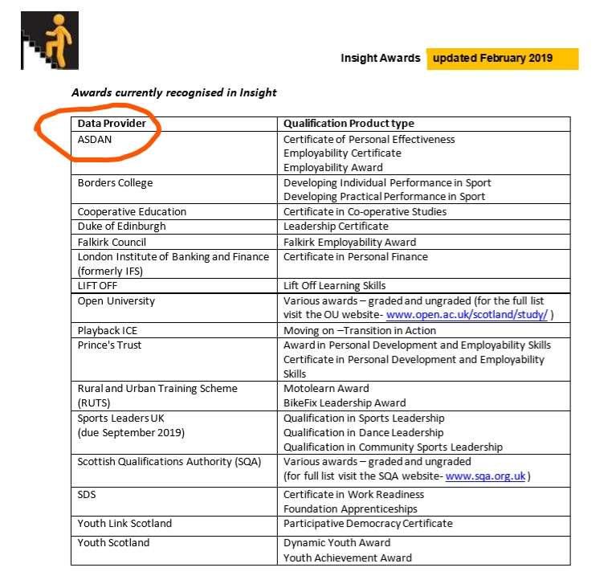
Awards on Insight
•RUTS: Motolearn and Bikefix courses
•Sport Leaders UK: Sports Leadership, Community Sports Leadership, Dance Leadership awards
•SafeCert: First Aid Awards
•Comedy and Confidence SQA credit rated
•Class of Your Own: Design, Engineer, Construct
•Newbattle Abbey College: Forest and Outdoor Learning Awards
ASDAN – No longer on SCQF however, because the ASDAN data from previous years will still be included (in the 3/5-year summaries), we need to leave them in the list of data providers – but need to be clear that their data isn’t current
Young Enterprise Company Programme due to be added in 2020
For further information contact the Insight Project team: insight@gov.scot
Notes:
Feb 2020 date - Dance qualifications and those owned by Sports Leaders UK are currently working with SG to have their programmes recognised on Insight
Give a bit of background as to why D of E Gold, Silver, Bronze isn’t on there but Leadership award is. Measured in time or volunteers hours, not difficulty or complexity of the task.
Same with John Muir Trust and Saltire. Good programmes but their structure doesn’t fit and it would take award from the award trying to fit them into the framework.

Slide 2
Learner journey – Business at Clydebank
LEVEL 5
LEVEL 6
LEVEL 7
BGE
National 5 Business management SCQF Level 5 with 24 credits
Higher Business management SCQF Level 6 with 24 credits
NPA Business and IT SCQF Level 6 with 24 credits
NPA Business and IT SCQF Level 5 with 24 credits
Advanced Higher Business management SCQF Level 7 with 32 credits
PDA IT in Business SCQF Level 7 with 32 credits
Notes:
Nat 5 and NPA 5 – First 2 units are the same allowing flexibility.
Comparable length of course (240 hours) for both the level 5 and 6 NPA and National courses
Example pathways that schools may be able to follow, not all subjects have a pathway like this.

Slide 3
Learner journey – PE at Clydebank
LEVEL 5
LEVEL 6
LEVEL 7
BGE
National 5 PE SCQF Level 5 with 24 credits
Higher PE SCQF Level 6 with 24 credits
NPA Sports Development SCQF Level 6 with 18 credits
NPA Sport and fitness SCQF Level 5 with 24 credits
Advanced Higher PE SCQF Level 7 with 32 credits
NPA Achieving excellence in sport SCQF Level 6 with 24 credits
NPA Sport and Recreation SCQF Level 5 with 24 credits
PDA SFA Refereeing SCQF Level 7 with 16 credits
Notes:
Variety of pathways a learner can take
Pathways available will depend on the variables at each school, time, staffing etc.

Slide 4
Changes to the Curriculum – Bearsden Academy
S4 Wellbeing Unit – SCQF Level 5 – Core PE
S5/6 Internet Safety award SCQF Level 4– through PSE
S6- Leadership Award –SCQF Level 6
NPA Acting & Performance Level 6
Level 5/6 – Modern Languages for Work Purposes (Level 4 now)
Level 5 Practical Cake Craft
Bakery Unit level 4 – Home Economics
S3 Level 4 Scottish Studies – Geography, PE, Drama, Art & Modern Studies
NPA Music for Wellbeing Level 6
NPA Acting & Performance Level 6
NPA Technical Theatre Level 6
Notes:
Important points: Generating awards from activity already happening in school. Not about increased workload for teachers.
Evidence for qualifications already being generated in many areas. Collate evidence and pass to SQA coordinator
Double bagging of evidence gathered
Level 4 Scottish Studies gained through generating evidence in other subjects
SfW course taught alongside Geography Nat 5 to gain 2 awards
Level 5 programmes used instead of Nat.5 to offer progression pathway
PC Passport delivered to ensure pupils have certification for digital skills
Statistics units gained in 2 year Higher Maths
PC Passport for low attaining S6 pupils. Shows they are digitally literate

Slide 5
Insight Tariff Points
Qualification and Grade | Insight Tariff Points
Advanced Higher – A | 480
Higher – A | 204
National 5 – A | 84
HNC Computing | 1,200
FA Engineering | 580
FA Civil Engineering | 560
FA Creative and Digital Media | 427
FA Social Services (CYP) | 407
FA Business Skills | 340
Notes:
Just some examples of allocated Insight points.

Slide 6
UCAS Tariff Points
Qualification | Grade | Notional hours | Size band | Grade band | Tariff total (Size X Grade) | Narrative
SQA National Progression Award (Band C) | P | 320+ | 4 | 7 | 28 | Three different size bands 2, 3, 4. Grade P aligned to grade band 7. Due to the potentially widely variable sizes of NPAs and the combinations of units at different SCQF levels, only credit at SCQF Level 6 or above is used for the calculation of the UCAS Tariff.
SQA National Progression Award (Band B) | P | 220-319 | 3 | 7 | 21
SQA National Progression Award (Band A) | P | 120-219 | 2 | 7 | 14
Scottish Higher | A | 240 | 3 | 11 | 33 | Size band 3. Uses midpoints to align to 11, 9, 7, 5 - between A level and AS as confirmed by the regulator.
Scottish Higher | B | 240 | 3 | 9 | 27
Scottish Higher | C | 240 | 3 | 7 | 21
Scottish Higher | D | 240 | 3 | 5 | 15
Notes:
Good to note that UCAS points for a pass NPA level 6 of 240 credits (21) is the equivalent to a Higher C (21) and more than a D (15)

