Slide 1


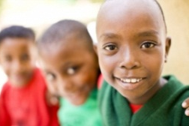


This project and its actions were made possible due to co-financing by the European Fund for the Integration of Third-Country Nationals
EAL Nexus resource
Macbeth Act 4
Key words
Subject: | English
Age ranges: | 11–14, 15–16
Topic: | Macbeth
Licence information | This resource is free to use for educational purposes. ©British Council 2015
Source | This resource was originally developed by Ruth Wilson for Wolverhampton Local Authority and has been adapted by EAL Nexus. Images from Self-Made Hero’s Manga Shakespeare series.

Slide 2
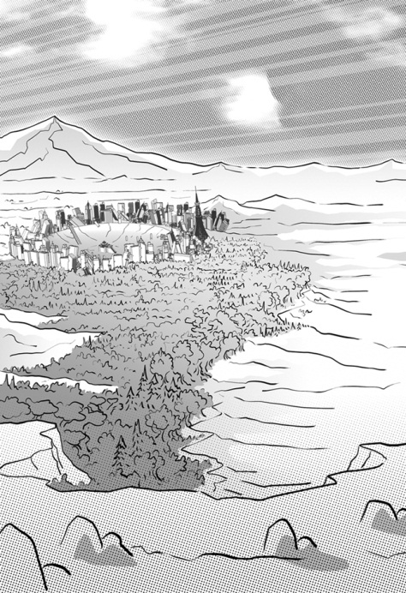
Birnam Wood

Slide 3
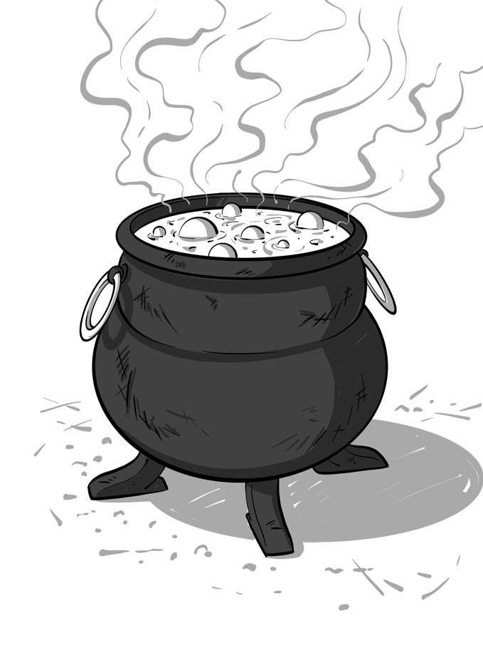
a cauldron

Slide 4
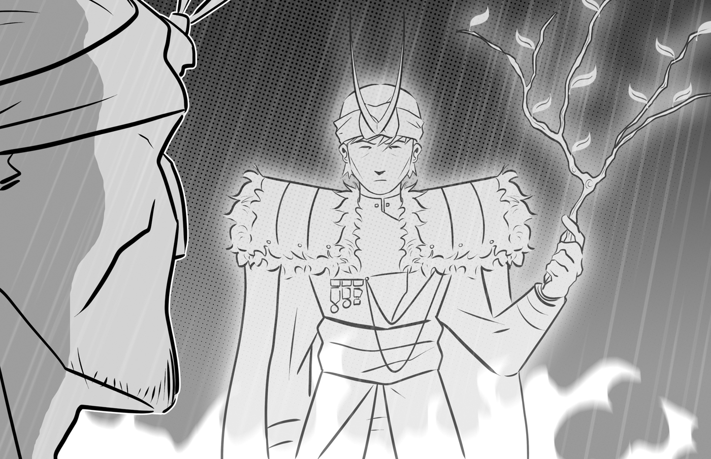
a child with a crown on his head and a branch in his hand

Slide 5
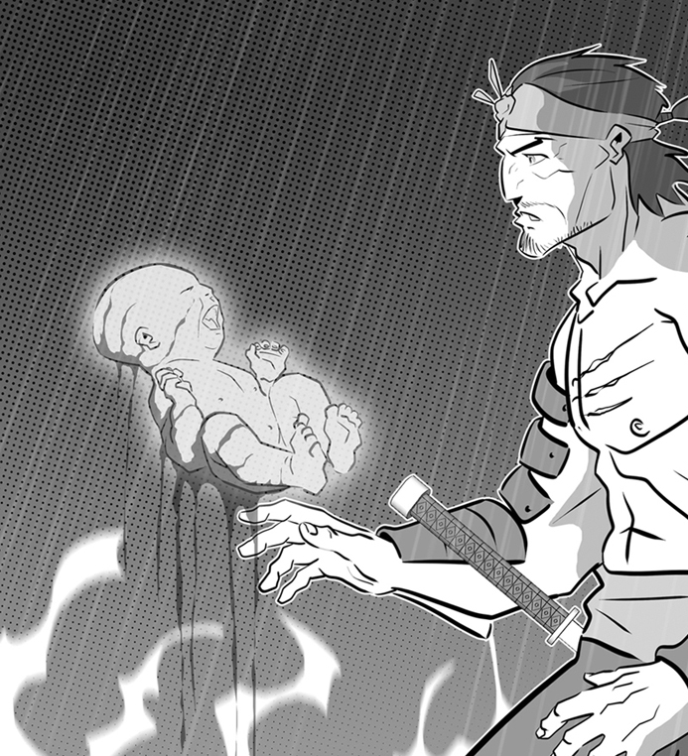
a child covered in blood

Slide 6
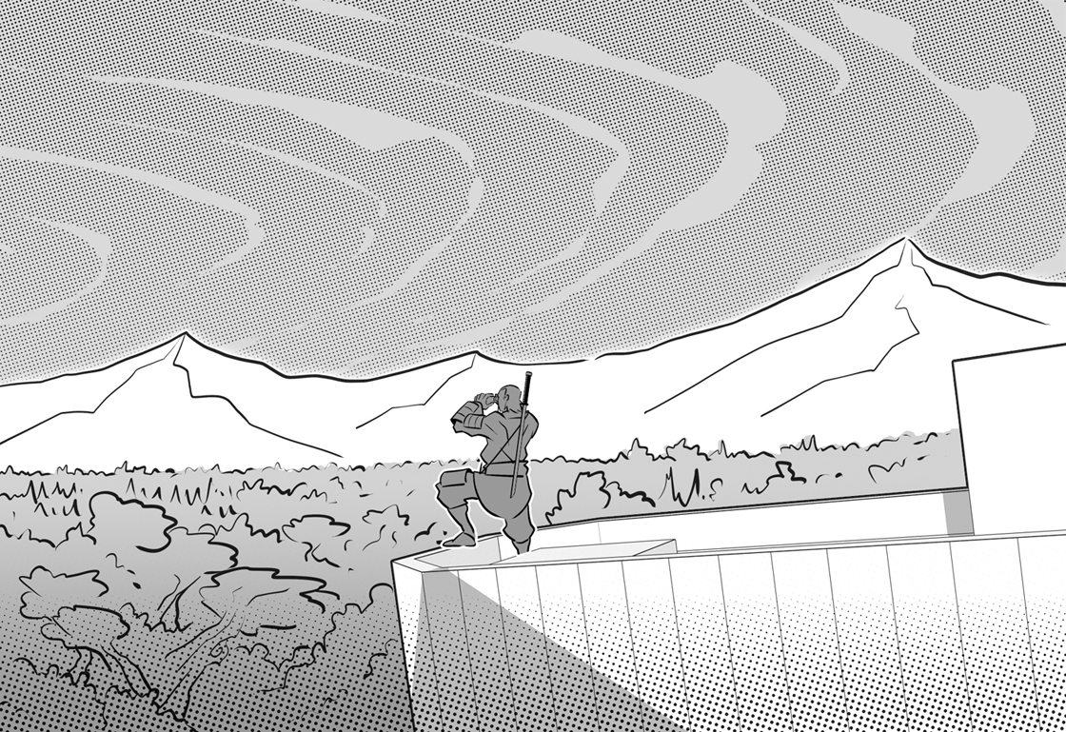
Dunsinane Hill

Slide 7
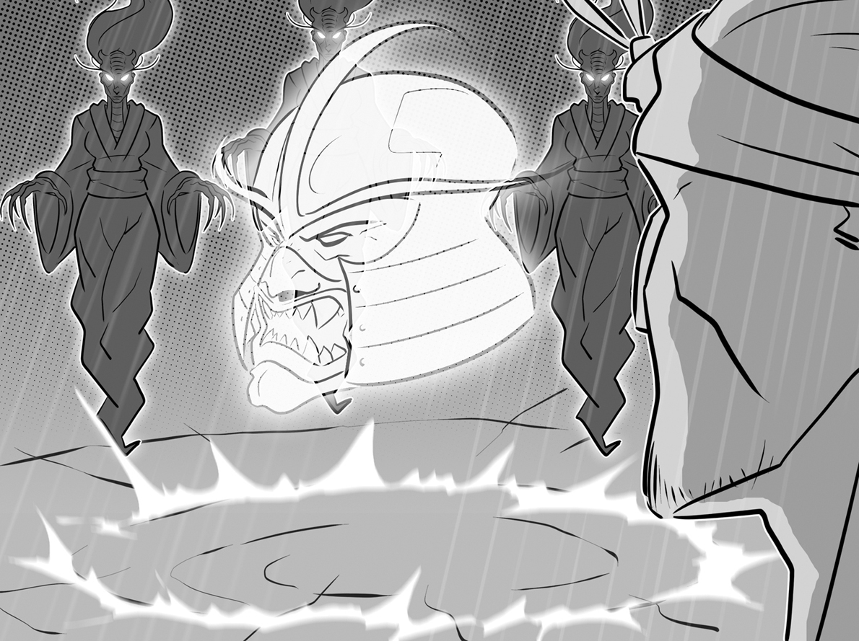
a head with a helmet

Slide 8
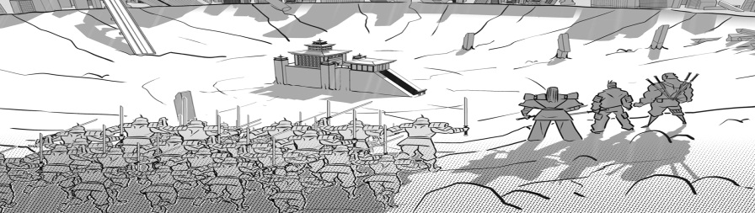
Malcolm’s army

