Slide 1





This project and its actions were made possible due to co-financing by the European Fund for the Integration of Third-Country Nationals
EAL Nexus resource
Macbeth Act 1
Key words
Subject: | English
Age ranges: | 11–14, 15–16
Topic: | Macbeth
Licence information | This resource is free to use for educational purposes. ©British Council 2015
Source | This resource was originally developed by Ruth Wilson for Wolverhampton Local Authority and has been adapted by EAL Nexus. Images taken from Self-Made Hero’s Manga Shakespeare series.

Slide 2
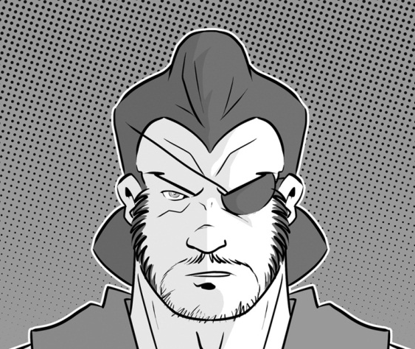
Banquo

Slide 3
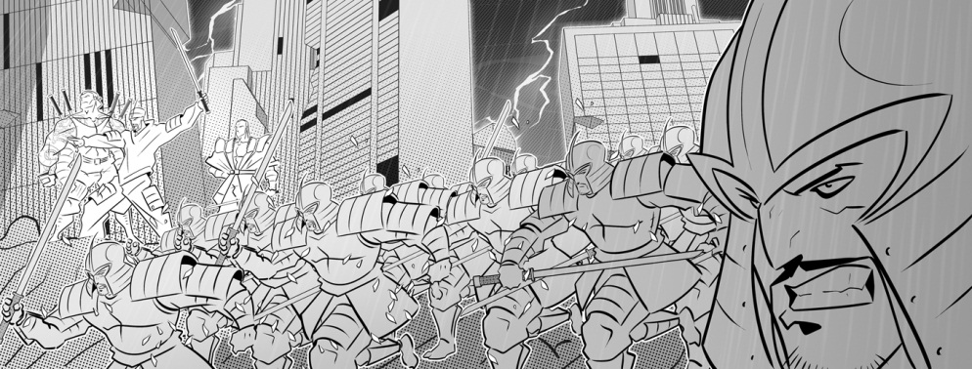
a battle

Slide 4
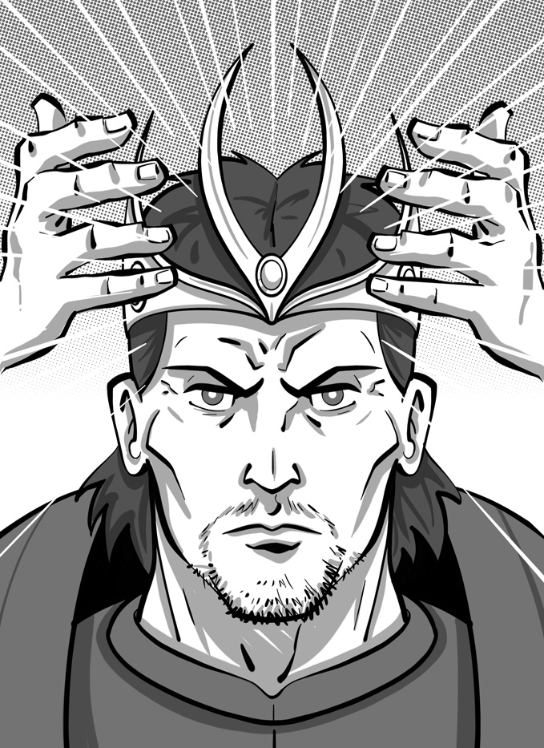
to become king

Slide 5
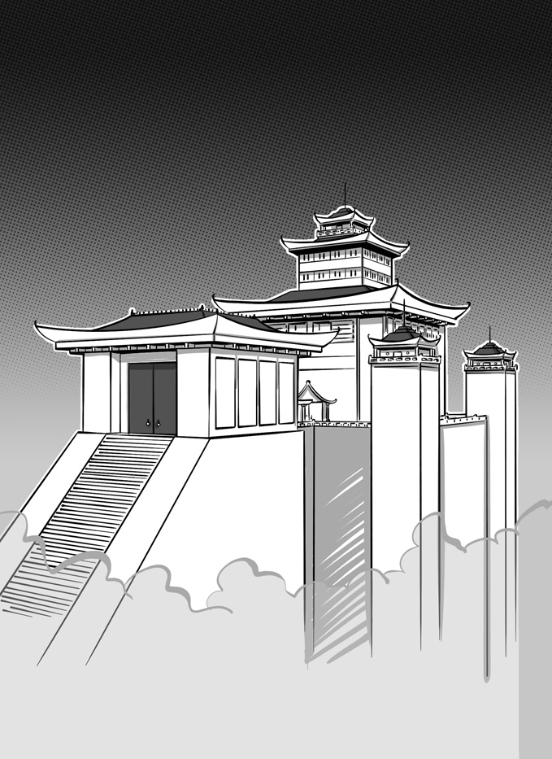
a castle

Slide 6
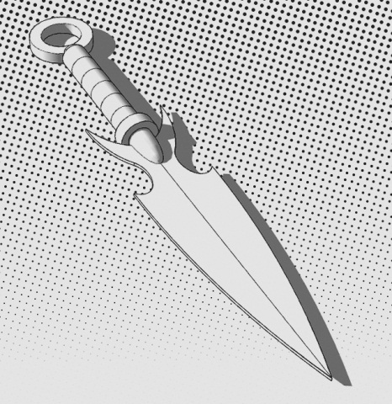
a dagger

Slide 7
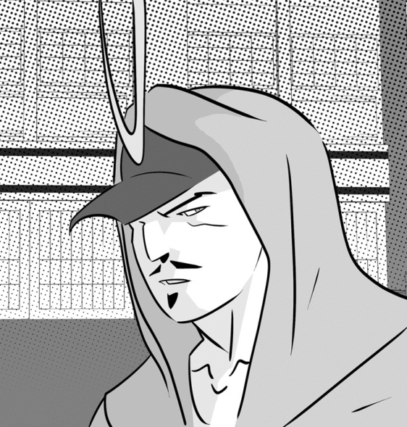
Donalbain

Slide 8
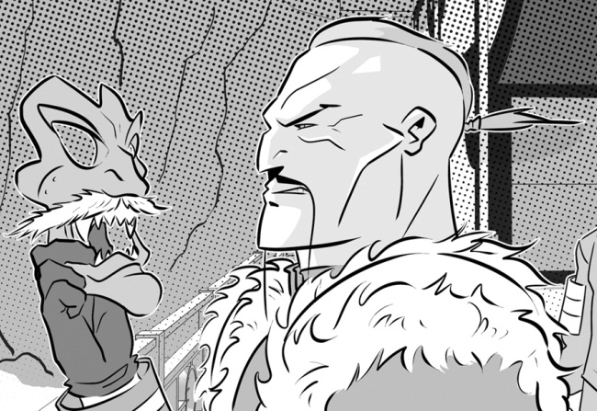
Duncan

Slide 9
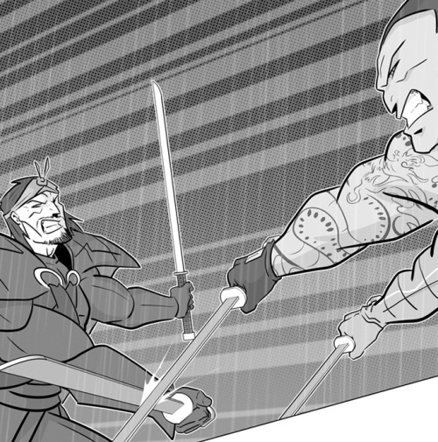
to fight

Slide 10
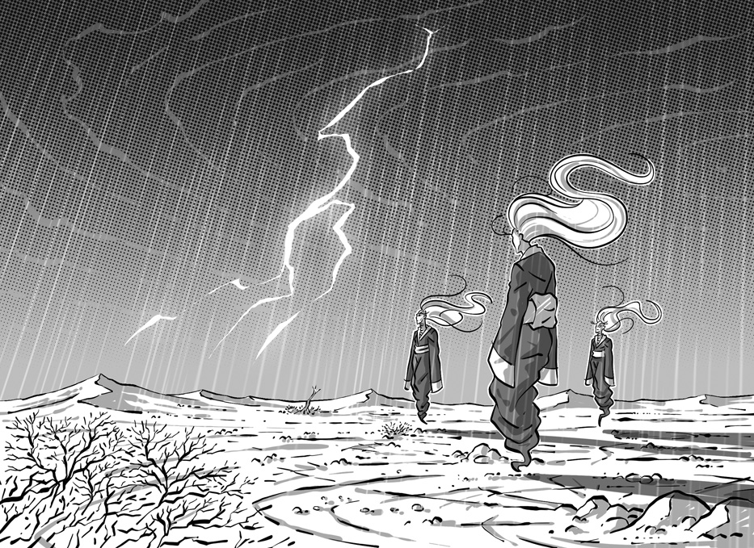
the heath

Slide 11
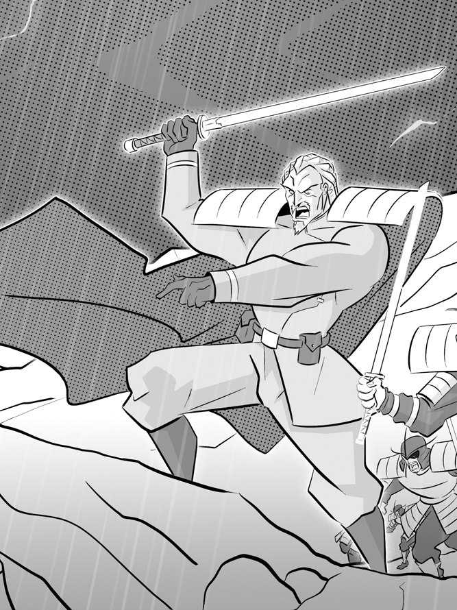
the King of Norway

Slide 12
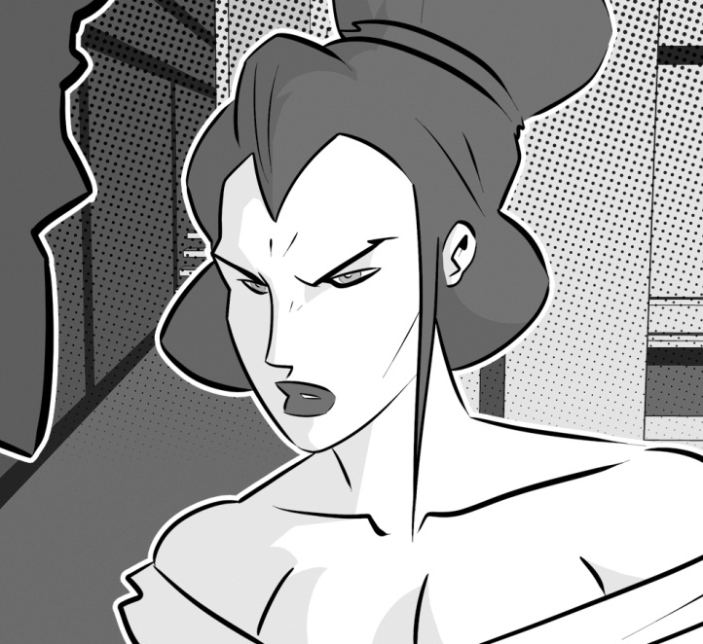
Lady Macbeth

Slide 13
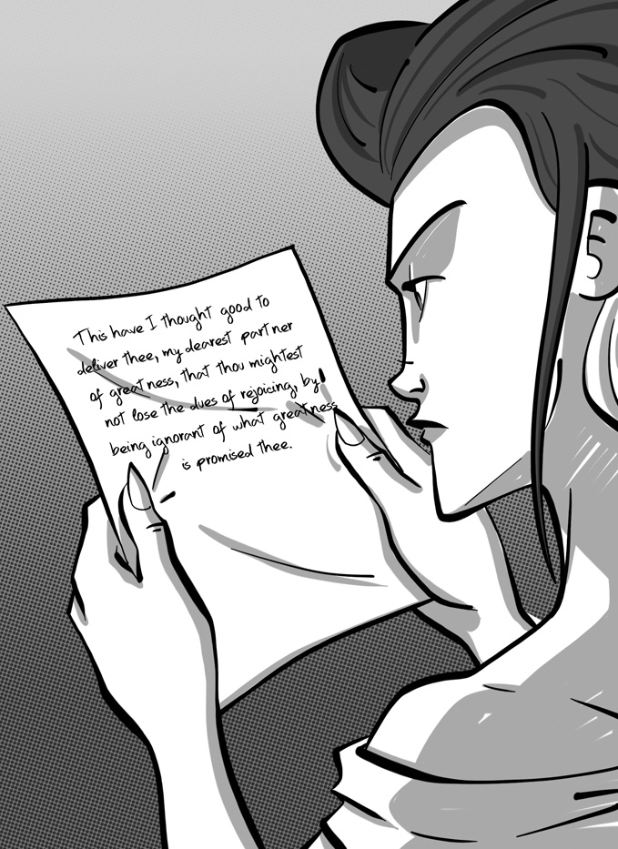
Lady Macbeth reading a letter

Slide 14
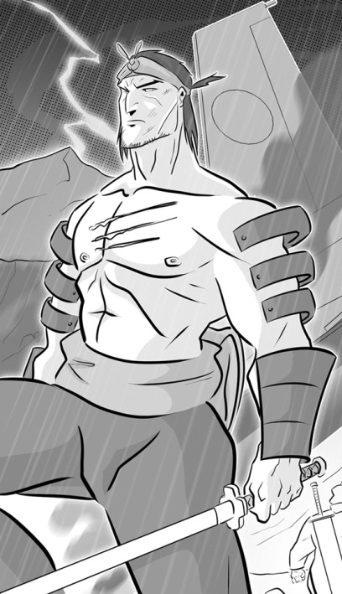
Macbeth

Slide 15
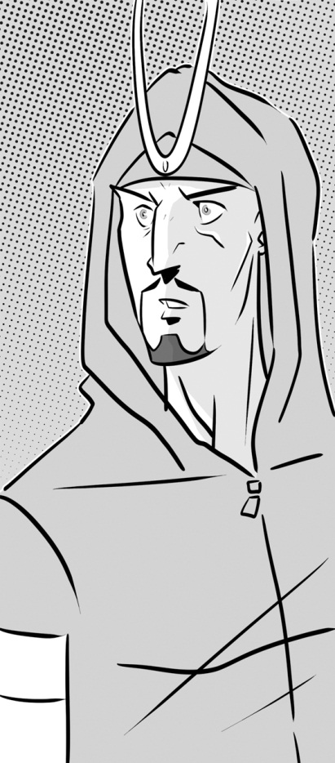
Malcolm

Slide 16
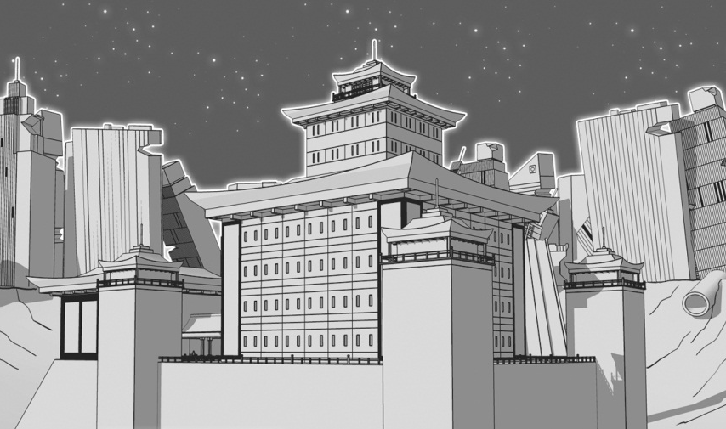
a palace

Slide 17
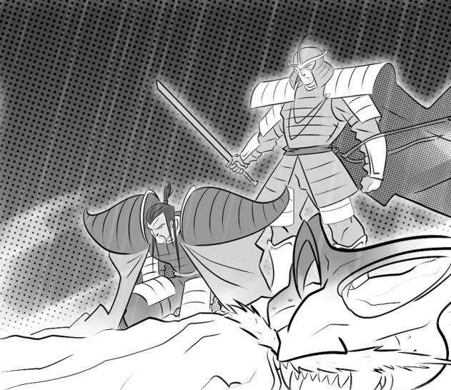
a prisoner

Slide 18
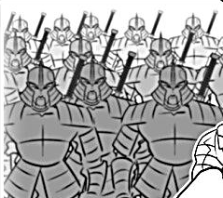
soldiers
a soldier

Slide 19
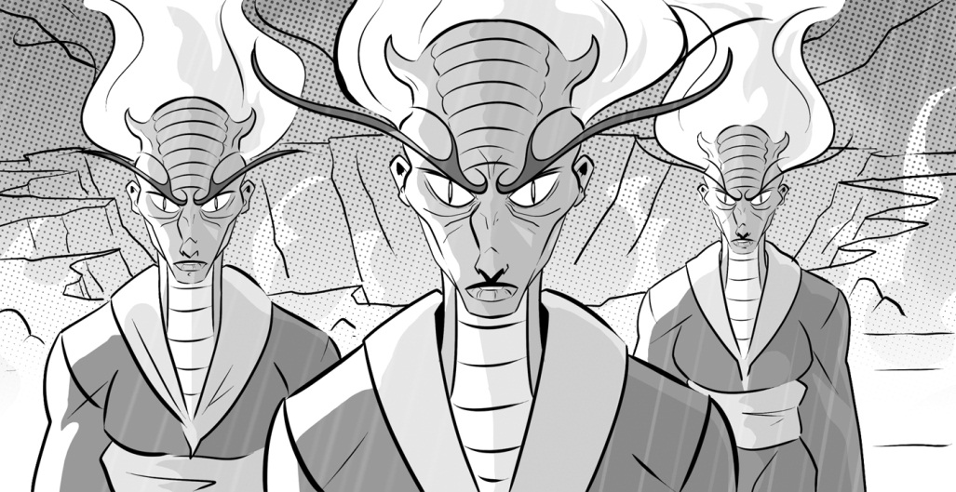
three witches

Slide 20
thunder and lightning

