Slide 1
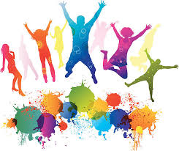
On Edge
Lesson 3 – Exploring Stereotypes

Slide 2
Outcomes
I understand the meaning of the term ‘stereotype’
I can identify who’s at risk from self-harm
I recognise that everyone differs in their ability to cope with different situations
I understand that we all use different coping mechanisms to deal with difficult feelings or situations

Slide 3
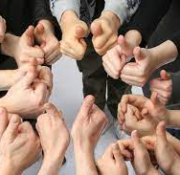
Keep safe
The topic of self-harm can be a very sensitive issue for some people
Pupils are expected to be supportive and respectful of others
If you feel concerned or worried, talk to a member of staff
Information will be available after each lesson if you want to talk to someone in private

Slide 4
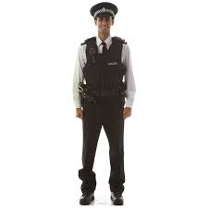
Policeman

Slide 5
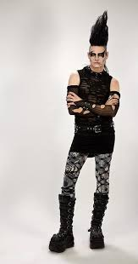
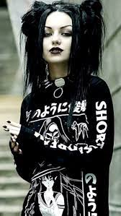
Goth

Slide 6
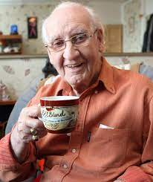
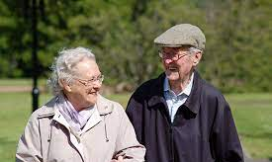
Pensioner

Slide 7
Business Woman

Slide 8
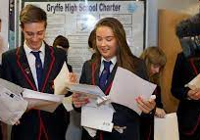
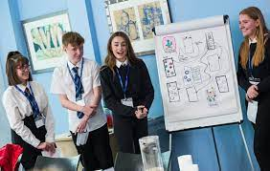
School pupil

Slide 9
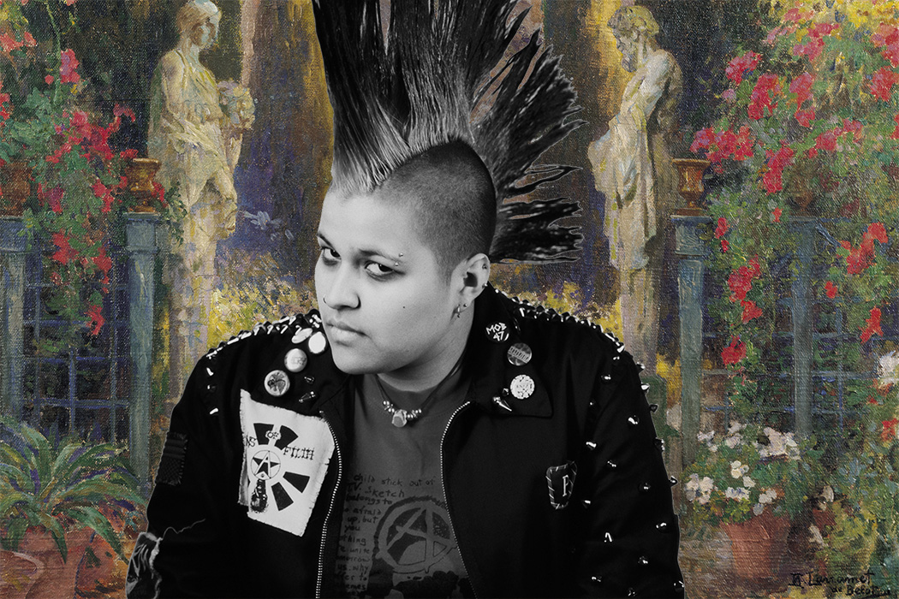
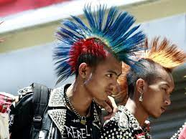
Punk

Slide 10
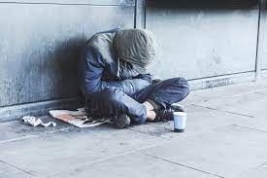
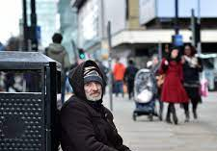
Homeless person

Slide 11
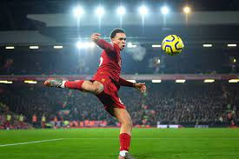
Footballer

Slide 12
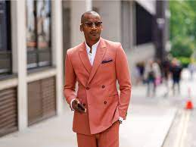
Rich person

Slide 13
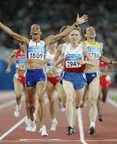
Dame Kelly Holmes
Hard Times No stranger to adversity herself, Kelly grew up in a council estate in Kent with her single mum. She struggled at school, and felt like she wasn’t any good at anything. It was her PE teacher who spotted her talent for running, and encouraged her to focus, work hard and believe in herself. Kelly says that this was the turning point for her. Career Change
Although her athletics career looked promising, at the age of 17 Kelly decided to put her running on hold in order to join the British Army. She was later recognised for her services to the Military when she received her MBE after almost ten years’ service. But watching the Barcelona Olympic Games from her barracks room on camp, she was inspired to return to the track in 1992. The Turning Point
The build-up to the Athens Olympic Games was the first year in seven that Kelly wasn’t injured, and she made the brave decision to double up in the 800m and 1500m. She became the first British female athlete to win both the 800m and 1500m, securing her place in history. She finished her illustrious career with twelve major championship medals from the Olympics, Worlds, Commonwealth Games and Europeans.

Slide 14
Stereotype definition
“Thinking all people who belong to a certain group are the same and labelling them. Stereotypes are often based on old fashioned ideas or are deliberately untrue and designed to hurt people.”
Equality and Human Rights Commission

Slide 15
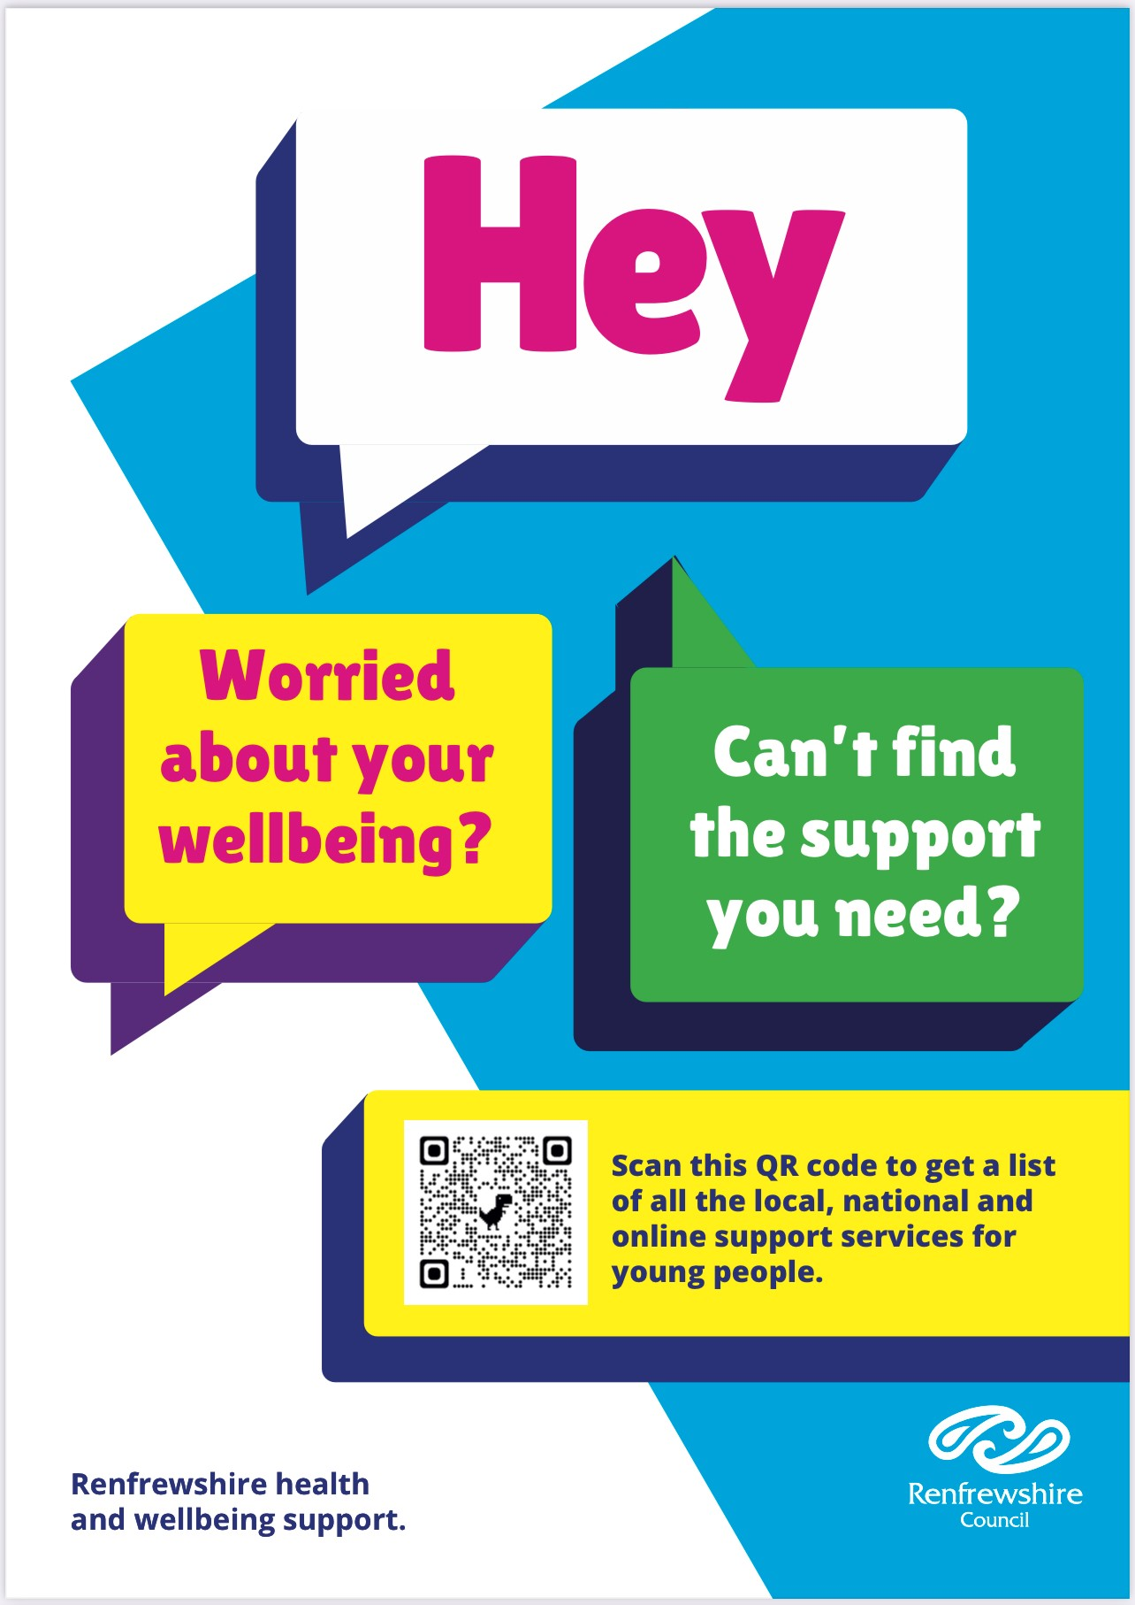
If you feel you need further information, support or someone to talk to, you can access local, online and national support services through Renfrewshire’s Signposting Resource for Young People. Look out for the poster and QR code round your school.

