Slide 1
On Edge
Lesson 2 – Dealing with Difficult Feelings

Slide 2
Outcomes
I recognise and understand different feelings
I understand that the feelings we find difficult to deal with are the painful ones
I understand that the feelings we find difficult to deal with are the ones most likely to lead to self-harm

Slide 3
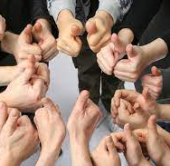
Keep safe
The topic of self-harm can be a very sensitive issue for some people
Pupils are expected to be supportive and respectful of others
If you feel concerned or worried, talk to a member of staff
Information will be available after each lesson if you want to talk to someone in private

Slide 4
How would I feel if?

Slide 5
Dealing with it
Difficult feelings
Easy feelings

Slide 6
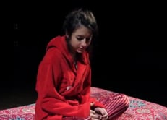
Millie’s Story
https://mindreel.org.uk/video/edge-learning-about-self-harm-millies-story

Slide 7
Millie’s Story
What was happening to Millie?
What or how was Millie feeling?
What were the physical things happening to Millie?
When did Millie try to tell someone?

Slide 8
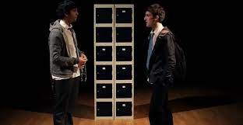
Dean’s Story
https://mindreel.org.uk/video/edge-learning-about-self-harm-deans-story

Slide 9
Dean’s Story
What was happening to Dean?
What or how was Dean feeling?
What were the physical things happening to Dean?
When did Dean try to tell someone?

Slide 10
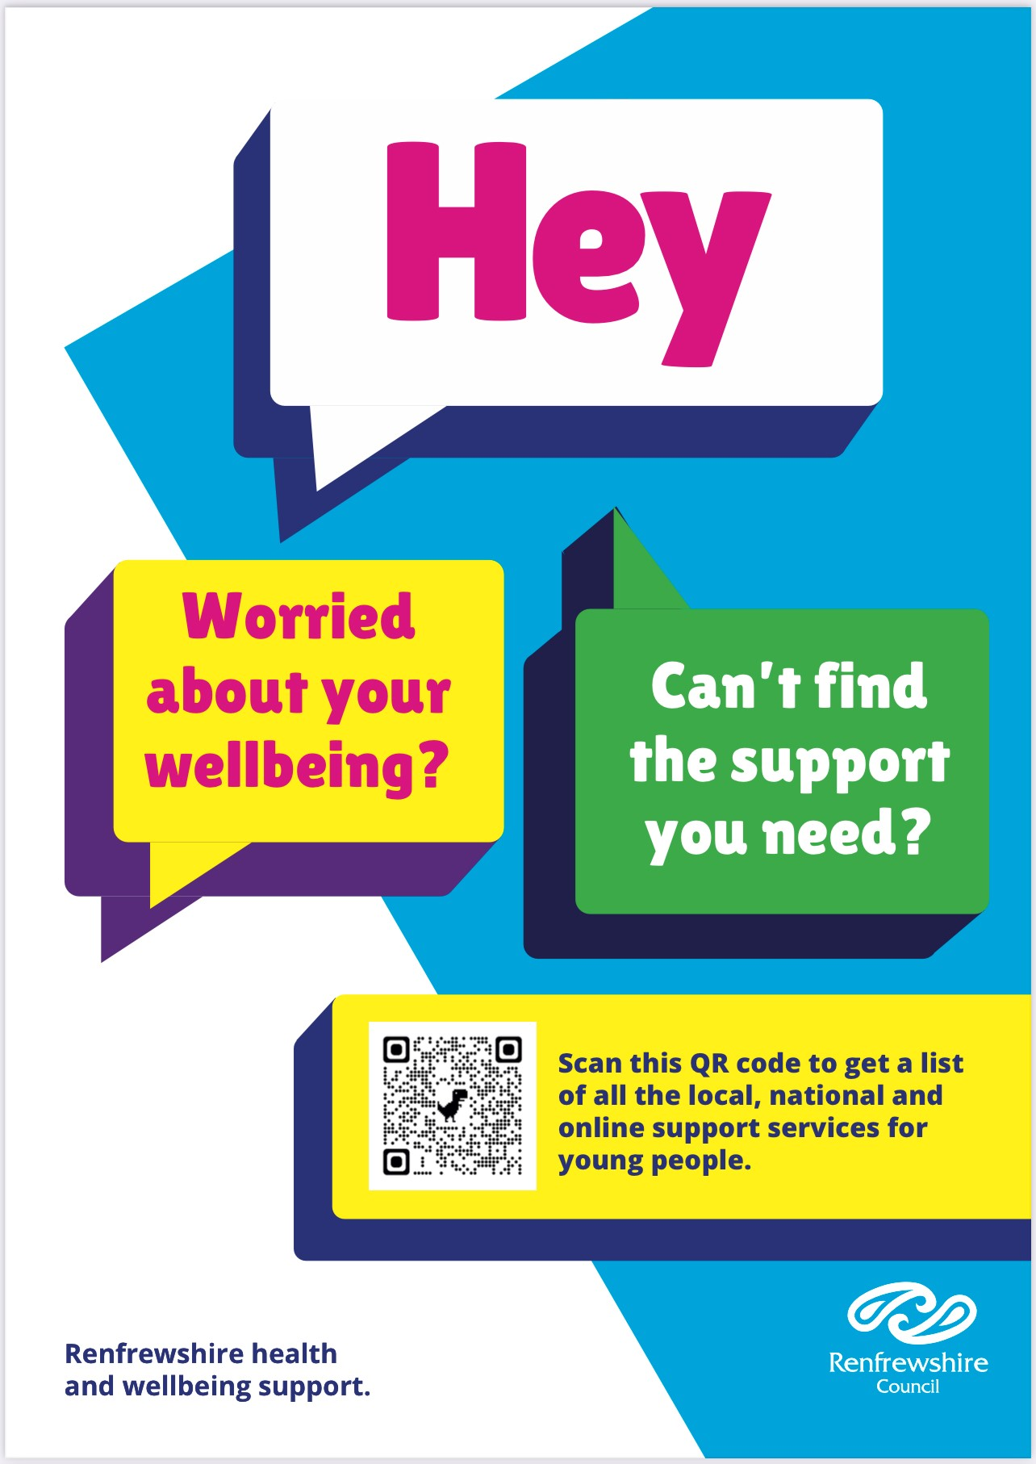
If you feel you need further information, support or someone to talk to, you can access local, online and national support services through Renfrewshire’s Signposting Resource for Young People. Look out for the poster and QR code round your school.

