Slide 1
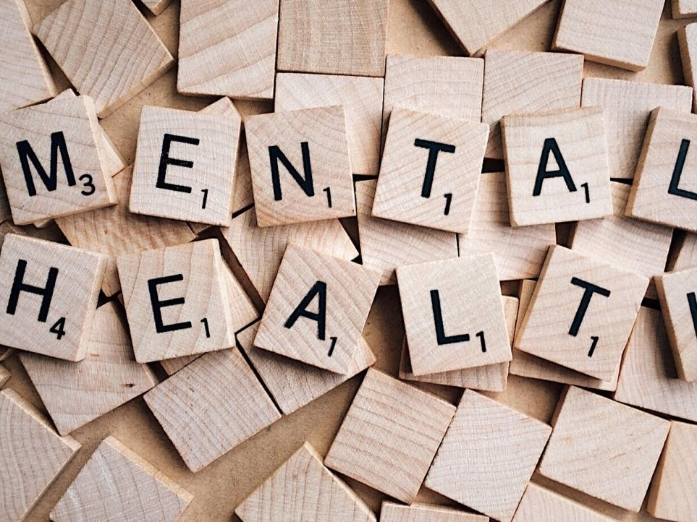
SQA Mental Health and Wellbeing Award

Slide 2
During your lessons you will develop your knowledge and understanding of topics concerning mental health and wellbeing.
From this, you will gain an SQA award.

Slide 3
Mental Health and Wellbeing Award
The award consists of 3 units:
Influences on Mental Health and Wellbeing
Understanding Mental Health Issues
Coping Strategies and Building Resilience

Slide 4
Why study mental health?
Everyone has mental health. It involves our emotional, psychological, and social well-being, and it affects how we think, feel, and act.
One in four adults in the UK are likely to have a mental health problem at some stage in their lifetime, experts believe.
It builds on your learning from S1 and S2.

Slide 5
Why?
Know the facts
Your attitude matters
It's good to talk

Slide 6
Course aims
The award aims to:
reduce stigma surrounding mental health.
arm young people with healthy coping strategies.
promote knowledge of the impact of mental health on behaviour.
dispel myths surrounding mental health.
promote understanding of positive and negative impacts on mental health.
help individuals to make the right choices.
promote understanding of the potential uses and impact of social media and the internet.
create resilience.

Slide 7
Key Terms
Discuss with a partner what the following terms mean to you:
Mental Health
Stigma
Resilience
Be ready to feedback to the class.

Slide 8
Key Terms
Mental health is defined as a state of well-being in which every individual realises his or her own potential, can cope with the normal stresses of life, can work productively and fruitfully, and is able to make a contribution to her or his community.
Add this definition to your
learning diary.

Slide 9
Key Terms
The definition of a stigma is a generalised negative belief about a particular group of people.
An example of a stigma is an actor not getting work because of past drinking problems.
Add this definition to your
learning diary.

Slide 10
Key Terms
As a character trait, resilience is a person’s ability to recover quickly from unfortunate circumstances or illness.
Add this definition to your
learning diary.

Slide 11
Unit 1- Influences on Mental Health and Wellbeing
On successful completion of the unit you will be able to:
Describe factors that may influence mental health and wellbeing.
Describe the influence of technology and social media on mental health and wellbeing.

Slide 12
Group Discussion
What do we already know?
Discuss the following in your groups:
What might influence someone’s mental health?
What might influence someone’s wellbeing?
How can mental health be affected by social media?
Be prepared to feedback to the class.

Slide 13
End of lesson! You should:
Understand why it is important to learn about mental health;
Have an awareness of some of the topics that you are going to study for your award;
Have discussed influences on mental health;
Have discussed how social media can affect mental health.

