Slide 1
Parents and Carers (Secondary)
Protect your children online
www.thinkuknow.co.uk/parents
Notes:
Note to presenter: Please read through the presentation thoroughly before delivery and familiarise yourself with the Thinkuknow websites (www.thinkuknow.co.uk) and NCA-CEOP Safety Centre (www.ceop.police.uk) if needed. There are delivery notes and instructions in italics on some slides to aid your delivery.
This presentation is specifically for P7 parents at the point of transition into S1. You may wish to briefly highlight:
Increase in use of secondary age pupils
Increase in ‘friends’ and groups when pupils enter S1
When online activity goes wrong and rolls over into school life, solving it needs parents/carers and school working together

Slide 2
What can you do?
www.thinkuknow.co.uk/parents

Slide 3
Chat little and often
Talk to your child about their life online
Take the opportunity to talk to them about how they stay safe
Explain any worries you may have
Notes:
What can you do to keep your child safe online?
Chat little and often
The best way you can protect your child is to establish a positive relationship with them around their life online. Talk to them – not just once but have ongoing conversations as part of your family life.
Ask them what they are doing online, and what they like and dislike about the apps and services they use. Take the opportunity to talk to them about how to stay safe on these services and in general. For example, you could ask about the types of issues that have arisen for their friends online, and what advice they would offer to help them feel safe. Talking about others, can help you avoid directly questioning what they do online, and possible embarrassment.
Explain to them any worries you have. Your child might think that you are getting worried for no good reason, but if you explain why something is troubling you they will understand why you want to talk to them. Tell them if it is something you have read about or seen their friends doing.

Slide 4
Report anything that worries them
Make sure they know they can come to you
Help them identify trusted adults
Let them know you won’t blame them
Direct your child to age appropriate information
Notes:
Remind them to report anything worrying, and how they can do this
It’s important that children and young people always know where to go if they come across something that worries them or makes them feel uncomfortable online.
To help, you could, encourage them to speak to you or another adult immediately if they have any worries or concerns. Help them to identify a trusted adult that they can approach, if they feel they can’t talk to you, even if this means on the phone.
Make sure they know that they can always report to CEOP if they are worried about sexual abuse online. Or if they are worried about something else, they can call a helpline, like Childline. We tell you more about this at the end.
Make sure they know that you would never blame them for anything that might happen online. Technology, flirtation, excitement and hormones are a powerful mix. This can make it hard for young people to think clearly about their actions online and to consider the possible consequences. Young people will take risks online, and they need to know that you will always give them calm and non-judgemental support.

Slide 5
Thinkuknow resources
www.thinkuknow.co.uk/parents
Notes:
Staff delivering internet safety in PSE have taken part in training around the challenges our children and young people face online, Thinkuknow resources developed to be age appropriate and also resources to help parents/carers navigate conversations around keeping their child or young person safe online.

Slide 6
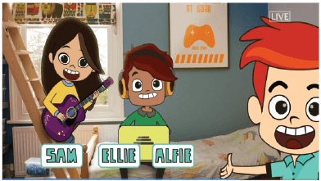
What is Thinkuknow?
Thinkuknow is the education programme provided by CEOP.
Thinkuknow offers resources for different audiences:
4-7
8-10
11-13
14+
Parents and Carers
Resources for those with special educational needs and disabilities (SEND)
Visit www.thinkuknow.co.uk for information and advice
Notes:
What is Thinkuknow?
Thinkuknow is the national education programme created by the CEOP Education Team at the National Crime Agency . The National Crime Agency is committed to protecting the public from serious and organised crime, and CEOP's role is to tackle the sexual abuse and exploitation of children both online and offline.
The Thinkuknow education programme aims to empower and protect children and young people from sexual abuse and exploitation.
Thinkuknow provides professionals with the resources to teach children and young people, aged 4 -18, about important online safety and relationships education topics that help keep children safe from sexual abuse online. The Thinkuknow programme includes films, animations, websites, presentations, and lesson plans which help professionals explore difficult and sensitive issues safely with children and young people.
We have also created information and advice for parents and carers to help build their confidence and knowledge in protecting their children online. The Thinkuknow films and activities are a great way to start and continue chats about online safety.
In addition to providing professionals with resources there is information and advice for parents and carers to help build their confidence and knowledge in protecting their children online. Thinkuknow also offers expert advice to parents and carers supporting children who are victims of sexual abuse and exploitation.
This presentation is part of the Thinkuknow package for parents and carers.

Slide 7
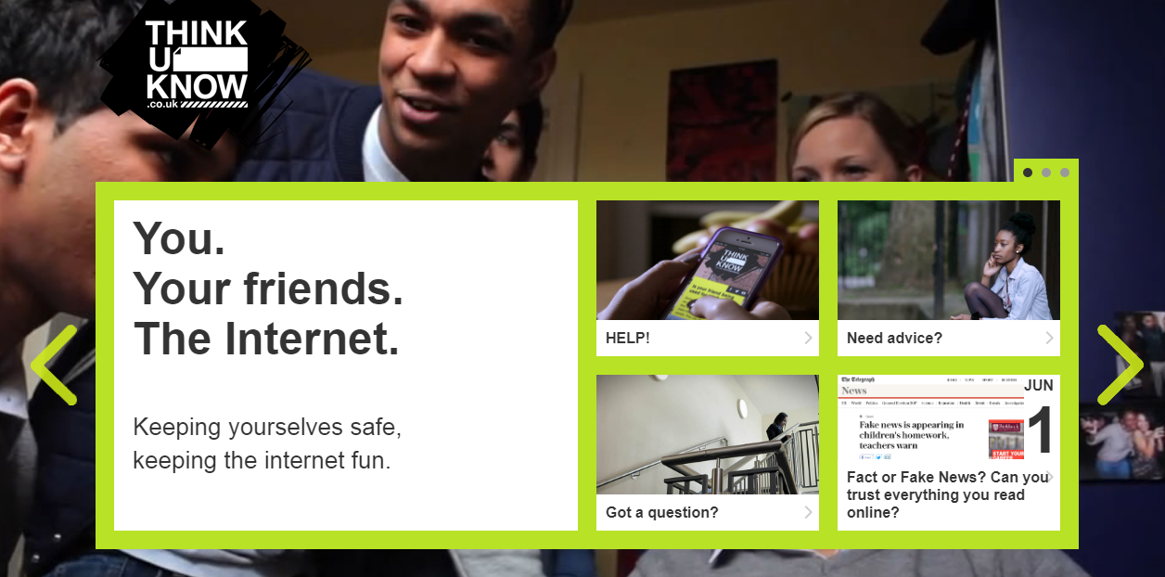
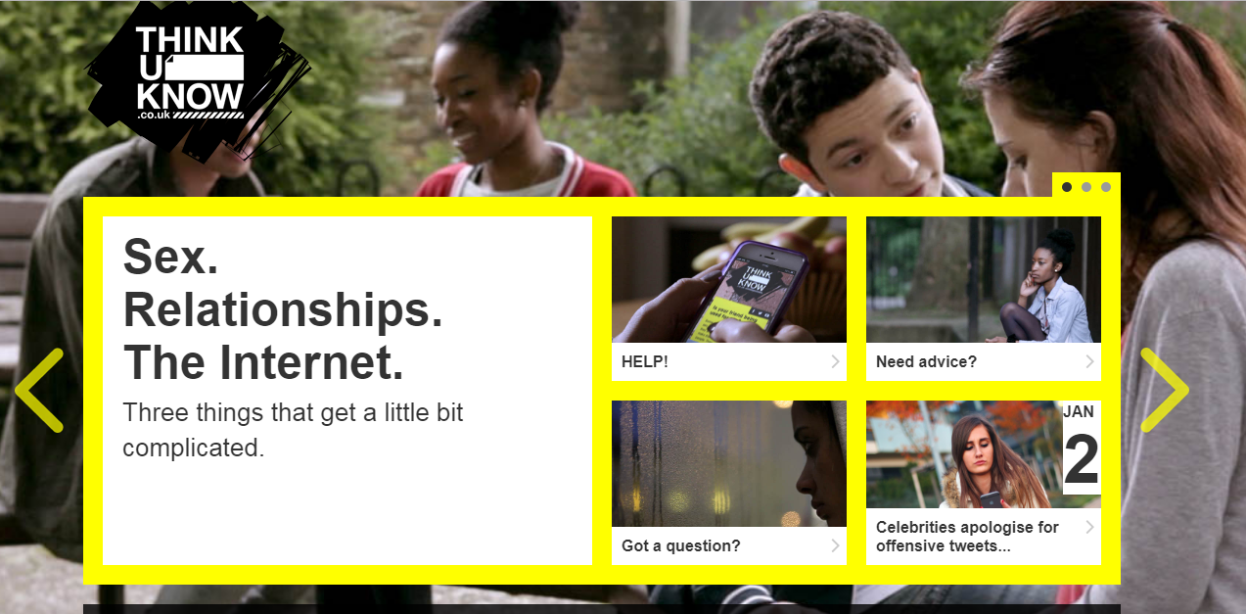
Thinkuknow teen websites
Notes:
There are two teen Thinkuknow websites. One for 11-13 year olds and one for 14+. The websites help young people to develop healthy approaches to friendships, relationships and the internet.
It teaches them to identify negative or unhealthy behaviour, respond with resilience, and know where to go for help if they ever feel anxious or threatened online or in a relationship. They cover topics such as: consent, healthy and unhealthy relationships, pressurising and threatening behaviours online, and reporting abuse to NCA-CEOP.
Encourage parents to take a look at the teen websites following the session and using them to start a conversation with their teenager.

Slide 8
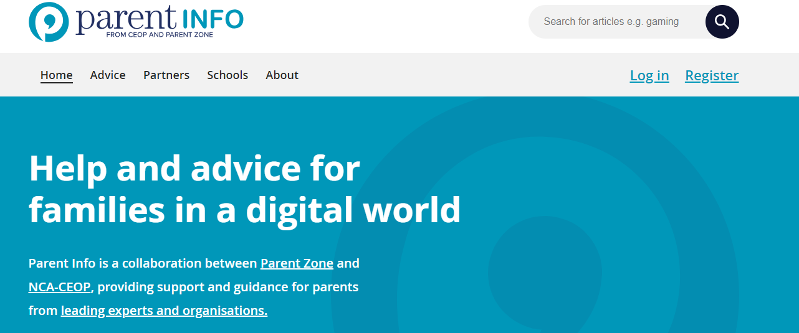
www.parentinfo.org
Notes:
Parent info
Parent Info is a partnership project between NCA-CEOP and the parent organisation Parent Zone.
It’s a website and advice service for parents and carers, which aims to build the resilience of their children through articles, tips and advice. Articles are written by expert organisations on a range of different topics, all linked by the internet. The website is divided into the following categories:
Games, apps and tech
Parenting
Safety and settings
Relationships and sex
Education and the future
Health and wellbeing

Slide 9
Other organisations who can support
Notes:
In PSE lessons we will focus on the positives of the online world and how to navigate it safely but also discuss what can go wrong and where to go for suppot if they come across worries them or makes them feel uncomfortable online. We will let them know there are organisations they can talk to, if they don’t feel able to talk to you or another trusted adult.
[You may want to leave the next section out.]
Childline is a confidential 24/7 counselling service run by the NSPCC for all children up to the age of 19. Children can speak to a trained counsellor on the phone or online about any issue that they are going through – www.childline.org.uk
Childline also have a Report Remove service, which allows children and young people under 18 to report a nude image or video of themselves that might have been shared online, and get it removed from the internet.
The Mix is another confidential helpline and support service for young people under the age of 25. The Mix specialises in topics such as sex and relationships, homelessness, drugs, mental health and finding a job. Get more information at www.themix.org.uk

Slide 10
Staying up to date:
@CEOPUK
ClickCEOP
www.thinkuknow.co.uk
www.thinkuknow.co.uk/parents
www.ceop.police.uk/safety-centre
Notes:
For more information on any of the resources we have talked about, reporting or further advice and guidance please visit our website – www.thinkuknow.co.uk/parents
You can also keep up to date by following NCA-CEOP on Twitter or Facebook.

