Slide 1
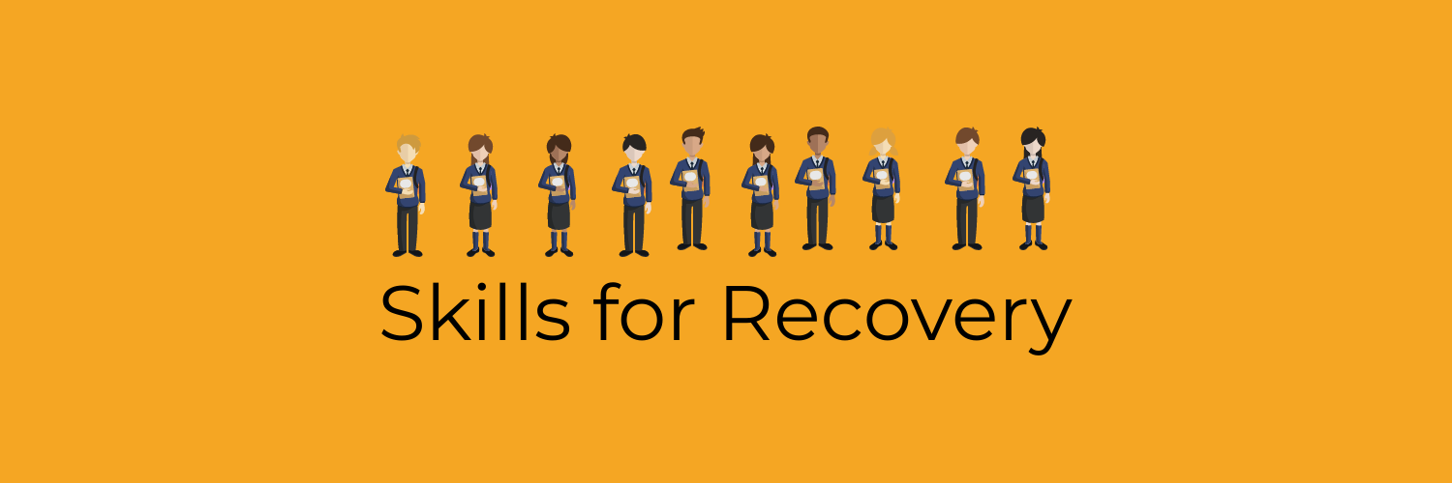




Slide 2
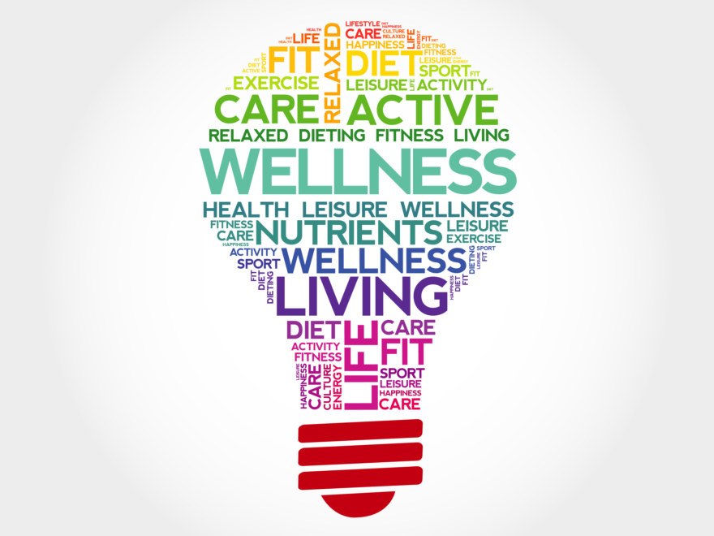
Week 3
Doing things that make us feel better straight away - Regulating

Slide 3
What you need to know
Adults understand it can be difficult being a young person
Things will get better, seem a bit brighter and you are going to be okay. You might not think it just now but you will be able to change things and be okay.
Understand that when you ‘flip your lid’, regulating strategies can help you think straight again. By doing something different we can change how we feel.

Slide 4
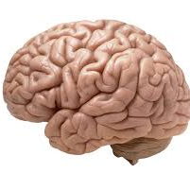
Task 1
This clip will help you understand what happens to the brain when things aren’t good for us.
https://www.youtube.com/watch?v=FTnCMxEnnv8&vl=en

Slide 5
What you need to know
Regulating strategies can be used at any time, in any place.
It’s helpful to try regulating strategies to find what works best for you. We’ll be giving you more examples today of techniques to try.

Slide 6
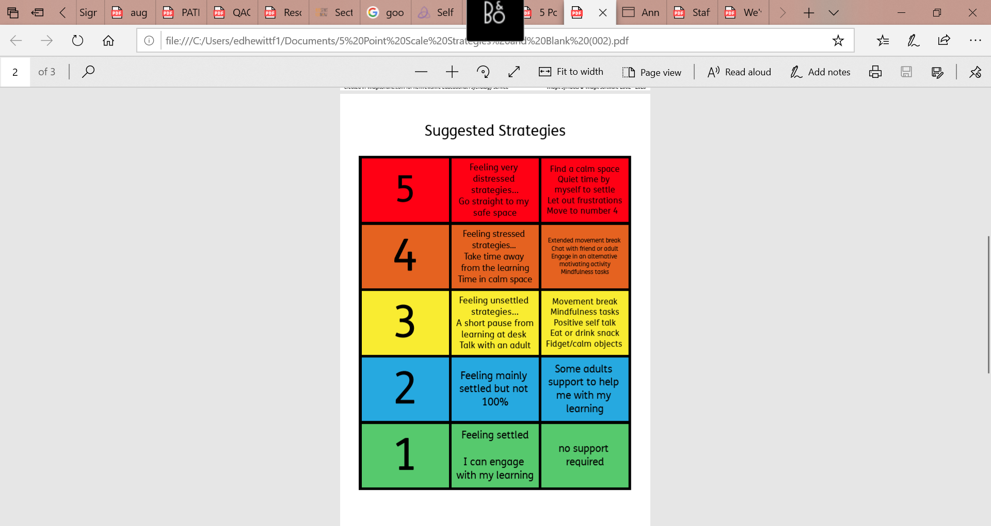
Try to notice how your body feels when you are anxious and what kind of activities help you to feel calmer. It may help to think of how you are feeling on a scale of 1-5.

Slide 7
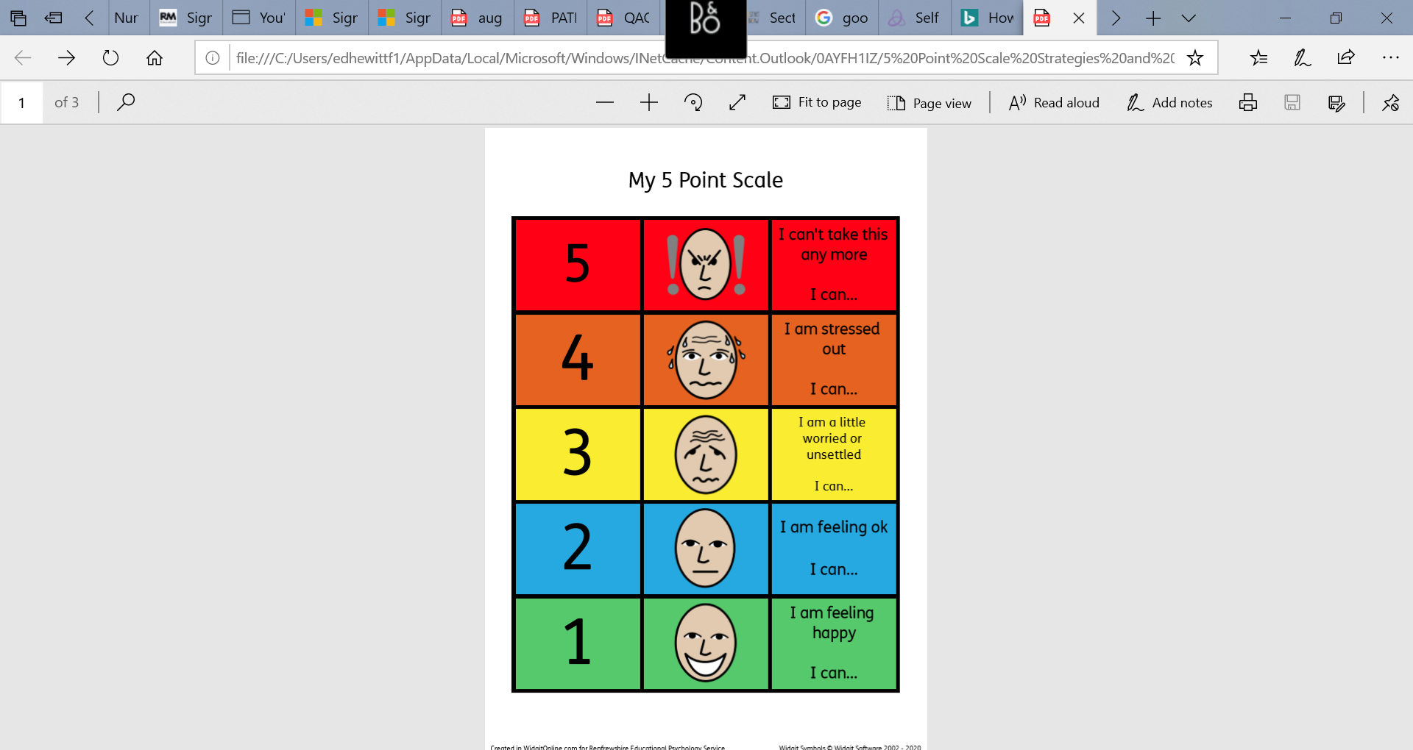
This is how you might look and feel….

Slide 8
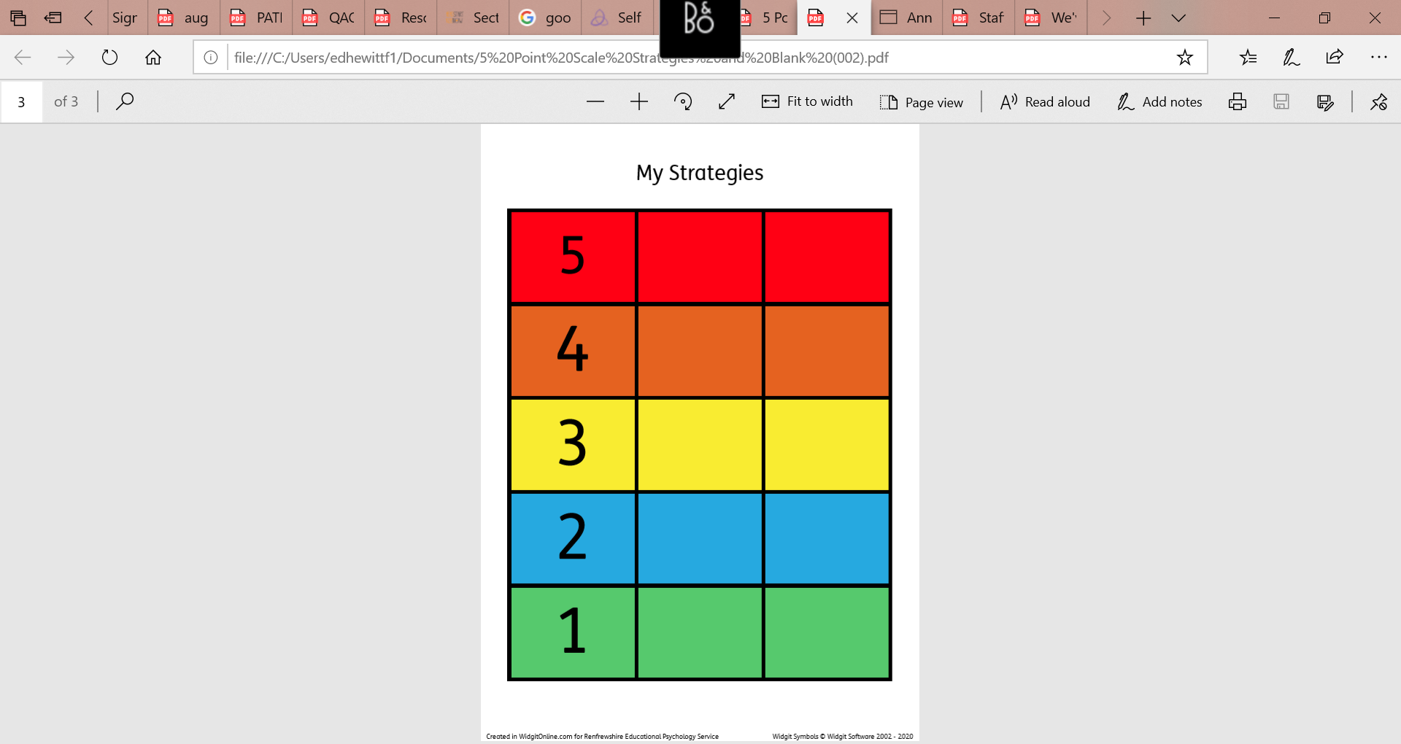
Think about trying your own scale of how you feel from 1 to 5. It is important for us to know how our feeling escalate and can get out of control.

Slide 9
What you need to do
Try short regulation breaks throughout the day (1-2 minutes can be enough!) for example…
breathing exercises (hopefully we’re getting better at these!)
mindfulness
movement
checking in with a trusted person

Slide 10
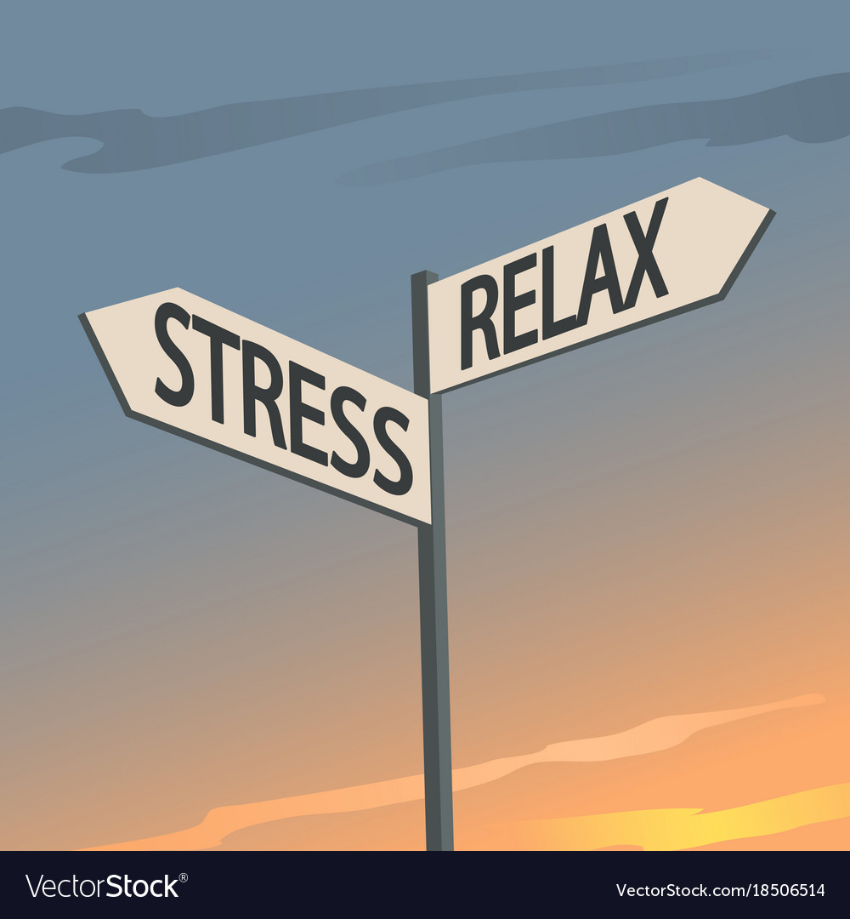
Task 2
Here’s some for you to try!
Bubble breath (Calm) https://www.youtube.com/watch?v=uxayUBd6T7M
Muscle tensing and releasing https://www.youtube.com/watch?v=FbhUxg9eHDE&feature=youtu.be
Mindfulness https://www.youtube.com/watch?v=ykDPtWdxOxs
‘The sushi train’ (Russ Harris) https://www.youtube.com/watch?v=tzUoXJVI0wo

Slide 11
What you need to do
Make a self soothe/calm box filled with things which make you feel more relaxed. Young Minds have a ‘how to’ guide here - https://youngminds.org.uk/blog/how-to-make-a-self-soothe-box/
This self care strategies bank can give you lots more ideas of things to try - https://www.annafreud.org/on-my-mind/self-care/

Slide 12


Task 3 - BreathPod
https://www.instagram.com/tv/CAN2n3sApyz/?utm_source=ig_web_button_share_sheet
If in doubt, breathe it out! If you feel you are getting better at breathing, you can skip to using bubble breath from the earlier slide.
https://www.youtube.com/watch?v=uxayUBd6T7M

