Slide 1
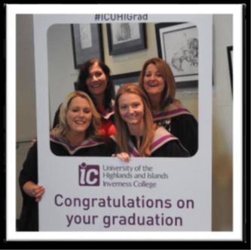
Scottish Borders
Council
Increasing Teaching Workforce

Slide 2
‘Grow Your Own’
Recruitment difficulties in particular subjects. – national issue.
Explore new partnerships and programmes.
Context of Scottish Borders
Notes:
National shortage of particular subjects
Scottish Borders – looked how we could create opportunities for training
Ability for people to remain in the Borders, who are committed to Borders.

Slide 3
University of the Highlands & Islands
PGDE course – 1 year (distance learning & school placements).
Probationary year.
Permanent teaching position.
First cohort 2017

Slide 4
Dundee University
18 month programme – PGDE & teaching experience.
4 days a week in school.
1 day – distance learning.
Started December 2018.

Slide 5
Next Steps- University of the Highlands & Islands.
Primary PGDE course – 6 places.
Currently recruiting for students to start in August 2019.
- Distance learning and Scottish Borders placements.

Slide 6
Summary
August 2019 – 4 new teachers in SBC
August 2020 – potentially 14 additional teachers.
August 2021 – potentially 12 additional teachers.
Between 2017 – 2021, 30 additional teachers added to the workforce

Slide 7
Home Economists
August 2019
1 additional Home Economist,
1 NQT,
3 Dundee Student- inductees,
2 flexible route probationers
August 2020
6 additional Home Economists,
1 NQT

