Slide 1

Notes:
This is a front cover page and can only be used at the beginning of a PowerPoint presentation once. Do not add anything else to this screen if it is being used.

Slide 2


A healthier future
Scotland’s diet and healthy weight delivery plan
For Scotland's learners, with Scotland's educators
Notes:
This is a front cover page and can only be used once. Use the corresponding green internal and back pages if you are using this page. You may add a title and a subtitle if needed only. Do not add anything else or move elements around.

Slide 3
The Challenge
The impacts of poor diet and overweight are profound. They affect not only our health, but also our ability to lead happy, fulfilling lives. They have also led to increased, unsustainable demand on the NHS and other public services.
The Scottish diet remains stubbornly unhealthy, and we are far from meeting our dietary goals . This has a direct impact on levels of overweight and obesity - and therefore health harm – in the population.
For Scotland's learners, with Scotland's educators
Notes:
This is an internal page in green and can be duplicated to create additional pages. Always keep the heading and footer as shown. Use the corresponding green front and back pages if you are using this page.

Slide 4
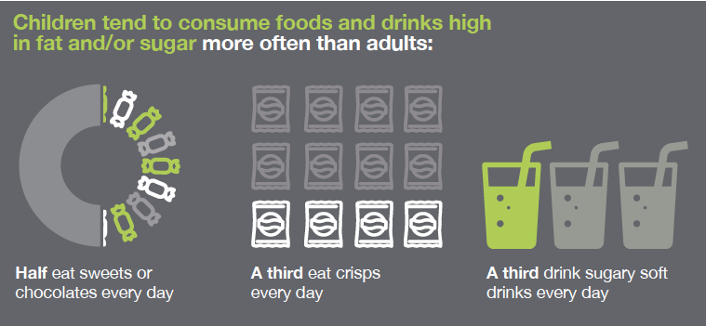
Where are we now?
For Scotland's learners, with Scotland's educators
Notes:
This is an internal page in green and can be duplicated to create additional pages. Always keep the heading and footer as shown. Use the corresponding green front and back pages if you are using this page.

Slide 5
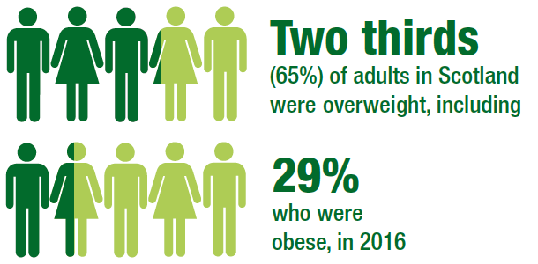
Scottish Health Survey 2016 : Obesity
.
For Scotland's learners, with Scotland's educators
Notes:
This is an internal page in green and can be duplicated to create additional pages. Always keep the heading and footer as shown. Use the corresponding green front and back pages if you are using this page.

Slide 6
The health harms associated with carrying excess weight.
.
Obesity is the second-biggest preventable cause of cancer, behind
only smoking, and is linked to around 2,200 cases of cancer a year in
Scotland.
Being overweight and obese is also the most significant
risk factor for developing type 2 diabetes, and can result in
increased risk of other conditions including cardiovascular disease
and hypertension.
Poor diet and weight often also go hand in hand with other risk
factors such as low physical activity, smoking and harmful drinking –
compounding health harms
For Scotland's learners, with Scotland's educators
Notes:
This is an internal page in green and can be duplicated to create additional pages. Always keep the heading and footer as shown. Use the corresponding green front and back pages if you are using this page.

Slide 7
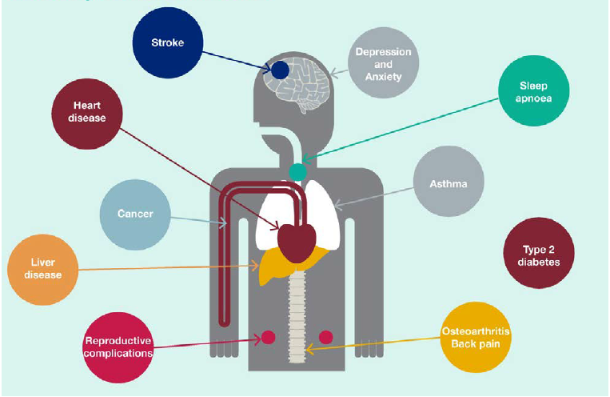
Obesity harms health

Slide 8
Deprivation impacts obesity
We know that people who live in more deprived areas tend to be most
impacted. Significant inequalities in levels of obesity persist between people
living in the least and most deprived groups in Scotland – and the gap may be
widening for children. Overall, around 32% of adults living in the most
deprived areas are obese, compared with 20% of those living in the least
deprived areas.

Slide 9
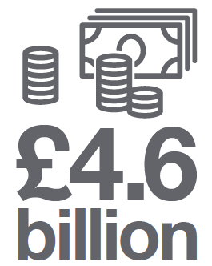
Socioeconomic implications of obesity
Annual cost to Scottish economy
Treatments and related costs
The annual cost of treating conditions associated with being overweight and obese is estimated to range from £363 million to £600 million.
The total annual cost to the Scottish economy of overweight and obesity, including labour market related costs such as lost productivity, is estimated to be between £0.9 billion and £4.6 billion.

Slide 10
Public opinion backs action
Nearly 70% of people believe that obesity harms Scotland either 'a
great deal' or 'quite a lot'.
The majority of people in Scotland are also in favour of at least one intervention to place restrictions on advertising, sponsorship and packaging of food and drink high in fat, sugar or salt.

Slide 11
Scottish government : vision
A problem of this scale must be met with an equally ambitious aim, and our
vision is for a Scotland where everyone eats well and has a healthy weight.
Recognising the specific need to tackle weight-related issues at an early
stage, this delivery plan also has an ambition to halve child obesity in
Scotland by 2030. We are also aiming to significantly reduce health
inequalities.

Slide 12
Scottish government : outcomes
This vision will be achieved by working towards five key outcomes:
Children have the best start in life - they eat well and have a healthy weight
The food environment supports healthier choices
People have access to effective weight management services
Leaders across all sectors promote healthy weight and diet
Diet-related health inequalities are reduced

Slide 13
Outcome 1: Children and young people have the skills they need to make healthy choices
“Food and Health Experiences and Outcomes are an entitlement from
ages 3-15, supporting children and young people to develop their understanding of a healthy diet.

Slide 14
Outcome 2: The food environment supports healthier choices
THe Scottish Government has been consulting on plans to restrict the promotion and marketing of targeted HFSS foods, within premises where these foods are sold to the public, to inform impact assessments and consideration of legislation to reduce associated health harms.
The consultation has been involved in seeking views on our intention to focus on food and drink:
high in fat, sugar or salt
frequently consumed
add calories or salt
but have little or no essential nutrients.

Slide 15
Outcome 3: People have access to effective weight management services
Evidence tells us that there is an increased risk of developing serious diseases, such as heart disease, cancer and type 2 diabetes, for people who are overweight or obese, as well as potential psychological and emotional consequences.
It is important that there is fair access to suitable, supportive and effective weight management services that provide support and advice, free from stigma and bias, to help more children, young people and adults in Scotland achieve and maintain a healthy weight.
Football Fans in Training
By targeting support for those with, or at risk of, type 2 diabetes we could therefore change this trajectory and make a positive impact on our population health.

Slide 16
Outcome 4: Leaders across all sectors promote health diet and weight
Improving the food we serve
Scotland's public sector to lead the way in promoting healthier food.
Ensuring everyone can eat well
Recognising that too many people are still affected by food insecurity and there is a need for continued action to ensure they and their families can eat well
Local leadership and action to improve diet and weight
Action by national and local government and partnerships across the system.
Improving the health, diet and weight of Scotland's workforce
What more can be achieved in the work place , recognising the links between the health and wellbeing of staff, performance, absenteeism, and recruitment and retention.

Slide 17
Outcome 5: Diet-related health inequalities are reduced
A strong focus on preventative measures and early intervention from pre-birth to adolescence will lessen inequalities.
Action designed to empower people to make better decisions, and a commitment to work differently with communities and co-produce services they will use. The design and delivery of weight management services as part of the Type 2 Diabetes Prevention Framework is a great opportunity to get this right.
There are population measures that impact everyone in Scotland. Learning from our wider experience such as the ban on smoking in public places, we know that these types of measures are more effective in reducing health inequalities than those aimed at changing people's behaviour.

Slide 18
Education Scotland
Denholm House
Almondvale Business Park
Almondvale Way
Livingston EH54 6GA
T +44 (0)131 244 5000
E enquiries@educationscotland.gsi.gov.uk
For Scotland's learners, with Scotland's educators
Notes:
This is a back cover page in green. You may edit the address if needed only. It can only be once and at the end of the PowerPoint presentation. Use the corresponding green front and internal pages if you are using this page.

