Slide 1
RNRA/NVR in Woodlands PS Jennifer Gibney, DHT & Donna Watt, CT
Notes:
1.30-2.00
Jennifer Gibney
Donna Watt

Slide 2
NVR at Woodlands
Woodlands Primary School
Friday 17th May
Donna Watt, Jennifer Gibney & Brigitte Short

Slide 3
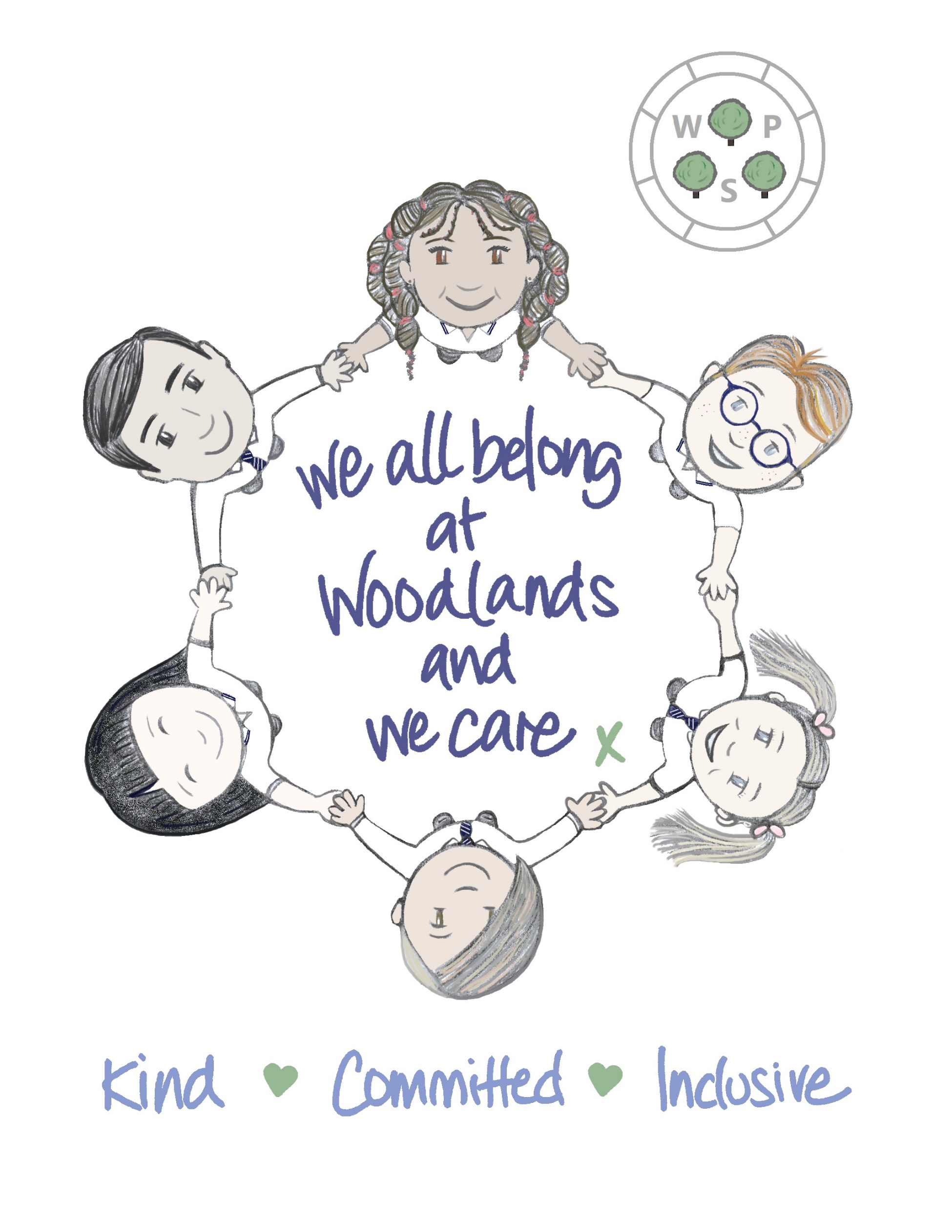
NVR at Woodlands
School context:
-School roll 249
-68% ASN
-72% SIMD 1-3
-Distressed and dysregulated behaviours
Notes:
Start with school context at Woodlands: one of our biggest challenges was effectively supporting distressed and dysregulated behaviours.
Brigitte: joint working planning meeting, no appetite for any RNRA/nurture training- no buy in. 25 cases brought to ed psych, mostly around behaviour and social/emotional. Looked at a systemic approach and EP took the group of 5 teachers November 2022 through the same structure as a parent group.
When other staff saw the impact this was having, it helped buy in. Whole-staff training August 2023- been very well received.

Slide 4
Impact
NVR in action at Woodlands (Donna)
Brigitte Short (education psychologist)
Notes:
Donna is going to share her personal experience of the impact of implementing NVR approaches in her classroom.

Slide 5
The Continuum of Supporters (Uri Weinblatt)
Wholly negative
Somewhat negative
Neutral
Partially Supportive
Fully Supportive
Realistically, you should only expect to move a supporter along two positions:
e.g. someone who starts off very ‘anti’ may become at best ‘neutral’ and agree not to jump in if the parent is ‘striking while the iron’s cold
However – there are always exceptions to the rule!
Notes:
LS
Supporters don’t have to be ‘all in’, our aim is only to get them to agree to do what they can
(Examples from groups)

Slide 6
Pupil Views
Teacher Views
“I feel that the new approach has helped me because I am supported in class.”
“I think it is good because we can work at our own pace.”
“I like zones because we can now get more work done.”
“I now don’t want to go somewhere that doesn’t use this approach.”
“Zones have had a positive impact on the learning of all pupils in class.”
“Zones are the way forward.”

Slide 7
Parent Views
“Our son enjoys the free choice in his learning, having the option to complete tasks in his preferred time frame. The ability to have flexibility in these choices has brought a more nurtured learning approach to his daily routine.”
“The impact of the zones introduced into the classroom, is difficult to put into words that will do it the justice it deserves. Without exaggerating, he regularly completes more work in a day than he previously would in a week. We no longer have any meltdowns at 3pm because he is no longer frustrated, instead he is proud. We see excitement when he comes home and the first thing he tells us, is how many tasks he achieved. Night and day from previous years and no longer affecting his self esteem.”

Slide 8
Autopilot statements
Relational gestures
Changes in environment
Deconstructed timetables
Bespoke curriculum offering (PEF)
Awareness of blocked care
What we’ve implemented Outline
Notes:
-Our focus has really been on moving from responsive to planned reactions to big behaviours. These are NVR approaches we have explored as a school.
-One of the most impactful things we’ve introduced has been deconstructed timetables which I’ll go into more detail about.
-Huge investment in support staff: NVR workshops (de-escalation/co-regulation strategies), trained in Lego Therapy, Attention Builders, sensory circuits
-Used flexibly within the school day and prioritise supporting emotional regulation.

Slide 9
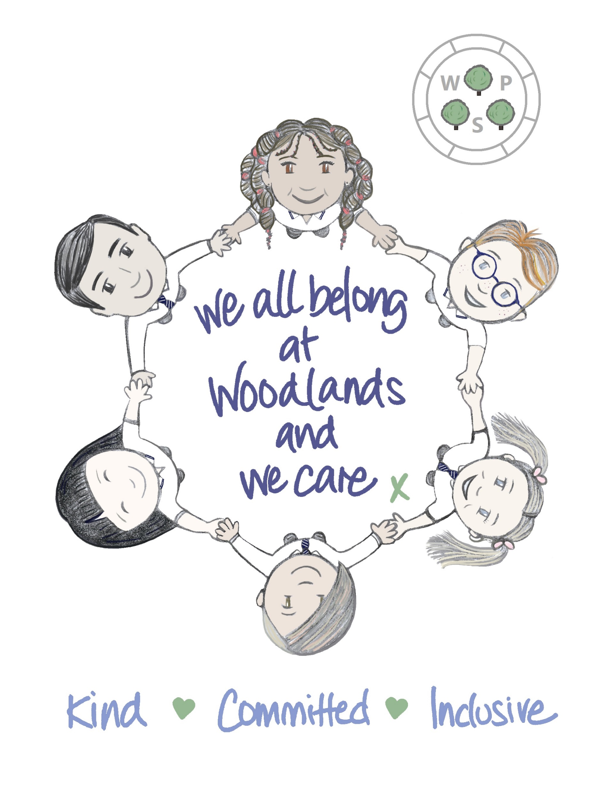
Autopilot Response
‘I cannot allow you to…BUT I can allow…’
Examples:
‘I cannot allow you to run out of class but I can allow 5 minutes walk with CA/time in calm corner/Go Noodle keep fit on iPad.’
‘I cannot allow you to swear but I can allow you to spend 5 minutes talking to me about it.’
I’m not going to chase you. I’m going to wait here until you are ready.’
Notes:
Resistance- staff have trialled various autopilot responses. One very simple but impactful script: ‘I cannot allow you to…but I CAN allow…’ (care AND push)
-Offering options (children who are demand avoidant/cling to their own agenda, helps them feel some control), practising dependency, following instructions.
-Match their energy! Being attuned to the child and providing options based on hidden needs, e.g. running out of class suggests they need some sort of movement break. Distressed behaviours- co-regulation activity.

Slide 10
Relational Gestures
‘I want you here.’
‘You belong, I care about you, you are part of our Woodlands family.’
‘Would you like to go for a walk together and tell me about your morning?’
When they come back to class- so happy to see you! So glad you’re back.
Notes:
Persist
Relational gestures are something which is easily implemented but very powerful. Keeping a child in mind, noticing their new bag/haircut, asking about their siblings, interests. Showing them you care and want them in your classroom. Unconditional offering of the relationship. This can be very difficult with a child who is putting up defensive walls but this is usually a test of trust.
Vision and values- very much influenced by NVR/nurturing approaches- power of belonging. Something lots of our pupils struggle with (feeling like they belong). Providing that identity as being part of the Woodlands family. Values- ‘this is what we do here- we are kind, committed, inclusive.’
The circle design reflects that sense of we all belong and diversity of our pupils represented.

Slide 11
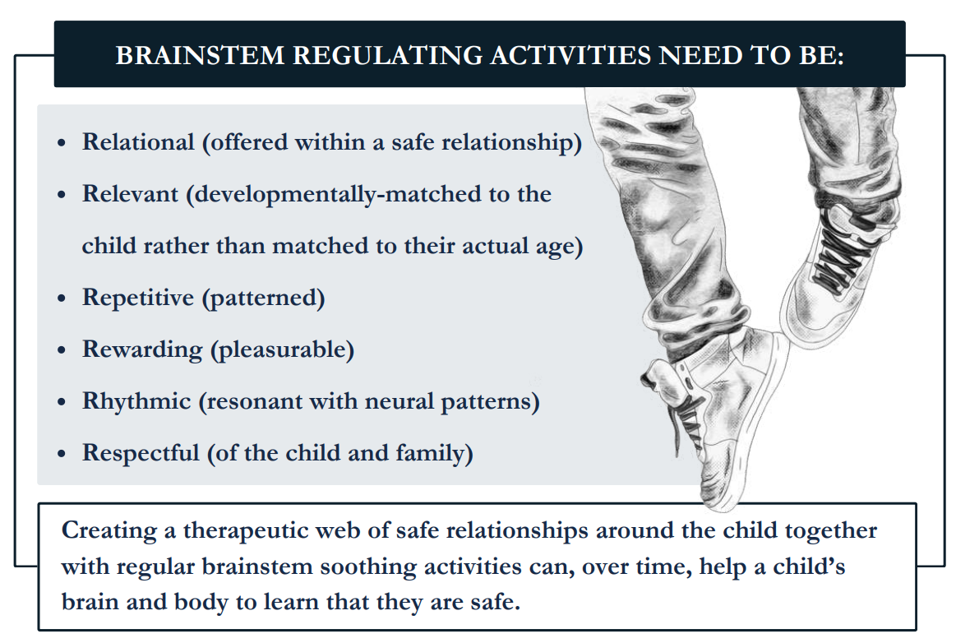
Sensory Breaks
Notes:
Persist- from NVR training, focus on hidden needs and what we can do to meet these.
Sensory/movement/brain breaks for all is best practice for an inclusive approach to keep stress at a minimum. All children will benefit but neurodiverse children will thrive! Sensory breaks (or ‘brain-stem calmers’) are recommended before cognitive tasks. Short bursts throughout the day, not just at the start or end of the day (5/10 minutes here & there with teaching in between). Help move children from high-anxiety state to their calmer, ‘thinking brain’.
Examples
Relational: offered within a safe relationship (key adult)
Relevant: developmentally matched to child rather than actual age
Repetitive: rhyming songs, clapping games, finger gym (Youtube- warm up for writing), breathing exercises, listening to music/natural sounds, massage, wiggle cushions, cutting & sticking, hole punching.
Rewarding: interactive play, gardening, cooking Helpful tasks: sweeping, hoovering, cleaning windows/tables, litter picking, delivering letters, organising supplies, etc. This can give children a purpose, make them feel useful and important. Self-esteem boost! Rhythmic: soothes lower parts of the brain responsible for fight/flight. Dance, running, walking/running, drumming, wobble chair, listening to soothing music, bouncing on a yoga ball)
Respectful: mindful of the child/family situation/triggers or past traumas (e.g. some children might not be comfortable lying down/closing eyes etc)
Outdoor activities cover a lot of the above: just being outside promotes relaxation and mental & physical health and wellbeing. Lots of traumatised pupils have never been supported to feel at home in the natural world. Gardening, den building, bird watching, treasure hunt for leaves/twigs/berries, litter picking.

Slide 12
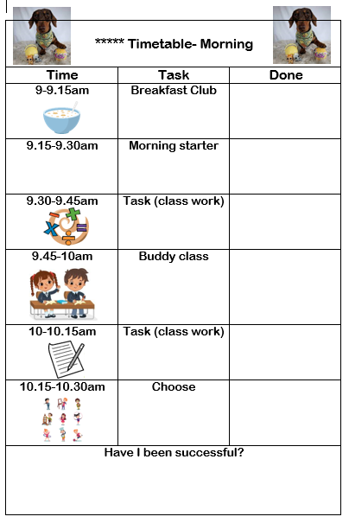
Deconstructed Timetables
Notes:
Persist
-Introducing these for our pupils who were constantly absconding from school building, wandering corridors, whole-class evacuations (flipping chairs, etc) has been the most impactful thing at reducing all of these big behaviours. These children were showing us they couldn’t cope with the school day, expecting them to remain within a classroom all day was setting them up for failure.
-The timetables are created alongside the child, they very much have a voice in what their day will look like. Make the time slots achievable- this wee one we had to break down to 15 minutes but this can be as long or short as is needed. Child stamps or ticks when they have completed each section/visuals (also acts as now/next/then).
-Soft start- breakfast club
-Buddy class- most children thrive in a role/responsibility. Gives a change of scenery and allows movement/makes child feel helpful/have a purpose.
-Have I been successful? Quick chat before each break/home time.
-You can build up to larger time slots as child is coping better, with the ultimate goal of them being settled/ready to learn in class full time.

Slide 13
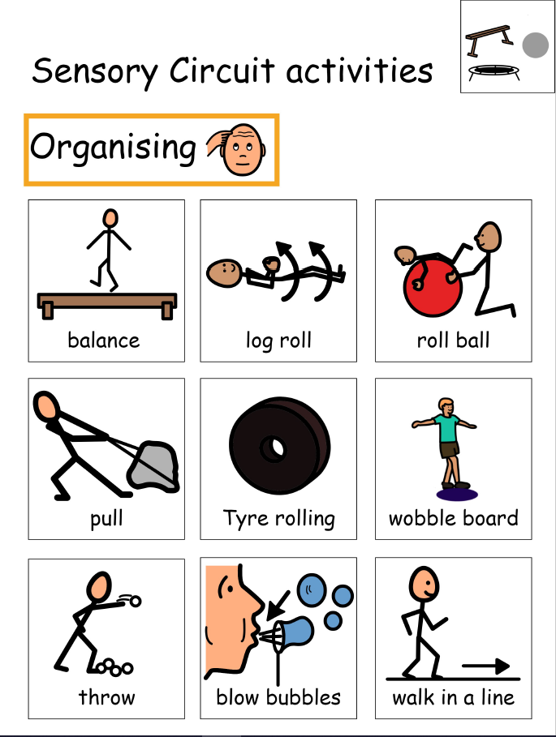
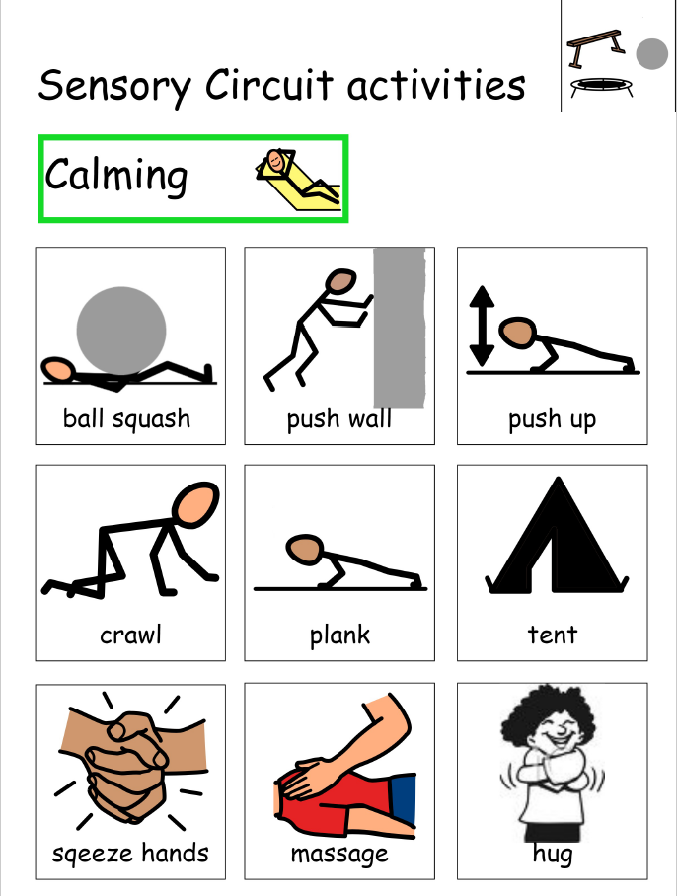
Sensory Circuits
Notes:
For pupils who are exhibiting sensory seeking/impulsive behaviours, e.g. biting, grabbing, pushing, etc. we have introduced sensory circuits.
A sensory circuit is a form of sensory integration & involves a sequence of physical activities that are designed to alert, organise and calm.
Should ideally be first thing in the morning (and after lunch too, where possible). Can also be utilised at different times of the day.
Step 1: start with an alerting activity (to provide stimulation within a controlled setting which prepares the brain for learning)
Step 2: move to an organising phase (activities that require motor sensory processing, balance and timing. Help improve focus & attention)
Step 3: finally, a calming activity to finish (important to ensure that children leave the circuit and return to their classrooms calm, centred and ready for learning)
We have the equipment set up in a spare classroom and visuals using Widgit for each child to choose from. (Renfrewshire are currently paying for a free subscription)

Slide 14
Equity Strategy
Notes:
Equity strategy session 24/25- data shows there is a clear poverty-related attainment gap at Woodlands. Hugely investing in developing bespoke curriculum offering. Universal offering to raise attainment for all pupils plus a bespoke approach to meet more complex needs based on skills-based learning and building cultural capital/local community links for pupils identified through data/filters of SIMD/clothing grants/free school meals & a variety of PEF lenses as outlined in national guidance, e.g. EAL, care experience, single parent families, etc.
Bespoke curriculum offering: art & music therapy, Place2Be counselling, Klas Kare nurture/play practitioner, Be Active, STEM/Microbits/cooking/gardening/ knitting/drama masterclasses (utilising support staff/teacher skills & interests)
-Development of Woodies Hub & Hive (breakout/alternative spaces for learning)
Focus on family learning and community-based interventions:
-’Our Families’ event, Reading Grans, Reading Café, Fun with Numbers
-Families First NVR parent group/EBSA programme/EPEC parenting group
-Donna parent groups next session

