Slide 1

RNRA/NVR in Todholm PS
Aileen Cochrane HT & Claire Hall DHT​, Todholm Primary School
Notes:
12.15-12.45

Slide 2
Todholm ELCC and Primary – Nurture and Inclusion Journey
Aileen Cochrane & Claire Hall​
Notes:
You’ll be glad to hear that I don’t think I have all the answers and that I acknowledge the level of challenges currently within ELCC and schools exacerbated by budget constraints and the inclusion agenda.

Slide 3

Todholm
Notes:
Todholm has my heart. There is absolutely no doubt that it is going through a period of transition the same as the rest of the world. I believe beyond all doubt that every single child at Todholm has a person.

Slide 4
School Demographic
Non-denominational school with 389 learners
ELCC with 56 learners
Urban setting in busy town
18% FSM
22% clothing grant
29% SIMD 1&2
28% learners with identified ASN
Two stream with 14 classes
Notes:
For those of you who are not familiar with Todholm.

Slide 5
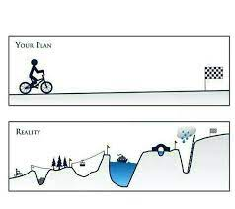
Full Disclosure
It’s a journey!
Every school, centre, staff is unique – as are the children and families.
Sometimes you can’t see the wood for the trees.
Notes:
I’m going to share our warts and all journey so far. I am not looking to paint a false picture.

Slide 6

Journey
Undertook RNRA training in November 2019
Identified Nurture principle in conjunction with all stakeholders
HT and Class teacher trained in NVR Level 1 in response to changing behaviours in March 2021
Two DHT’s, another Class teacher since trained
PT currently completing NVR
August 2023 all staff NVR Part 1

Slide 7
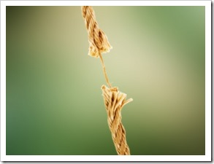
Rationale for change
In Service Day February 2022
Increase in distressed behaviour
Notes:
February 2022 was one of those days I deeply regretted being on the Senior Management Team! We effectively took the temperature of the staff and it was icy cold!

Slide 8
The measure of intelligence is the ability to change.
“
”
Albert Einstein
Notes:
We had to not only acknowledge how the staff were feeling but take genuine action that would affect change.

Slide 9
Quick Wins
No bell
Steering Groups combined to create Relationship Working Party
New Relationship Policy
Good practice visits
Building staff capacity
Clear expectations
Staff survey identifying support needs
De-escalation session
Guest speaker James Docherty
Professional learning – belonging, attachment, NVR

Slide 10
What has worked well
(whole school)
Introduction of shared language
Whole staff approach: Training; Relationship Policy; CIRCLE training; PATHS
Soft Starts
Calm corners
Nurture suites
SLT on gate
Termly pupil surveys
Staff Wellbeing surveys', SLT agenda
Welcome, end and sends
Staff Newsletter
Rookie Minds, Exchange counselling
Presence Profile
Supply Teacher Pack

Slide 11

NVR / RNRA Wins!
Correction in private
Recognition rather than praise
Recognition boards
Relational gestures
Strike while the iron is cold
Small basket behaviours
Shield of shame

Slide 12
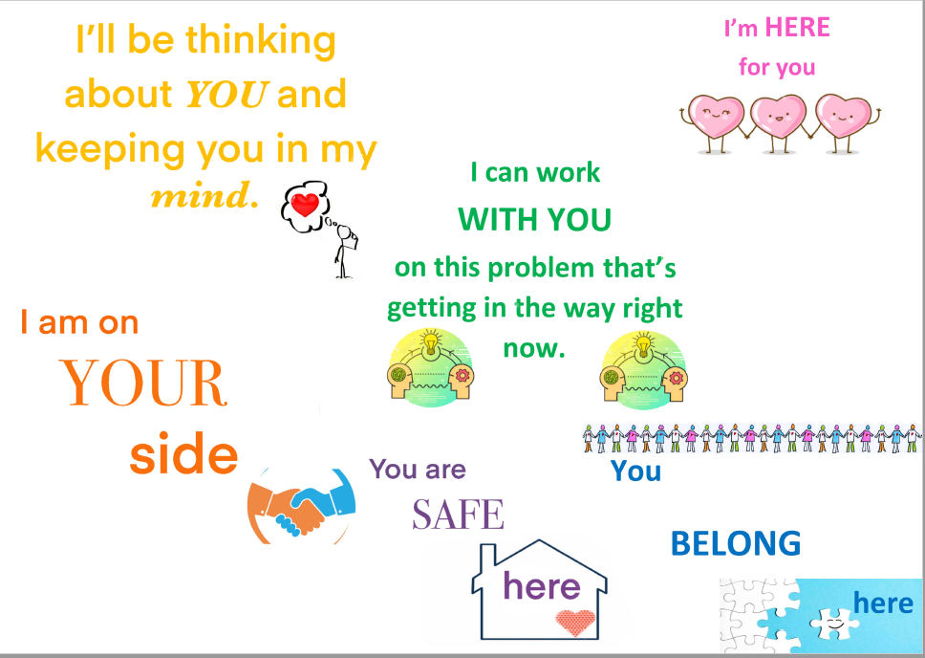

Slide 13
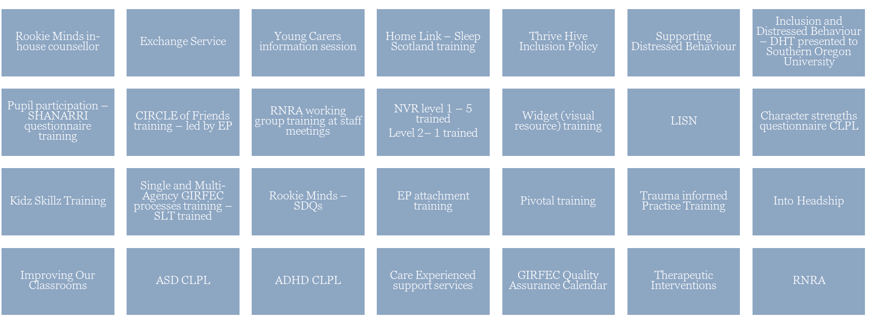
Inclusion Overview

Slide 14
What has worked well
(1%)
Seeing behind the behaviour (RNRA, NVR)
Rookie Minds, Exchange counselling
Bespoke timetables
Therapeutic interventions
Following processes (LISN, ESRG etc.)

Slide 16
So what?
Reduction of 30% to 7% in children accessing Nurture suites
Increase in staff confidence – almost all staff now confident in managing dysregulated behaviours
Improved classroom environments
Reduction in parental complaints
Staff using inclusive language and understanding that all behaviours are communication

Slide 17
Challenges
Parental concerns
Budget
Physical Space
Changing Staff
Recruitment of high-quality Inclusion staff
Changing the culture

Slide 18
Next Steps
Tweak staff wellbeing programme
Mini scripts
Emotional presence
Further develop presence profiles
Recognition rather than praise
Trauma informed

Slide 19
Thank you
aileen.cochrane@renfrewshire.school
claire.hall@renfrewshire.school

