Slide 1
NVR Development Across the Authority Fiona Williams, Depute Principal Educational Psychologist, Renfrewshire
Notes:
11.15-11.30

Slide 2
Pre
Post

Slide 3
Non-violent Resistance Approach: Main Principles
Resist
Persist
Unite
Repair
Notes:
These are the 4 main principles that underpin the approach

Slide 4
NVR in Renfrewshire
Parent Support
Centrally
Training
Level 1
Level 2
School Support
Training
Individual schools/ Localities
Coaching
Core group
Coaching
Targeted through casework
Targeted through casework
Notes:
We would now like to briefly describe to you our implementation strands for NVR: As you can see there are three main strands to our work, parent support (where NVR originated), training and schools.
Parent groups –Parents can access these groups through our Ren10 website where they can make a self-referral. We offer a blend of online and face to face groups and we have also created some specific anxiety/EBSA and ASD groups within specific establishments. We also offer parents support individually through our link EP role within schools. Since our first parent groups were implement (first lockdown) our parent groups continue to be in high demand.
Our second implementation strand is Training – Professionals across both education and social work can access Level 1 & 2 training via our authorities CPD calendar and this year we had training running every term. Practitioners who have just completed level 2 also carry out some practitioner enquiry related to NVR and we offer regular coaching to support with this and build confidence. Online coaching is also available to staff at any level and we are looking to strengthen the network of support for those who are actively implementing NVR as we are aware of how important this is to fidelity of the intervention.
School Support – We have also developed a whole-establishment training which can be delivered over two half day sessions with support of link EPs. Schools implement the approach through their RNRA implementation framework and this is supported by their link EP.

Slide 5
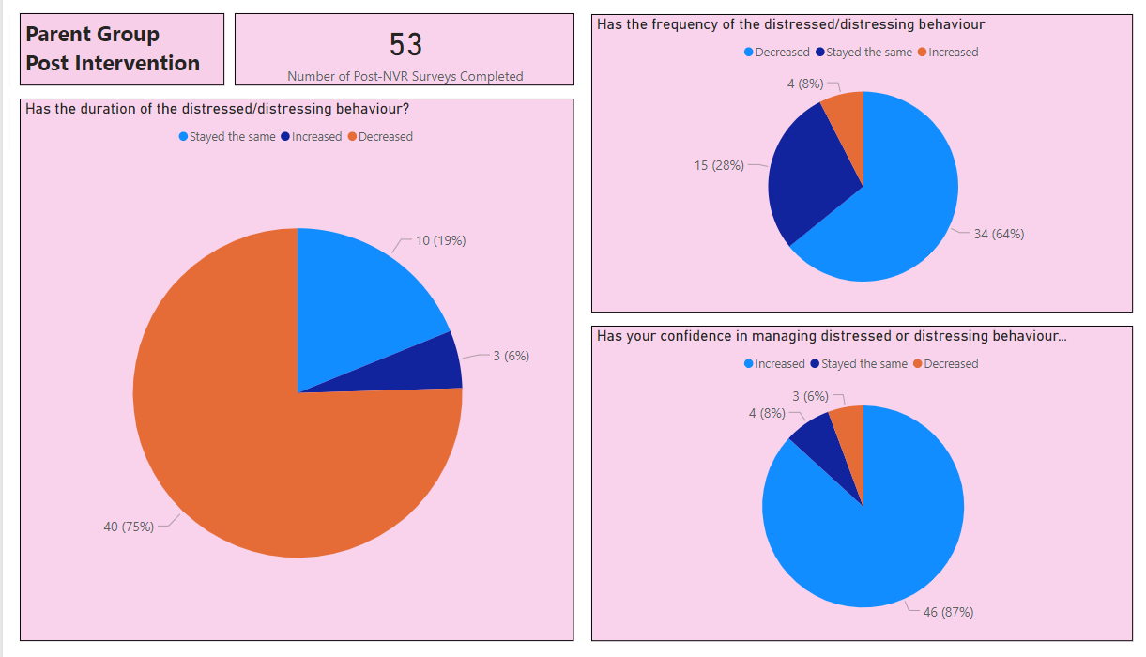
Parent Group Data
Notes:
We will now share with you some of the data we have gathered across these 3 strands:
Firstly, this is our data for the last 9 months approx. of parent groups
64% of parents report that the frequency of distressed & distressing behaviour decreases
87% of parents report their confidence in managing distressed and distressing behaviour increases

Slide 6
Nurture Principles and NVR
Nurture Principles & NVR
All behaviour is communication
- de-escalation
- unmet needs
- relational gestures
- active resistance/sit ins
- vigilant care
- persistence
Language is a vital means of communication
- announcements
- message campaigns
- autopilot statements
- non-shaming language
The classroom offers a safe base
- de-escalation
- relational gestures
- non-shaming
- vigilant care
- key adult 'presence'
Children's learning is understood developmentally
- unmet needs
- priorities (baskets)
- design of announcement
and targeted resistance
Nurture is important for wellbeing
- unite/supporters
- relational gestures/repair
- positive message campaign
- adult self-care and 'presence'
The importance of transitions in children's lives
- unmet/hidden needs
- priorities (baskets)
- building relationships/connection
- prepared responses
Notes:
Ciara
Obviously, with our overarching focus on developing nurturing environments through RNRA in our establishments we needed to ensure that NVR aligned with the ethos and focus of the 6 nurture principles which are at the heart of RNRA. This diagram shows how well the strategies in NVR support and extend the work already being carried out on RNRA. As such NVR trained staff can easily integrate discrete aspects of NVR into whichever NP change ideas are the focus for them at that point in time.
*pick out a few examples to expand on for example: if we are thinking about all behaviour is communication, here schools can determine what is being communicated by the behaviour, what is the unmet need, how best to meet this need through relational gestures and connection, how to de-escalate distressed or distressing behaviour, how to use active resistance and presence, where and when to introduce vigilant care and what persistence in the school context entails…
Additionally, the implementation structure embedded within RNRA has also given us the perfect vehicle to support the roll out of NVR to those school who want to look at ways to adapt the strategies within a wider whole-establishment approach where rather than focusing on a NP, NVR itself is the primary focus – we show how this is achieved in a few moments…

Slide 7
Whole-establishment NVR Implementation Pathway
READINESS
RNRA core training
Link EP discussion re capacity
Needs Analysis – NVR in SIP
Staff Selection
IMPLEMENTATION
Create change ideas based on NVR learning through the core group (supported by link EP)
Complete Action Plan including considering impact and evaluation measures
Evaluate these STOC using PDSA cycles
Report back on adopt, adapt, abandon via the action plan and accreditation framework
TRAINING
Level 1 training (3 full days) attended by two members of staff at least one SMT
Planning with link EP
Whole-establishment training co-delivered - 2 half days with EPS and L1 trained staff
Session 1 – Repair & persist
Session 2 (at least a term later) – Unite & Resist
CONTINUOUS IMPROVEMENT
Continuous cycle of development, monitoring and evaluation through the action plan (supported by link EP)
Access to coaching to support and troubleshoot issues and ensure fidelity to the NVR intervention (available for both establishments and EPs) – facilitated by Lead NVR team
Notes:
Ciara
Whole-establishment NVR - Here you can see how it works in practice…
In terms of readiness - prior to undertaking whole school NVR there is an expectation that schools will already have started on the RNRA pathway and as a minimum will have received core training which includes a good grounding in attachment theory. There will also have been discussion with the link EP around the establishments capacity to undertake NVR, taking into consideration other initiatives that they may be focusing on at that time. NVR should be integrated into the School Improvement Plan and their should be named staff identified to lead the implementation within the school going forward.
At phase 2 – we would be looking to ensure that at least two members of staff (including one member of Senior management) have completed the full 3 day training. These staff members would then plan and deliver the whole-establishment training along with their link EP. This training would be delivered in two blocks at least a term apart. The first training would look at the repair and persist elements of NVR – focusing on de-escalation, understanding unmet needs and relationship building. The second would look at the resist and unite elements. In this way we try to ensure that any resistance strategies that schools take forward are introduced into an environment where a calmer, relational focus has been established.
Following training, schools can then embark on a process of implementing NVR strategies into their school/classroom environment. This is led by a core group of individuals who meet regularly (supported by their EP) and they trial and carry out small tests of change. An example of this might be planning in relational gestures with a target group of children or working on the consistent use of autopilot statements by a small group of staff. The impact of these changes would then be measured in terms of classroom behaviour and relationships. Depending on how successful individuals find these strategies, the core group may decide to adopt them universally cross the school, adapt them to suit different contexts or abandon them because they do not suit their children or environment. This process happens in cycles and is documented via their RNRA action plan.
You can see how this process provides the basis for a longer-term, sustained improvement cycle which is further supported by coaching which is available on a drop-in basis for both school staff and EPs and is delivered by the Renfrewshire’s Lead NVR team. This helps troubleshoot any issues that inevitably arise as well as supporting fidelity to NVR methods and strategies.

Slide 8
NVR Level 1 training (3 days) Approx 350 staff across Renfrewshire trained since 2019/20
No. of establishments with NVR trained staff:
19 Early Years
43 Primary
11 Secondary
6 Additional Support Needs
Breakdown of roles:
Education – HTs, DHTs, CTs, Support assistants, Keyworkers, Nursery Officers, Nursery managers, Pupil Support Coordinators, Inclusion Support Assistants, Home-link, EPs
Social Workers (various remits)
Functional Family Therapists
Families First
Youth workers/Third Sector
NVR Level 2 training (3 days) 85 Level 2 trained staff
Whole school training (two half days)
24 establishments have started or are about to start whole-school NVR (4 Secondaries, 19 Primaries & 1ELCC)
I Primary School has already submitted evidence as part of their RNRA accreditation
Notes:
This is a very brief overview of our training:
350 staff across education, social work, health & community workers – details in slide
85 trained to Level 2
24 establishments on NVR whole school journey & one accredited. St Charles – have a look at their stall

Slide 9
Longitudinal Data - Training
93.5% still using NVR regularly or frequently
93.5% scale 7 or higher compared to around 37% who scale 7+ pre training. This is similar to immediately post training which indicates confidence has been sustained
Notes:
A follow up survey was carried out recently to start to look at whether or not staff were still implementing strategies and also explore any longer term impacts. These were some of the key findings

Slide 10
Longitudinal Data - Training
84% of respondents noticed reduced incidences of distressed and distressing behaviour using NVR
Notes:
Lisa
A follow up survey was carried out recently to start to look at whether or not staff were still implementing strategies and also explore any longer term impacts. These were some of the key findings

