Slide 1
RNRA/NVR in Linwood HS Linda Shaw, DHT & Laura McKee, PT Creative Arts
Notes:
2.00-2.30
Linda Shaw DHT
Laura McKee, PT Creative Arts

Slide 2
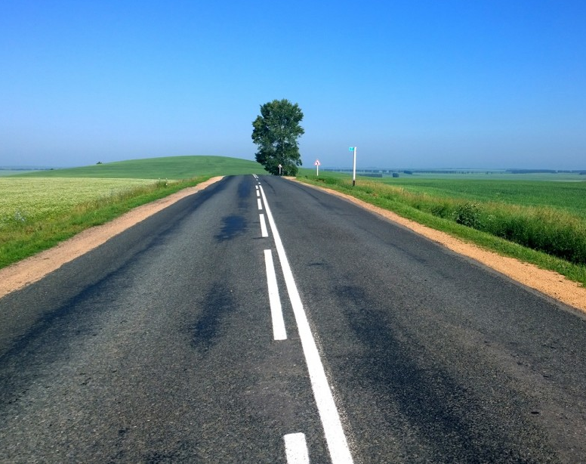
Option 1 for slide 1
Linda Shaw
Depute Head Teacher
Pupil Support LHS
Laura McKee
PT Creative Arts

Slide 3
School context
RNRA road map
Previous destination
Hitting the highway

Slide 5
After RNRA – NVR was the next step in our nurture journey
Individual Staff Training (Level 1 and 2)
Whole school roll out – Intro to NVR over two sessions, facilitated by Educational Psychologist and DHT Pupil Support
En route –
Our NVR Journey

Slide 6
Will the training of staff and the introduction of the principles of ‘Non Violent Resistance’ have a significant impact on the distressed behaviour of a young person both in school and with their family?
I was keen to take on a role in supporting the role out of NVR strategies within a whole school context. In addition, I worked closely with our DHT Pupil Support, Brigitte (Educational Psychologist), parents and the rest of the staff team involved in the learning of a particular pupil, with whom we made some NVR interventions.
En route –
Case Study

Slide 7
The context of the first targeted pupil with whom we worked is:
S3 girl who has been exhibiting distressed and dysregulated behaviour on an escalating basis since she started in S1.
Behaviours could include: walking out of class without permission, wandering corridors, shouting out/making noises/laughing loudly/singing whilst the lesson is taking place, swearing, argumentative behaviour with other pupils, refusal to participate in lessons, refusal to leave the class for de-escalation, escalating classroom conflicts causing entire class to be relocated.
Pupil is awaiting consultation with CAMHS to query ASD/ADHD/anxiety
En route –
Context

Slide 8
This pupil had been identified as having increasing difficulties within my department and on further examination, across the school.
We met with DHT nurture and Ed Psych to discuss this pupil.
All teachers had been asked to complete a circle participation scale for this pupil and this was reviewed.
We then used the NVR Planning tool to identify Resilience, Adversity, Protective Factors and Vulnerability factors.
En route –
The Process

Slide 9
After this initial meeting, a solution-oriented case conference was held with all of the teachers/support staff who work with this young person. We worked to identify the strengths of this young person as well as discussing the issues and triggers arising for them. Additionally we looked at current de-escalation strategies which have been successful.
En route –
The Process

Slide 10
The young person is a charismatic leader and thrives when given responsibility tasks or leadership roles, particularly when supporting younger pupils.
The young person is much stronger in ‘practical’ subjects.
She craves connection and relationships from teachers but doesn’t always have the ability to express this in a healthy way.
She is able to reflect on her behaviour when she is calm.
En route –
Strengths

Slide 11
The young person struggles to stay in the classroom environment.
She has issues with emotional regulation.
Relationships with staff and peers can be strained.
She refuses to complete written work and will create a ‘distraction’ or leave class to get out of it.
She is restless and has difficulty remaining in her seat.
Uses her phone freely in class and will contact Dad constantly.
En route –
Difficulties

Slide 12
Through this discussion with her teachers we were able to identify a ‘small basket’ behaviour that we will focus on actively resisting.
We want her to remain in class to access some learning
En route –
Basket Behaviours

Slide 13
We identified in discussion around this young person, that she struggles a great deal with navigating relationships but does crave them.
It was noted that often, after a blow up/escalated situation, the young person would always ‘wander’ past the class later in the day for a chat. It seems this was her way of clumsily repairing the relationship.
This highlighted the importance of unconditional relational gestures to this young person and will be a key strategy in support.
En route –
Relational Gestures

Slide 14
We came up with a mini announcement for this pupil for school with comments agreed by the group of teachers.
This was delivered to her with Dad present
Dad is not actively engaging with NVR at this stage but is supportive of any action taken by the school.
En route –
Mini Announcement

Slide 15
Some autopilot statements were also agreed:
I want you to stay in class, to do this we need to…
I’m not giving you INTO trouble, I’m trying to get you OUT of trouble
En route –
Autopilot Statements

Slide 16
Since the introduction of the NVR processes:
The pupil has spent some time on a reduced timetable, focusing on her strengths but has improved her time spent within the classroom.
Worked on emotional regulation (zones).
Significantly reduced the number of referrals for distressed behaviour in class.
Improved her ability to remain within class.
Teachers surveyed had expressed a marked change in her willingness to engage with supports.
Pupil has built more positive relationships with several teachers who were previously blocked.
En route –
Results

Slide 17
As Dad has been kept informed of the process, next step would be to involve Dad in a parent group which would allow him to implement the processes for issues that arise at home.
Working towards tackling some of the medium and big basket behaviours.
Roll out this process with additional pupils needing this kind of support.
Work towards traditional and alternative pathways to best support the pupil’s future.
Understand that this is a dynamic process, and that challenging behaviour can still present despite improvements and supports.
En route –
Next Steps

Slide 18
As a class teacher
As a Principal Teacher
As a Parent
En route –
Impact

Slide 19
EBSA Pilot
SEEMIS coding
Data Dashboard
Collaboration
Test of change
Parents NVR group
On the road again
En route

Slide 20
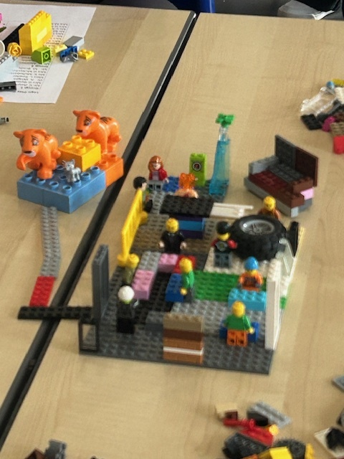
Feedback from staff

Slide 21
‘Build connections to work towards goals.’
‘The magic happens when the children experience success and create lasting memories.’
‘ The magic is being able to open the door to pupils’ belief in themselves.’
‘ Safe, warm and welcoming. Being the warmth in grey spaces.’
‘Never give up. You can’t see the top of the hill but you will always make it.’
Feedback from staff

