Slide 2
Dr Vicky Baker Lecturer in Gender-based Violence, Manchester Metropolitan University
Notes:
9.25-10.25

Slide 3
Understanding distressed behaviours and violence towards parents and carers:
Hearing from young people themselves
Dr Vicky Baker
Lecturer in Gender-based Violence
Manchester Metropolitan University (Man Met)
School of Nursing and Public Health
Supporting Distressed Behaviour through Relational Approaches – Nurture Conference Renfrewshire 17th May 2024

Slide 4
Violence towards parents and carers – overlaps with education
Research into violence towards parents and carers is a relatively new and under-researched area – more so than other forms of family violence
Research has found that children’s violence is often not confined to the home, with:
significant overlap with violence/aggression towards teachers ¹²³
simultaneous dating violence and school bullying ⁴
Conversely, violence in schools has also found to be a predictor of physical and verbal aggression towards mothers and fathers at age 15/16 ⁵
Teachers have reported feeling powerless in the face of aggression ⁶
Supporting Distressed Behaviour through Relational Approaches – Nurture Conference Renfrewshire 17th May 2024

Slide 5
Violence towards parents and carers – overlaps with education
Further, those children using violence at home are more likely to:
report being bored in class, and truant ⁷
face school exclusion ³
struggle to meet their potential and achieve academically ⁸
However, the direction of causation is unclear ⁸
Explanations spanning contexts relate to:
emotional dysregulation ⁹
neurodevelopmental difference ⁹
adoption ⁹
young people needing to feel in control when feeling vulnerable ⁶
Supporting Distressed Behaviour through Relational Approaches – Nurture Conference Renfrewshire 17th May 2024

Slide 6
Addressing a gap – young people’s voices
Research into violence towards parents and carers is dominated by the accounts, experiences and perceptions of parents and practitioners
This is problematic as young people’s constructions of why they use violence at home may be different to parents’
This PhD research involved:
Young people aged between 14 and 18
From both youth justice and mainstream education contexts in England
With a focus on their personal accounts of using violent and harmful behaviours at home
Supporting Distressed Behaviour through Relational Approaches – Nurture Conference Renfrewshire 17th May 2024

Slide 7
Methods and participation
A mixed methods design using self-report surveys and in-depth interviews
221 young people aged between 14 and 18 years (75% female)
Two sites – a sixth form college (16-18) and a youth offending service (14-18)
Phase 1: Self-report surveys (n=221)
“how common is adolescent-to-parent violence and what does it look like?”
Phase 2: Depth interviews (n=21)
“how do young people experience adolescent-to-parent violence and its impacts?”
Supporting Distressed Behaviour through Relational Approaches – Nurture Conference Renfrewshire 17th May 2024

Slide 8
What did behaviours look like?
Young people described a range of harmful behaviours towards parents, including those which were:
Supporting Distressed Behaviour through Relational Approaches – Nurture Conference Renfrewshire 17th May 2024

Slide 9
What did behaviours look like?
Young people described a range of harmful behaviours towards parents, including those which were:
Physical
“And the last straw, ‘cos I ran out of the house afterwards, I smashed her head against the wall”
(Penelope, 17 years)
Supporting Distressed Behaviour through Relational Approaches – Nurture Conference Renfrewshire 17th May 2024

Slide 10
What did behaviours look like?
Young people described a range of harmful behaviours towards parents, including those which were:
Verbal
“I was just screamin' for hours, callin' her [mother] names, tellin' her how disgusting she is, tellin' her how much she failed.”
(Jodea, 17 years)
Supporting Distressed Behaviour through Relational Approaches – Nurture Conference Renfrewshire 17th May 2024

Slide 11
What did behaviours look like?
Young people described a range of harmful behaviours towards parents, including those which were:
Emotional or psychological
“I was like, “I’ll file reports on you ‘cos you hit me”, even though she didn’t. And I’d go to the levels of getting my friends to hit me…to make bruises…”
(Ruth, 18 years)
Supporting Distressed Behaviour through Relational Approaches – Nurture Conference Renfrewshire 17th May 2024

Slide 12
What did behaviours look like?
Young people described a range of harmful behaviours towards parents, including those which were:
Economic or material
“So I was arguin' wiv' 'em [Mum and Nan] and then...after that I went into my room and just ended up smashin' my room up and just...punched the wall and things like that.”
(Jason, 16 years)
Supporting Distressed Behaviour through Relational Approaches – Nurture Conference Renfrewshire 17th May 2024

Slide 13
Causes, contexts, and motivations
Young people discussed a range of causes and contexts from which their violence towards parents arose
Supporting Distressed Behaviour through Relational Approaches – Nurture Conference Renfrewshire 17th May 2024

Slide 14
Causes, contexts, and motivations
Young people discussed a range of causes and contexts from which their violence towards parents arose
Supporting Distressed Behaviour through Relational Approaches – Nurture Conference Renfrewshire 17th May 2024

Slide 15
Causes, contexts, and motivations
Young people discussed a range of causes and contexts from which their violence towards parents arose
Explanations centred around five main intersecting themes of:
Supporting Distressed Behaviour through Relational Approaches – Nurture Conference Renfrewshire 17th May 2024

Slide 16
Causes, contexts, and motivations
Young people discussed a range of causes and contexts from which their violence towards parents arose
Explanations centred around five main intersecting themes of:
Past and ongoing experiences of violence, abuse and trauma
‘Cos that's what happened to me. People have been violent to me... that's how it's brought me up…all that's in my head now, after what's happened, is just violence.…I can't stop myself from doin' it. It just happens and I'm like... I want to stop but my brain's gone.
(Jenn, 14 years, victim of peer violence)
Supporting Distressed Behaviour through Relational Approaches – Nurture Conference Renfrewshire 17th May 2024

Slide 17
Causes, contexts, and motivations
Young people discussed a range of causes and contexts from which their violence towards parents arose
Explanations centred around five main intersecting themes of:
Past and ongoing experiences of violence, abuse and trauma
The dynamics of power, control and agency in the parent-adolescent relationship
The first time I think it [violence] happened was that she took my phone off me... so I tried taking hers? 'Cos like... if you're gonna take my phone, then I'm just gonna take yours then...
(Ruth, 18 years)
Supporting Distressed Behaviour through Relational Approaches – Nurture Conference Renfrewshire 17th May 2024

Slide 18
Causes, contexts, and motivations
Young people discussed a range of causes and contexts from which their violence towards parents arose
Explanations centred around five main intersecting themes of:
Past and ongoing experiences of violence, abuse and trauma
The dynamics of power, control and agency in the parent-adolescent relationship
Their experiences of stress and coping
One example would be when we had our mock [exams] going on, so it was really stressful at that time. Had a lot going on with friends at that time. And me and my mum clashed over something and I got quite violent and I was like punching, kicking… And I smashed her head against the wall.
(Penelope, 17 years)
Supporting Distressed Behaviour through Relational Approaches – Nurture Conference Renfrewshire 17th May 2024

Slide 19
Causes, contexts, and motivations
Young people discussed a range of causes and contexts from which their violence towards parents arose
Explanations centred around five main intersecting themes of:
Past and ongoing experiences of violence, abuse and trauma
The dynamics of power, control and agency in the parent-adolescent relationship
Their experiences of stress and coping
The quality of communication with parents
... when we get into an argument, she doesn't listen to me, an' then I don't listen to her… an' we end up clashing.
(Ronnie, 17 years)
Supporting Distressed Behaviour through Relational Approaches – Nurture Conference Renfrewshire 17th May 2024

Slide 20
Causes, contexts, and motivations
Young people discussed a range of causes and contexts from which their violence towards parents arose
Explanations centred around five main intersecting themes of:
Past and ongoing experiences of violence, abuse and trauma
The dynamics of power, control and agency in the parent-adolescent relationship
Their experiences of stress and coping
The quality of communication with parents
…violence was 'cos I was over-the-top angry. It's just that, if I get angry and cross the line, I can like, lose control of myself.
(Penelope, 17 years)
Their difficulties with anger and emotion regulation
Supporting Distressed Behaviour through Relational Approaches – Nurture Conference Renfrewshire 17th May 2024

Slide 21
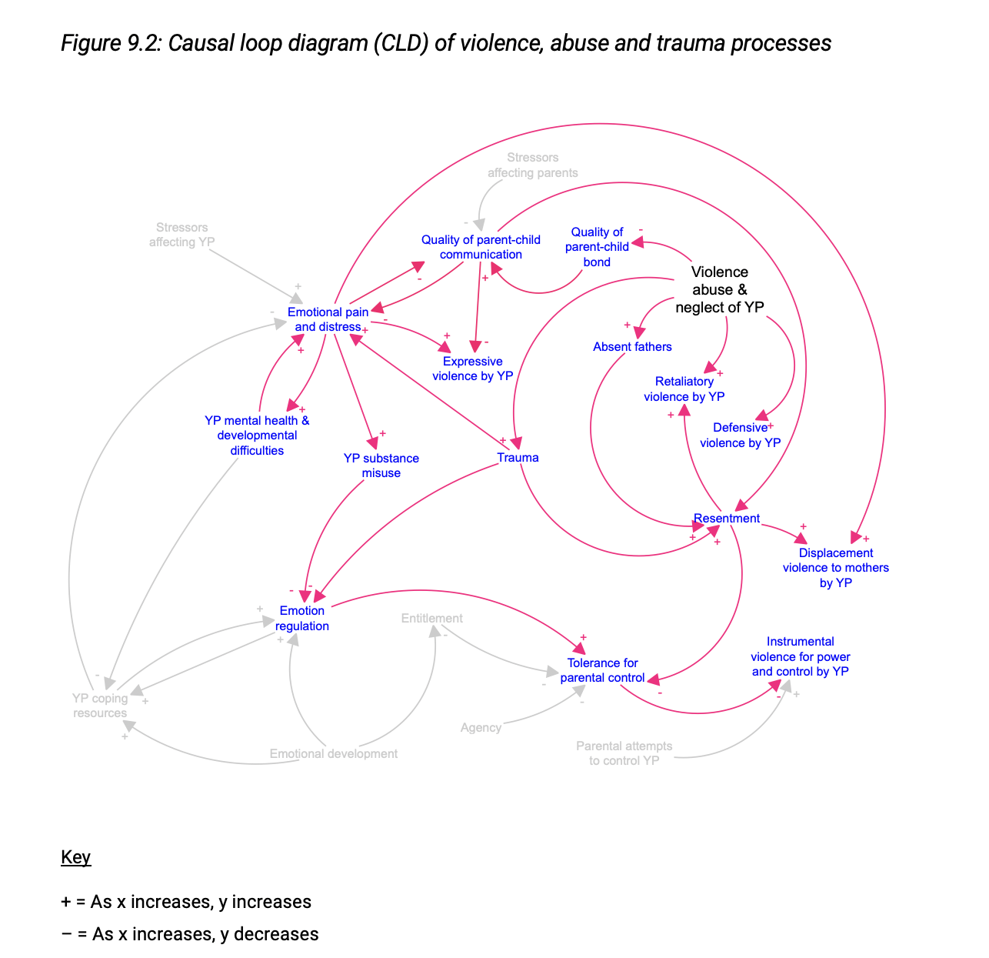
Thinking systemically
Contextual factors often intersected
For example, histories of domestic abuse caused trauma and resentment in young people, with a lack of communication and difficulties with emotion regulation compounding problems
Thinking systemically can help us to see how causes and contexts can intersect, resulting in escalation and a worsening of the problem
Intervening or supporting families at key points can disrupt these cycles
Supporting Distressed Behaviour through Relational Approaches – Nurture Conference Renfrewshire 17th May 2024

Slide 22
Adverse Childhood Experiences (ACEs)
Domestic abuse between parents
Child maltreatment
Peer violence
Emotional and cognitive development
Mental health
Feelings of resentment, anger and blame
For most interviewees, violence, abuse and trauma provided the backdrop to their childhoods
Although not always connected explicitly, these experiences were implicated in relation to their:
These impacts made it harder to regulate emotions in the face of everyday stresses, strains and negotiation
Supporting Distressed Behaviour through Relational Approaches – Nurture Conference Renfrewshire 17th May 2024

Slide 23
Struggling to support child wellbeing
In some cases, parents did not seem to know how to support the emotional and mental health needs of their adolescent children
This resulted in young people using violence as a means of:
Mothers were nearly always the targets of violence and often blamed for abusive/absent fathers
coping with their trauma
communicating distress
parenting alone
young people were closer to their mothers
feared their fathers
knew their mothers wouldn’t leave them
Supporting Distressed Behaviour through Relational Approaches – Nurture Conference Renfrewshire 17th May 2024

Slide 24
The gendered nature of violence and parenthood
Me? Being aggressive towards me dad? Are you crazy?!
(Jodea, 17 years)
Supporting Distressed Behaviour through Relational Approaches – Nurture Conference Renfrewshire 17th May 2024

Slide 25
The gendered nature of violence and parenthood
So, I think I thought that if I was horrible to Dad he'd leave for good and he'd never come back. Whereas in a really selfish way, I knew Mum would stay...no matter what would happen.
(Ruth, 18 years)
Supporting Distressed Behaviour through Relational Approaches – Nurture Conference Renfrewshire 17th May 2024

Slide 26
Motivations, functions and intentions
Young people’s descriptions of their use of violence highlighted a variety of ‘intentions’ or ‘functions’
Such intentions included:
Supporting Distressed Behaviour through Relational Approaches – Nurture Conference Renfrewshire 17th May 2024

Slide 27
Motivations, functions and intentions
Young people’s descriptions of their use of violence highlighted a variety of ‘intentions’ or ‘functions’
Such intentions included:
‘letting off steam’
At the time I was really... obviously I was angry and upset. But when I'd smashed everythin' up I had like... I just had that relief, it just calmed me down…
(Jason, 16 years)
Supporting Distressed Behaviour through Relational Approaches – Nurture Conference Renfrewshire 17th May 2024

Slide 28
Motivations, functions and intentions
Young people’s descriptions of their use of violence highlighted a variety of ‘intentions’ or ‘functions’
Such intentions included:
‘letting off steam’
self-defence and retaliation in response to violence and abuse from parents
Like, he'll push me and then I'll punch him.
(Pete, 15 years, victim of stepfather)
Supporting Distressed Behaviour through Relational Approaches – Nurture Conference Renfrewshire 17th May 2024

Slide 29
Motivations, functions and intentions
Young people’s descriptions of their use of violence highlighted a variety of ‘intentions’ or ‘functions’
Such intentions included:
‘letting off steam’
self-defence and retaliation in response to violence and abuse from parents
a means of punishing mothers for past harms
I isolated myself...but convinced myself that mum isolated me…which caused a lot of problems…'Cos obviously I blame her for everything, even though it wasn't her fault.
(Ruth, 18 years, victim of sexual assault)
Supporting Distressed Behaviour through Relational Approaches – Nurture Conference Renfrewshire 17th May 2024

Slide 30
Motivations, functions and intentions
Young people’s descriptions of their use of violence highlighted a variety of ‘intentions’ or ‘functions’
Such intentions included:
‘letting off steam’
self-defence and retaliation in response to violence and abuse from parents
a means of punishing mothers for past harms
a way of communicating distress and ‘crying out for help’
They don't really understand mental health too well. And the only way I could make them understand was just by acting up…I was cryin' out for help but I was doing it in ways that actually were just making people not wanna help me.
(Ruth, 18 years)
Supporting Distressed Behaviour through Relational Approaches – Nurture Conference Renfrewshire 17th May 2024

Slide 31
Motivations, functions and intentions
Young people’s descriptions of their use of violence highlighted a variety of ‘intentions’ or ‘functions’
Such intentions included:
‘letting off steam’
self-defence and retaliation in response to violence and abuse from parents
a means of punishing mothers for past harms
a way of communicating distress and ‘crying out for help’
and lastly, a way of gaining power and control over their privileges, space and movement in and outside of the home.
Like say if she says, ‘Oh, that doesn’t go with that’ or ‘I don’t like them shoes’ or ‘You’re not gettin’ this, you’re not gettin’ that’.
(Jo, 14 years, discussing her ‘triggers’)
Supporting Distressed Behaviour through Relational Approaches – Nurture Conference Renfrewshire 17th May 2024

Slide 32
What young people said would help
Young people’s thoughts on how their violence might be addressed identified:
Things that parents could do
Things that young people could do
Things that services could do
Supporting Distressed Behaviour through Relational Approaches – Nurture Conference Renfrewshire 17th May 2024

Slide 33
What young people said would help
These included:
Talking, listening and not shouting
Spending quality time together
Space to grow and the space to calm down when angry
A confidant to hear their side of the story and guide them through conflict with parents (key worker/youth work model)
Therapeutic support to heal past trauma
Not acting in anger, thinking first
Supporting Distressed Behaviour through Relational Approaches – Nurture Conference Renfrewshire 17th May 2024

Slide 34
What young people said would help
“It's really such a communication barrier that was between us, and I think, if we just learnt to let that barrier down, let that wall down, and just sit down and talk more, about everything, then it would just stop everything arising.”
(Penelope, 17 years)
“Because...I know for a fact I couldn't speak to mum…but speaking to a therapist helped…I didn't trust anyone...at all...and I felt like I could tell her stuff”
(Ruth, 18 years)
Supporting Distressed Behaviour through Relational Approaches – Nurture Conference Renfrewshire 17th May 2024

Slide 35
What young people said would help
I think I would need someone to talk to at that time... rather than going off about it to her… So then I could calm down in the situation and know what to do.
(Ronnie, 17 years)
Well, it’s the fact that someone just sits there and listen to you…and hears your side of the story. Instead of just assuming that you’re lying…or telling you you’re lying when you’re not.
(Ant, 16 years)
Supporting Distressed Behaviour through Relational Approaches – Nurture Conference Renfrewshire 17th May 2024

Slide 36
Key implications for practice
Given the number of young people with histories of trauma and mental health difficulties, support for families experiencing this issue should be trauma-informed and wellbeing focused
Support and assessment should draw on the perspectives of parents, practitioners and young people – contributing to a more holistic understanding
Support should focus on communication, supporting young people to manage emotions, process trauma, and re-build relationships (ecological)
Parents and carers should be provided with a safe and non-judgmental space to reflect upon their own trauma, histories and behaviours
Given the multitude of external and concurrent stressors, multi-agency and specialist service support should be sought to address developmental and mental health issues, educational concerns, bereavement and financial problems.
Supporting Distressed Behaviour through Relational Approaches – Nurture Conference Renfrewshire 17th May 2024

Slide 37
Questions?
Please email any further questions over to me at:
v.baker@mmu.ac.uk
Supporting Distressed Behaviour through Relational Approaches – Nurture Conference Renfrewshire 17th May 2024

Slide 38
References
Biehal, N. (2012) ‘Parent Abuse by Young People on the Edge of Care: A Child Welfare Perspective’, Social Policy and Society, 11(2), pp. 251–263. doi:10.1017/S1474746411000595.
Jaureguizar, J., Ibabe, I., & Straus, M. A. (2013) ‘Violent and prosocial behavior by adolescents toward parents and teachers in a community sample’, Psychology in the Schools, 50(5), pp. 451–470.
Papamichail, A., & Bates, E. A. (2022) ‘“I Want My Mum to Know That I Am a Good Guy …”: A Thematic Analysis of the Accounts of Adolescents Who Exhibit Child-to-Parent Violence in the United Kingdom’, Journal of Interpersonal Violence, 37(9-10), NP6135-NP6158.
Arias-Rivera, S. and Garcia, V. H. (2020) ‘Theoretical framework and explanatory factors for child-to-parent violence. A scoping review’, Anales de Psicologia, 36, pp. 220-231.
Pagani, L. et al. (2004). Risk Factor Models for Adolescent Verbal and Physical Aggression toward Mothers. International Journal of Behavioral Development, 28, 528-537.
Cottrell, B. (2001) Parent abuse: The abuse of parents by their teenage children. Family Violence Prevention Unit, Health Canada.
Supporting Distressed Behaviour through Relational Approaches – Nurture Conference Renfrewshire 17th May 2024

Slide 39
References
Paulson, M. J., Coombs, R. H., & Landsverk, J. (1990) ‘Youth who physically assault their parents’, Journal of Family Violence, 5(2), pp. 121–133.
Baker, V. and Bonnick, H. (2021) Understanding CAPVA: A rapid literature review on child and adolescent to parent violence and abuse for the Domestic Abuse Commissioner’s Office. Respect.
Selwyn, J., Wijedasa, D.N. and Meakings, S.J., (2014) Beyond the Adoption Order: challenges, interventions and disruptions. A report for the Department for Education. University of Bristol School for Policy Studies, Hadley Centre for Adoption and Foster Care Studies
Supporting Distressed Behaviour through Relational Approaches – Nurture Conference Renfrewshire 17th May 2024

Slide 41
Keynote Reflection and Discussion
Within your context
What are the main messages from Vicky’s research?
How does your nurturing approach / philosophy of care meet the requests of young people?
Are there other things you might do?
Young peoples’ thoughts on what would help
Communication, talking, listening and not shouting
Quality time together
Space to grow
Support with anger and emotional regulation
A confidant to hear their side of the story and support them with conflict (key worker model)
Support to help heal past trauma
Notes:
10.25-10.45

