Slide 1
Inclusive Communication Environments in Schools:
Supporting pupils with language and communication differences in Renfrewshire

Slide 2
Our current approach
Renfrewshire Council Educational Psychology Service and Renfrewshire Paediatric Speech and Language Therapy Service have developed a joint initiative to develop the capacity of all educational establishments to support and develop the language and communication skills of all children.
We want schools and nurseries to be able to demonstrate an ongoing development to meet the speech, language, and communication differences of all pupils. This may include training, learning conversations, work with families and children/young people, and links with other agencies.
There are three key indicators which form the basis of supportive practice:
  Indicator One: A physical environment that enhances and promotes opportunities for speech, language, and communication for all pupils.
  Indicator Two: Adult communication (verbal and non-verbal) that promotes interaction and responds to individual needs.
  Indicator Three: The use of supportive learning strategies to develop language and communication skills and promote participation from all learners.

Slide 3
A framework for creating inclusive communication environments
A physical environment that enhances and promotes opportunities for speech, language, and communication for all pupils.
Adult communication (verbal and non-verbal) that promotes interaction and responds to individual needs.
The use of supportive learning strategies to develop language and communication skills and promote participation from all learners.
Ongoing development to meet the speech, language, and communication needs of all pupils.

Slide 4
Suggested strategies
The next slides show examples of changes or strategies which schools and nurseries can use to increase the support for their pupils with speech, language and communication differences.
These changes are designed to be used with whole classes where possible to ensure all pupils receive support when it is needed.

Slide 5
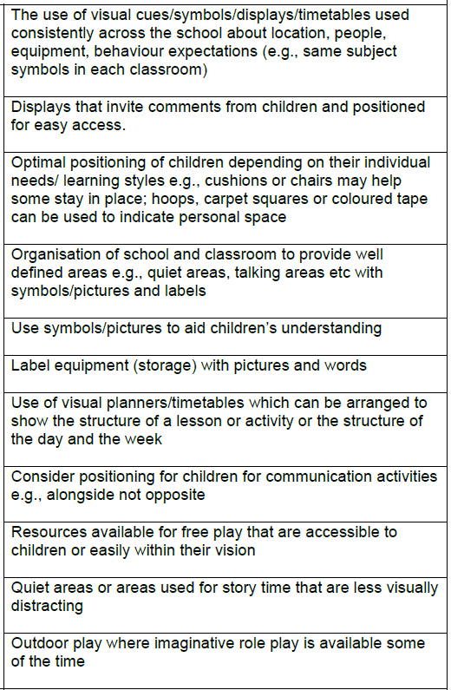
A physical environment that enhances and promotes opportunities for speech, language, and communication for all pupils.

Slide 6
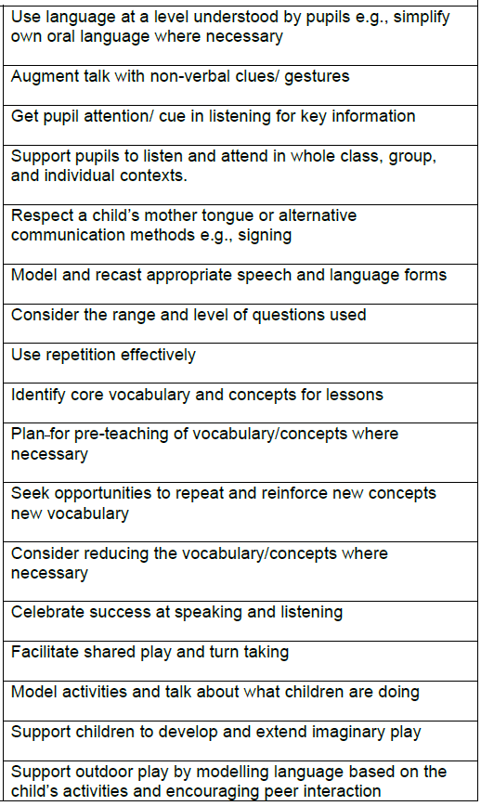
Adult communication (verbal and non-verbal) that promotes interaction and responds to individual needs.

Slide 7
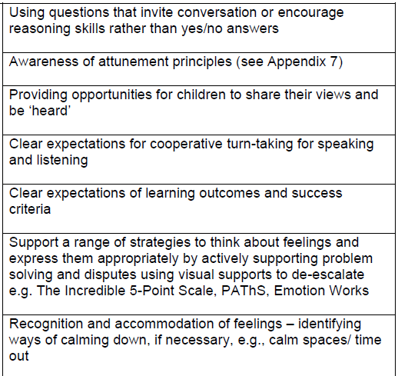
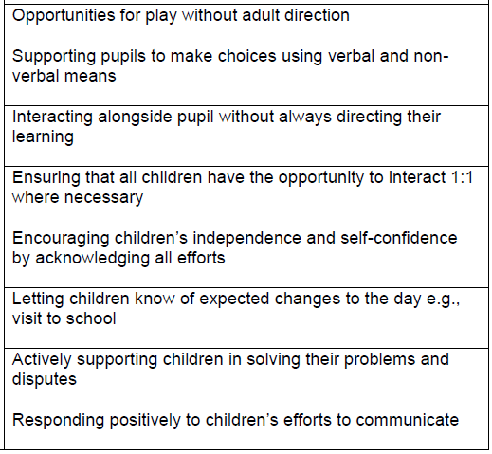
Adult communication (verbal and non-verbal) that promotes interaction and responds to individual needs.

Slide 8
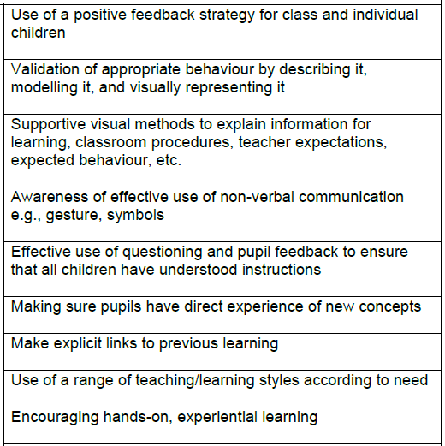
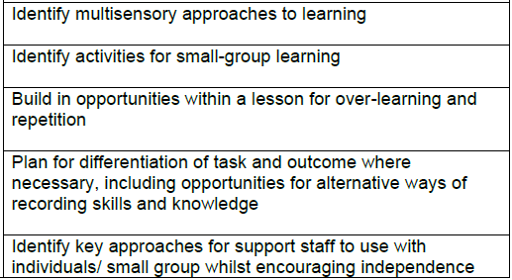
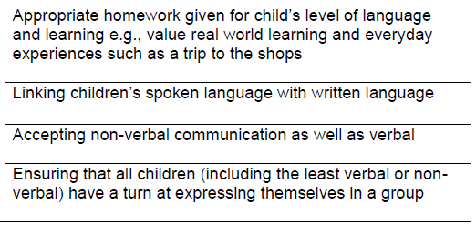
The use of supportive learning strategies to develop language and communication skills and promote participation from all learners.

