Slide 1
Intro to Photography

Slide 2
What will we be learning….
How we can take better photographs
We will look at a different skills and group tasks will be set.
We will get out and about and take some photographs
Have a bit of fun and enjoy photography, as part of Art

Slide 3
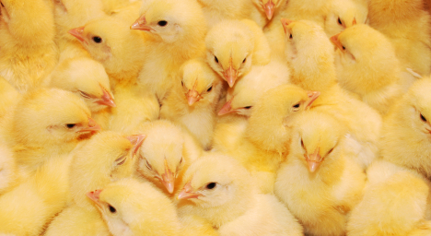
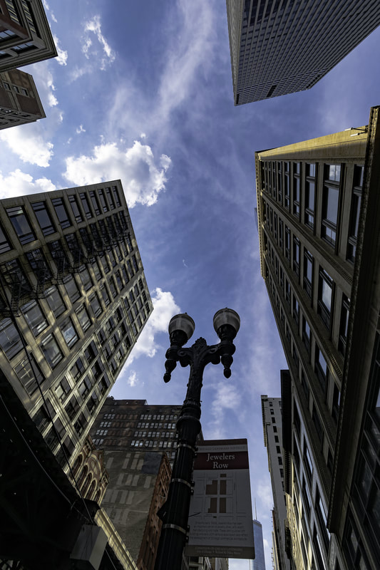
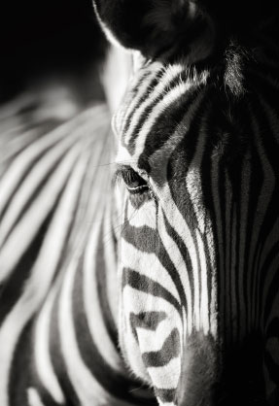
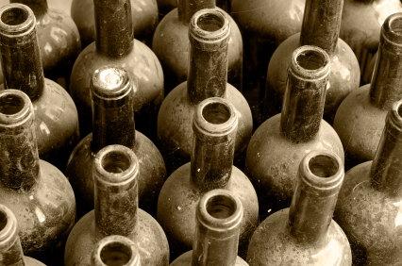
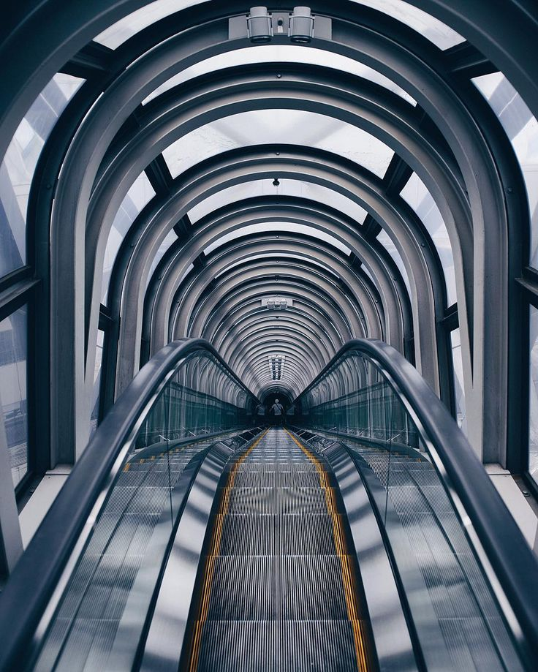
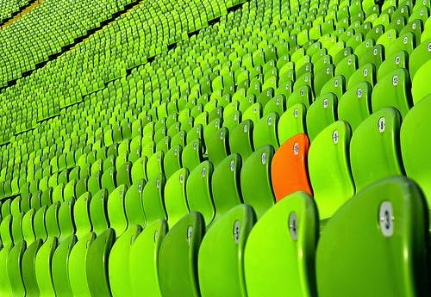
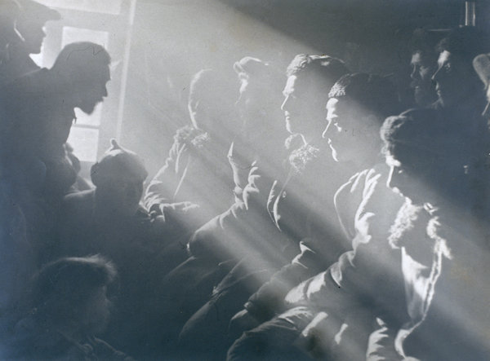
Basic elements of photography & getting to know your camera
The basic elements of photography are the same for Art.
Colour, shape or form, Light (or tone), texture, pattern, line, & composition.

Slide 4
Composition is one of the key factors in taking great images. This is the area we will look at in detail. Composition is the arrangement of shapes in an image.
There are many ways to take great images using composition as a tool.
LEADING LINES
RULE OF THIRDS
VIEWPOINT
SYMMETRY
FRAME WITHIN A FRAME
NEGATIVE SPACE

Slide 5
Each week we will look at one or two different elements and take a series of photos which I set as a challenge! Some tasks will be based on an ELEMENT others will just be for FUN.
I am looking for you to have fun, be creative and think about using the elements you have learned about ,in your shoots.
ARE YOU READY?!

Slide 6
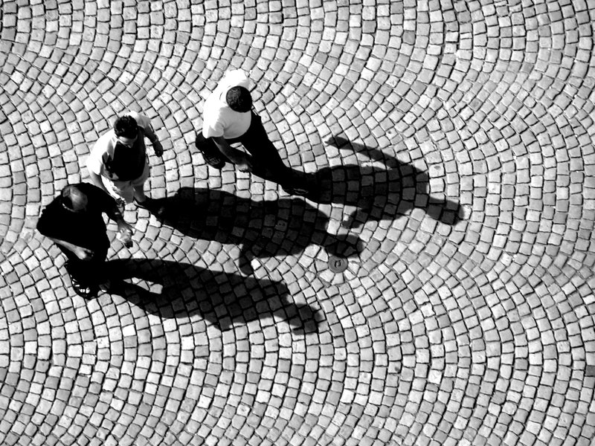
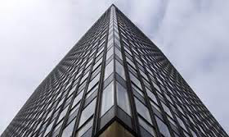
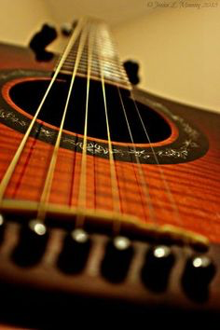
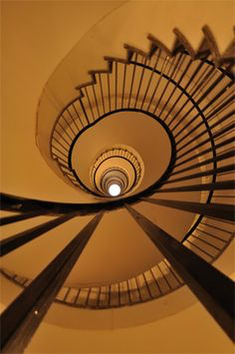
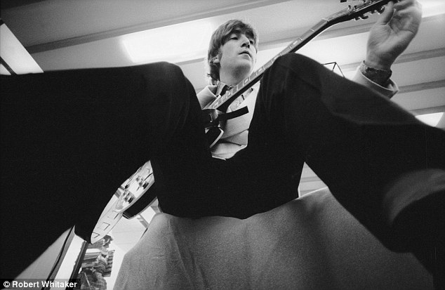
WEEK 1: VIEWPOINT

Slide 7
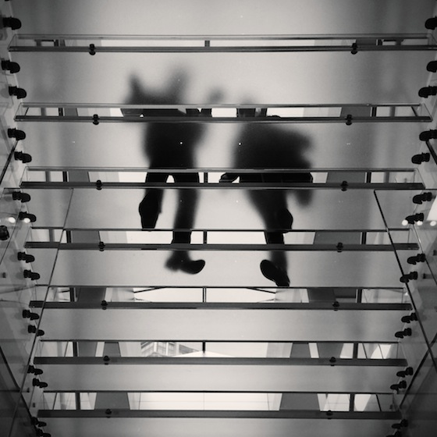
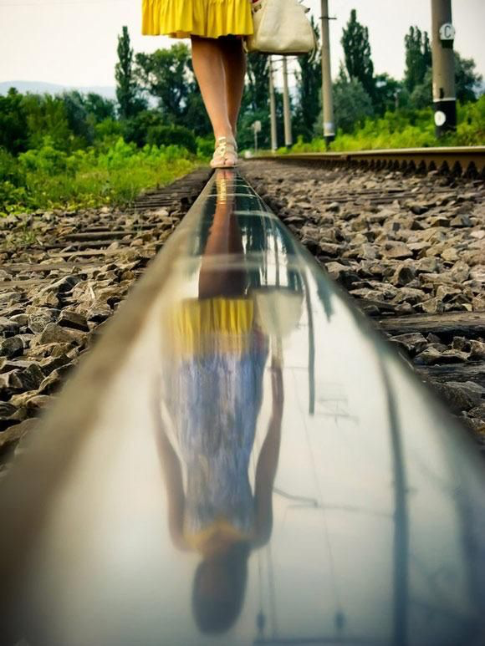
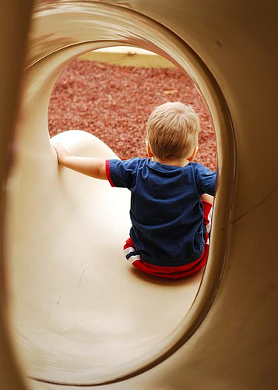
Image making: VIEWPOINT
Viewpoint: refers to the position we take the photograph from. The viewpoint can dramatically change the feel of the photograph.
Choose your subject (wisely).
Capture compositions that emphasise ‘viewpoint’.
Be creative (arial, looking up etc).

Slide 8
Task 1
Using your camera or phone, to capture the themes below.
Make sure to be creative (take photos no one else will),
Think about COMPOSTION & VIEWPOINT, and take turns being the photographer.
No combining items into one image.
ELEMENTS OF PHOTOGRAPHY – an everyday object from an unusual viewpoint, looking up, the inside of something.
FUN SHOOTS – A bad habit, Sky, the best dance move ever!

Slide 9
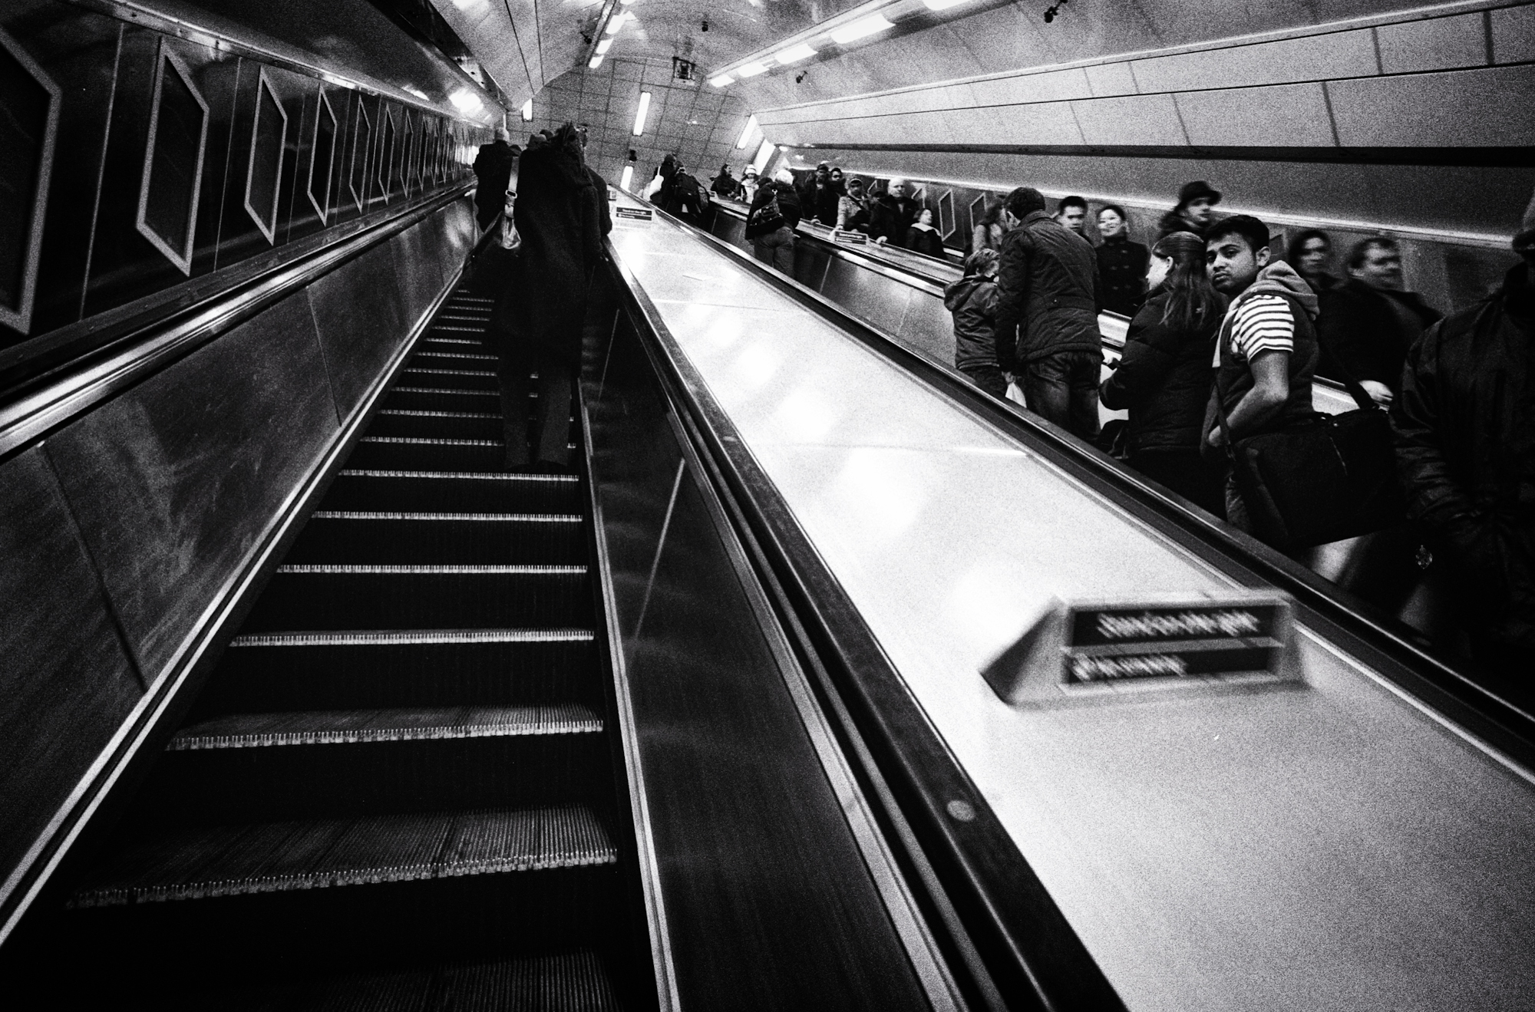
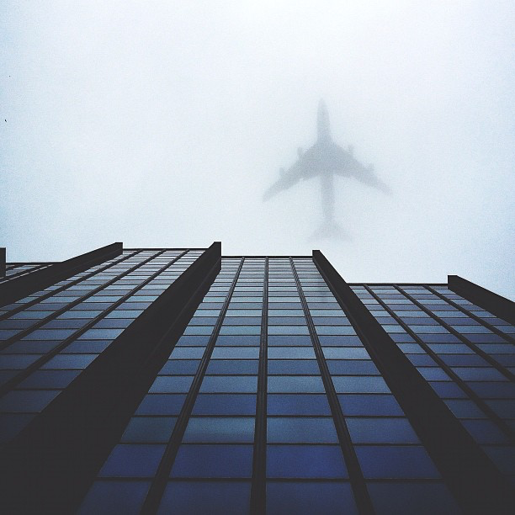
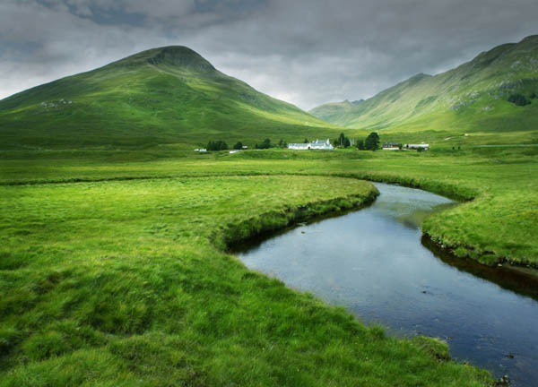
Task 2: LEADING LINES

Slide 10
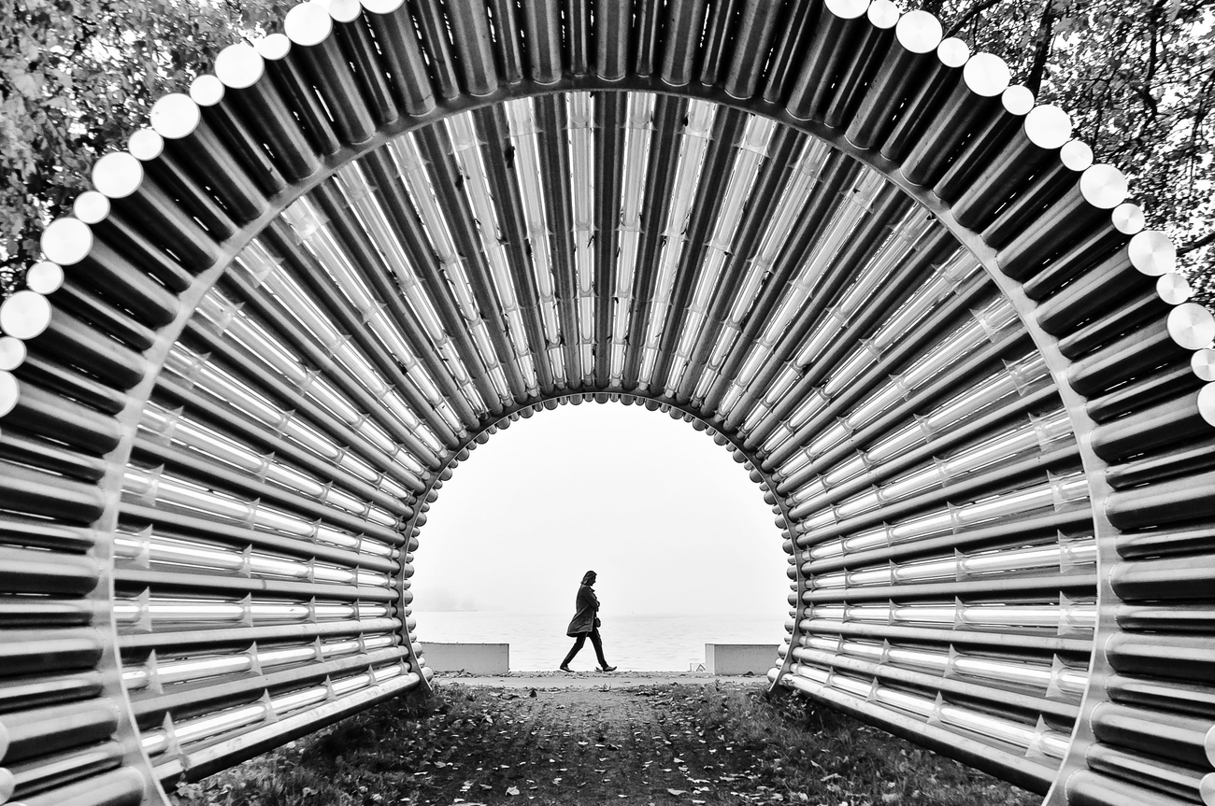
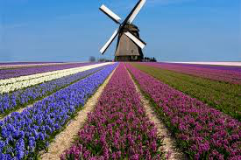
Task 2: LEADING LINES
Leading lines: one of the most effective compositional tools available to photographers. They are used to draw attention to a specific part of the frame; whether it is a person or something in the background of the frame.

Slide 11
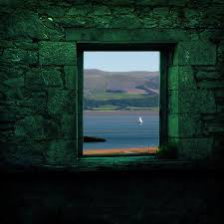
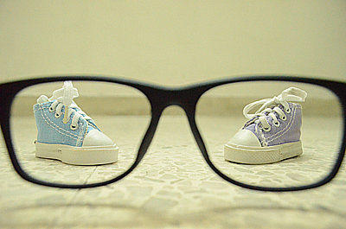
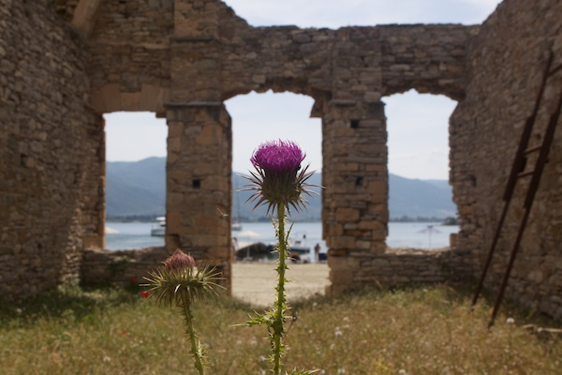
Task 2: FRAME WITHIN A FRAME

Slide 12
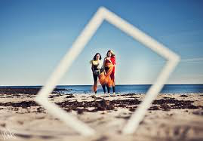
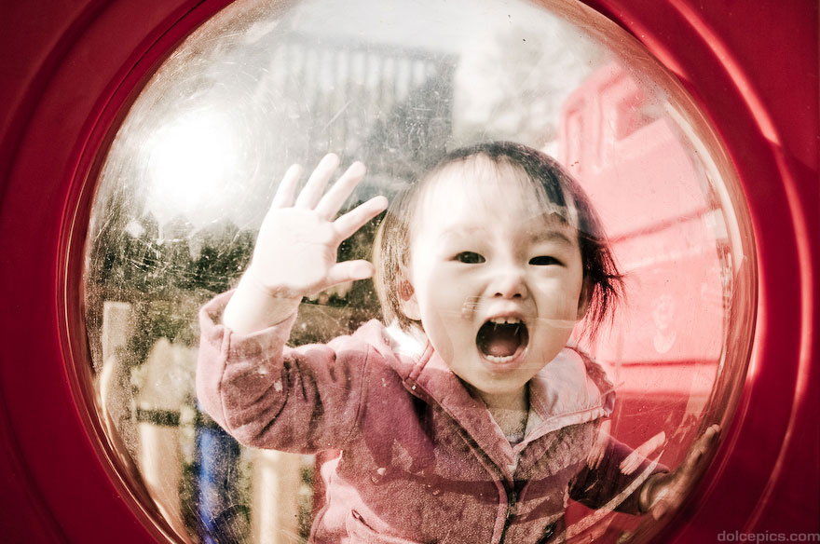
Task 2: FRAME WITHIN A FRAME
Frame within a frame: a great way to lead your viewers’ eyes into a photo. This can add depth and perpective, as well as drawing their attention to one detailed area.

Slide 13
Task 2
Usin Using your camera or phone, to capture themes below.
Make sure to be creative (take photos no one else will),
Think about COMPOSTION, FRAME WITHIN A FRAME & LEADING LINES, and take turns being the photographer.
No combining items into one image.
ELEMENTS OF PHOTOGRAPHY – Reflections of me, In the distance, Peek a boo
FUN SHOOTS – Kung foo fighting, Something broken, Umbrellas

Slide 14
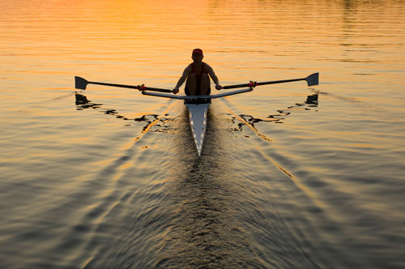
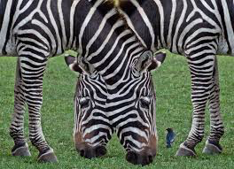
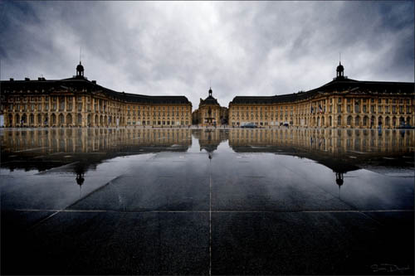
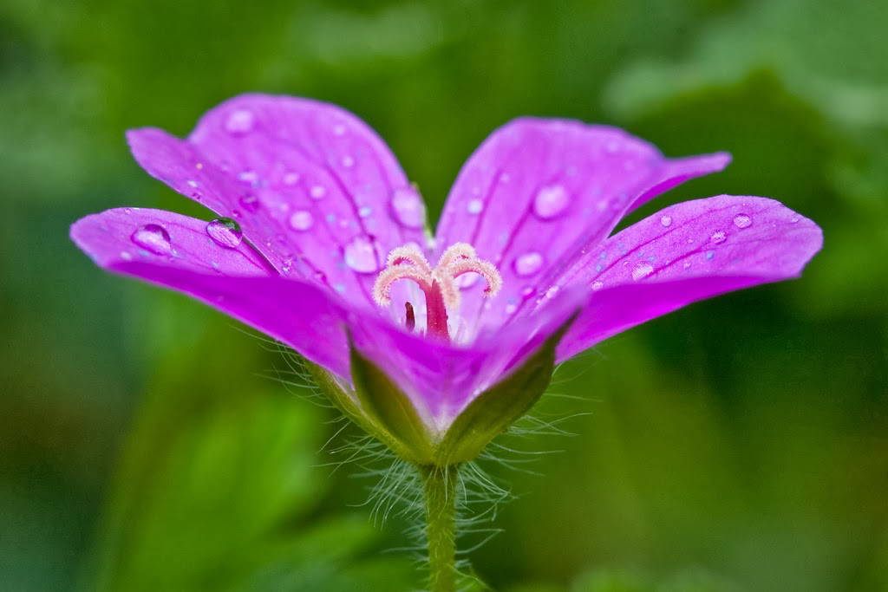
Task 3: SYMMETRY

Slide 15
Task 3: SYMMETRY
Symmetry: Keeping your subject symmetrical is another good technique to use. You can achieve amazing results by exploring interesting ways to show symmetry in your subject or finding a break in the symmetry.

Slide 16
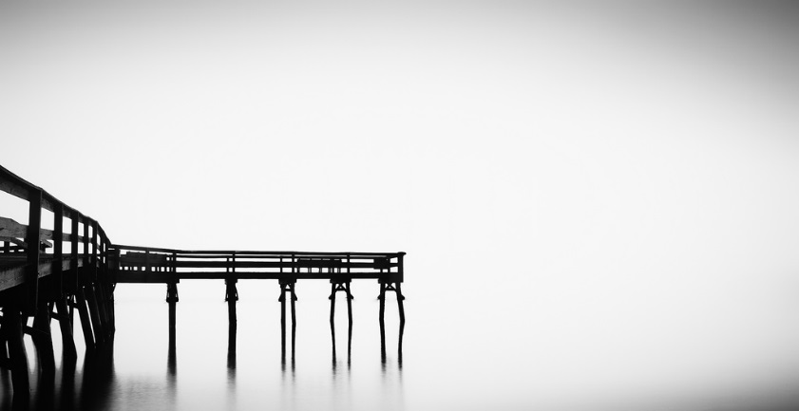
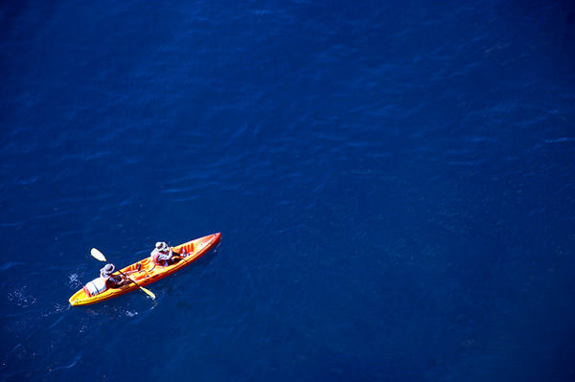
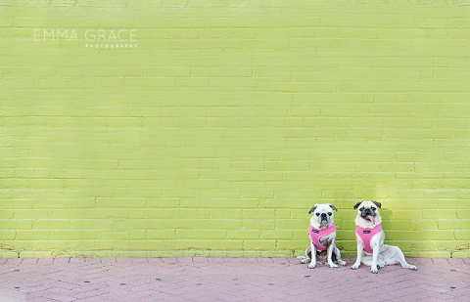
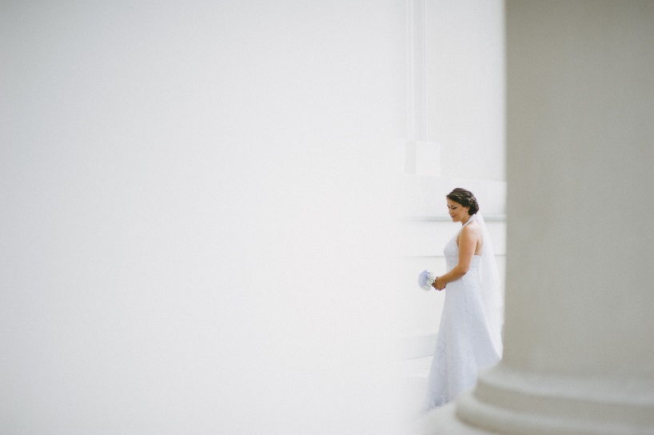
Negative Space
Negative space is the area between and around objects in a photo.
Objects (the subject) is the positive space.
It can be used to see shapes and sizes more effectively and produce better composed images.

Slide 17
Task 3
Using your camera or phone, to capture the themes below.
Make sure to be creative (take photos no one else will),
Think about COMPOSTION, NEGATIVE SPACE & SYMMETRY, and take turns being the photographer.
No combining items into one image.
ELEMENTS OF PHOTOGRAPHY – Lonely, Two peas in a pod, How many?
FUN SHOOTS – Cool pairs of shoes, Love is, See the rainbow

Slide 18
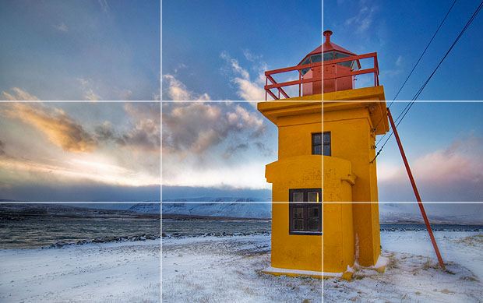
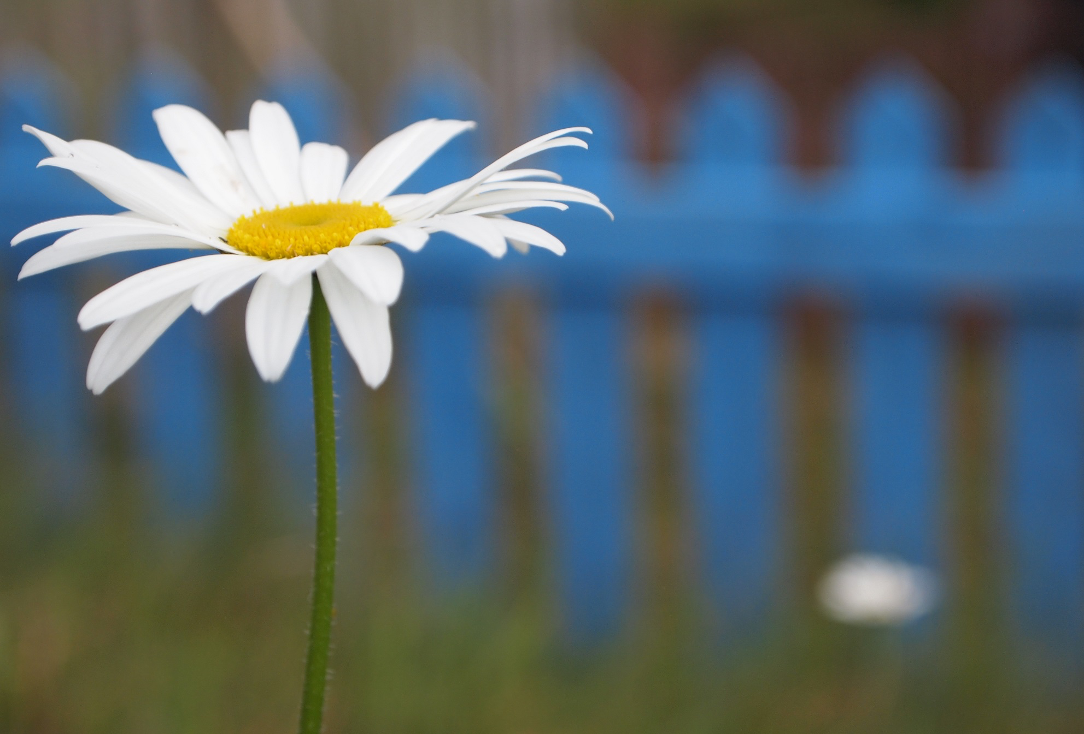
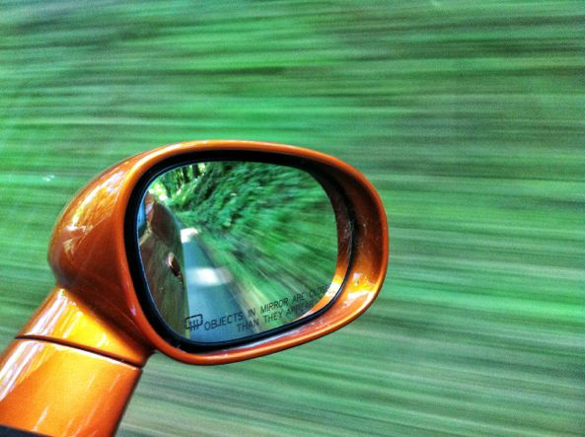
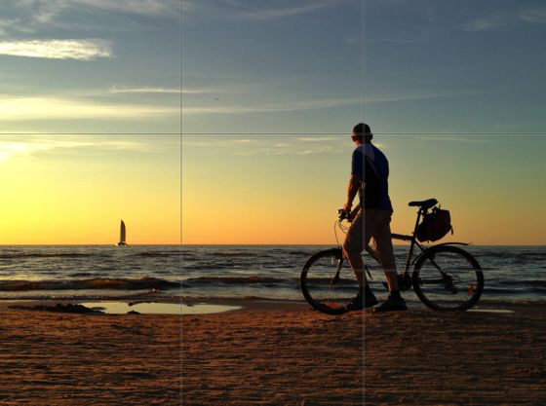
Image making: RULE OF THIRDS

Slide 19
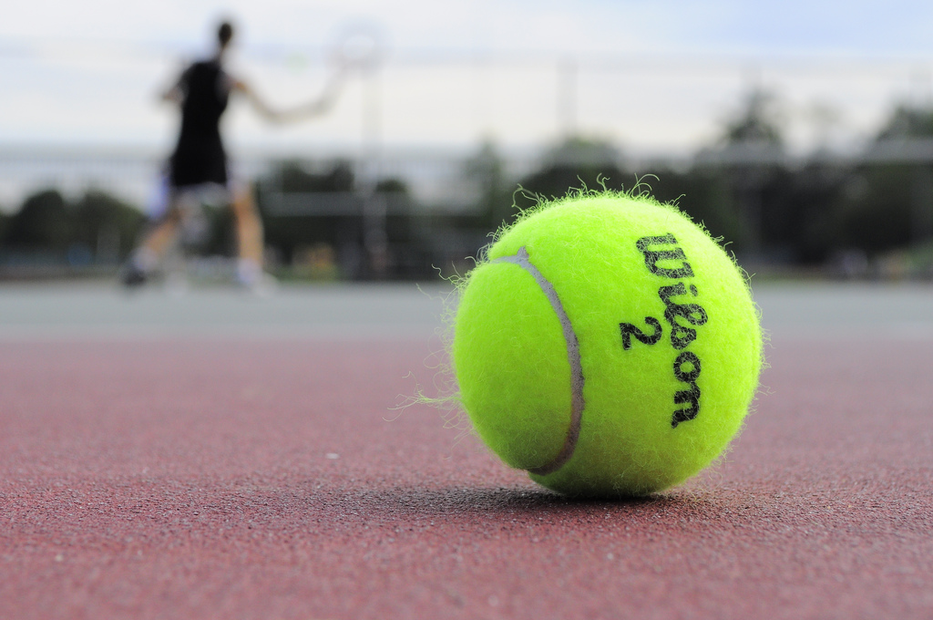
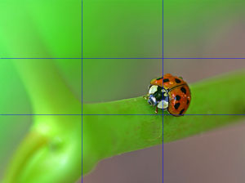
Image making: RULE OF THIRDS
Rule of thirds: an essential photography technique. It can be applied to any subject to improve the composition and balance of your images.

Slide 20
Task 4
Using your camera or phone, to capture the themes below.
Make sure to be creative (take photos no one else will),
Think about COMPOSTION & RULE OF THIRDS, and take turns being the photographer.
No combining items into one image.
ELEMENTS OF PHOTOGRAPHY – Textures up close, Split into 3’s, Warm
FUN SHOOTS –Earth quake!!, Two things that rhyme, Faces

