Slide 1
Ralston Primary School Help Video for Parents
Video 2- How to access Class Notebook and add work.

Slide 2
What is Class Notebook?
Class Notebook is an online jotter where only you and your teacher can see your work.

Slide 3
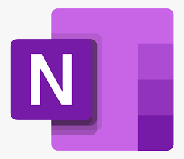
How to access Class Notebook
You access it through Teams.
You access Teams through glow on a computer or through the app on a tablet or phone.
You can access Class Notebook directly by also downloading the OneNote app on a mobile or tablet.
Use your glow email address and password to download Teams and the OneNote app.
.

Slide 4
1. Search for “glow Scotland”. 2. Select the first website.

Slide 5
3.Your username and password.
. Username starts with gw, then two digits, surname and first name.
Your username might have a number or your middle name in it. gw20bloggsjoe1
If your name is too long there may be some letters missing.
Your email address is your username with @glow.sch.uk gw20bloggsjoe1@glow.sch.uk
Contact your teacher if you forget any of these details.

Slide 6
3. Enter your username and password.

Slide 7
4. 4. Teams tile Search for the Teams tile using the menu on the side or add it to your launch pad.

Slide 8
5.How to log out of glow and switch users.
Always log out when you are finished.
If you have more than one child sharing a device you must log out and close your browser before starting again.
If you don’t the second user can not log on.

Slide 9
Thanks for watching and remember to ask your teacher if you need any help with glow and Teams.
Music- https://www.bensound.com

