Slide 1
Renfrewshire Council Support Staff Conference October ‘22
Notes:
WELCOME!
House Keeping. Register (on tables) Toilets/fire alarm
Each of you provide dedicated, professional support in early years and school settings each and every day.
You contribute in a variety of ways to the wellbeing, learning and development of some of our most vulnerable children and young people.
Today we hope to celebrate this and give you the opportunity to come together with your colleagues to discuss your professional roles as well as gain information and for the authority to seek your feedback.

Slide 2
Agenda
9:00 Arrival/Welcome
9:15 ISO Locality Update
10:00 Skills Survey Feedback / Scottish Education Pupil
Support Staff Consultation
10:30 Tea/Coffee
10:45 Celebrating Success
11:15 Induction Training Task
11:45 PM Agenda/ Closing Remarks

Slide 3
Locality Update
XXXXXXX- Inclusion Support Officer

Slide 4
Skills Survey Feedback
XXXXXXX– Inclusion Support Team

Slide 5
You told us you have not had training in:
Care Experienced Pupils – 78%
Trauma Informed Practice – 78%
Dyslexia – 62%
Restorative Approaches – 59%
ADHD – 58%
Mental Health – 51%
Bullying – 56%

Slide 6
You told us that:
272 of you were not aware of the training materials on the Education Scotland website
288 of you have IT access in your schools
310 of you have GLOW email addresses

Slide 7
You also said:
“Very little time for training.”
“I would like to attend on as many training
courses as possible”
“Classroom Assistants not many modules on
Renfrewshire CPD to attend”
“A lot of my training has been ‘on the job”
“My day to day duties leave little or no time
to look for training opportunities.”
“I would like to be able to access further
training and development opportunities”

Slide 8
Next steps
Further training during the remainder of the session on the areas you have identified
Induction Programme for new staff created by you today
Dialogue with you and with managers and decision makers about how we can create time for training opportunities
Dialogue between you and your line manager ensuring you have IT access and appropriate logins for GLOW, Renfrewshire CPD and iLearn

Slide 9

XXXXX– Inclusion Support Team
Notes:
All of the following refers to ASNAS and Classroom assistants
As previously mentioned you all play a vital role in helping children and young people who require additional support.
As valued members of our learning communities, the Scottish Government and Education Scotland would like to engage with you through a national discussion on the support staff workforce in Scotland.
Your views along with those of, pupils, parents and carers, other staff and leaders will be used to inform ways in which the Government can empower and assist you in meeting the needs of the children you support by engaging in dialogue
Your views and comments are therefore critical in ensuring that the support provided by the Government is achievable and impactful, both for you and for the children and young people you support.
We would urge you to engage with this process as much as possible

Slide 10
How to get involved
Notes:
The engagement programme aims to provide flexible and accessible opportunities to support participation.
There are a variety of different way you can have your say: 3 main ways are:

Slide 11
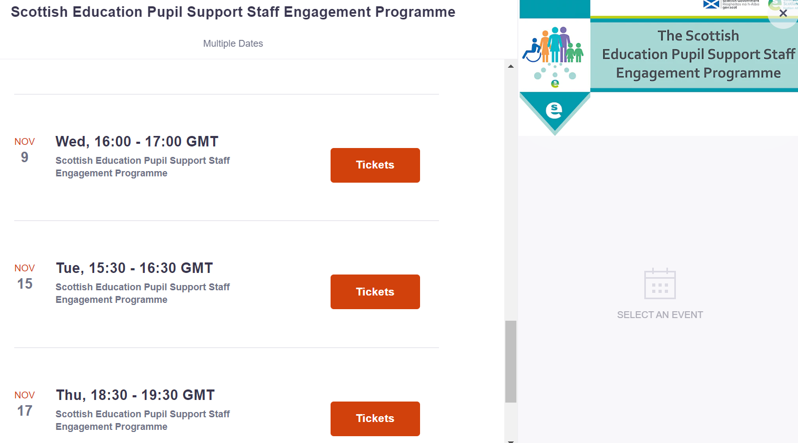
Online webinars with discussion rooms
How to get involved
Notes:
Online webinars with discussion rooms Twilight, in-service and weekend – Register to attend
These can be accessed at the Education Scotland Website

Slide 12
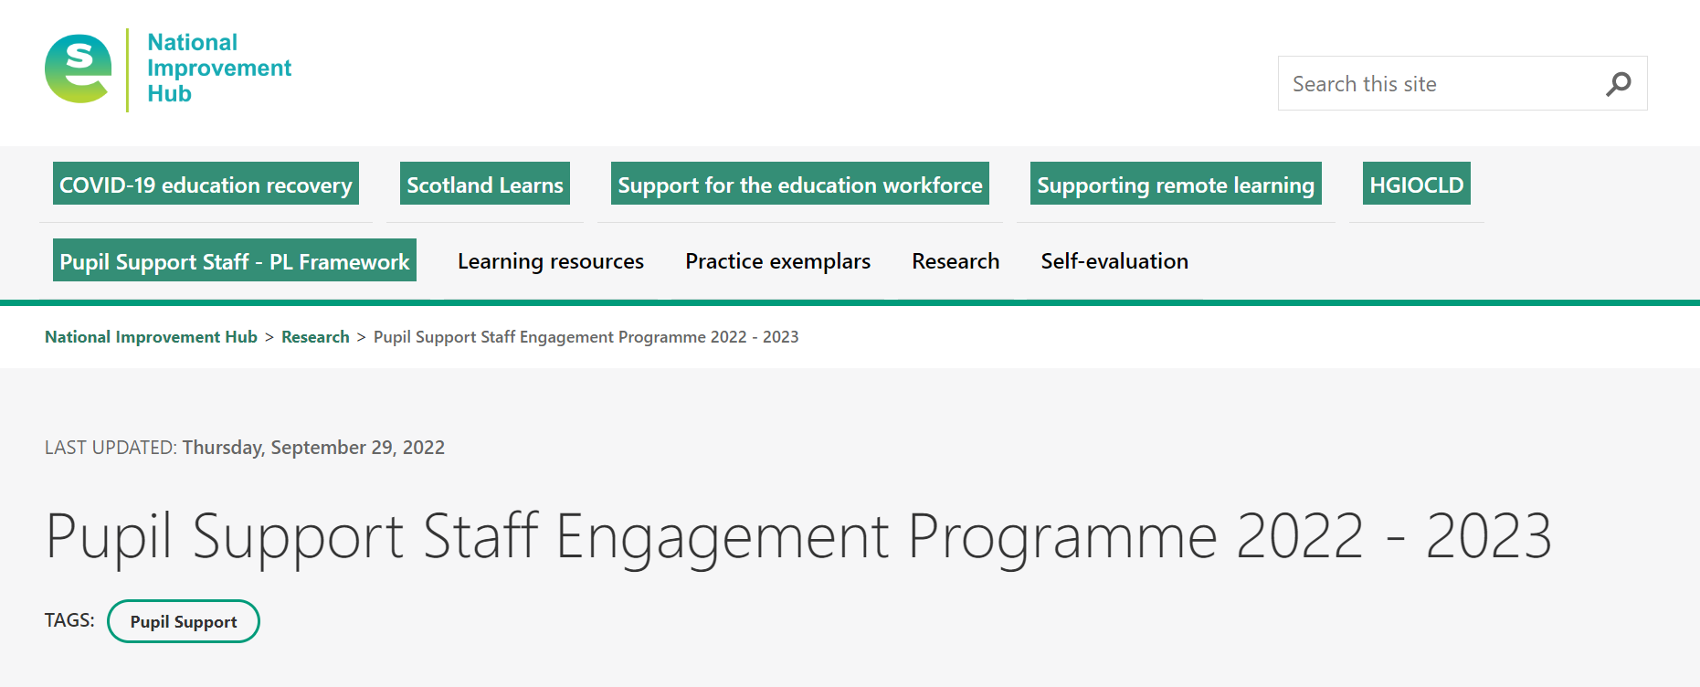
Any Time Access
How to get involved
Notes:
2. Any time access These are pre-recorded presentations with survey links – This will be available on Education Scotland Website by the end of October 2022

Slide 13
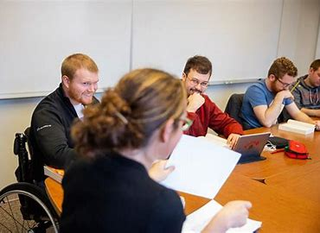
Local Authorities in-person sessions
Notes:
3. Local authorities in-person sessions in-person sessions are being arranged with some Local Authorities.
These would involved feedback sessions with representatives of Education Scotland/ Scottish Government.

Slide 14
Break!

Slide 15
Celebrating Success
Consider a challenging situation you faced that had a positive outcome for your learner(s)
2. What was it you did that led to the successful outcome?
3. What one piece of advice would you offer other
professionals who may find themselves in that situation?
4. Now find a partner you don’t know and share your experiences

Slide 16
Induction Task

Slide 17
Induction Task
Please consider the following:
What priority areas should be included?
What would be the best way to deliver the induction
eg. Online, face to face, twilight, during the school day?

Slide 18
Priority Areas: | Best Way to Deliver Induction:

Slide 19
Afternoon CLPL
Notes:
There is now a variety of i-Learn modules created specifically for support staff.
I-Learn can be accessed by going to Renfrewshire council home page
Then type i-learn in the search box
There are a variety of modules to choose from
They do not all need to be completed by the end of the day

Slide 20
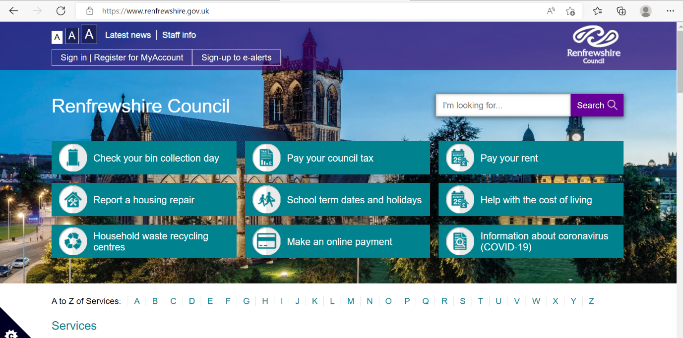
Notes:
Go to renf council home page and type ilearn in the search box

Slide 21
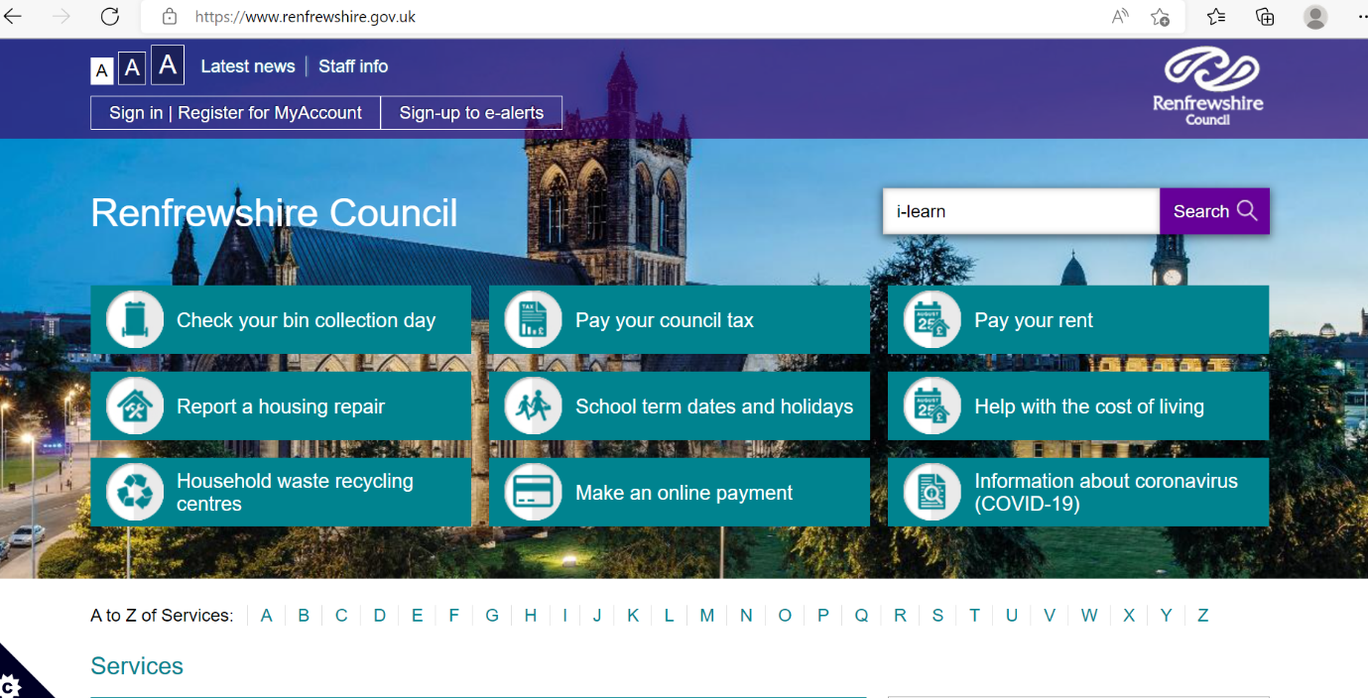
Notes:
Type ilearn in the search box

Slide 22
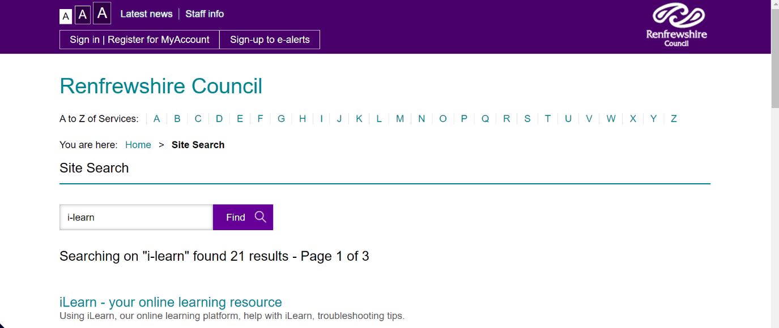
Notes:
Click ilearn link

Slide 23
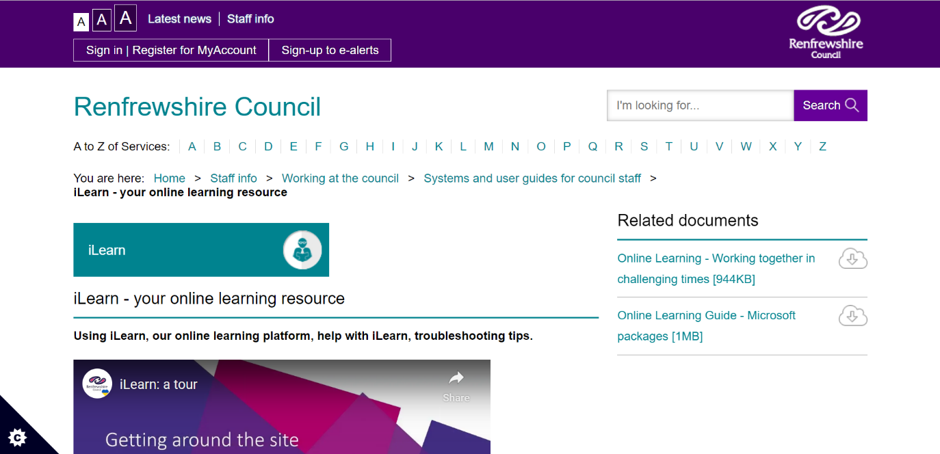
Notes:
Click ilearn link

Slide 24
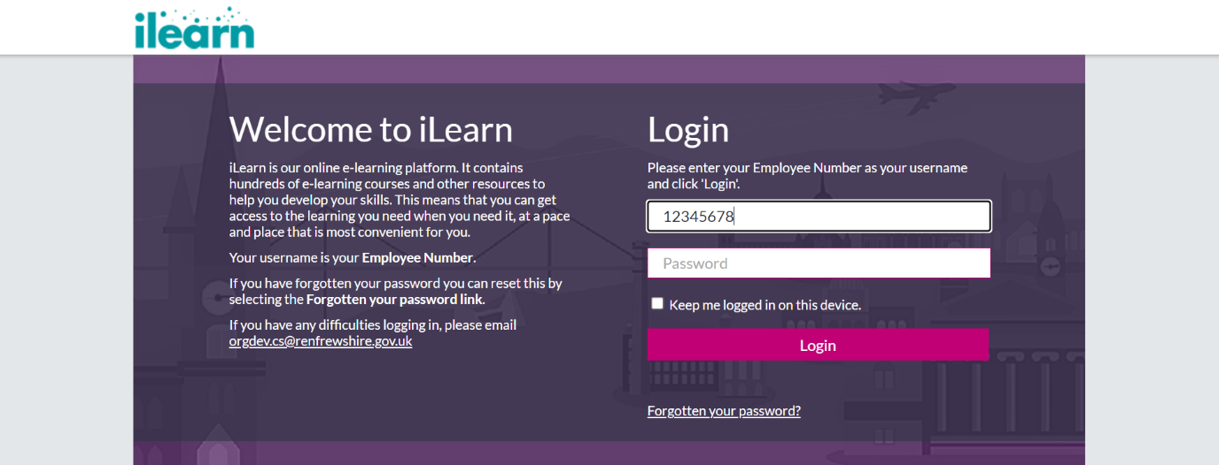
Notes:
Enter employee number and password

Slide 25
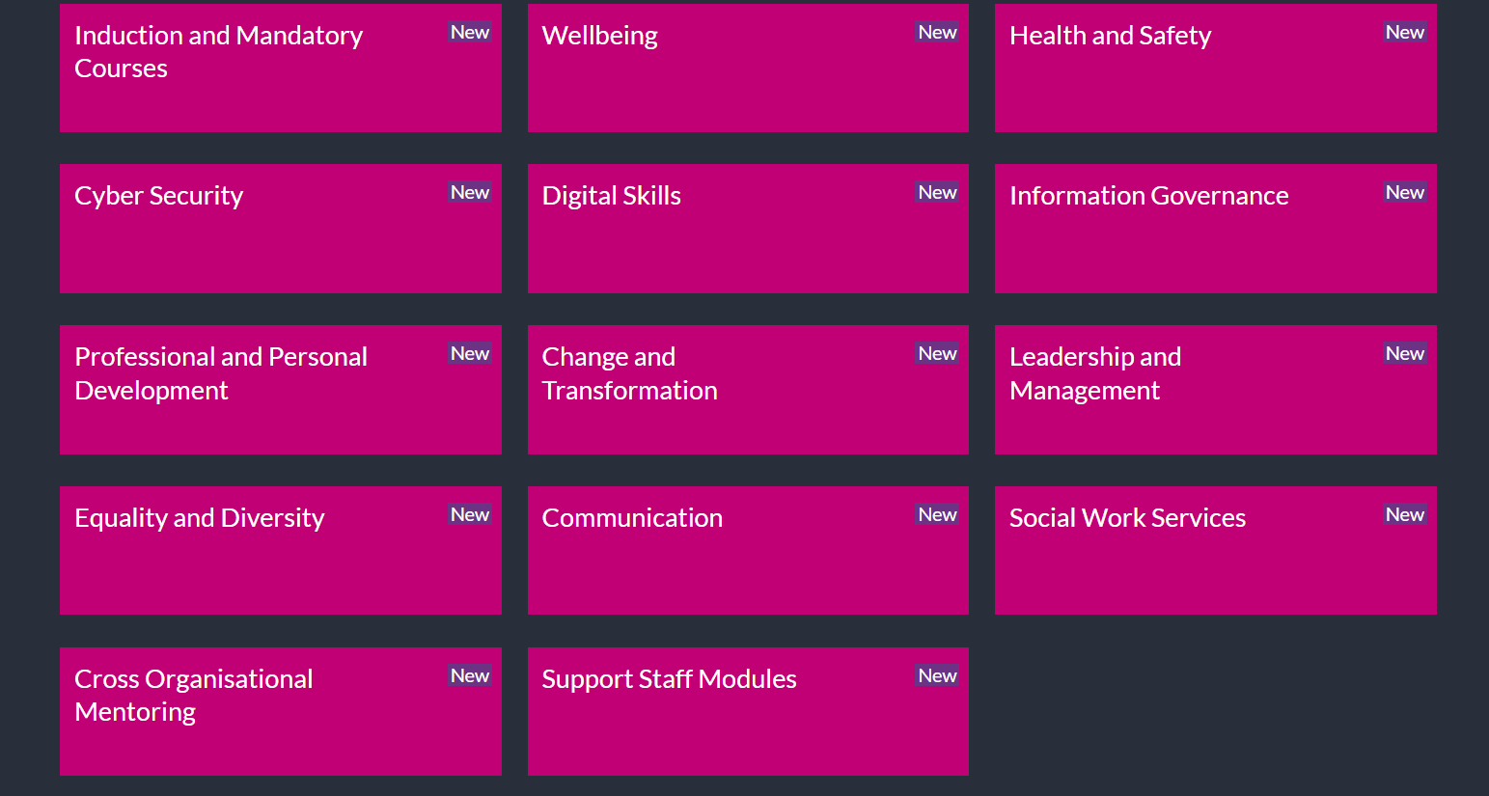
Notes:
Select support staff modules

Slide 26
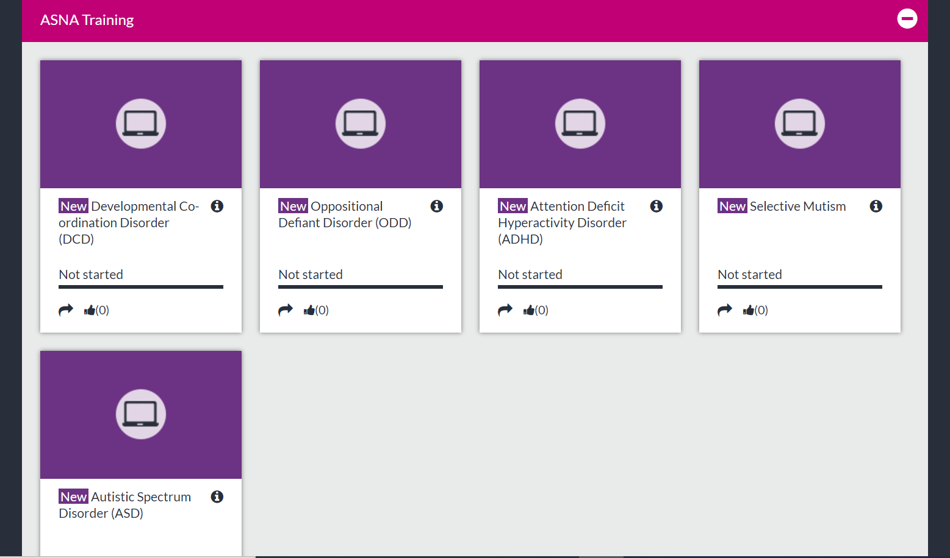
Notes:
Click the module you wish to complete.

Slide 27
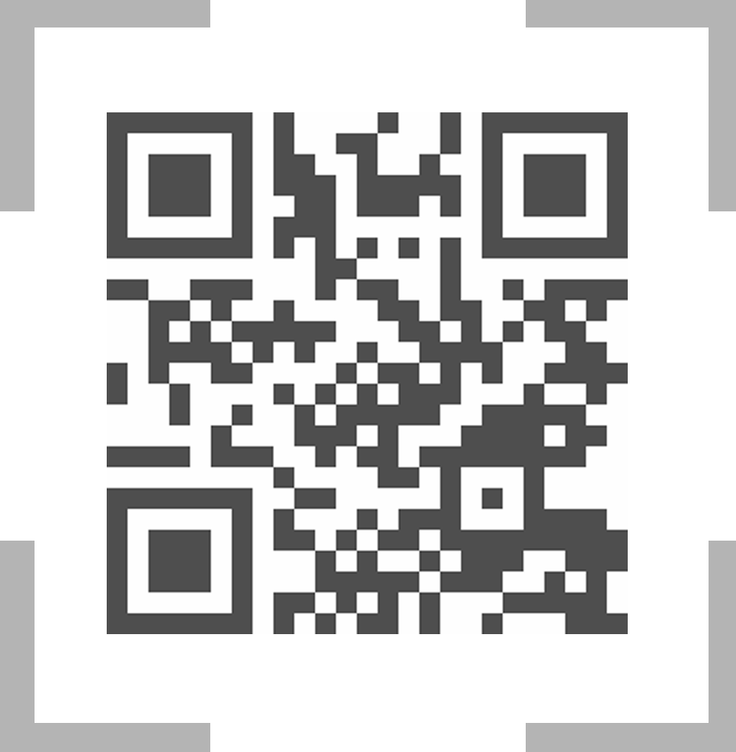
Thank You!

