Slide 1


Welcome to Renfrewshire Council’s Support Staff Induction
As a valued member of our team, the purpose of this course is to give some background to the important role you will be undertaking and how we will support you in carrying this out
Notes:
Intro: As we move to Locality Model you will find yourself giving support to a wider variety of CYP either through A&G or direct pupil support in/out reach.
Some of these children will have ASD profile.
This training is a result of feedback from yourselves and is designed to introduce you to the world of the learner with an autistic profile and other linked or associated conditions.
It will- offer initial supports and signpost further training.

Slide 2
Support Staff Induction
Your Induction Programme consists of five areas:
1. Scottish Educational Context and Knowledge
2. Communication and Collaboration: Developing positive relationships
3. Child Wellbeing and Development
4. Personal and professional development
5. In School Support

Slide 3
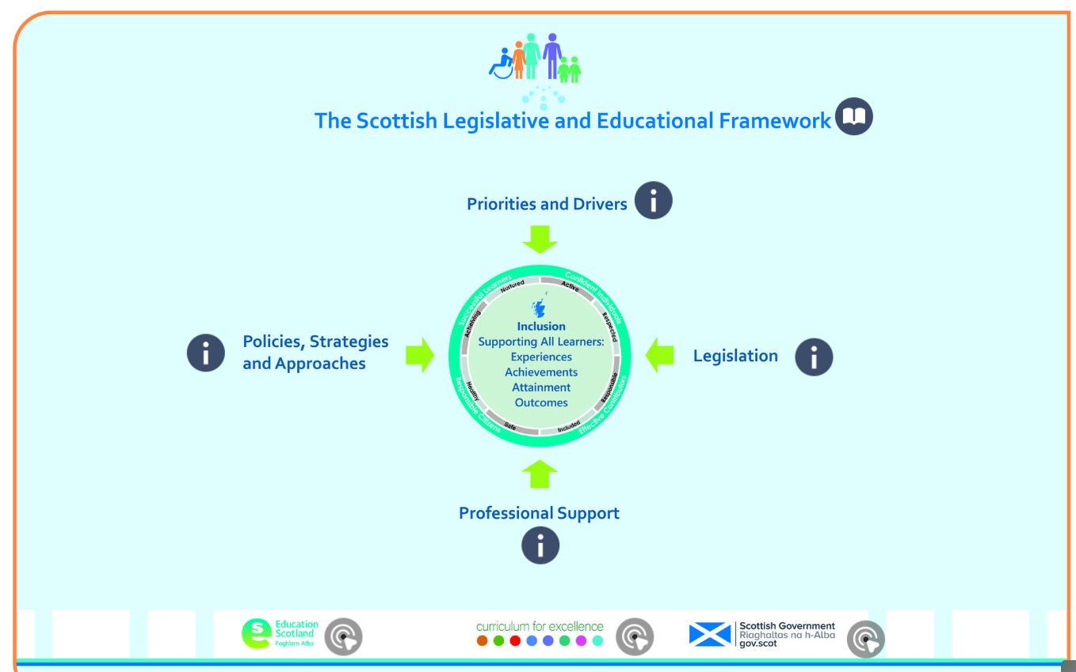
1. Scottish Educational Context and Knowledge
This section gives you information about the priorities, policies, legislation and support framework which helps us meet the needs of our learners
Click the picture to find out more

Slide 4

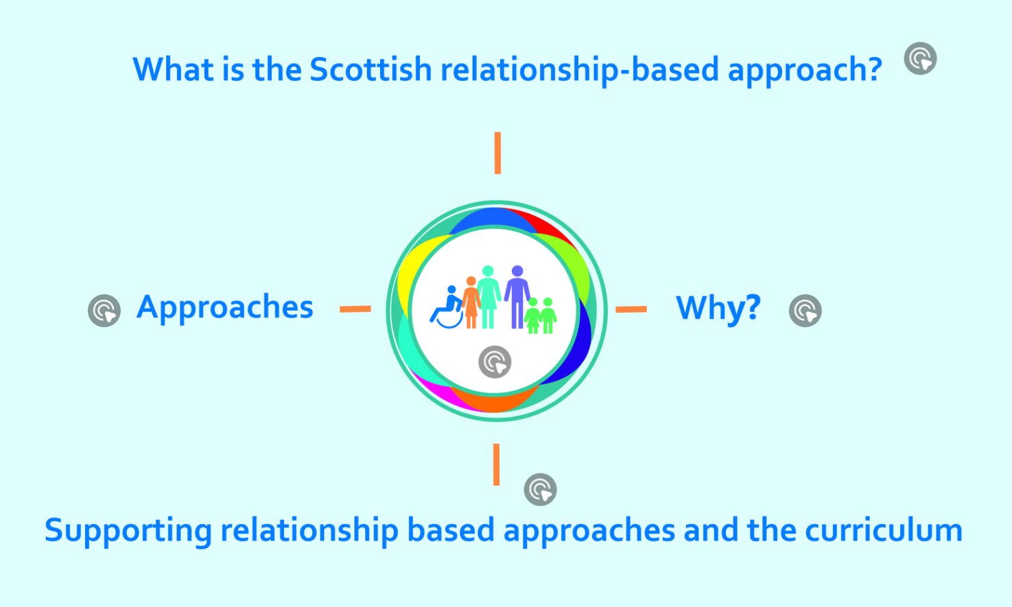
2. Communication and Collaboration:
Developing positive relationships
This section outlines the approach we take to supporting behaviour in our schools
Click the picture to find out more

Slide 5
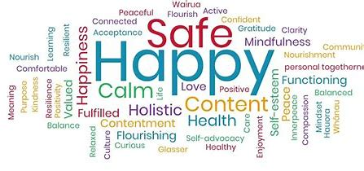
3. Child Wellbeing and Development
In this section we will look at Child Protection, the wider scope of Safeguarding, GIRFEC and
associated legislation
As an employee of Renfrewshire Council, you must receive Child Protection (Part1) training. If you have not yet received this, please contact your line manager to arrange a suitable training date

Slide 6
What do we mean by ‘Child Protection?’
3. Child Wellbeing and Development
Child protection refers to the processes involved in consideration, assessment and planning of required action, together with the actions themselves, where there are concerns that a child may be at risk of harm.
Child protection guidance provides overall direction for agencies and professional disciplines where there are concerns that a child may be at risk of harm.
Child protection procedures are initiated when police, social work or health professionals determine that a child may have been abused or may be at risk of significant harm.
Further Reading

Slide 7
What do we mean by ‘Safeguarding’
3. Child Wellbeing and Development
This is a much wider concept than child protection and refers to promoting the welfare of children, young people and protected adults. It encompasses:
Protecting from maltreatment
Preventing impairment of their health or development
Ensuring that they are growing up in circumstances consistent with the provision of safe and effective care
Taking action to enable all children, young people and protected adults to have the best outcome
It must be understood that everyone who works with children and young people has a responsibility to safeguard them and promote their welfare.

Slide 8
How do you know if you are getting it right?
3. Child Wellbeing and Development
In Scotland, child protection has to be seen in the context of the wider Getting It Right For Every Child (GIRFEC) approach, the Early Years Framework and the UN Convention on the Rights of the Child.
GIRFEC promotes action to improve the wellbeing of all children and young people in eight areas. The primary indicator for child protection is:
To keep a child safe and, in so doing, attention is given to other areas of wellbeing as appropriate.

Slide 9
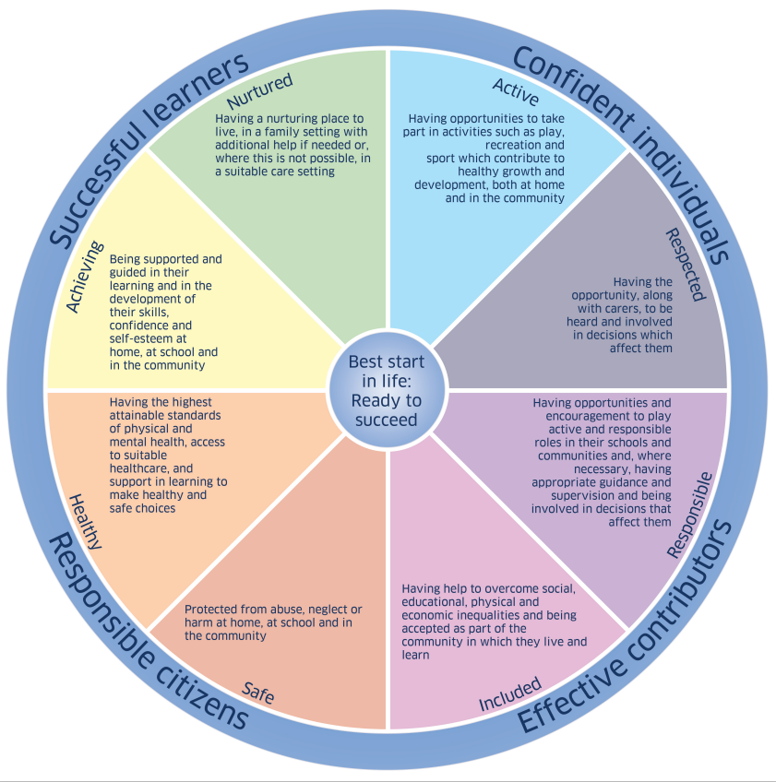
How do you know if you are getting it right?
3. Child Wellbeing and Development
The ‘Wellbeing Wheel’ outlines the eight indicators of wellbeing that every adult should consider when observing or recording strengths and risks to a child’s or young person’s wellbeing. These observations should inform any assessment of a child’s or young person’s wellbeing, therefore it is essential that every adult is clear about what each these indicators mean.

Slide 10
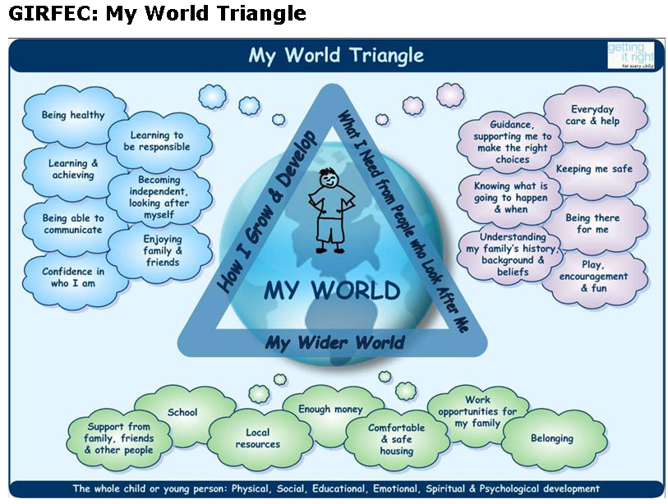
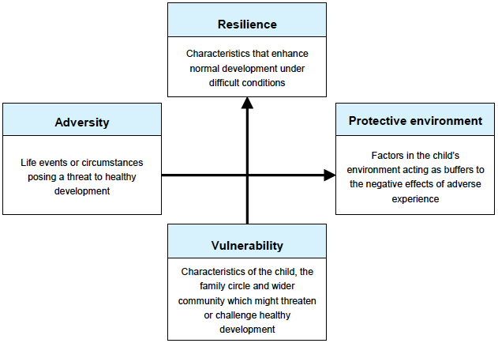
3. Child Wellbeing and Development
There are other tools we can use that are integral to promotion and assessment of wellbeing. These are:
My World Triangle
Resilience Matrix

Slide 11
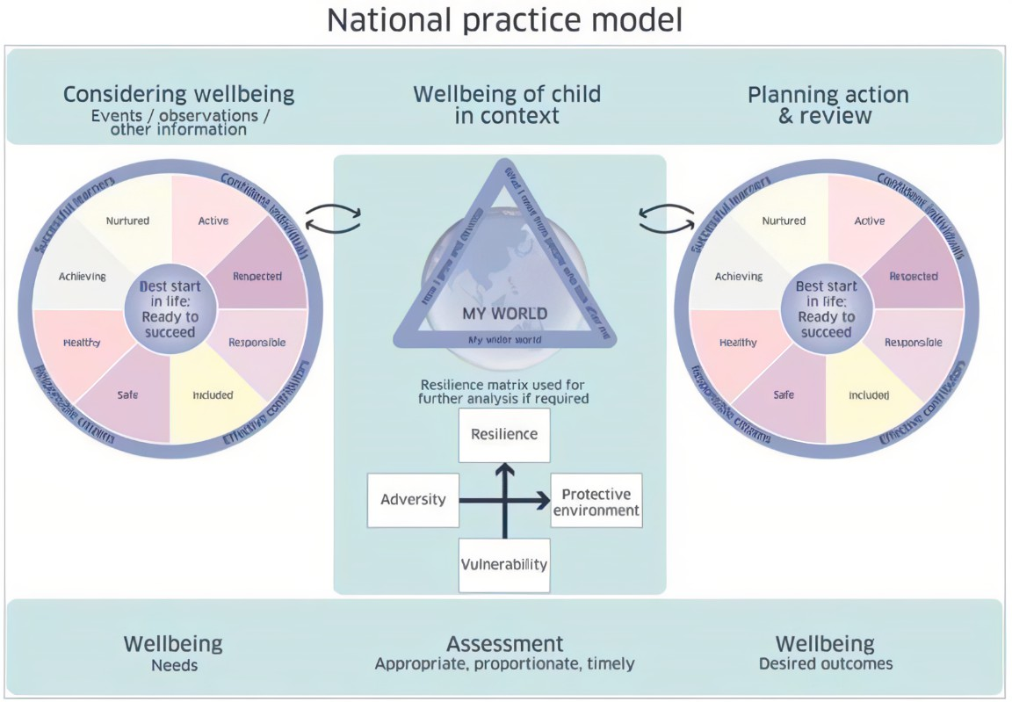
3. Child Wellbeing and Development
The Wellbeing Indicators, My World Triangle and Resilience Matrix combine to create the GIRFEC ‘National Practice Model’.
This model is a series of tools that are integral to promotion and assessment of wellbeing.

Slide 12

Current Legislation
3. Child Wellbeing and Development
Children (Scotland) Act 1995
This remains one of the primary pieces of legislation providing the range and scope of local authority intervention in the lives of children and their families.
Links have been attached to each of the Acts, should you wish to read them.
The Act is Available Here

Slide 13

Current Legislation
3. Child Wellbeing and Development
Local Government in Scotland Act 2003
Parts 2 and 3 of this legislation are concerned with scope and establishment of local Child Protection Committees.
The Act is Available Here

Slide 14
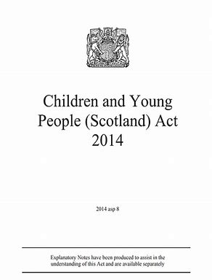
Current Legislation
3. Child Wellbeing and Development
The Children and Young People (Scotland) Act 2014:
places a duty on local authorities and schools to ensure the wellbeing of children and young people is safeguarded, supported and promoted. The voice of the child or young person is essential in understanding their needs and ensuring their wellbeing is safeguarded, supported and promoted. Fostering strong relationships between staff and children and young people is essential to this practice.
The Act is Available Here

Slide 15

Current Legislation
3. Child Wellbeing and Development
Prevent, Section 26 of the Counter-Terrorism and Security Act, 2015
This legislation places a duty on central bodies to have due regard to the need to prevent people being drawn into terrorism.
Section 26 of the Act is Available Here

Slide 16


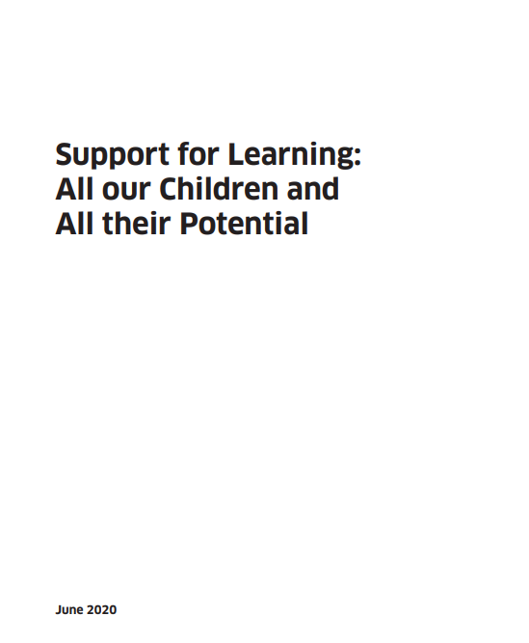



Current Legislation
3. Child Wellbeing and Development
There is also a range of ‘umbrella’ legislation which supports the work we do:

Slide 17
What does this mean for you?
3. Child Wellbeing and Development
Receive / listen
  Listen carefully
  Take all concerns seriously and act promptly
  Inform that this information will be passed onto the relevant people
Capture details of the concern
  Record information in writing as soon as possible
Refer
  DO NOT investigate
  It is not your job to decide if a child has been abused but it is our responsibility to report our concerns
Record
  Follow local authority Child protection / safeguarding procedures
  Always seek advice if you are unsure and always follow up to see what action has been taken
Do NOT delay!

Slide 18

The Role of Pupil Support Staff
4. Personal and Professional Development
As a member of Renfrewshire Council’s Pupil Support Staff Team, you are a valued and essential member of the school community.
You will be in a position to create close and meaningful relationships with children and young people and may be best placed to know aspects of their views and experiences.
Your contribution to discussion around the needs, strategies and planning for a child or young person is essential.

Slide 19
The Role of Pupil Support Staff
4. Personal and Professional Development
Your role is extremely varied, requires flexibility and may include the following:
Relationship building with the child or young person
Encouraging and supporting children and young people to engage in their learning
Enhancing communication at all levels, providing appropriate feedback to children,
young people and professionals
Taking on the role of significant adult in offering emotional support and
unconditional acceptance to vulnerable children
Gathering and communicating children and young people’s views
Implementing personal care plans
Implementing specialist programmes as advised by a therapist or teaching staff

Slide 20
The Role of Pupil Support Staff
4. Personal and Professional Development
Continued….
In secondary schools, providing appropriate aspects of support for SQA assessment
arrangements for candidates with additional support needs.
Linking with class teacher/pupil support teacher and parents (as agreed by senior
managers) therapists/peripatetic teachers and others, during protected time, when
possible
Motivating and inspiring children and young people
Moving and handling
Playground support

Slide 21
The Role of Pupil Support Staff
4. Personal and Professional Development
Continued….
Proactive support and management of pupil behaviour following Risk Assessments
and Behaviour Protocols if required
Providing support with a specified support plan, including support for independent living
Supporting eating and drinking where necessary
Welcoming and departing at beginning and end of day, and escorting throughout the day

Slide 22
Continual Professional Development
4. Personal and Professional Development
To support your career long development, there will be a wide variety of training made available to you.
This training will fall into 3 categories- Informed, Skilled and Enhanced, as outlined in Education Scotland’s Pupil Support Staff Professional Learning Framework.
Each of these links above will take you to a list of development opportunities.

Slide 23
Continual Professional Development
4. Personal and Professional Development
In addition to this, Renfrewshire Council will offer you a variety of opportunities to continue your professional development
These will be delivered in a variety of ways:
Face to face
Support Staff Conferences
i-Learn
Signposted via Support Staff area on GLOW
Other local arrangements within your school

Slide 24
What should I expect?
5. In School Support
It is important to us that you are a valued and included member of our school team. As such, there is a variety of information you can expect to receive from us within the first week of starting your job:
Introduction to your Senior Management Team (including your line manager)
Discussion with line manager about the children/young people you will be supporting
Current or important workplace updates including a copy of the School Improvement Plan/relevant whole school approaches/policies/School Handbook
Tour of the building and fire evacuation plans
Access to School Network, GLOW, Business World, ilearn,CPD and any other appropriate IT Systems

Slide 25
Thank you.
You have now completed your induction training!
Notes:
Intro: As we move to Locality Model you will find yourself giving support to a wider variety of CYP either through A&G or direct pupil support in/out reach.
Some of these children will have ASD profile.
This training is a result of feedback from yourselves and is designed to introduce you to the world of the learner with an autistic profile and other linked or associated conditions.
It will- offer initial supports and signpost further training.

