Slide 1
OUR LADY OF PEACE PRIMARY SCHOOL & ELCC CLASS
School improvement plan summary
2024-25

Slide 2
The improvement plan of Our Lady of Peace Primary School & ELCC Class for 2024-25 is based on the establishment, Renfrewshire Council and the National Priorities set by the Scottish Government. The national priorities address four areas for improvement:
Place the human rights and needs of every child and young person at the centre of education;
Improve attainment, particularly in literacy and numeracy;
Close the attainment gap between the most and least disadvantaged pupils;
Improve children’s health and wellbeing; and
Improve children and young people’s employability skills so that they move into positive and sustained destinations.

Slide 3
Contents of Summary
Vision, Values & Aims
School Improvement Progress during Session 2023-24
School Improvement Plan Priorities for Session 2024-25
Request for Feedback

Slide 4
Vision, Values & Aims
These are at the heart of all that we do
Our team are role models for children and for each other
All staff are responsible for teaching these children
We use the language of our values in our daily conversations
Our vision, values and aims were written in consultation with all staff, parents and children during session 2020-21.

Slide 5
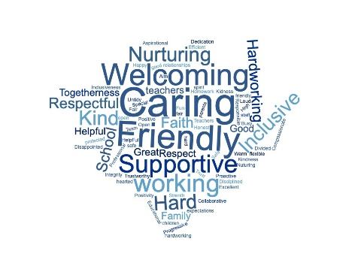
Our Vision
We are a family at Our Lady of Peace
Our vision is of a school where children are welcomed, where they feel safe, where they are connected and are supported to learn and to grow.
We are Always Learning, and Aiming High
Our vision, values and aims were written in consultation with all staff, parents and children during session 2020-21.

Slide 6
Our Values
Welcoming: You are welcome at OLOP and accepted for who you are. We recognise how diverse our school community is, and we celebrate that. At OLOP, we offer support and learning at all levels that gets it right for our children and their families. We put our children at the centre of what we do and the decisions we make.
Achieving: We are a team at OLOP. We encourage everyone to ‘Aim High’ and to ‘do their best.’ Effort and hard work are part of who we are. We will offer each child the support they need, and we provide a range of stimulating teaching and learning experiences for all children and in partnership with parents, take into account their individual educational, pastoral and social needs.
Love & Kindness: Kindness helps us create a school where we feel safe and valued. We think about the impact our words and behaviour have on each other. We respect and listen to each other. We recognise the diversity in our school, and we celebrate it. We will challenge all unkind behaviour and actions in an honest and supportive way.
Our vision, values and aims were written in consultation with all staff, parents and children during session 2020-21.

Slide 7
Our Aims
Our Lady of Peace is a community of faith and learning.
We aim to:
Promote effective partnerships with parents, children, the Church* and the community
Ensure a safe, relaxed and happy environment in which children can feel confident and secure, where children’s rights are respected, and gospel values* promoted
Be an inclusive school and value the views and experiences of all our children
Create a motivating environment where all learners are encouraged to achieve their full personal and academic potential and where success is celebrated
Our vision, values and aims were written in consultation with all staff, parents and children during session 2020-21.
Items marked with a * apply to the school only.

Slide 8
School Improvement Progress during Session 2023-24
Click here
to read our
Standards & Quality Report

Slide 9
School Improvement Plan Priorities for 2023-24
Celebrating & Supporting Our Community – our successes, our differences, our uniqueness
2. Review of Assessment, Tracking & Monitoring Procedures
3. Develop high quality learning, teaching and assessment leading to improved attainment and achievement in Writing

Slide 10
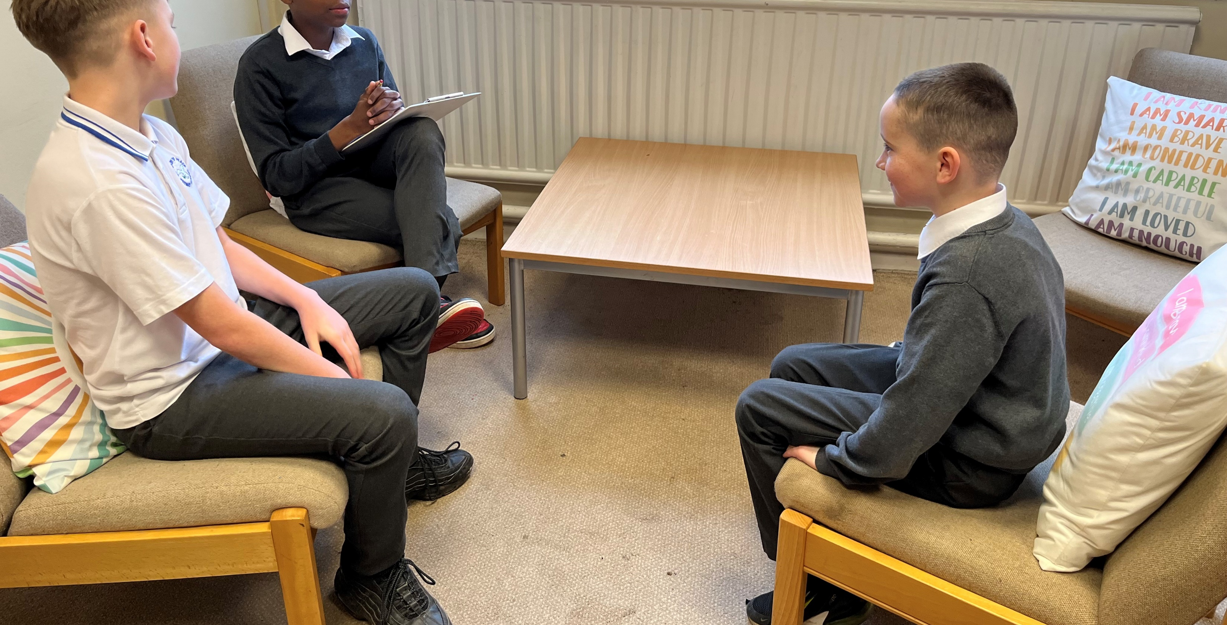
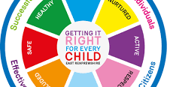
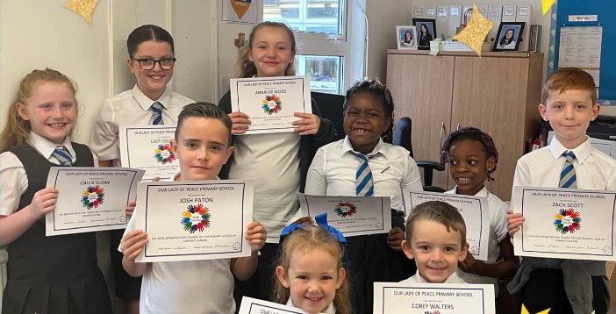
Priority 1:
Celebrating & Supporting Our Community – our successes, our differences, our uniqueness
Seek more effective ways of celebrating our successes – linked to Skills for Learning, Life & Work, Enterprise, Career Education, Visible Learning
Seek ways to celebrate the different cultures within our OLOP Community
Removing barriers to ensure wellbeing, equality & inclusion
Developing and Maintaining Positive Relationships
Further develop Pupil Voice and Pupil Leadership Skills

Slide 11
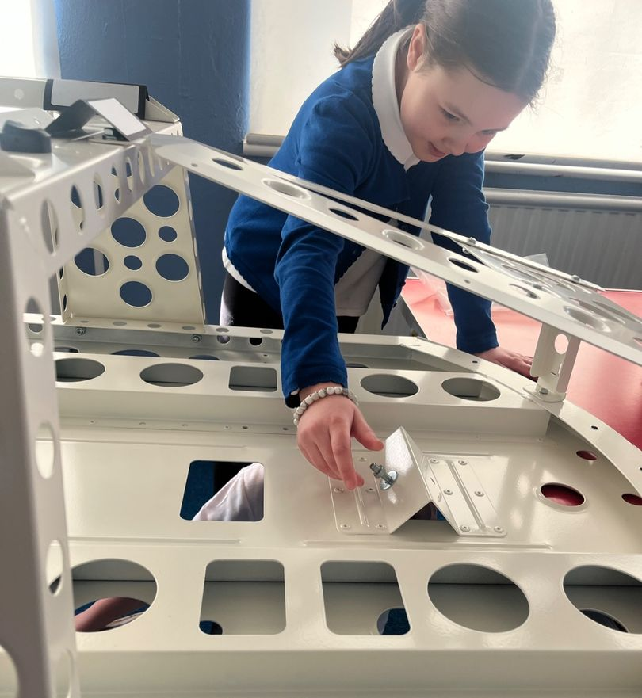
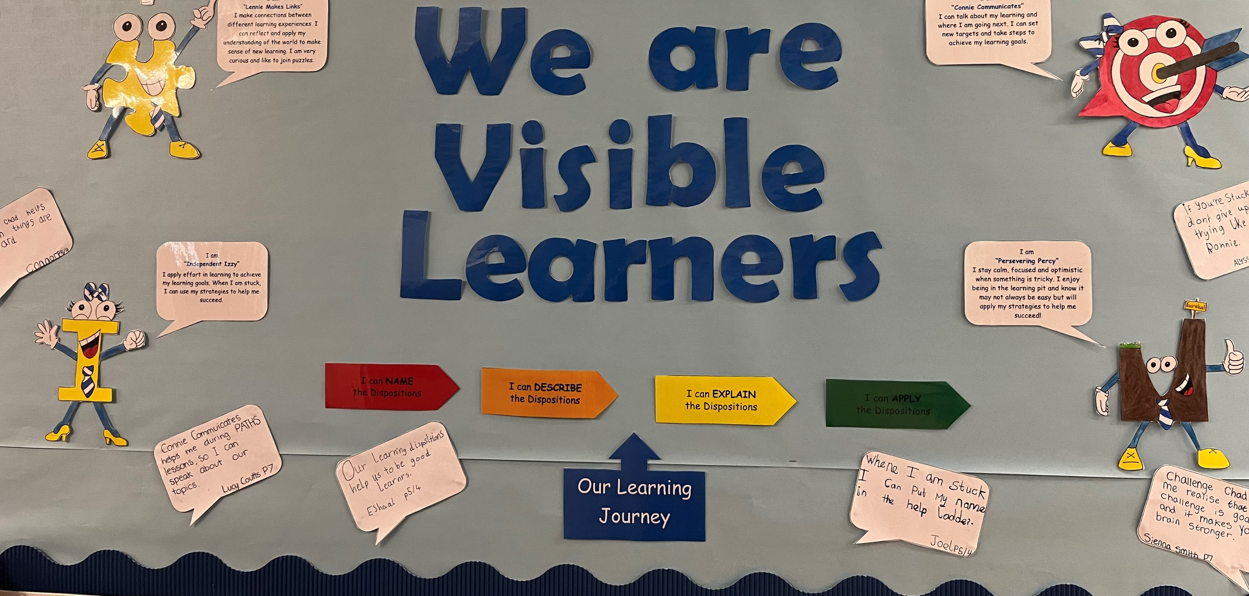
Priority 2:
Review of Assessment, Tracking & Monitoring Procedures
Use of Assessment Data to inform teaching
Ensuring the principles of planning, observation, assessment, recording and reporting are an integral feature of learning and teaching
Ensuring the principles of planning, observation, assessment, recording and reporting are an integral feature of learning and teaching
Assessment of other Curricular Areas - STEM
Further Implementation of Visible Learning

Slide 12
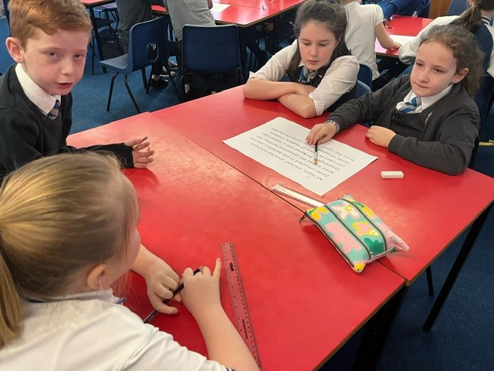
Priority 3:
Develop high quality learning, teaching and assessment leading to improved attainment and achievement in Writing
Continue to develop and implement the Talk for Writing Approach from ELCC Class to Primary 7 - Year 2
Use of prior learning and pass on information and GL Assessments to inform teaching
Continue to seek children’s changing views by using the ‘Myself as a Writer’ survey annually.
Facilitate time for staff to plan for learning, teaching and assessment across stages.
Modelling & Coaching provided as required from Writing Leads in school and ELCC Class
Provide support for learning to targeted groups: Use of PEF to top up core teacher staffing by 0.6 fte to allow experienced class teacher to be non-class committed and provide support for learning to targeted groups.

Slide 13
Maintenance Agenda

Slide 14
Our Lady of Peace Primary School & ELCC Class, in common with every other school in Scotland, continually evaluates its work to ensure that the service it provides for its young people is of the best quality.
We value feedback.
It you have any comments, please email the school:
ourladyofpeaceenquiries@renfrewshire.gov.uk
Thank you!

