Slide 1
OLOP ELCC
Meet the Team

Slide 2
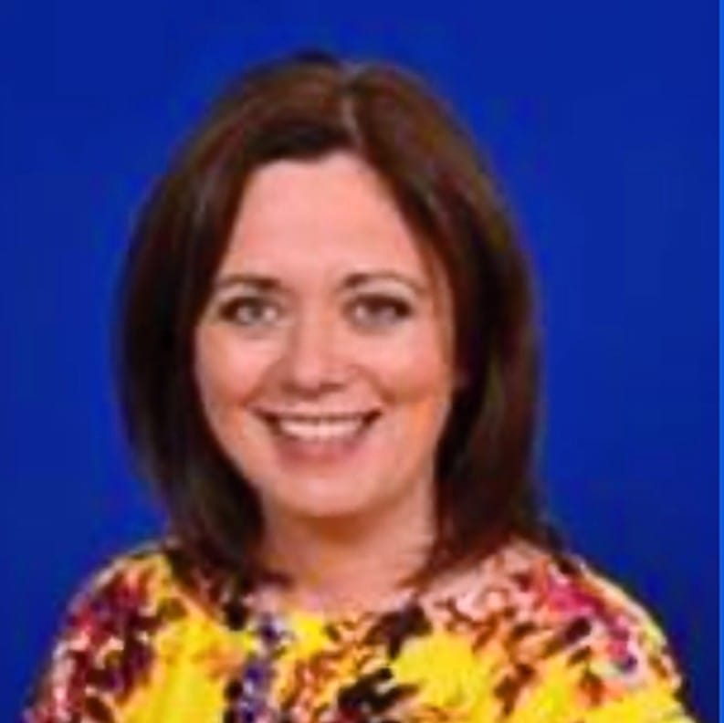
OLOP ELCC Family
Mrs Lesley-Anne Dick
Head Teacher

Slide 3
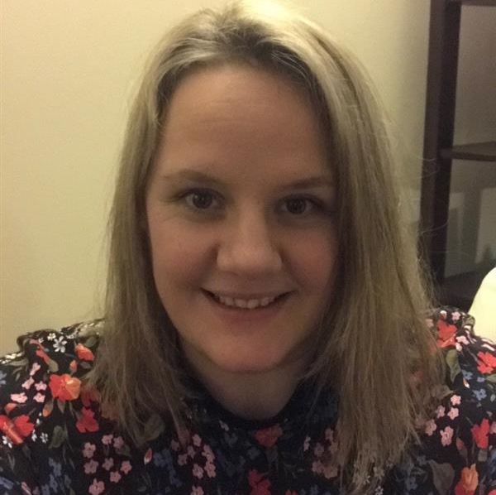
OLOP ELCC Family
Miss Claire McLaren
Depute Head Teacher (ELCC – P4)

Slide 4
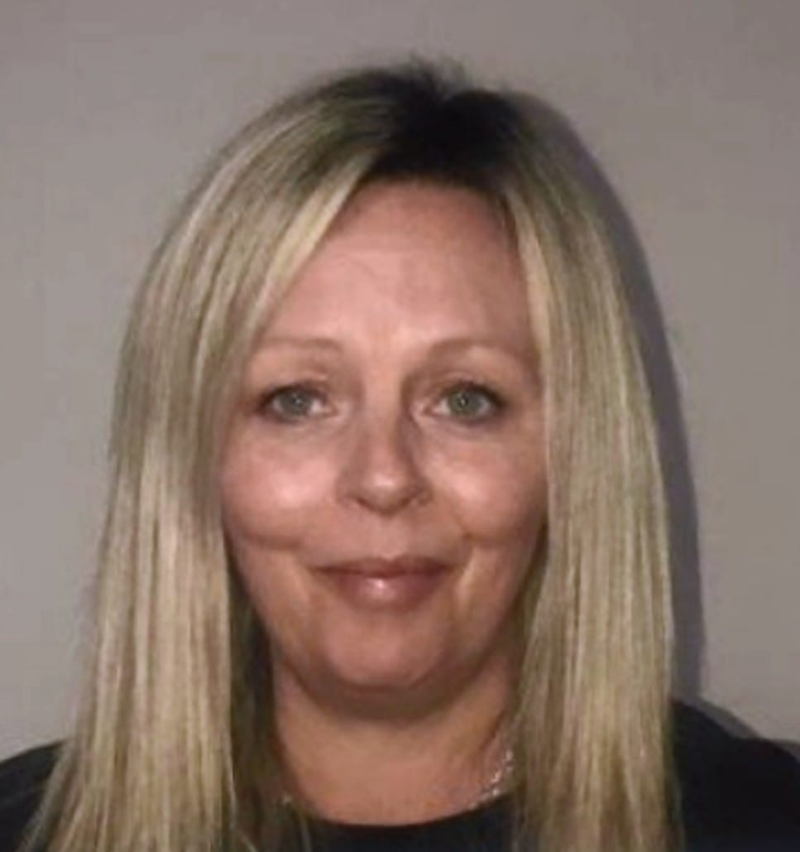
OLOP ELCC Family
Miss Linda McGoldrick
Senior Early Learning & Childcare Officer

Slide 5
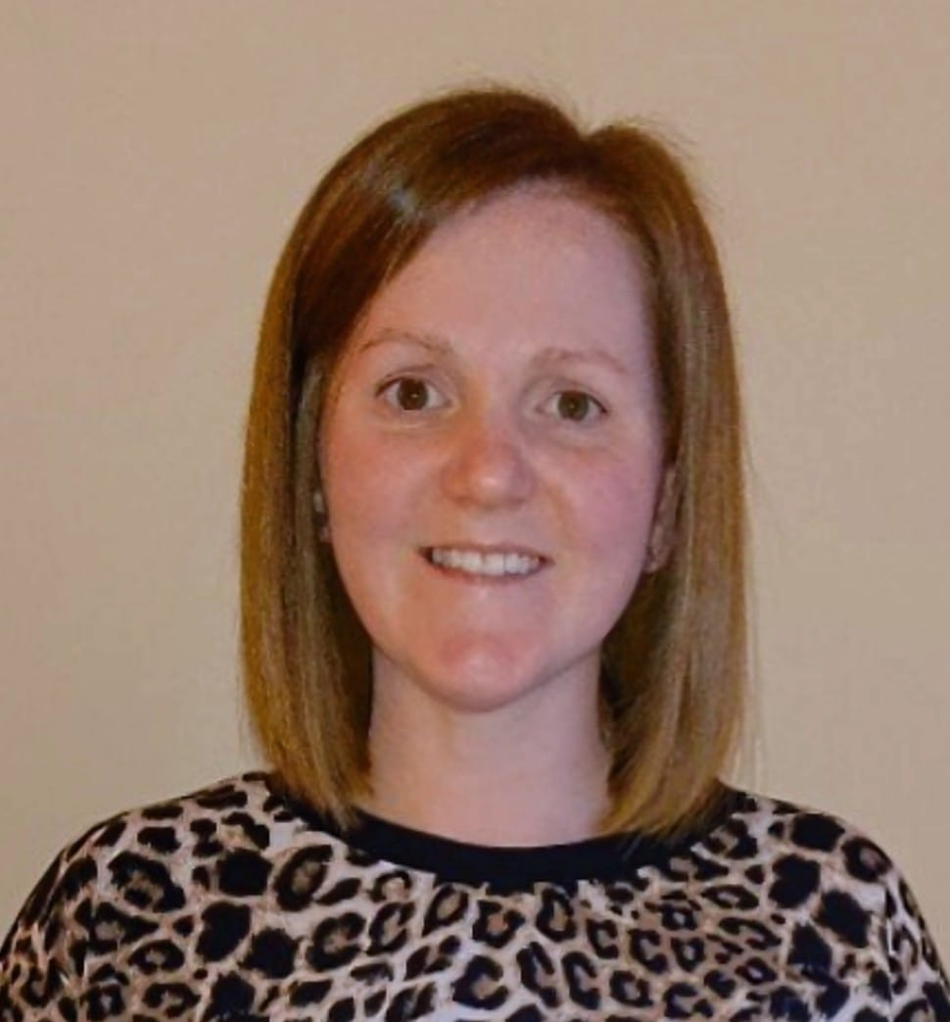
OLOP ELCC Family
Mrs Natalie Sommerville
Graduate

Slide 6
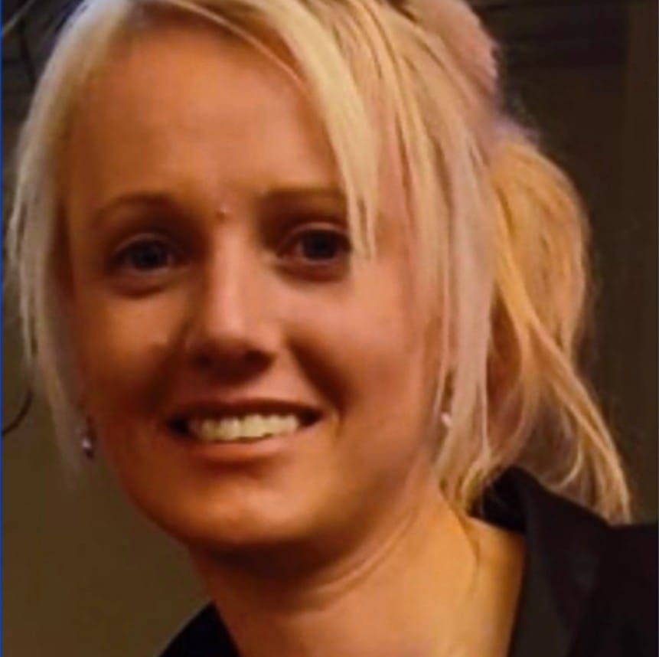
OLOP ELCC Family
Mrs Wendy McKinnon
Blue Group - Early Learning & Childcare Officer

Slide 7
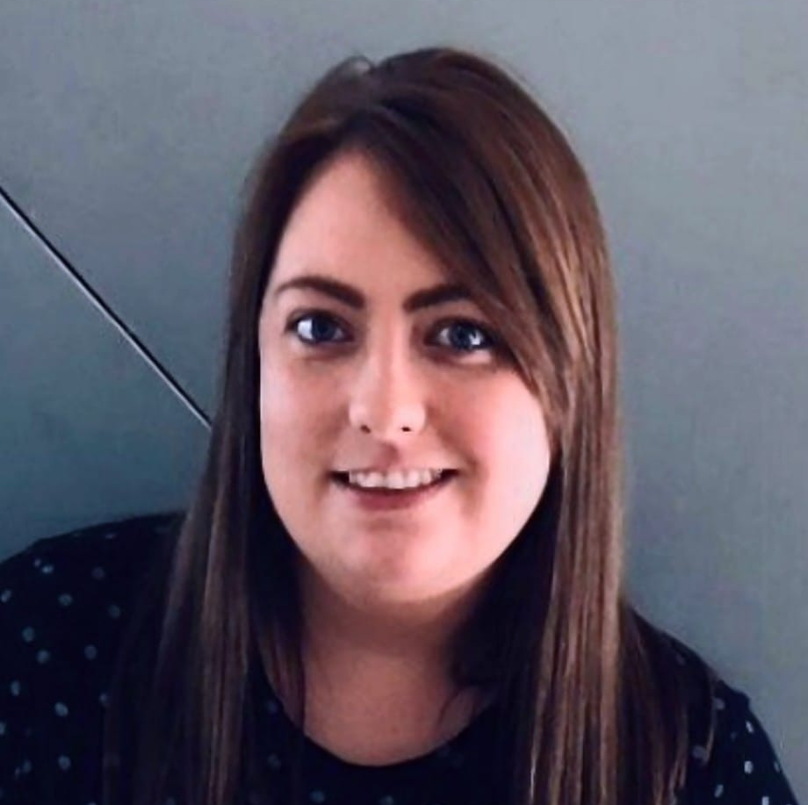
OLOP ELCC Family
Miss Kerry McDowall
Purple Group - Early Learning & Childcare Officer

Slide 8
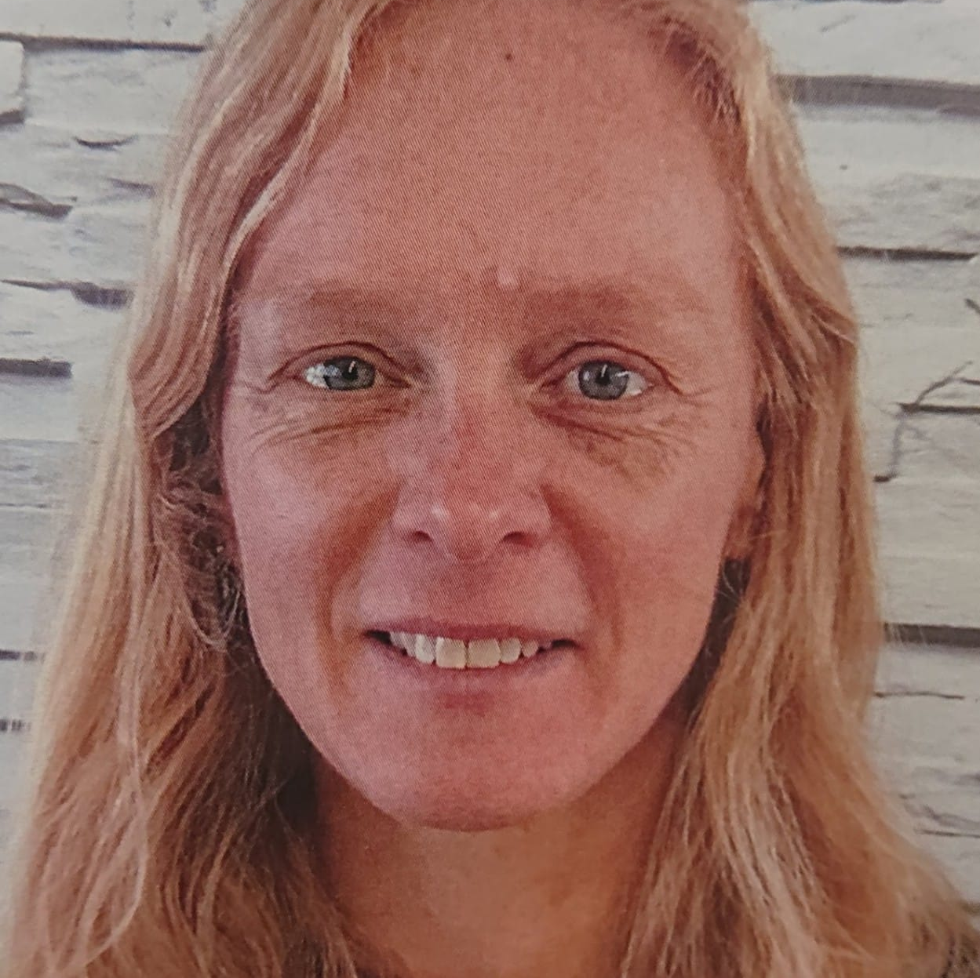
OLOP ELCC Family
Mrs Fiona McLaughlin
Purple Group - Early Learning & Childcare Officer

Slide 9
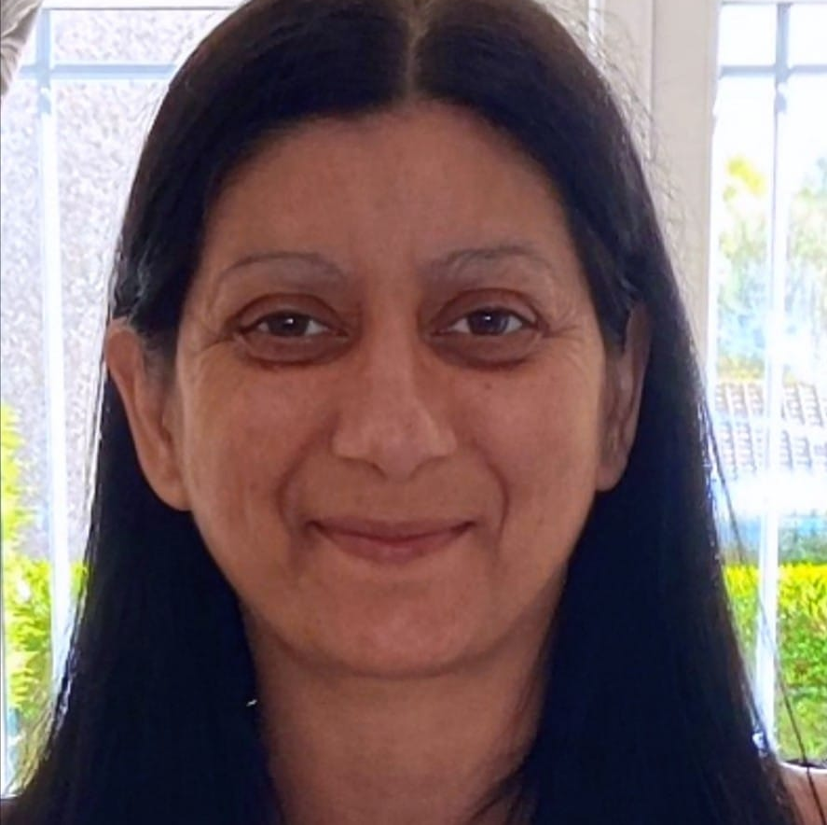
OLOP ELCC Family
Mrs Sarah Jamieson
Early Learning & Childcare Officer

Slide 10
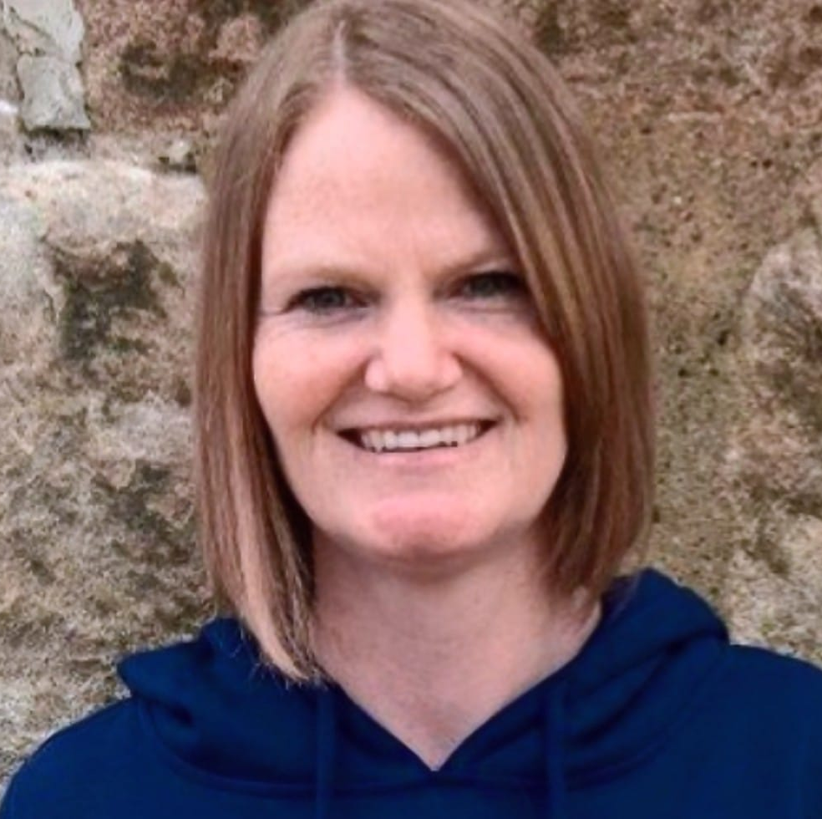
OLOP ELCC Family
Mrs Kelly Meechan
Early Learning & Childcare Support Officer

Slide 11
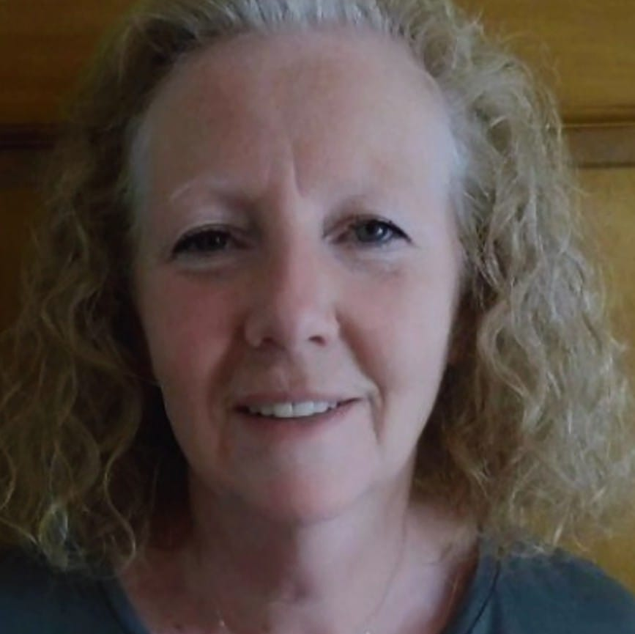
OLOP ELCC Family
Mrs Caroline Evans
Green Group - Early Learning & Childcare Officer

Slide 12
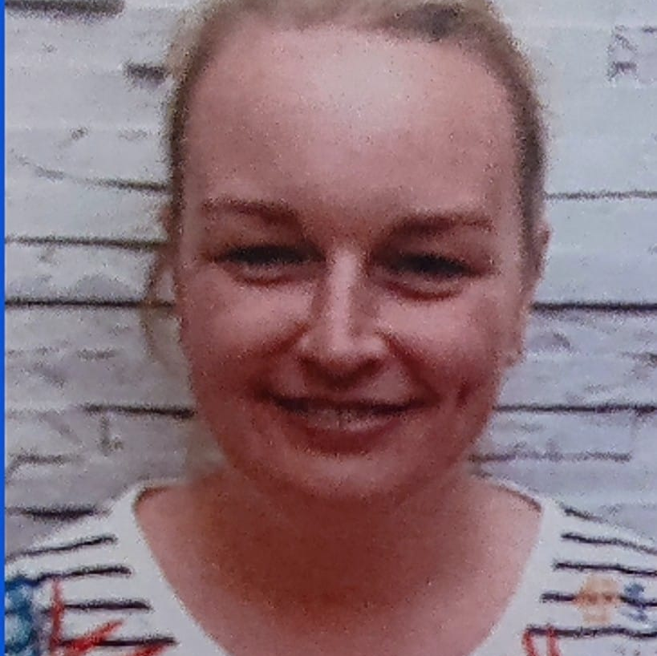
OLOP ELCC Family
Mrs Emma Hagen
Red Group - Early Learning & Childcare Officer

Slide 13
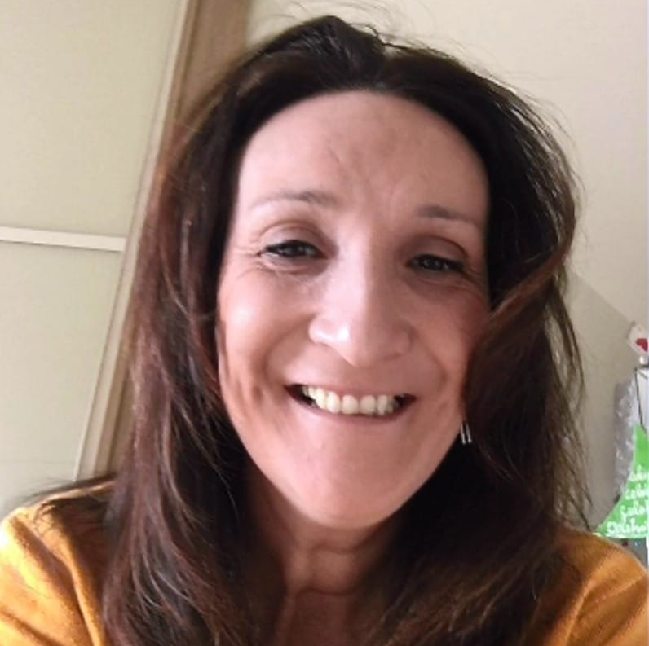
OLOP ELCC Family
Mrs Rachel Owens
Red Group - Early Learning & Childcare Officer

Slide 14
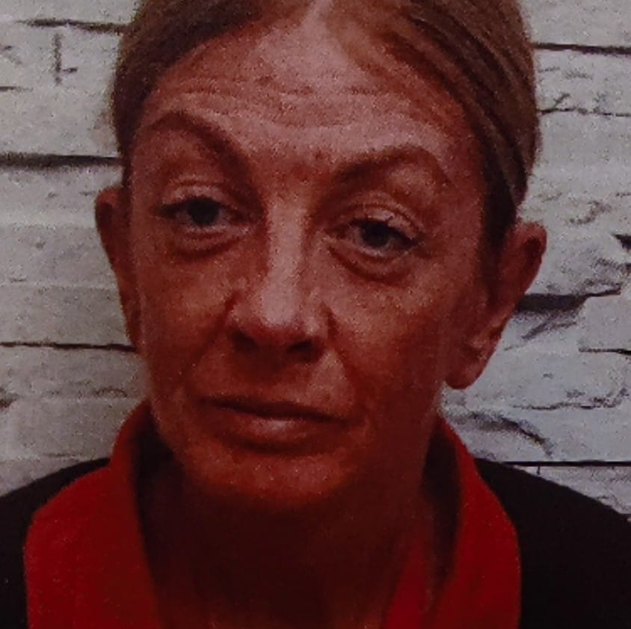
OLOP ELCC Family
Miss Pauline McCann
Yellow Group - Early Learning & Childcare Officer

Slide 15
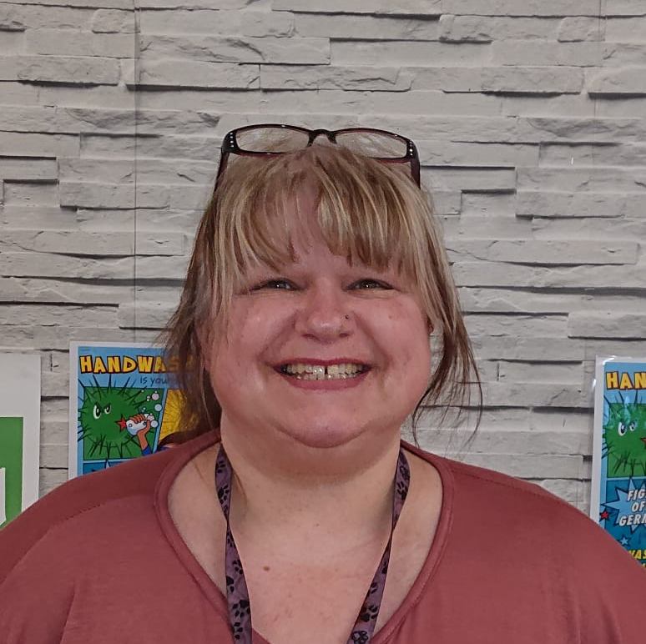
OLOP ELCC Family
Miss Deborah Sinclair
White Group - Early Learning & Childcare Officer

Slide 16
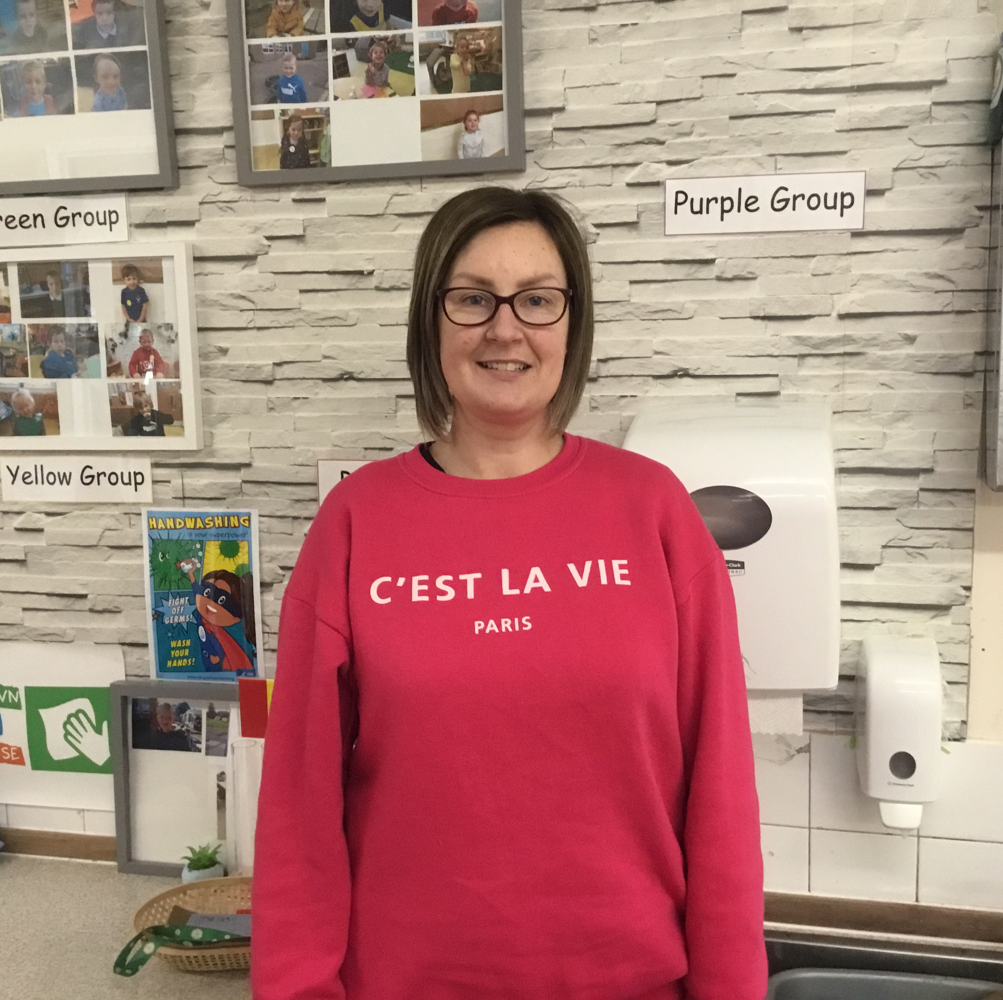
OLOP ELCC Family
Mrs Gillian Sloan
Group Support - Early Learning & Childcare Officer

