Slide 1
Transition to High School 2020
Welcome to Park Mains High School!

Slide 2
Introduction Welcome to Park Mains High School’s essential guide to starting S1. We are eagerly awaiting your arrival and are excited to see you all again! In this Power Point you will find lots of information about High School . There are a few tasks to help you understand how some things work: homework, how the school day works, what is expected of you, what subjects will be on your timetable and uniform information.

Slide 3
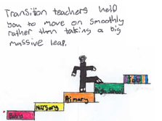
School Information

Slide 4
School Information Head Teacher: Mr Michael Dewar
Here at Park Mains we have 4 House Teams: Skye, Bute, Mull and Arran
Classes are split into these Houses.
If you have a sibling in a house you will automatically be in the same House as them.
Each House has their own Pastoral Care teacher Team
There are House Events which happen regularly throughout the year.

Slide 5
Homework and Studying

Slide 6
Homework
Myth | Reality
There will be loads of homework for every subject. I’ll never be able to manage it all. | Teachers will never ask you to do a lot at home, and you will always be given a reasonable deadline.
The homework will be too hard – I’ll never be able to do it all! | Teachers will never ask you to do something you haven’t been taught.
Once I have it at home, there’s no-one to help me. | If someone at home can’t help you, you can always ask a friend just like you would have done at Primary School.
There are always a lot of misconceptions surrounding homework at High School. Here are a few:

Slide 7
It is true that there are differences but they are positive ones!
Homework will be issued slightly differently than at Primary School as you will meet several teachers throughout your day.
You may not be given diaries, which you may have had at Primary School, instead the school uses an online programme called ‘Show My Homework’.
You will be given a login and password for this and you will be able to access it on your phone, tablet or laptop.
Here you will be able to see tasks set by your teacher and the dates that they are due in
This will enable you to plan your week as we know many of you will attend out of school clubs.
Jot down the homework tasks you were expected to complete each week from primary school.
Look at your list and think about the different subject areas covered and the amount you had. It won’t be much different to High School. Try the next task to help organise your time.

Slide 8
Planning Your Time Effectively
Imagine you are given the following homework on a Monday. Use the grid to help you to plan and organise your time. Add in any clubs/extra-curricular activities first to see where your spare time is.
Geography – one page of the homework booklet which includes answering three questions based on work done in class and drawing a diagram that you went over in class. To be handed in next MONDAY.
English – Reading three chapters of your class novel for FRIDAY.
Maths – one page of the homework booklet due to be submitted each day. There are five questions on each page and each page should take no longer than 15 minutes.
French - Revise days of the week and months of the year for WEDNESDAY.
ICT – There is a big project using all of the skills you have learned in this unit due to be submitted in 4 weeks. You are expected to complete at least one task per week.

Slide 9
Day | After school-tea time | 6 - 7.15pm | 7.45 – 9pm
Mon
Tue
Wed
Thur
Fri
Day | Late AM | Early Afternoon | Late Afternoon | Evening
Sat
Sun

Slide 10
The school week/ timetable/daily routine

Slide 11
Peek at a Week Take a look at the S1 timetable on the next page. List the different subjects that the pupil goes to for the whole week. Use tally marks to show how many times per week they have that subject. What do you think you’ll be learning? Complete the table.
Subject | Frequency | What will I learn?

Slide 12
Example Timetable for S1
Day | 1 | 2 | 3 | 4 | 5 | 6 | 7
Monday | Information Technology CFE MrMilligan | Mathematics CFE Mrs Campbell | Technological Studies CFE Mrs Marshall | History CFE Mr Hiddleston | English CFE Mrs MacLennan | Religious Studies CFE Mr Patrick | CFE-STEM Miss Divers
Tuesday | Physical Education CFE Miss Heeps | Music CFE Mr Tervet | Technological Studies CFE Mrs Marshall | Mathematics CFE Mrs Campbell | Religious Studies CFE Mr Patrick | English CFE Mrs MacLennan | Science CFE Mrs McLaughlin
Wednesday | Art CFE Miss Fraser | French CFE Mr McHugh | Tutorial Mrs Gillespie | Physical Education CFE Miss Heeps | English CFE Mrs MacLennan | Science CFE Miss Tawseen
Thursday | Mathematics CFE Mrs McLaughlin | Physical Education CFE Miss Heeps | Art CFE Miss McKernan | History CFE Mr Hiddleston | Music CFE Miss Taylor | French CFE Mr McHugh | Information Technology CFE MrMilligan
Friday | Mathematics CFE Mrs McLaughlin | French CFE Mr McHugh | English CFE Mrs MacLennan | Science CFE Mrs McLaughlin | Geography CFE Miss Macleod | Home Economics CFE Miss Tugman

Slide 13
Working It Out
Use the timetable and school day information to answer the following questions.
1. You are absent on a Wednesday – when is the next day you will be able to catch up with work missed in a) English? b) Maths?
2. What day(s) will you need to bring your PE kit?

Slide 14
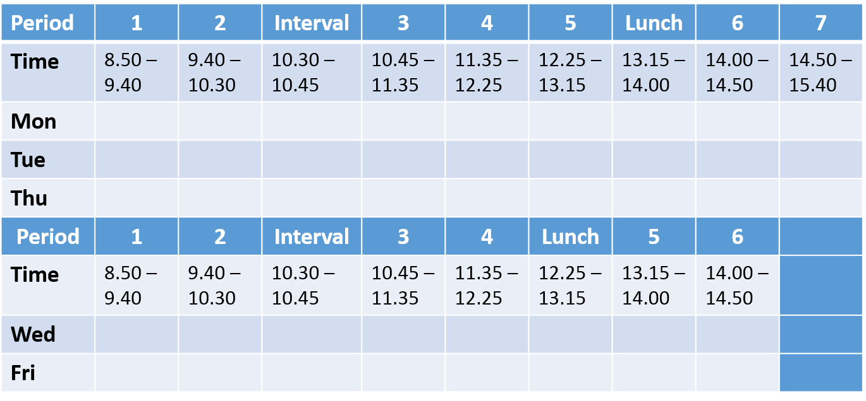
Daily Routine
High School is timetabled on a 33 period a week structure.
This means that over the course of the week pupils will have three ‘late’ days and two ‘short’ days.
The timings and days are indicated below:

Slide 15
Moving around the school

Slide 16
Map Of School Click on the Link and you will see a map of Park Mains High School Map

Slide 17
Finding Your Way Around
•Have a look at the map of your new school
•Pay careful attention to which floor different subjects are found on
On which floor will you find:
Modern Languages Art
Science Social Subjects Computing School Office Maths Dining and social area Library
Look at the where the stairs are located.
Can you work out how you would move from: English to Modern Languages? Music to PE? Maths to Art?

Slide 18
Uniform and values

Slide 19
School Uniform
At Park Mains High School all pupils wear school uniform.
School Uniform consists of:
White Shirt
School Tie
Black Trousers/Skirt
Black Shoes / All black Trainers
Black School Jumper/Cardigan (No big Logos)
The following items of clothing are unsuitable for school wear:
Denim jeans or jacket
Track suits
Baseball caps
Football colours
Extremes of fashion

Slide 20
Our School Values Respect Opportunity Commitment Community

Slide 21
School Values Look up each of the values and write down what each means. Give an example of how you could demonstrate this at school and in your own home.

Slide 22
Additional Information
The canteen serves a selection of hot and cold meals for lunch and is also open at break for snacks.
Mondays, Tuesdays and Thursdays are late days which means there are 3 periods between break and lunch. On these days you may want to fuel up at break as lunch isn’t until 1.15pm.
We hope this book has helped you to feel prepared for High School and has answered any questions you may have had.
We can’t wait to see you all and welcome you into Park Mains!
See you soon

