Slide 1
R.S.H.P.E. PARENTS’ PRESENTATION
Kilbarchan Primary School

Slide 2
What is R.S.H.P.E?
Relationships, Sexual Health and Pregnacy Edcuation

Slide 3
What’s in the Curriculum?
Health and Wellbeing
I can expect my learning environment to support me to:
• meet challenges, manage change and build relationships
• experience personal achievement and build my resilience and confidence
• understand and develop my physical, mental and spiritual wellbeing and social skills
• understand how what I eat, how active I am and how decisions I make about my behaviour and relationships affect my physical and mental wellbeing
• participate in a wide range of activities which promote a healthy lifestyle
• understand that adults in my school community have a responsibility to look after me, listen to my concerns and involve others where necessary
• learn about where to find help and resources to inform choices
• assess and manage risk and understand the impact of risk-taking behaviour
• reflect on my strengths and skills to help me make informed choices when planning my next steps
• acknowledge diversity and understand that it is everyone’s responsibility to challenge discrimination.
Relationships, sexual health and parenthood
Learners develop an understanding of how to maintain positive relationships with a variety of people and are aware of how thoughts, feelings, attitudes, values and beliefs can influence decisions about relationships, and sexual health. They develop their understanding of the complex roles and responsibilities of being a parent or carer.

Slide 4
EARLY/FIRST (Nursery – Primary 4) | SECOND (Primary 5 – 7)
I am aware of how friendships are formed and that likes, dislikes, special qualities and needs can influence relationships. HWB 0-44a / HWB 1-44a I understand positive things about friendships and relationships but when something worries or upsets me I know who I should talk to. HWB 0-44b / HWB 1-44b | I understand that a wide range of different kinds of friendships and relationships exist. HWB 2-44a I am aware that positive friendships and relationships can promote health and the health and wellbeing of others. HWB 2-44b
I know that there are people in our lives who care for and look after us and I am aware that people may be cared for by parents, carers or other adults. HWB 0-45a / HWB 1-45a | I am identifying and practising skills to manage changing relationships and I understand the positive impact this can have on my emotional wellbeing. HWB 2-45a
I am aware of the need to respect personal space and boundaries and can recognise and respond appropriately to verbal and non-verbal communication. HWB 0-45b / HWB 1-45b / HWB 2-45b
I recognise that we have similarities and differences but are all unique. HWB 0-47a / HWB 1-47a I am aware of my growing body and I am learning the correct names for its different parts and how they work. HWB 0-47b / HWB 1-47b | I recognise that how my body changes can affect how I feel about myself and how I may behave. HWB 2-47a

Slide 5
EARLY/FIRST (Nursery – Primary 4) | SECOND (Primary 5 – 7)
I am learning what I can do to look after my body and who can help me. HWB 0-48a / HWB 1-48a | I can describe the physical and emotional changes during puberty, understand why they are taking place and the importance of personal hygiene. HWB 2-48a
I am learning about respect for my body and what behaviour is right and wrong. I know who I should talk to if I am worried about this. HWB 0-49a / HWB 1-49a | I know that all forms of abuse are wrong and I am developing the skills to keep myself safe and get help if I need it. HWB 2-49a
I am learning about where living things come from and about how they grow, develop and are nurtured. HWB 0-50a / HWB 1-50a | I am able to describe how human life begins and how a baby is born. HWB 2-50a
I am able to show an awareness of the tasks required to look after a baby. HWB 0-51a / HWB 1-51a | I can describe the role of a parent/carer and the skills, commitment and qualities the role requires. HWB 2-51a

Slide 6
CONTENT OF THE PROGRAMME AND Types of activities

Slide 7
P1 - p3

Slide 8
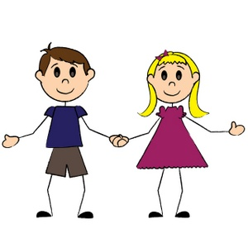
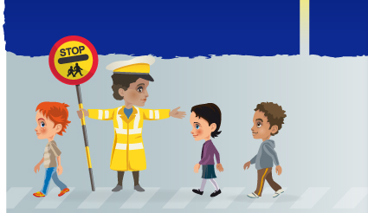
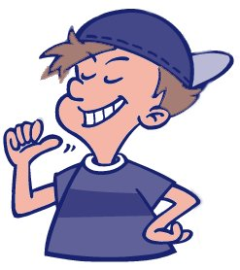
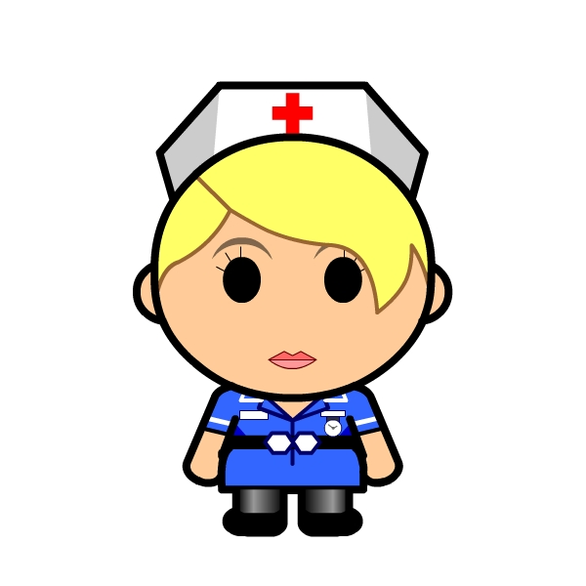
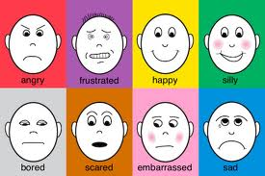
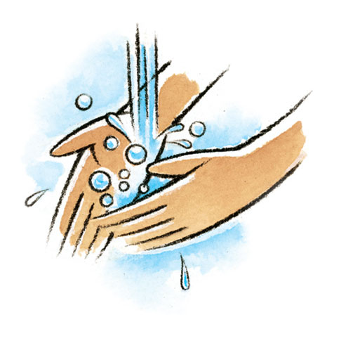
Bodies growing and changing as we get older
Keeping Safe
Living and Non-Living things
What makes us individual/unique?
Primary 1 - 3
Special People who care for me/People who help us
Recognising Feelings
Keeping Safe - Hygiene
Bullying

Slide 9
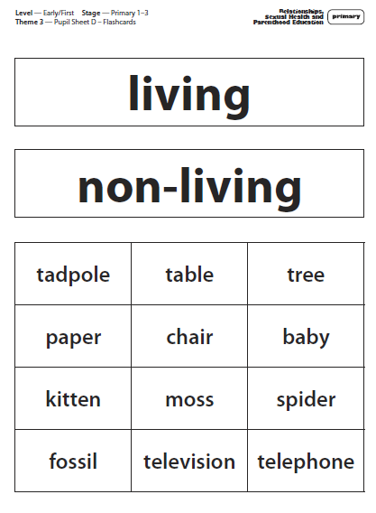

Slide 10
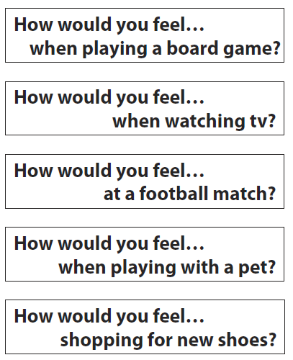
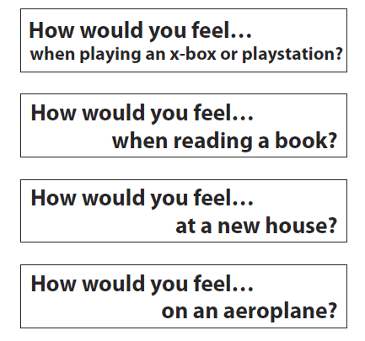

Slide 11
P4 and p5

Slide 12
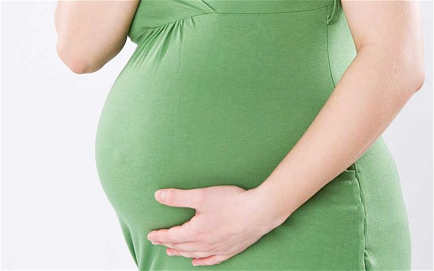
Changes in the body
How Human Life Begins
Being part of a Family
Expressing and Dealing with Feelings and Emotions
Primary 4 and 5
Friendships
Bullying

Slide 13
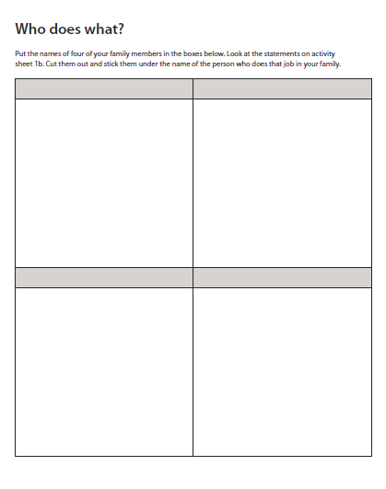
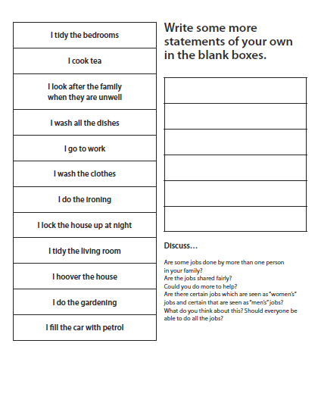

Slide 14
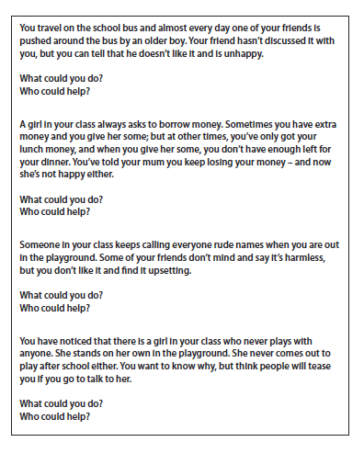

Slide 15
P6 and p7

Slide 16
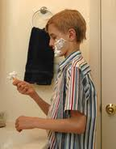
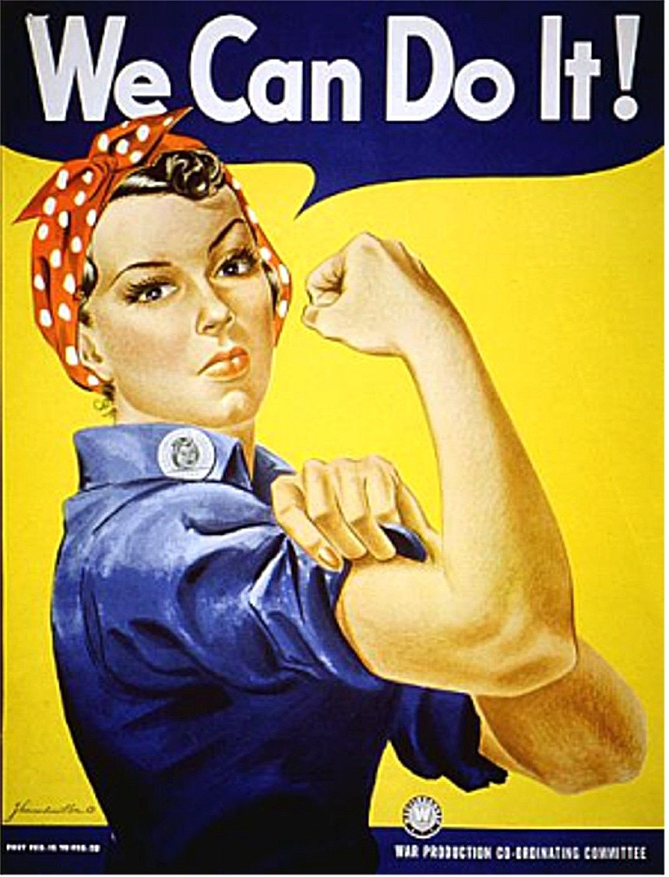
Physical Changes at Puberty
Body Image and Self Worth
Family
Primary 6 and 7
Menstruation, Pregnancy and Birth
Emotional Changes at Puberty
Gender Identity
Friendships

Slide 17
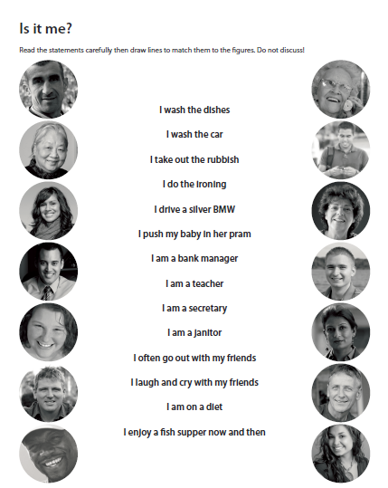

Slide 18
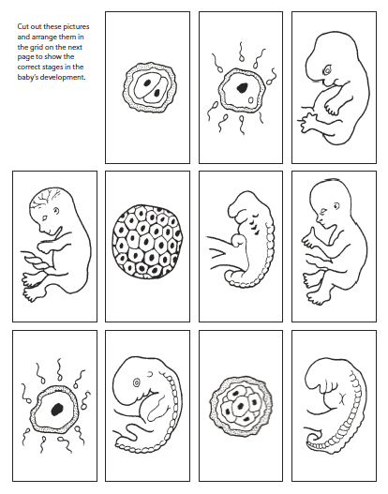

Slide 19
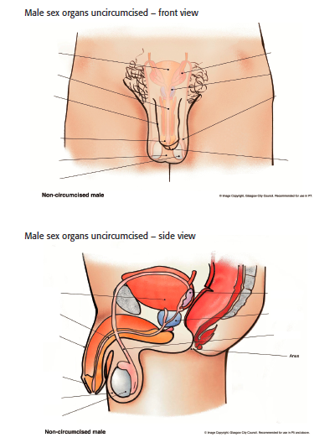
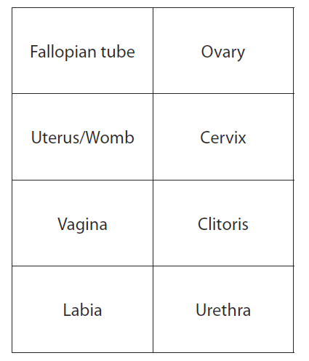
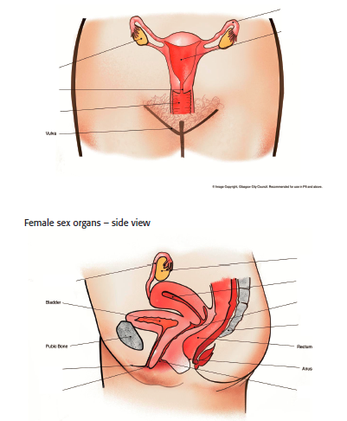
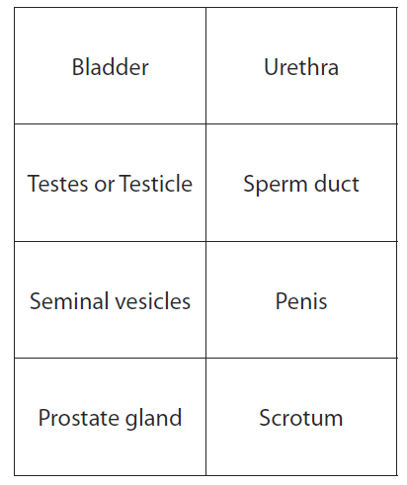

Slide 20
Home-school link opportunities

Slide 21
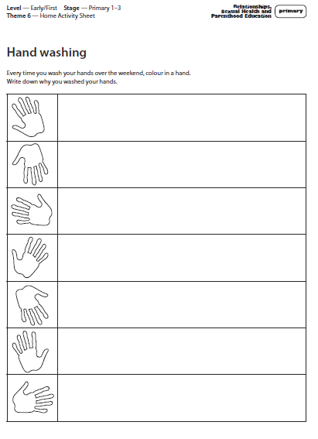
Primary 1 - 3

Slide 22
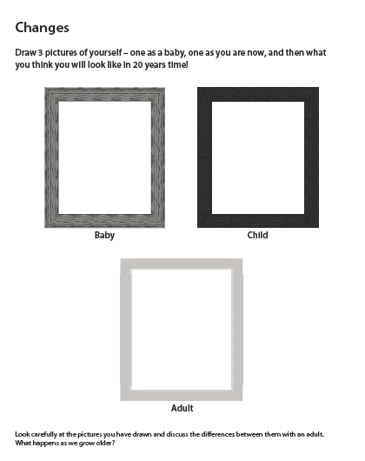
Primary 4 and 5

Slide 23
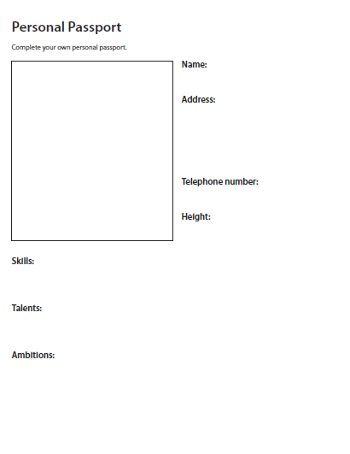
Primary 6 and 7

Slide 24
EVALUATION AND ASSESSMENT TOOLS

Slide 25
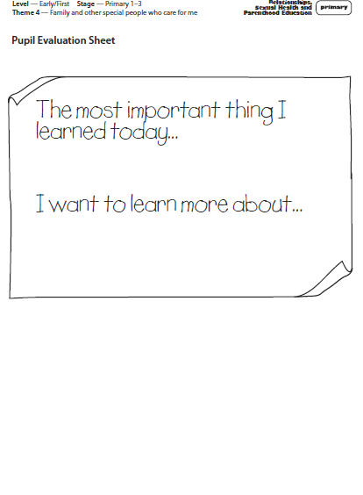
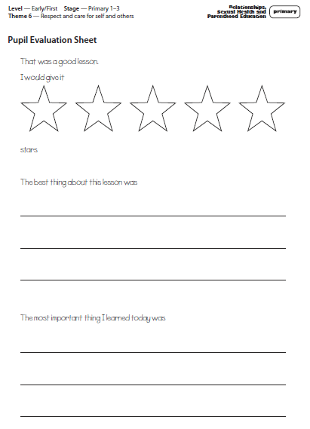
Primary 1 - 3

Slide 26
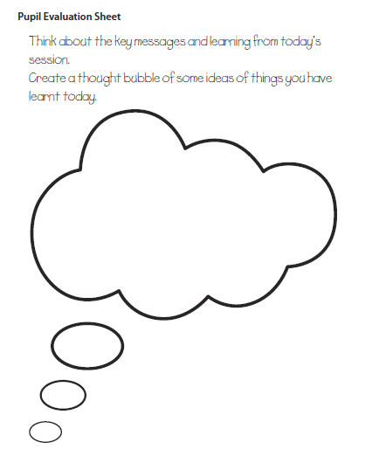
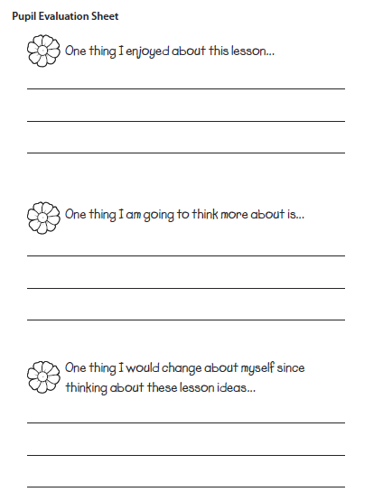
Primary 4 and 5

Slide 27
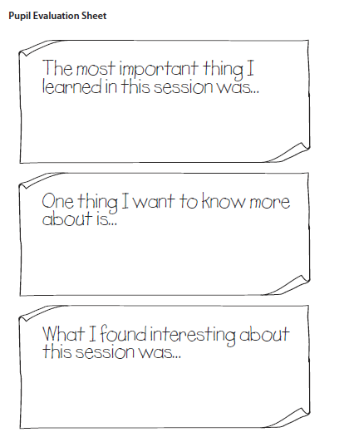
Primary 6 and 7

