Slide 1
Notes:
Presentation is to explain the revised programme for Relationships, Sexual Health and Parenthood Education that is being rolled out to Renfrewshire Schools called I am Special. Throughout this presentation you will see that Relationships Sexual Health and Parenthood Education has been shortened to RSHPE.
Delivery of relationships, sexual health & parenthood education is not new to schools in Renfrewshire as we have had a programme in place for both primary and secondary schools for a number of years. This new approach is an extension of existing good practice and it seeks to strengthen the links between schools and the home.

Slide 2
Notes:
Presentation is going to cover these four areas – read them out

Slide 3
Notes:
First then, I am going to speak a little about why there is a need for a robust approach to RSHPE in Renfrewshire

Slide 4
Notes:
The main reasons as to why we needed to develop a robust approach were two-fold:
Firstly there is a lot of information to indicate that there are a growing number of concerns about young people’s sexual health and well-being
Secondly the more questions we asked, the more we realised that what we were doing needed to change

Slide 5
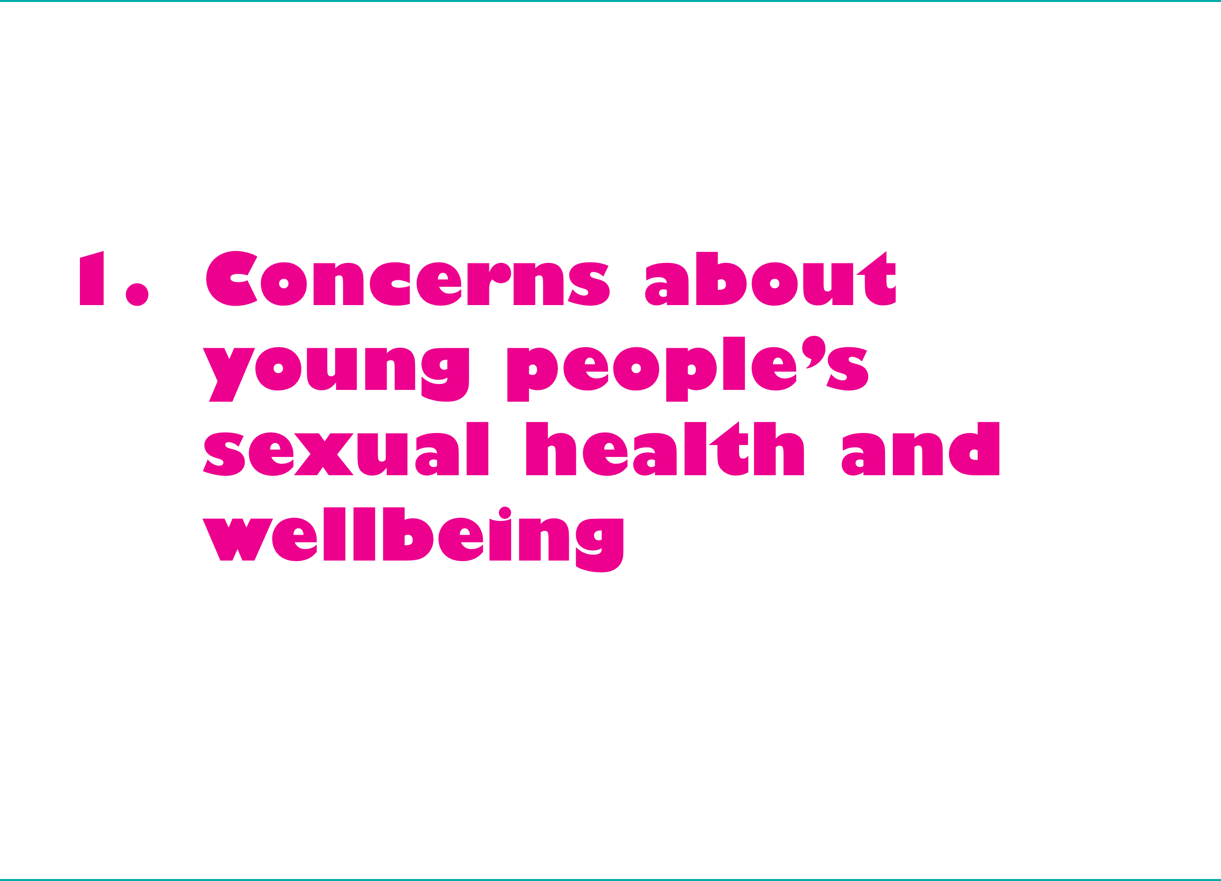
Notes:
Firstly to deal with the concerns around young people’s sexual health & well-being…

Slide 6
Notes:
To get a broad perspective on what we are talking about here, we are going to look at things under 4 main headings............read them out.
Firstly, for the wider social context – in our society ‘sex’ is very much a commodity. It is used to sell products but is also sold in itself through pornography. We are all very aware that we are surrounded nowadays by very explicit imagery e.g. music videos, advertising, films and gaming etc. What was once considered ‘extreme’ pornography has now entered mainstream media and children and young people often have ready access.
Children therefore from early childhood are bombarded by sexual imagery that, more often than not, is very exploitative and is not based on good sexual health.
We live in a society where childhood has become very sexualised where often even very young children are encourage to dress like ‘mini adults’
Further, there is considerable pressure now on young children at primary level to look a certain way. Evidence of 8/9 year olds talking of going on diets etc
Moving on to information that young people have told us about their behaviour................................

Slide 7
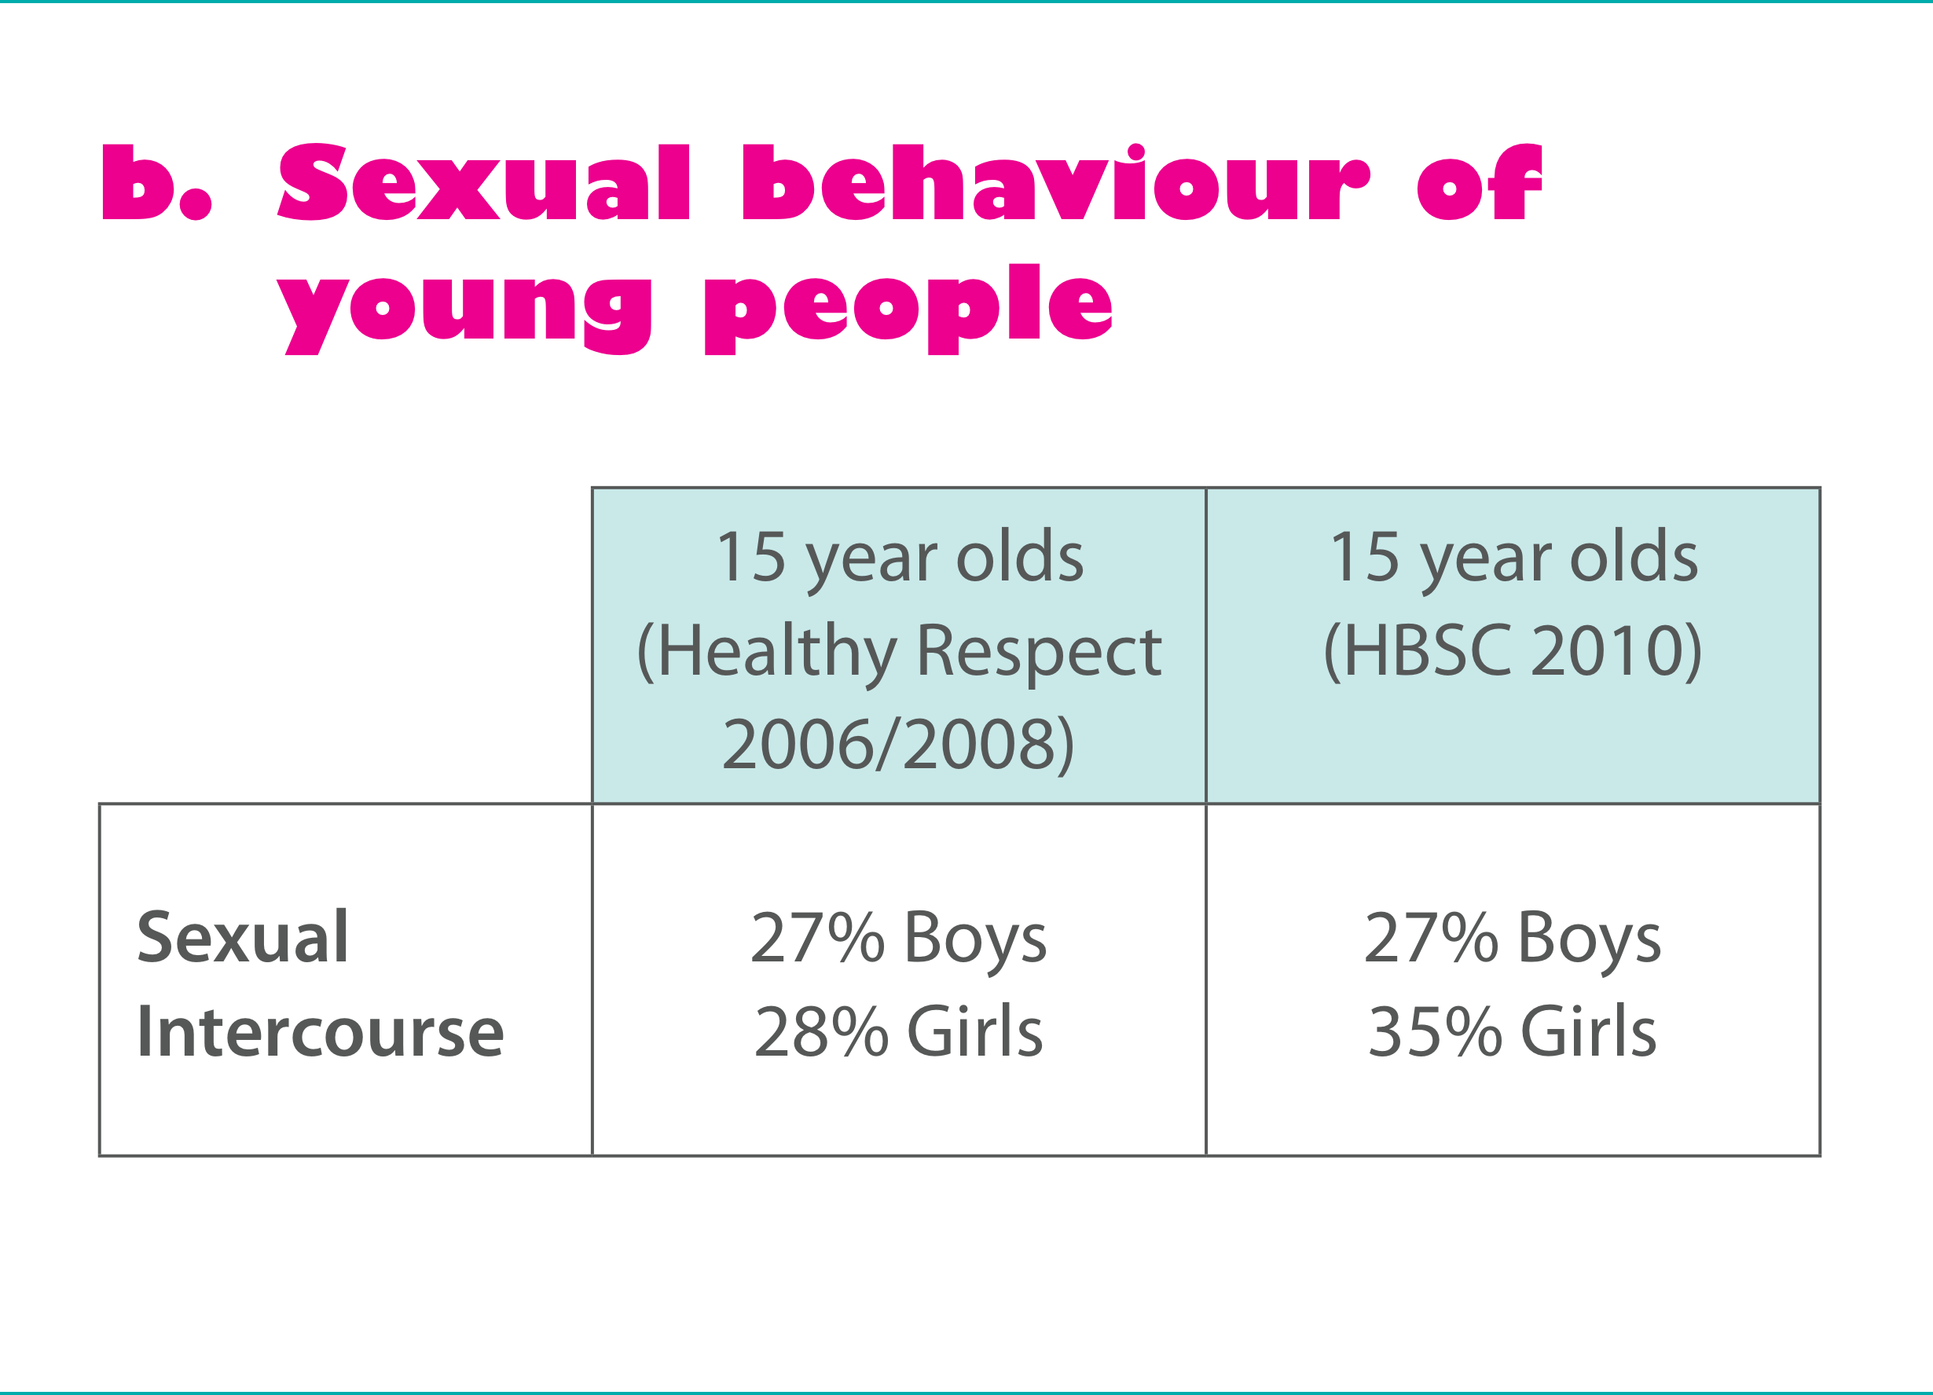
Notes:
These are findings from 2 research projects in Scotland, both projects engaging with 15 year olds.
The first column highlights the data gathered from the Healthy Respect study carried out in East Dunbartonshire secondary schools over a period of 3 years and they found that…..read out.
The second study is a national study that looks at Health Behaviours of Scottish School Children and these figures are from 2010….read out.

Slide 8
Notes:
In 2006 a comprehensive consultation with 2700 young people aged between 13-19 was carried out in Glasgow, it found that ……read out

Slide 9
Notes:
In the same consultation, young people told us when they had first taken part in each activity. Rather worryingly they told us that…..read out.

Slide 10
Notes:
It is also not surprising that the rates of sexually transmitted infections (STIs) are rising quite dramatically in the under 25 population…read out.
Chlamydia is on the rise and it is worth noting that Chlamydia often doesn’t present any symptoms so young people may be unaware that they are infected.
Rather worryingly, they told us .........................read out findings.

Slide 11
Notes:
Before looking at the local teenage pregnancy rates picture, it is worth pointing out that the UK has significantly higher teenage birth rates that most of our European neighbours.

Slide 12
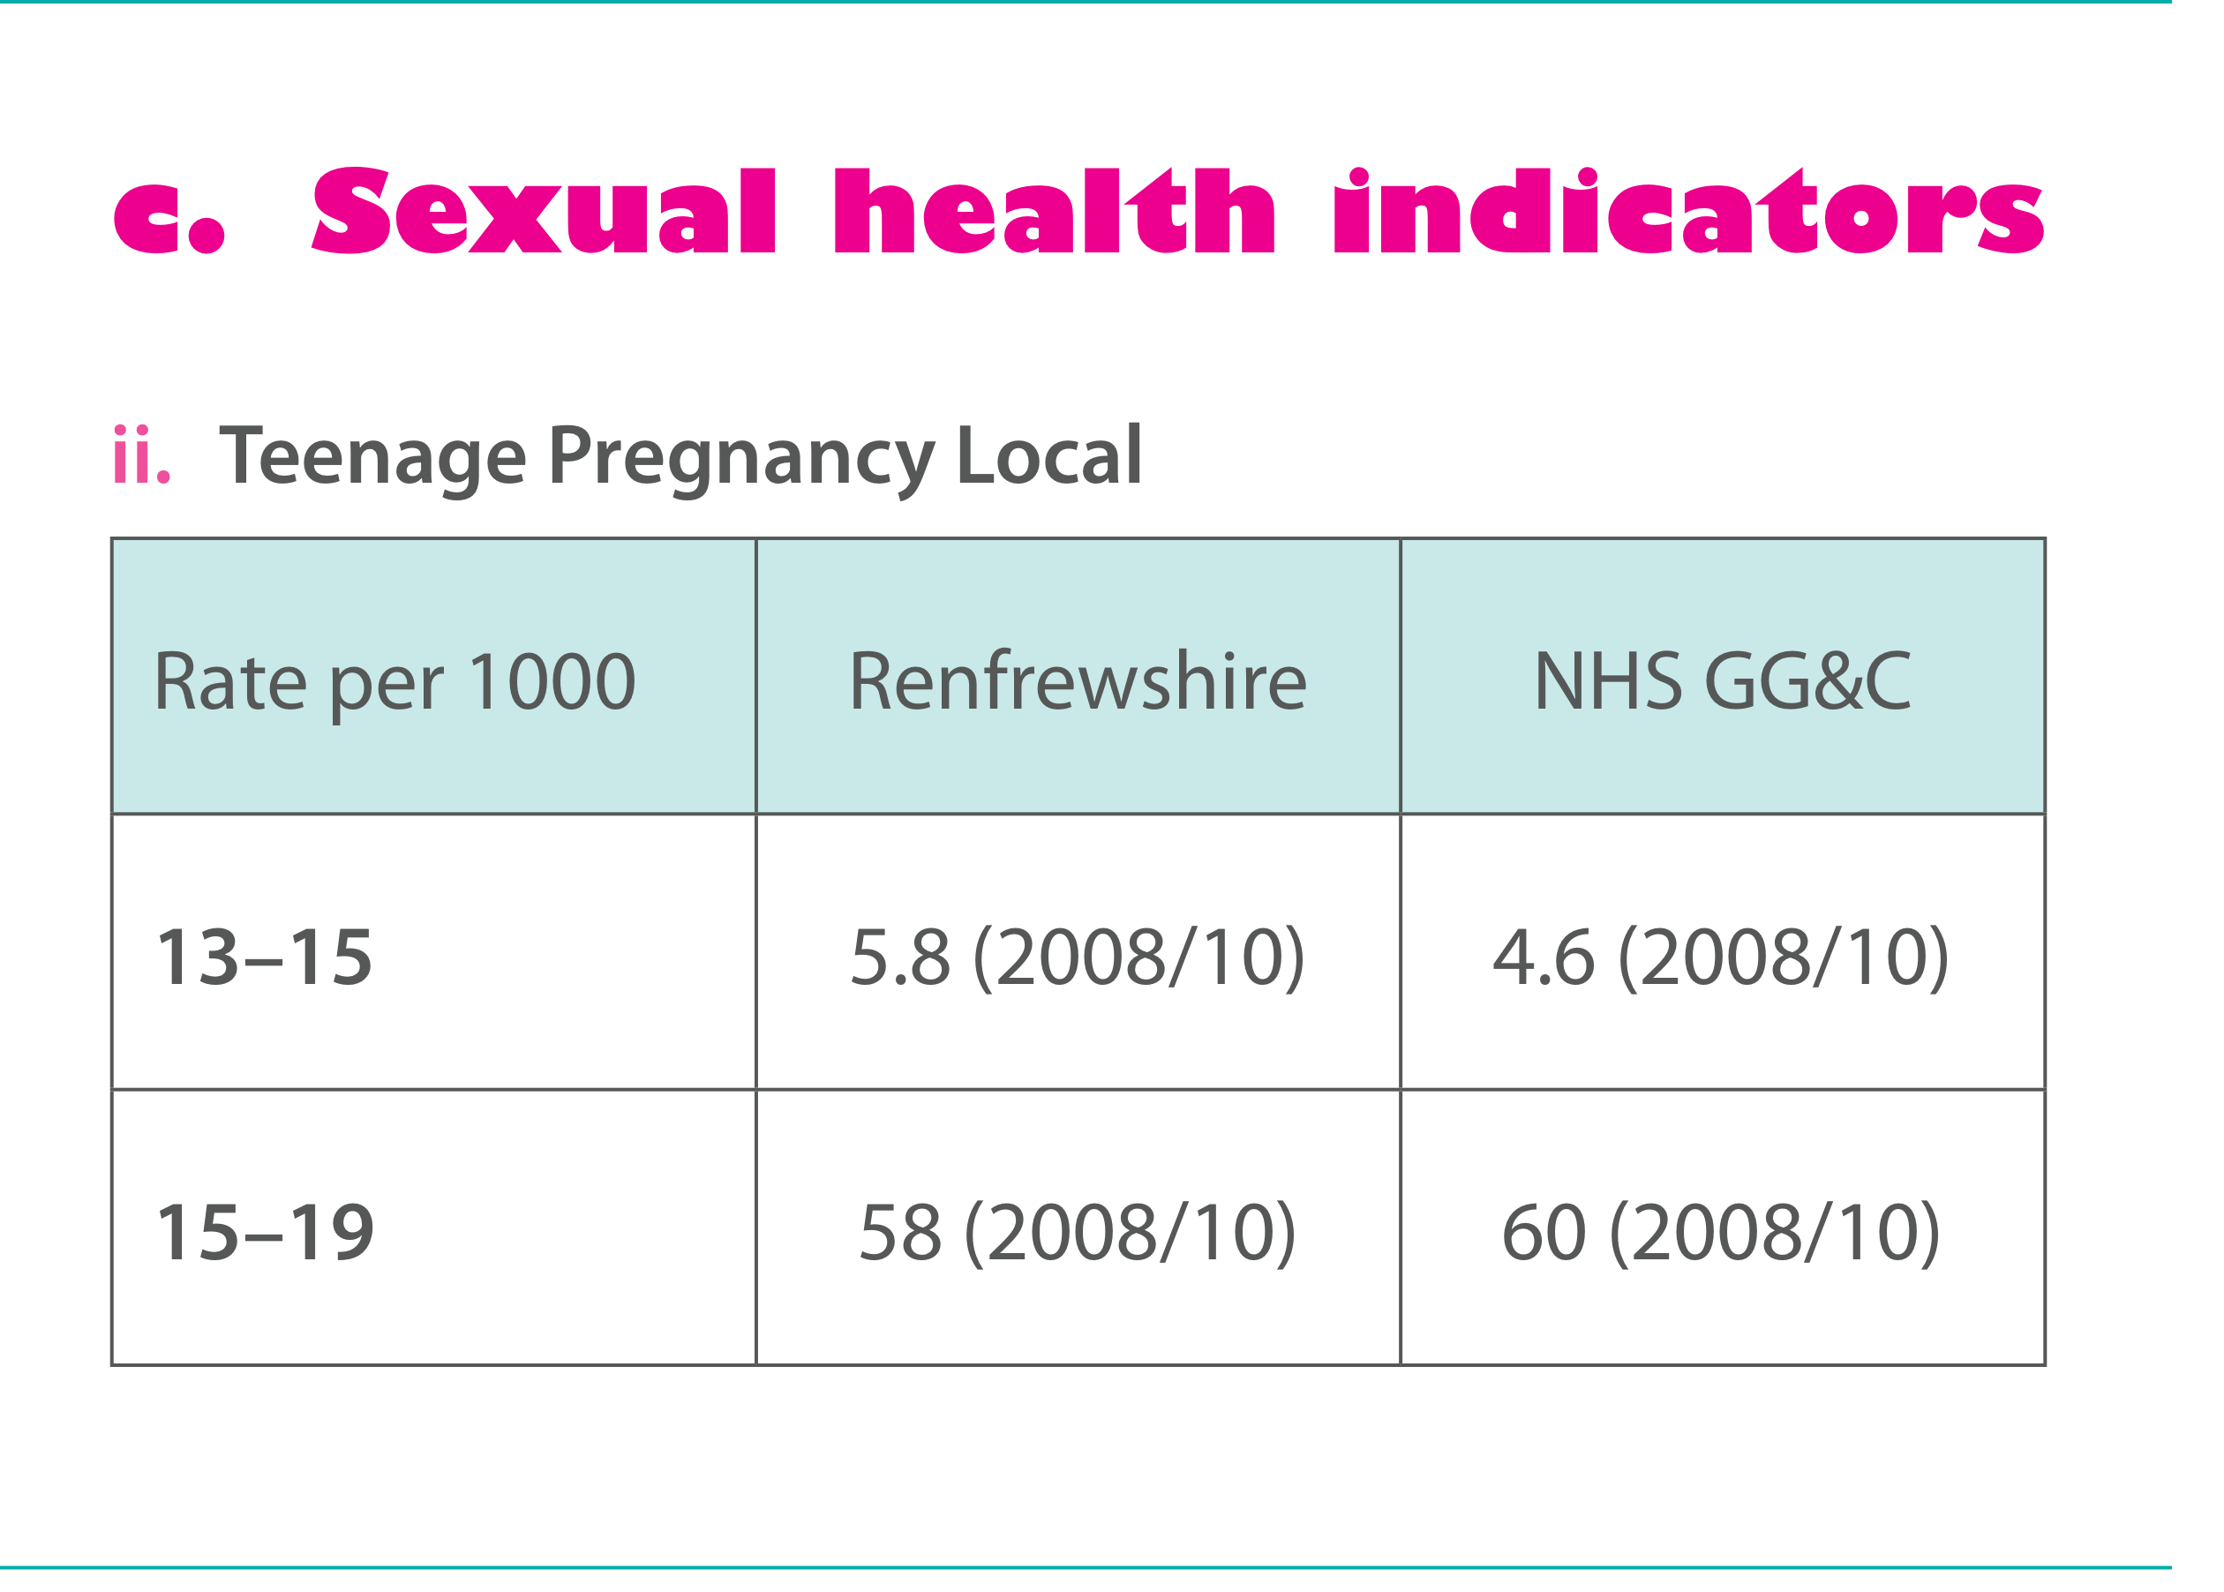
Notes:
You can see from this table how Renfrewshire teenage pregnancy rates compare with Greater Glasgow and Clyde as a whole ….read out

Slide 13
Notes:
If we look beyond actual sexual activity to a broader sense of sexual well-being, the picture is also not good.
Many young people today, for all the outward sophistication, are often given inaccurate information and therefore lack knowledge about their own bodies. Secondly, they often struggle with emotional changes and relationships.
Childline recognised that a significant number of their calls were about sexual health and well-being and so decided to look into what this information was saying.
The Childline Report ‘It’s My Body’ (2007) presented a picture of young people struggling to come to terms with a variety of issues and not being sure about where to go to get information and advice.
All in all, what this group of slides show is that we have yet another generation of young people growing up with poor sexual health.

Slide 14
Notes:
The second reason why it was felt there was a need for a robust approach to sexual health in Renfrewshire was that through the work of the Sexual Health Steering Group, it was becoming clear that what we were currently doing wasn’t good enough

Slide 15
Notes:
Through feedback from Parents, Young People and Teachers it was clear that there was an inconsistent approach to RSHPE across the piece. There were differences in terms of:
What was being taught
When subjects were taught
How well informed parents were about what was being taught
In addition many teachers did not feel confident delivering RSHPE and had not received any proper training.
Also we were becoming more aware of how important school-based RSHPE is for certain groups of children. In particular:
Boys (who are often aren’t speaking to parents and who often get their sexual messages from friends and pornography)
Young People who are in care
Young People whose parents don’t discuss sexual health issues because they themselves are too embarrassed or don’t feel unconfident

Slide 16
Notes:
So with all this as a back-drop it was decided that a more robust approach was needed.

Slide 17
Notes:
This new approach to relationships, sexual health & parenthood education (RSHPE) in Renfrewshire schools consists of 3 main strands…read them
The new approach to RSHPE in schools is a more comprehensive approach than that which previously existed. Also, it is much more than what is taught in the classroom. It has three key themes:
-Improving what is delivered in the classroom
-Raising the level of involvement of parents in their children’s learning
-Ensuring that young people have access to age-appropriate wider information and services.
We know that these strands in isolation won’t be that effective.
Together they will make a far better contribution to improving young people’s sexual health & wellbeing.

Slide 18
Notes:
First, to give you some information about the programme..............
The curriculum material has been written in a way that each year is a building block for future years. A great deal of effort has been made to ensure that the material is age and stage appropriate. It closely follows national guidance in respect of what should be taught and when.
Although the overall programme is called ‘relationships, sexual health & parenthood education’, at early primary level the emphasis is very much on ‘relationships’, focusing on family, friendships, caring for people and things etc. P6 and P7 sees issues about puberty and its emotional consequences being introduced.
At secondary level, there is again a strong ‘relationships’ and ‘emotions’ theme throughout. There is also an emphasis on encouraging young people to ‘delay’ engaging in sexual activity until they are ready to deal with its physical and emotional consequences.

Slide 19
Notes:
It has within it some key themes, some of which are more prominent at secondary level.
Promoting the idea of ‘delay’ i.e. that young people should be encouraged to delay engaging in sexual activity until they are physically and emotionally equipped to deal with it and its consequences.
A deliberate use of the term relationships and sexual health to emphasise that this is much more than teaching about ‘sex and contraception’. Considerable space is given to looking at emotions, friendships, relationships, values etc.
Issues of personal safety run throughout the curriculum and vary depending on the pupils stage of development. They include privacy, use of technologies, assertiveness, seeking help etc.
Gender differences are another recurring theme in which the different experiences of boys and girls and negative stereotypes are addressed.
Materials celebrate diversity and acknowledge that children come from and experience different backgrounds and circumstances.
Children are encouraged to know and use the correct names for body parts so that they learn to use them in a factual way, devoid of embarrassment or shame.
Welcome to look at the materials at the end.

Slide 20
Notes:
With the introduction of any new approach it is crucial to get feedback from key stakeholders and in the case of this new approach to I am Special, the feedback from parents/carers, pupils and teaching staff is important.
Monitoring and evaluation of this particular programme will be ongoing but what we already know from evaluations of similar programmes elsewhere is that…

Slide 21
Notes:
These next slides can be read more or less straight off.
If you wish you can pick out bits from the evaluation report that particularly caught your eye.

Slide 22
Notes:
For this slide it is worth pointing out that many parents did not know that the pilot was happening, especially:
Parents of secondary pupils
Fathers (they left these things to their partners)
Those that knew the least, often thought that very graphic information was being given to children at a young age. They were re-assured that this was not the case.
Most parents liked the idea that it covered such a wide range of topics and dealt with emotions, responsibilities, relationships etc.
Some parents did question why children should be taught the correct names for body parts at primary level. Following discussion, most accepted that we need to move away from seeing these words as ‘dirty’ or ‘shameful’. Some were still not comfortable with the idea, but said they would not withdraw their children because of it.
It is worth noting that there was disquiet in only one primary parents forum last year. Even within this school, the majority of children attended all the lessons.

Slide 23
Notes:
These next slides can be read more or less straight off.
If you wish you can pick out bits from the evaluation report that particularly caught your eye.

Slide 24
Notes:
These next slides can be read more or less straight off.
If you wish you can pick out bits from the evaluation report that particularly caught your eye.

Slide 25
Notes:
These next slides can be read more or less straight off.
If you wish you can pick out bits from the evaluation report that particularly caught your eye.

Slide 26
Notes:
These next slides can be read more or less straight off.
If you wish you can pick out bits from the evaluation report that particularly caught your eye.

Slide 27
Notes:
Title page

Slide 28
Notes:
Before actually going on to explain what is being asked of you it is worth highlighting what we know about the parental role.
Firstly, research clearly indicates that young people who communicate with their parents and who talk with them about sexual health and well-being are:
a) more likely to delay the onset of first sexual activity
b) are more likely to use protection at first sexual intercourse
Talking will not encourage young people to become sexually active.....it will have the opposite effect.
Secondly, as mentioned earlier, parents and schools need to work together to have the greatest effect.
Thirdly, parents have consistently told us that they would like to know in advance when and what their child is being taught in RSHPE so that they can either:
Provide some input at home beforehand;
Work alongside what is being provided in school;
Brush up on their own knowledge and / or
Anticipate questions that may arise as a result of RSHPE input.
Parents have reported that if they feel prepared and confident, they are more likely to answer their children’s questions openly rather than shut the conversation down as quickly as possible out of embarrassment.

Slide 29
Notes:
On the basis of what parents have told us, we have tried to improve our communication with you, giving you more information about what is being taught and when.
Secondly, prompts have been built into select lessons from P6 to S4 called home activity exercises. These are straightforward work-sheets for the parent and child to do together. No specialist knowledge is needed. The child does all of the writing.
We would ask you and your child to sign the tear-off slip to state that the exercise has been done. The child then returns this to their class teacher.
Thirdly, you child will receive a booklet called ‘The Wee Book of Life, Love & Living’. In the pilot year we found that this was a good way of sparking off conversation at home.

