Slide 1
S1 Multi-Track Project
<MY NAME>

Slide 2
<DATE>
So far I have.....
Created a folder on my …........... It is called ................ I am storing it on the desktop because............
In this folder, I have saved a ….......... file so that I can keep a record of my work.
I have also created an …............ file. This programme will let me create a piece of music.

Slide 3
<DATE>
Today I have chosen 4 instruments to use in my piece. They are .................................
I have copied these files into my folder.
Take a screen shot "print screen" key and put the picture here.

Slide 4
I also …........... my audio files into Audacity.
Take a screen shot ("print screen" key) of your Audacity file and put the picture here.

Slide 5
<DATE>
Today I created a new ….........
To do this I chose …......... from the menu and then selected "New …................."

Slide 6
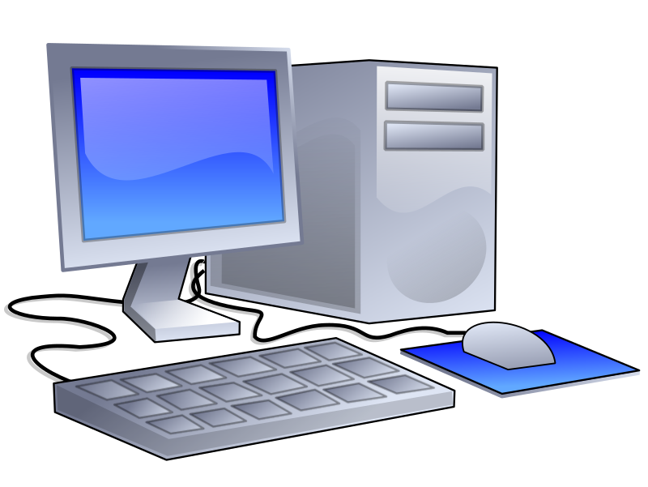
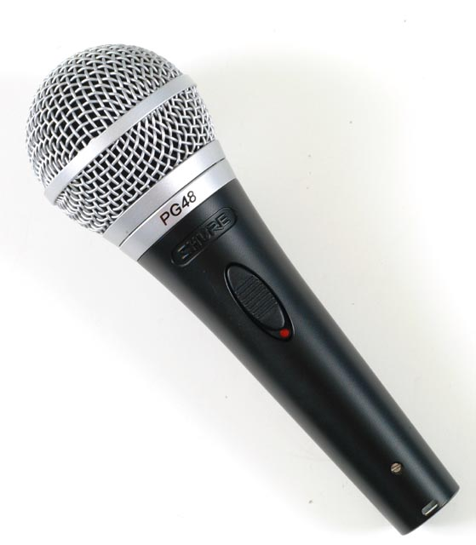
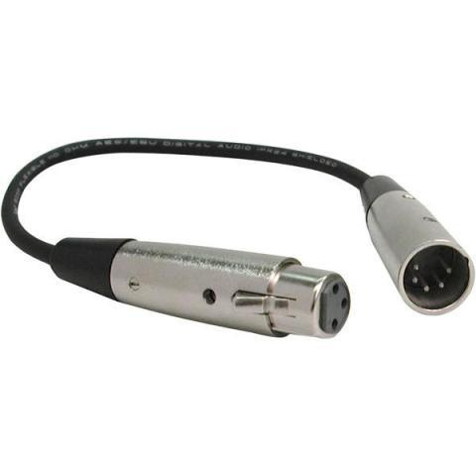
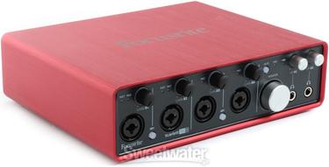
Today I set up a microphone. Here is a diagram of the signal path I created.
A signal path is how the path the sound signal takes to the recording device. Here is all the equipment you used. Drag them into the correct order and then delete this box.

Slide 7
<DATE>
Today I recorded a …......... I took …...take/s.
Put a screenshot of your project here.

Slide 8
<DATE>
Today I mixed my music. I felt that the …........... was too …........ so I................
I also felt that the ............ was too …........ so I...................

Slide 9
<DATE>
Today I ............ my piece of music. I saved it in …....... It is a ….....file.
Put a screenshot of where your wav file is saved.

Slide 10
Evaluation
Answer the following questions to evaluate your project.
Did youi enjoy working on this project?
What did you find easy?
What did you find difficult?
Would you do anything differently the next time?

