Slide 1
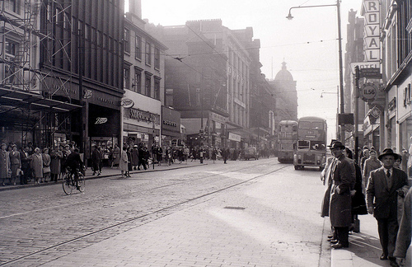
National 5 English
Scottish text:
Sailmaker
By Alan Spence

Slide 2
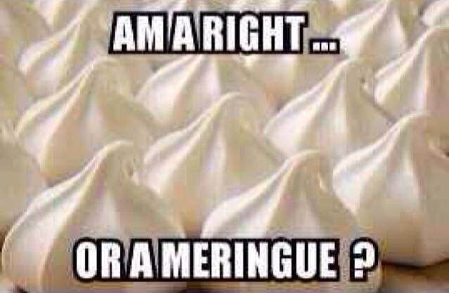
Scots Language

Slide 3
Do you speak Scots?
aboot, baffies, clarty, dreich, flit, glaikit, heid, ken, kirk, lang, lassie, mither, nane, pure, puddock, rare, scunnered, stooshie, stramash, wean
How many of these words can you explain the meaning of? Write down the word and its explanation beside it in your jotter.

Slide 4
The Author: Alan Spence
Alan Spence, an author of poetry, novels, short stories and plays, was born in Glasgow. As a poet, Alan has made zestful use of haiku in 'Glasgow Zen', 'Seasons of the Heart', 'Clear Light' and 'Morning Glory'.
He has received many awards for his writing. Alan Spence is based in Edinburgh where he and his wife run a Meditation Centre. Contemplative meditation is at the heart of his life and the perspective derived from this practice informs all of his work.
Alan is Professor in Creative Writing at the University of Aberdeen, where he is also the artistic director of the annual Word Festival.

Slide 5
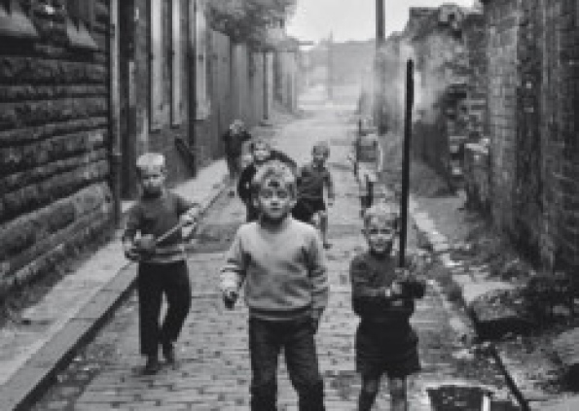
Spence’s Glasgow
Glasgow’s cultural/religious divide; The Orange Order; Glasgow Rangers
1960’s poverty
A qualified affection
for his Glasgow
childhood

Slide 6
Act 1
Pages 6-8
In your jotter (heading above):
What tragic thing do we learn has happened to Alec and Davie in the opening few pages?
What is the relationship between Alec and Davie?
“Yer mammy’s dead” – is Davie really repeating this line to Alec? Why is it repeated three times in the play?
Why does time seem to pass quickly over these opening few pages?

Slide 7
Act 1 - Characterisation
Pages 6-15
Quote | What this tells us about the character:
“Ah’ve got a bit of bad news for ye son. Yer mammy’s dead” (Davie) | This blunt delivery shows us that Davie is unsure how to tell his son about the death. He feels he cannot show his grief in front of Alec.
“Part of me already knew, accepted it. Part of me couldn’t. Part of me cried.” (Alec)
“There’s just you and me now son. We’ll have tae make the best of it.” (Davie)
“My mother was dead. My mother was dead.” (Alec)
“After the funeral. Back hame. House full ae people. Aunties an Uncles. Folk we hadnae seen for years. On and on.” (Alec)

Slide 8
Act 1
Pages 8-15
How can you describe Ian and Alec’s relationship based on these pages?
How do we know that Alec is proud of and looks up to his dad at this young age?
The theme of SECTARIANISM emerges for the first time in these pages. Find a quote which shows this theme and explain its meaning.
Find a quote from page 11 that shows that Davie is struggling to cope with the loss of his wife.
Choose 3 words to describe Ian. Find a quote to back up your choices of words.

Slide 9
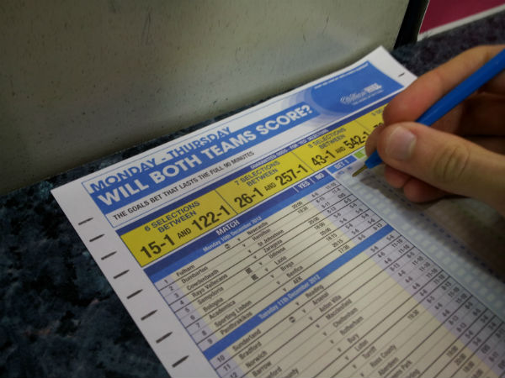
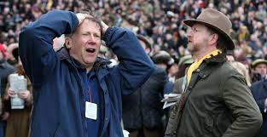
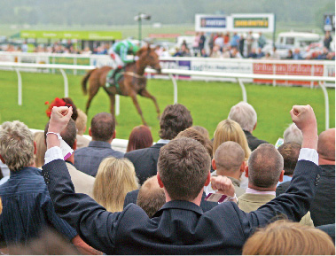
Gambling
In Act 1 we learn about Davie’s tendency to gamble which was illegal at the time. In your groups discuss the following:
Do you think betting on sports and other things should still be illegal?
What is your experience of betting/gambling? Do you believe you have ever gambled before?

Slide 10
Taking notes: Characterisation
Take a fresh DOUBLE PAGE in your jotter and draw one diagram per double page:
Alec
Davie

Slide 11
Characterisation
In each diagram, write down any words you associate with this character. E.g. personality, quotes, behaviour, their relationships with other characters, etc. While we are reading the play, you should be adding to these diagrams constantly.
Death of mother affected him greatly -
“Part of me already knew, accepted it. Part of me couldn’t. Part of me cried.”
E.g. son of Davie
Alec
Tries to mask his emotions – “Ah’ll make breakfast”
Davie

Slide 12
Act 1 - Characterisation
Pages 16-23
In your jotter (heading above):
Do we see Davie getting better or worse at coping with the death of his wife (p16-20)? Quote to support your answer.
What does Alec think about gambling and what does this tell us about him?
“Ah’m gonnae fix it up, when ah’ve got the time.” Why do you think Davie hasn’t fixed Alec’s boat for him yet?

Slide 13
Act 1 - Characterisation
Pages 16-23
He is an avid Rangers fan and a bit of a bigot – “he’s pure mental when it comes tae Rangers an aw that”
“And he’s a pape” – this suggests that…
Billy
What are your first impressions of Billy as a character? How is he different from his brother Davie? Start character notes for him on a fresh page. Add quotes, explanations, etc.

Slide 14
Act 1 - Themes
A theme of a text is a central topic or message that the writer is trying to discuss throughout the story.
In the first few pages, some important themes are established: Loss/Grievance, Religion and Family.
Draw a table similar to the one below and try to find at least two quotations from the text that show these themes (2 quotations per theme):
Theme | Quotation(s)
Loss/Grievance | e.g. “My mother was dead. My mother was dead”
Religion
Family

Slide 15
Music in Sailmaker
“I’ve been aware of music since I was very young. The radio was always on in our house and growing up through the 60’s music was hugely important to me.
Music is a good way of suggesting very profound emotions. For most people those emotions are expressed in popular song. Music has resonance. It suggests other levels of meaning.
Music also gave me a way of pinning something to a time. I just hear the opening bars of The Who’s ‘My Generation’ and it’s 1965 again. I’m there.” Alan Spence
In your own words explain what music means to Alan Spence and why he might use it so much in his plays.
What music do you think will remind you of your youth? Make a list in your jotter of all the songs connected to strong memories for you. Give details of the memory too if you feel comfortable doing so.

Slide 16
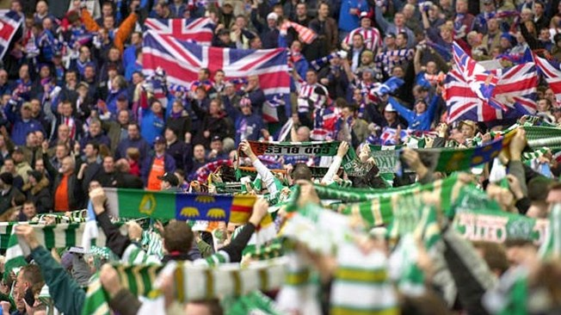
Act 1 – Theme: Sectarianism
Pages 23-30
“Away ye go! How can a colour be bad? Just because Catholics wear it.”
“Even Rangers play on green grass!”
“Fillin the boy’s head wi rubbish”
Copy down the quotes above and explain what they suggest about Davie’s character. Add your points to your mind map also.
What does Davie mean when he says “it takes a green stem tae haud up an orange lily”?

Slide 17
Act 1 – Davie and Alec
At the end of Act 1, Davie is badly beaten up by the bookie’s hard men and sacked from his job as a ‘tick man’. This adds to his frustration and feeling of worthlessness.
Discuss and take notes:
How does Alan Spence change the mood just before we learn the news about Davie? (Look at the story before)
How does Davie break the news to Alec and where have we seen this language before? Why has it been repeated?
Alec puts the yacht away at the end of the scene – what might this symbolise? Think about their relationship and Davie’s job.

Slide 18
Act One
Below are some of the key THEMES from Sailmaker. Choose 3 themes and write about how they are presented in Act 1 (e.g. where we can see evidence of the themes):
RELIGION SECTARIANISM GRIEF/LOSS POVERTY VIOLENCE DREAMS/AMBITIONS SOCIAL CLASS ESCAPISM/IMAGINATION FAMILY

Slide 19
Agree or Disagree?
Considering what we have read so far, try to decide whether you AGREE or DISAGREE with the following statements:
1. Davie should be more like his brother Billy.
2. Alec is disappointed with his father.
3. Davie is overwhelmed with grief at the loss of his wife.
4. It is Davie’s own fault that he is in a financial mess.

Slide 20
Act 2 – Davie and Alec
At the start of Act 2, we discover that Alec is quite similar to Davie at a younger age but there are also hints that they are starting to drift apart.
Find a piece of evidence (quotation) from pages 33-35 to show that Alec and Davie were similar when Davie was Alec’s age. Explain your quote.
The theme of AMBITION/DREAMS is evident in this scene. Find a quote from either Davie or Alec that shows this theme and be prepared to explain the quote.

Slide 21
Act 2 – Symbolism
Think back to the start of Act 2:
How is the mirror symbolic of Davie’s life at this point in the play?

Slide 22
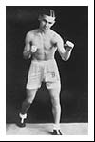
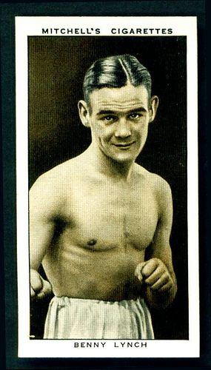
Benny Lynch
He was born on 12 April 1913 in Glasgow and began boxing as a teenager in a bid for fame and fortune to escape the poverty and deprivation of his family background.
Lynch stood out. From an early age, he was an exceptional fighter, combining assured ring artistry with percussive punching power - unusual in a fighter whose body frame appeared so slight.
He excelled as an amateur and turned professional aged 18 in 1931.
Lynch's professional record was impressive. In his first 30 fights he won 20 and drew 5. In 1933 alone, he fought 17 times – unthinkable now.
Fame dealt Lynch a cruel blow. His status as a local hero in the working class Gorbals led to money problems and alcoholism.
His decline into alcoholism was rapid. His marriage broke up. On 8 August 1946, Lynch died in the Southern General Hospital of malnutrition and respiratory problems. He was 33.
Explain why Benny Lynch might be a hero to Davie.
In what ways are the two men similar?

Slide 23
Act 2
Pages 36-38
In your jotter (heading above):
Why is Alec so involved with Religious groups at this point?
In your own words, summarise the problem Alec faces in this extract and how he deals with it (aim for 4 bullet points).
Alec is clearly uncomfortable in this scene. Show how the writer’s word choice and sentence structure make this clear. Quote to support your answer.
Alec uses a mix of proper English with a little bit of Glasgow dialect. What do you think this tells us about the character of Alec?
As well as RELIGION, the theme of SOCIAL CLASS is also explored in this section. Find a quote which shows this theme and explain it.

Slide 24
Act 2
Pages 39-45
This section is about Alec sitting an exam to go to a private school on a bursary and then progressing on to achieve entry into university. His father has said on the previous page that for Benny Lynch, boxing was “the way out”. For Alec it will be his brains.
What does “the way out” actually mean here?
a) “Ah’d watch ma bum if ah was you!” What is Ian insinuating here about private schools?
b) How does this connect to the theme of SOCIAL CLASS?

Slide 25
Alec’s Exam
Questions:
1. Why are the exams particularly important to Alec?
2. Find one quote which reflects the theme of POVERTY here.
3. What might it suggest about Alec that he finds English easier than Maths?

Slide 26
Act 2
Pages 51-56
In your jotter (heading above):
1. Where has Davie been and what is Alec doing when Davie gets home?
2. a) How is Alec feeling about Davie when he comes home?
b) Choose a quote which backs up your answer. Explain it.
3. How does Alan Spence use stage directions on page 53 to show Alec’s frustration with Davie? Quote to support your answer.
4. “Think ah came fae another planet” – what does this quote tell us about Alec and Davie’s relationship?
5. What is Davie’s opinion of male/female relationships?
6. “Wallop.” – earlier in the play this quote was the punchline to a joke that Davie and Alec shared. What does it mean at the end of this section?

Slide 27
Starter: Mind Maps
Update all your character mind maps – think about things you might be able to add about each character from what we’ve learned so far in Act 2. Remember to back up your statements with quotes from the text!
Example:
Alec
In Act 2 he is still unable to motivate himself and is drinking more heavily
Changing to become more middle class – e.g. private school, university, better grasp on language, etc
Davie
Hero is Benny Lynch

Slide 28
Turning point
Turning points of a text are points at which things change irreversibly.
Where are the key turning points in Sailmaker?

Slide 29
Timeline Act 2
Using your copy of the play, create a TIMELINE of all events that happen in Act Two of Sailmaker. See the grid below to get started:
Start
End
Alec appears to have turned to religion and attends church
Alec and Davie burn the yacht

Slide 30
Sailmaker Quick Quiz
What tragic event do we read about at the start of the play?
What city do Alec and Davie live in?
What football team do they support?
What relation is Ian to Alec?
Give two reasons why Alec and Davie are poor.
Explain how Alec tries to break out of the working class.
What is Davie’s brother called?
What job does Davie’s brother do along with his son Ian?
How does Alec react in the church when a woman asks him about Jesus?
Give two reasons why Alec is annoyed at Davie when he comes back from the pub.

Slide 31
Sailmaker Quick Quiz
What tragic event do we read about at the start of the play?
What city do Alec and Davie live in?
What football team do they support?
What relation is Ian to Alec?
Give two reasons why Alec and Davie are poor.
The death of Alec’s mum and Davie’s wife
Glasgow
Glasgow Rangers
Cousins
Davie loses his job; gambling; death of mother; can’t spend his money wisely

Slide 32
Sailmaker Quick Quiz
6. Explain how Alec tries to break out of the working class.
7. What is Davie’s brother called?
8. What job does Davie’s brother do along with his son Ian?
9. How does Alec react in the church when a woman asks him about Jesus?
10. Give two reasons why Alec is annoyed at Davie when he comes back from the pub.
Studies hard, goes to a private school, goes to university
Billy
Painters
He runs away and kicks a bin
Davie is drunk; talking nonsense; Alec is trying to study; thought Davie was missing;
Davie talks about another woman; Davie distracts Alec from his work

Slide 33
End of Play Task
Put the following events from the play in the order in which they happen. Write the full sentences:
Davie gets beaten up and loses his job
Alec burns items he finds in the Glory Hole including the yacht
Davie tells Alec his mother is dead
Alec runs away from the Mission after having his faith challenged
Alec gets into private school and university
Alec first asks Davie to fix up his yacht
Davie comes in drunk and Alec fights with him
We first hear of Davie’s job as a tick man and his drinking/gambling

Slide 34
End of Play Task
Put the following events from the play in the order in which they happen. Write the full sentences:
ANSWERS:
c) Davie tells Alec his mother is dead
f) Alec first asks Davie to fix up his yacht
h) We first hear of Davie’s job as a tick man and his drinking/gambling
a) Davie gets beaten up and loses his job
d) Alec runs away from the Mission after having his faith challenged
e) Alec gets into private school and university
g) Davie comes in drunk and Alec fights with him
b) Alec burns items he finds in the Glory Hole including the yacht

Slide 35
Act 2 - Themes
Pages 56-64
A theme of a text is a central topic or message that the writer is trying to discuss throughout the story.
Towards the end of the play, we see real evidence of some of the key themes in the text: SOCIAL CLASS, POVERTY and HOPE TURNING TO DISAPPOINTMENT
Draw a table similar to the one below and try to find quotations from the text that show these themes and any others:
Theme | Quotation(s)
Social Class | e.g. “We got some stuff about other religions in school. Hinduism and Buddhism and that” This shows that Alec…
Poverty
Hope turning to disappointment | e.g. “”I actually thought you wrote it, ye know – made it up yourself” This shows that over time, Alec has…

Slide 36
Structure chart
’
Alec and Davie fight
Davie bets using Alec’s bursary money
Alec gets starts his new school
Alex runs away from the Mission
They burn items Alec finds in the Glory Hole.
Davie gets beaten up and loses his job
Davie tell Alec his mother has died
The symbolic burning of the yacht.
Yacht introduced
First told of Davie’s job as a tickman and his gambling/ drinking.

Slide 37
Textual analysis (Page 51 – 55)
1. a) With close reference to the text, explain how the playwright shows Davie to be very drunk at this point. (4)
b) How is Alec feeling when Davie comes home? Provide evidence from the text to support your answer. (2)
c) How does the playwright use stage directions to emphasise the tension between both characters? (3)
d) Explain in your own words the things that Davie says that make Alec irritated. (3)
e) Sailmaker is a play that explores father and son relationships. With reference to this extract and other points in the play, explain how this theme is explored by the playwright. (8)

Slide 38
Textual Analysis Answers
a) With close reference to the text, explain how the playwright shows Davie to be very drunk at this point. (4)
“Last orders please” - Davie uses language you would expect to hear in a pub
Short sentences shows that Davie is incoherent affected by the alcohol
Davie sings to Alec suggesting he is inebriated
Davie repeats himself throughout again suggesting he is incoherent and affected by alcohol e.g. “Nae harm in it.”
Davie doesn’t detect Alec’s bad mood straight away – delayed reactions from the drink
“Ye’d think ah came in steamin every night!” Davie admits himself that he is drunk in this line of dialogue
Davie has “dutch courage” from the alcohol to ask about Alec’s girlfriend – this is uncharacteristic of him as he is usually shy

Slide 39
Textual Analysis Answers
b) How is Alec feeling when Davie comes home? Provide evidence from the text to support your answer. (2)
Alec is feeling angry/irritated/frustrated with his father
The stage directions initially say that Alec doesn’t look up – this suggests he is so angry he will not look at Davie
He answers Davie with short one-word answers e.g. “Aye”, “Naw” suggesting he does not wish to converse with him
He doesn’t want to discuss any of his business with Davie suggesting he is irritated by him
c) How does the playwright use stage directions to emphasise the tension between both characters? (3)
“(Not looking up)” – suggests that Alec has reacted negatively to Davie’s entrance
“(Shrugs)” – Davie’s negative body language shows he recognises that Alec isn’t listening to him and creates tension between the two characters
“(Grudging)” – This suggests that Alec doesn’t want to talk to Davie and is doing so against his will
“(Eats crisps, swigs iron brew from the bottle)” – this creates tension as Davie just helps himself to Alec’s food and drink despite Alec being angry with him
“(Bangs down book)” – this clearly shows Alec to be angry with Davie

Slide 40
Textual Analysis Answers
d) Explain in your own words the things that Davie says that make Alec irritated. (3)
Davie talks about drinking in the pub with his friends
Alec gets irritated by Davie repeating himself e.g. “David Copperfield is it?”
Davie’s singing also infuriates Alec as he is trying to concentrate on his studies
Davie talks about a girl called Peggy that he met at the pub.
Davie asks Alec if he is seeing any girls which seems to irritate him

Slide 41
Textual Analysis Answers
e) Sailmaker is a play that explores father and son relationships. With reference to this extract and other points in the play, explain how this theme is explored by the playwright. (8)
At the start of the play, Davie and Alec have a strong relationship (1), however by the end they have both drifted apart from each other and are very different (1).
In this extract, we can see that the relationship between Alec and Davie is becoming increasingly more fragmented as Alec is progressing in life but Davie still cannot move forward (1). “DAVIE: Ah give up! ALEC: Ye always do.” This suggests that Alec realises at this point in the play that Davie has stagnated and does not have the respect for him that he did at the start.
This relationship is different in Act 1 where we can see that Alec is very proud of his father’s trade and admires him (1). He says “Ma da’s a sailmaker”. The fact that he uses the job title shows he holds Davie in high regard (1).
However at the end of the play it is clear that Davie and Alec’s relationship has completely broken down (1). “Alec burns the yacht” – the yacht has symbolised their relationship throughout the play and the burning now symoblises that they are parting in their separate ways. It is a sad ending and indicates that there will no relationship between father and son (1).

