Slide 1
BGE Reading Log
Why we read:
• For fun and because we enjoy it
• To explore the world we live in
• To escape in a book and relax
• To acquire knowledge
• To develop our reading skills
• To follow instructions

Slide 2
Reading Journal. Name:……………………………………………………Form:……………
The front has been left blank so you can personalise it yourself.

Slide 3
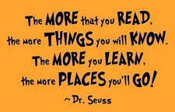
“There is more treasure in books than in all the pirate’s loot on Treasure Island.” – Walt Disney
“Reading is to the mind what exercise is to the body.”
What will inspire you this year?
Let’s get reading!
“I encourage everyone to read as much as possible because knowledge is power!” – Clint Dempsey
“Never judge a book by it’s movie”
“Reading gives us some place to go when we have to stay where we are.”

Slide 4
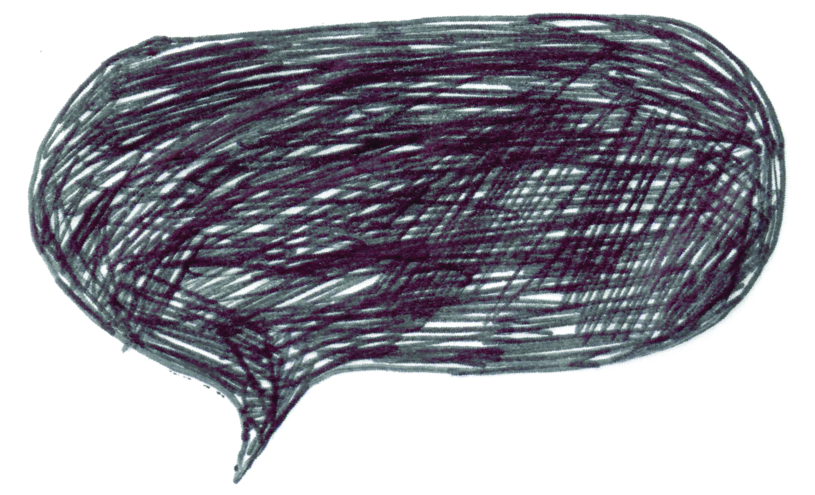
You need to fill in your reading log every time you read for 20 minutes or more – this counts at school and at home.
When you have read for 20 minutes or more you must get your reading log signed by an adult.
Complete a personal reading task of your choice.
What am I supposed to do?
What is the aim?
Reading regularly will help you in all your subjects and will help you improve your grades!

Slide 5
Reading log – What are you reading?
Title and Author | How many pages did you read? | How long did you read for? | Adult’s signature
E.g. Harry Potter and the Philosopher’s Stone by J.K Rowling | 10 | 20 mins | R.Killick

Slide 6
Title and Author | How many pages did you read? | How long did you read for? | Adult’s signature
E.g. Harry Potter and the Philosopher’s Stone by J.K Rowling | 10 | 20 mins | R.Killick

Slide 7
Fiction tasks

Slide 8
Questions on plot
How did the writer hook your attention?
Summarise the main events in the order in which they happened. (No more than four sentences!)
What is the most exciting, important or memorable event in the story?
What makes you wonder in this book? What confuses you? What came as a surprise?
How does the book end? Do you want to give that away?
Think about:
Use present tense when you talk about what happens in a story.
Talk about what you felt about what was happening.

Slide 9
Write an alternative (different) ending to a book you have read.

Slide 10
Questions on character
1. Choose a character you find interesting and explain why this is the case.
2. If a character makes an important decision, explain whether you agree with a character’s choice.
3. If a character makes an important decision, explain what might have happened if they had chosen differently.
4. Choose a character that could be described as a villain or a ‘baddie’ and explain how the writer has made him or her convincing.
5. Choose a character that could be described as a hero or a ‘goodie’ and explain how the writer has made him or her convincing in this role.
6. What do you like/dislike about the main character in the book? Explain your ideas by referring to the character’s:
• actions and behaviour
• relationships with others
7. Using clues from what you have read so far, predict what will happen to your chosen character in the remainder of the story.

Slide 11
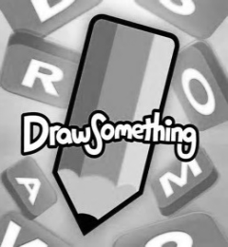
Draw and label a character from a book that you have read.
Make sure you write which book it is from.

Slide 12
Questions on setting
Describe the story’s setting. Think about when and where the story took place. You can consider the following to help:
• Era
• Time
• Dialect
• Cultural aspects
• Season
• Public/Private
• Mood
• Rural/Urban
Write down five or six quotations which describe the setting. Comment on how the setting has added to your enjoyment of the novel.
What impact does the setting have on the events of the novel, and on the reader?
Did the setting make the story more tense? More exciting?
Was it a very familiar setting, which you could relate to, or was the story set in a different world, which might be exciting / intriguing?

Slide 13
Draw and label a setting from a book that you have read.
Make sure you write which book it is from.

Slide 14
Questions on language and style
Who narrates the story? Does that make any difference?
Is there lots of description in the narration?
How are the characters developed? Is there much dialogue?
Is the language very chatty and informal, or more formal?
Choose a descriptive passage from the book and write a list of examples of imagery – similes, metaphors, alliteration etc. Explain what these images help you imagine.
Use a dictionary to help you give the definition of six challenging words from your text.
Pick out six words from your text and use a thesaurus to give a synonym (alternative words with similar meanings)
Pick out six challenging words from your text and use the surrounding words (context) to help you give a definition.
Give 4 examples of good adjectives used in your text
Give 4 examples of good adverbs used in your text.

Slide 15
Diary Entry
Recount an event from another character’s point of view.

Slide 16
Questions on theme
Theme is a key issue such as: Race, gender, poverty, war, love…
What is the author saying about life and living in this book?
Did the book raise your awareness of an issue?
Is the book just for entertainment, or does it have another purpose?
What ideas has the novel left you questioning?
Have you learned anything important about the world, or about people, even yourself? Explain.

Slide 17
The end…
Did you like the ending of the book? Why or why not? Do you think there was more to tell? What do you think might happen next?
Write your own ending or continue the story.

Slide 18
Reflection
What emotions did this book make you feel? Did you laugh aloud? Did you get choked up? Angry? Did you feel anxious, fearful, or triumphant? Explain your reactions.
What connections are there between the book and your own life? Explain.
In what ways are you like any of the characters? Do any of the characters remind you of friends, family members, or classmates? Explain.
What are the best parts of the book? Why? What are the worst parts of this book? Why?

Slide 19
Write a book Review
Things to consider:
Who would you recommend this book to and why?
Why should people read this book?
What will you remember about this book?

Slide 20
Non fiction tasks

Slide 21
Autobiography/Biography
Share five key facts that you have learned about the person so far. Explain why you find these facts particularly interesting.
Why did this person appeal to you? What did you know about them before you read the book?
What did you learn about this person’s achievements?
What is your favourite anecdote (little story)?
Did you find out anything surprising or shocking? Summarise what you learned.
Did the writer include quotes from a variety of people in the text? If so how did this make the text more interesting.

Slide 22
Quiz time
Write a quiz to go with a non-fiction text.

Slide 23
Information text
Why were you interested in reading this particular non-fiction text? Have you read other books on the same subject or in the same series?
Share five key facts that you have learned about the topic so far. Explain why you find these facts particularly interesting.
What did you know about the topic before reading the book?
Does the book explore different opinion? What are these opinions and which do you agree with?
Did the writer include quotes from a variety of people in the text? If so how did this make the text more interesting.
Did the writer use features such as graphs, tables, illustrations, appendix etc that made the subject matter more accessible or enjoyable? Give examples.

Slide 24
Write a biography
Find information about the author and write a short biography.

Slide 25
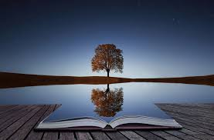
What have you enjoyed reading and why?
What’s your favourite genre and why?
Who is your favourite character and why?
Has anything you’ve read surprised you? Why?
What is your favourite book and why?
Reflection
Write down some thoughts on what you have read so far.
Answer in full sentences.

