Slide 1
S1 Reading Log

Slide 2
Reading Journal. Name:……………………………………………………Form:……………
The front has been left blank so you can personalise it yourself.

Slide 3
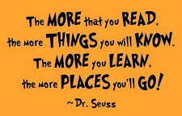
“There is more treasure in books than in all the pirate’s loot on Treasure Island.” – Walt Disney
“Reading is to the mind what exercise is to the body.”
What will inspire you this year?
Let’s get reading!
“I encourage everyone to read as much as possible because knowledge is power!” – Clint Dempsey
“Never judge a book by it’s movie”
“Reading gives us some place to go when we have to stay where we are.”

Slide 4
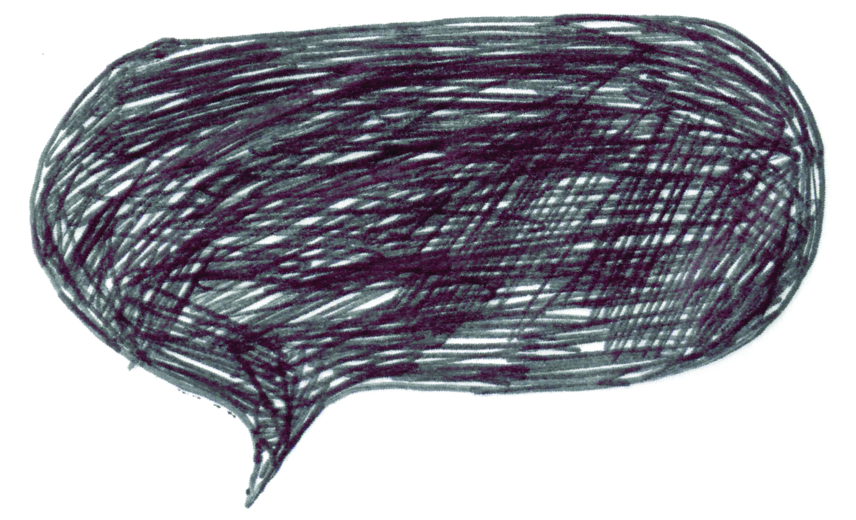
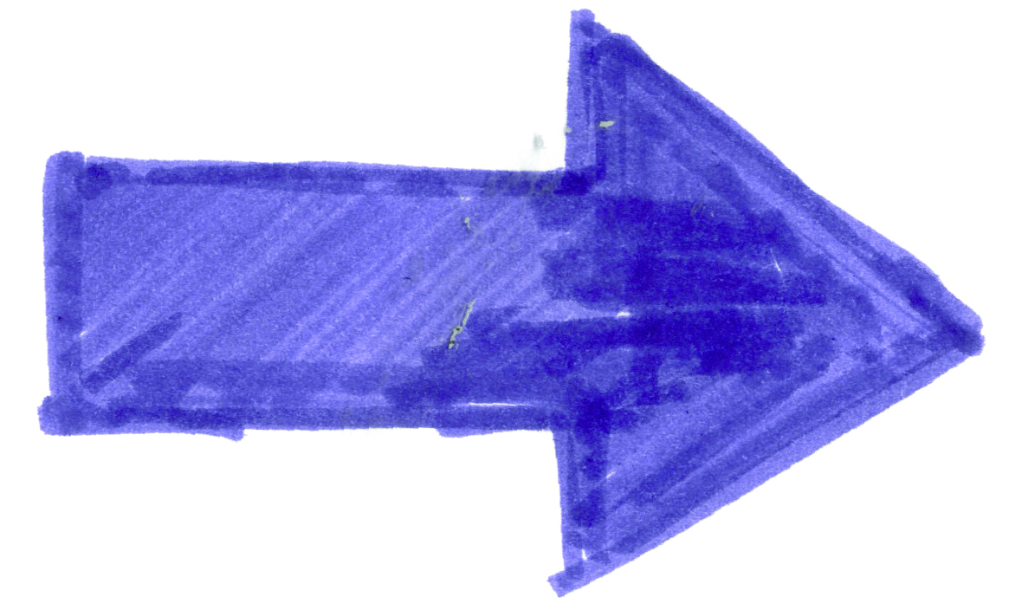
You need to fill in your reading log every time you read for 20 minutes or more – this counts at school and at home.
When you have read for 20 minutes or more you must get your reading log signed by an adult.
What am I supposed to do?
Reading regularly will help you in all your subjects and will help you improve your grades!
What is the aim?
The group with the most amount of stickers will win a prize, but how do you get stickers?
By getting to a grey square on the reading log.
By completing a task in the reading journal.
By completing a whole book.
How do I get stickers?

Slide 5
Reading log – What are you reading?
Title and Author | How many pages did you read? | How long did you read for? | Adult’s signature
E.g. Harry Potter and the Philosopher’s Stone by J.K Rowling | 10 | 20 mins | R.Killick

Slide 6
Title and Author | How many pages did you read? | How long did you read for? | Adult’s signature
E.g. Harry Potter and the Philosopher’s Stone by J.K Rowling | 10 | 20 mins | R.Killick

Slide 7
Front Cover
Can you re-design the front cover of a book you have read recently.
Hint: You might want to include your favourite parts of the story or your
favourite characters but don’t forget the title and author!

Slide 8
Storyboard
When you have finished a whole book can you create a storyboard of below featuring the main parts of the story?
Hint: Don’t forget to write a caption at the bottom of each image.

Slide 9
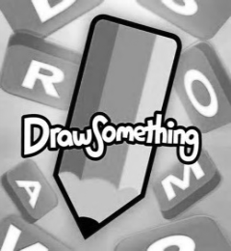
Draw a scene or a character from a book that you have read.
Make sure you write which book it is from.

Slide 10
Write down some thoughts on what you have read so far.
Answer in full sentences.
What have you enjoyed reading and why?
What’s your favourite genre and why?
Who is your favourite character and why?
Has anything you’ve read surprised you? Why?
What is your favourite book and why?

Slide 11
Summarise a book you have read in 150 words or less
Words:

Slide 12
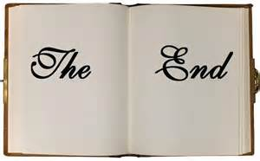
Write an alternative (different) ending to a book you have read.

Slide 13
When you have completed a book imagine you have a 10 minute interview with the author, what questions would you ask them?

Slide 14
Imagine your favourite book is being turned into a film.
Who would play the main characters and why?

