Slide 1
Writing stimulus
Your task:
Look through all of the slides. As you do, write down your response to the images. You could outline story ideas, write small paragraphs, create a mind map but there must be evidence of your response.
Now select your favourite idea and plan out a more detailed response. Think about genre, plot structure, characterisation, setting, language…
Use your idea to write a short story, no more that 350 words long.
You can repeat this exercise as many times as you like.

Slide 2
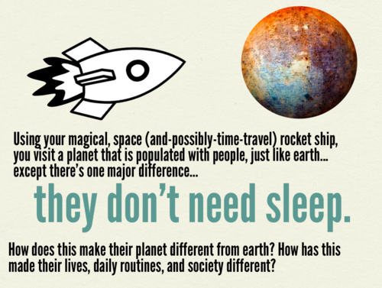

Slide 4
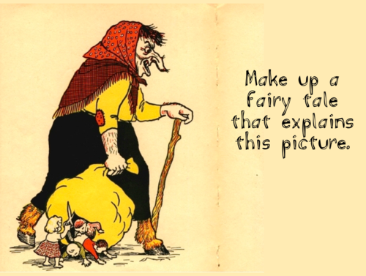

Slide 6
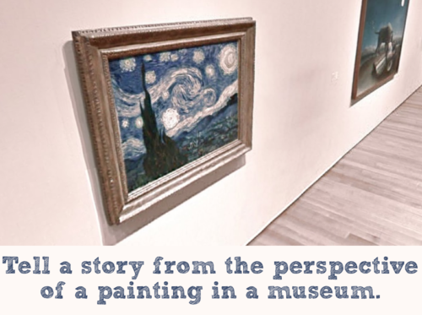

Slide 7
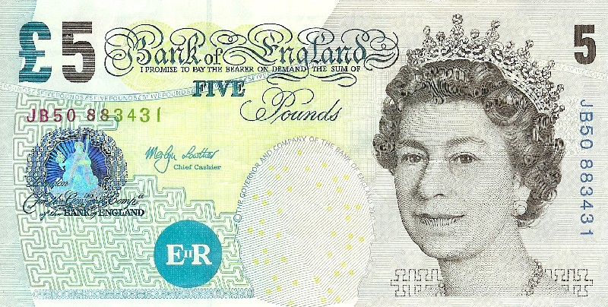
Write a first person account of one day in the life of a 5 pound note

Slide 8
