Slide 1
Personal/reflective writing
Your task:
Look through all of the slides. As you do, write down your response to the images. You could outline memories, write small paragraphs, create a mind map but there must be evidence of your response.
Now select your favourite idea and plan out a more detailed response. Think about your personal journey, thoughts and feelings, setting, atmosphere, other people involved, theme…
Use your idea to write a reflective piece, no more that 350 words long.
You can repeat this exercise as many times as you like.

Slide 2
What shall I write about?
Can you quickly finish the following 5 sentences in any way you think fits your own life experiences?
The worst...
The happiest...
The saddest...
The hardest...
The most frightening...

Slide 3
Notes:
Press Up arrow to pause show… Goes round on a quick approach.
Thank you to: http://writingprompts.tumblr.com/ for most of the ideas.

Slide 4
Now try this…
What is your opinion/view on the following comments. Has your opinion changed as you’ve gotten older?
What makes a good friend?
Family is important.
School is a waste of time.
All we need is love.
The environment is everyone's responsibility.
Reflect: What experiences have helped you to form these opinions?

Slide 5
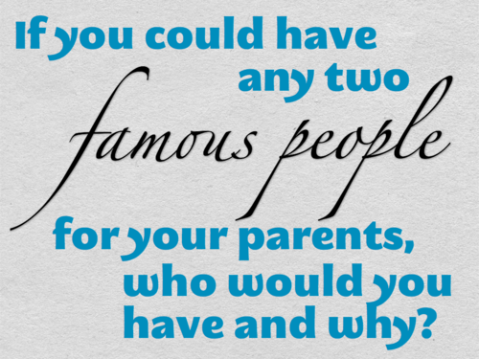

Slide 6
Now try this…
Write one sentence for each of the options below.
Which event or time in your life
Has made you grow up or mature
Has changed your family
Has been the most confusing
Showed you the best of people/someone
Showed you the worst of people/someone?

Slide 8
Who shall I write about?
Which person...
Has most influenced you
Has most helped you
Has most hurt you
Do you miss the most
Are you glad to be rid of

Slide 9
