Slide 1

Welcome
To
Park Mains High
School
Ambition Resilience Kindness

Slide 2
Format of Evening
Head Teachers welcome, Mr Dick
S1 Year Head 2026, Miss Taylor
S1 Pupils
S1 Principal Teacher Pastoral Care, Mrs Gillespie
PT Inclusion Support Team, Miss O’Donnell
S6 School Captain
Tour of School Building, S6 Leadership Team

Slide 3
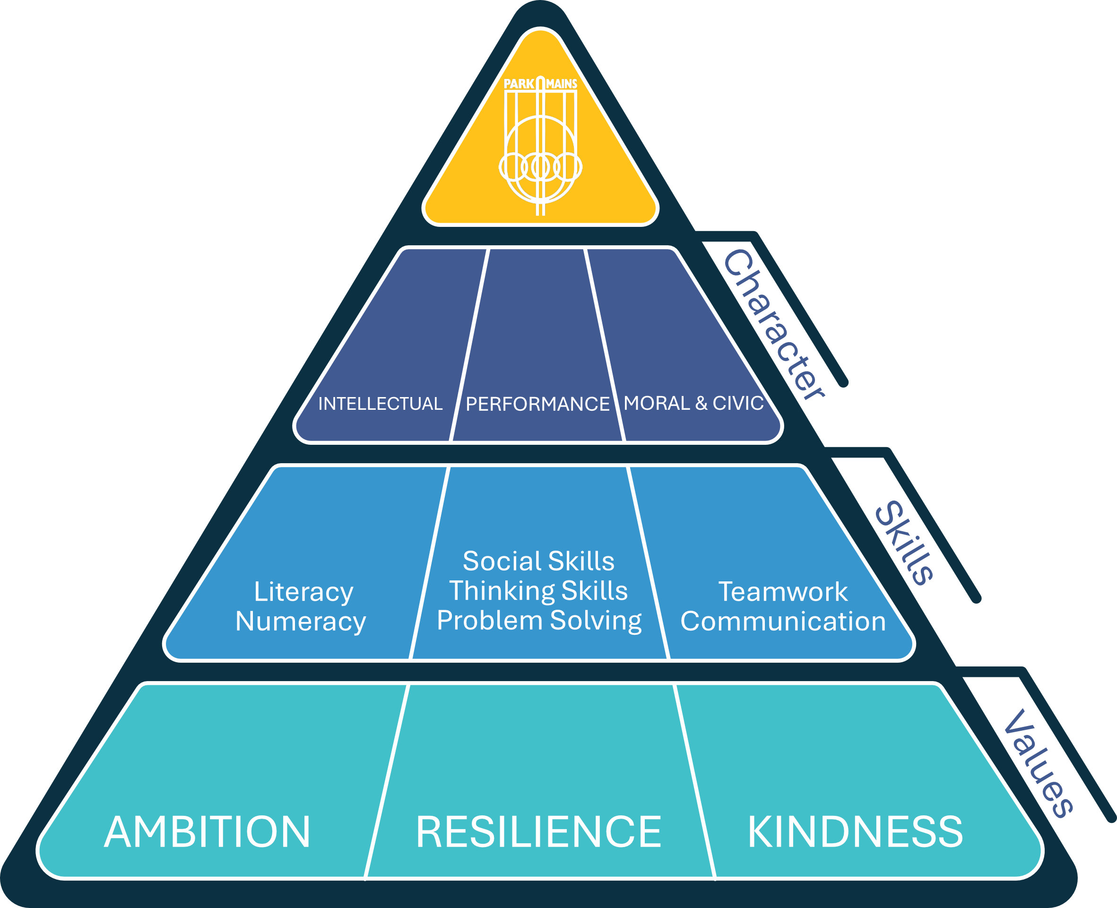
Culture and Ethos

Slide 4
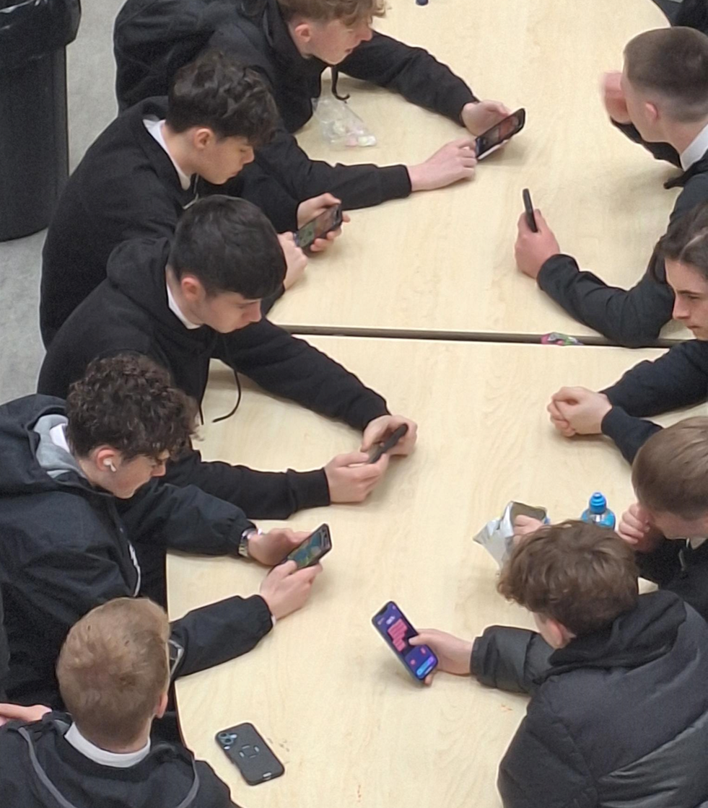
Mobile Phones
No mobiles phones in the school building
Pupils can use their mobile phone at break and lunch outside the building
Additional ICT resources purchased

Slide 5
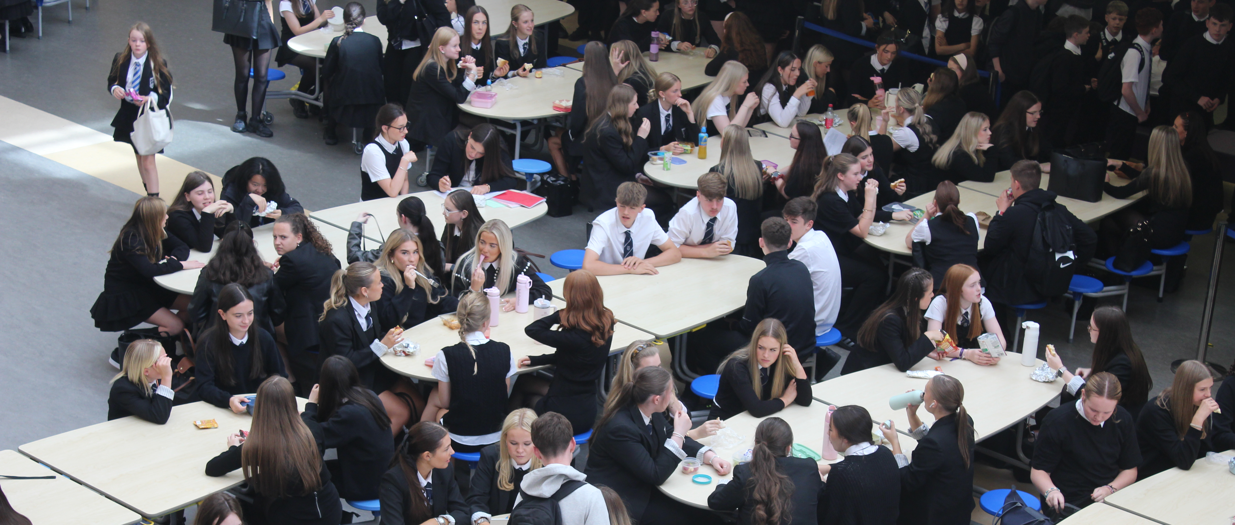
Mobile Phones
No mobiles phones in the school building
Pupils can use their mobile phone at break and lunch outside the building
Additional ICT resources purchased

Slide 6
A day in
the life
of S1

Slide 7
S1 Curriculum
Curriculum for Excellence – continues
Working at 3rd level outcomes.
English and Literacy | Mathematics and Numeracy | Modern Languages | Social Subjects | Science | Technologies | Expressive Arts | Health and Wellbeing
5 periods | 5 periods | 3 periods | 4 periods | 3 periods | 5 periods | 4 periods | 4 periods
 |  | French | Geography History Modern Studies RMPS | Biology Chemistry Physics | Business Computing Design Graphics Home Economics | Art (2) Music (2) | PE (3) Tutor (1)

Slide 8
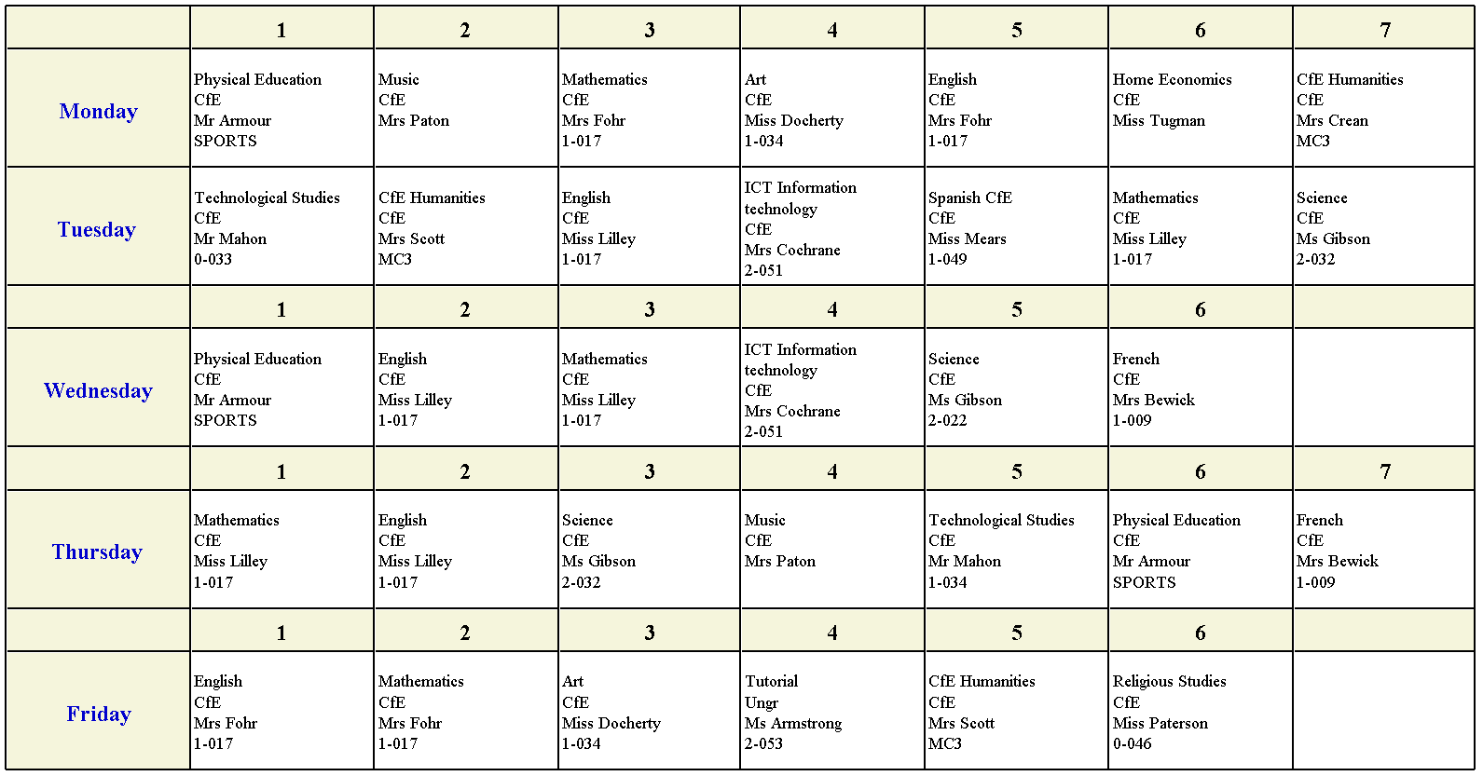
Mock Timetable

Slide 9
Start of the Day | Long Day |  |  |  | Short day
Warning bell at 8.45am In class by 8.50am | Monday | Tuesday |  | Thursday | Wednesday | Friday
 | Period 1 |  | 8.50 – 9:40 |  | Period 1 | 8.50 – 9:40
 | Period 2 |  | 9.40 -10.30 |  | Period 2 | 9.40 -10.30
 | Break |  | 10.30-10.45 |  | Break | 10.30-10.45
 | Period 3 |  | 10.45 – 11:35 |  | Period 3 | 10.45 – 11:35
 | Period 4 |  | 11.35 – 12.25 |  | Period 4 | 11.35 – 12.25
 | Period 5 |  | 12.25 – 1.15 |  | Lunch Time | 12.25 – 1.15
 | Lunch Time |  | 1.15 – 2.00 |  | Period 5 | 1.15 – 2.00
 | Period 6 |  | 2.00 – 2.50 |  | Period 6 | 2.00 – 2.50
 | Period 7 |  | 2.50 – 3.40

Slide 10
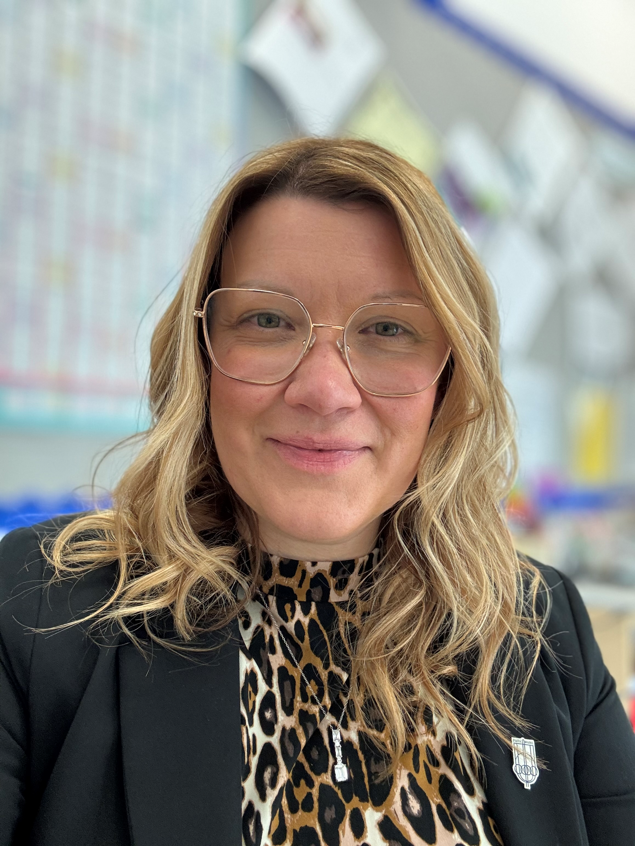
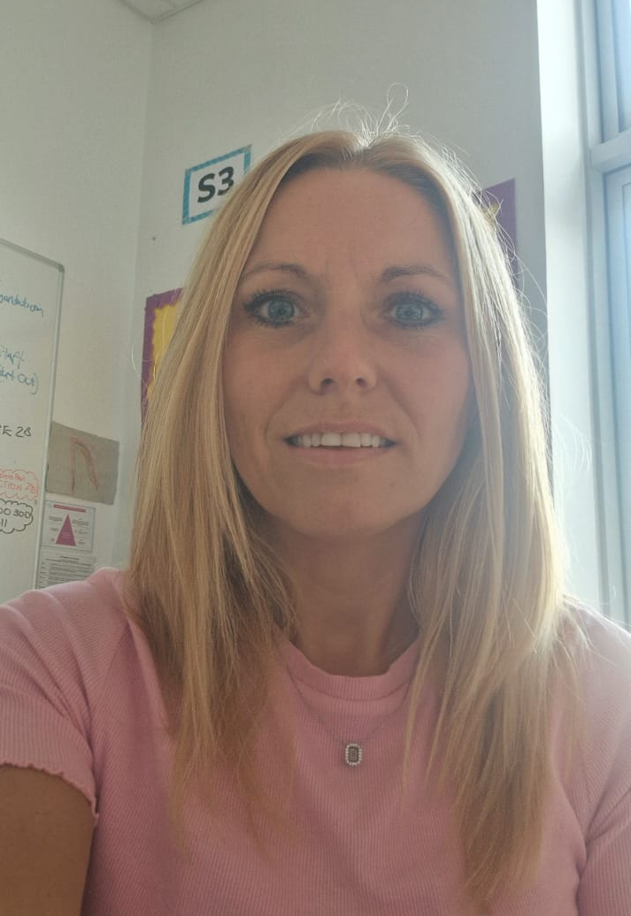
S1 Year Group Team
Miss Taylor
DHT
Mrs Gillespie
PT Pastoral Care

Slide 11
Young Person
Class Teacher
PT Curricular
Office Staff
Canteen Staff
Extracurricular Staff
PT Inclusion Support
Tutor Teacher
SLT
Inclusion Support Team
My S1
Support
Network

Slide 12
Introducing Mrs Gillespie
First point of contact for queries.
Also, the person that young people should go to if they require support with anything.
Pastoral care monitor attendance and time keeping.
Offer guidance with every aspect of school including course choice at the end of S2.

Slide 13
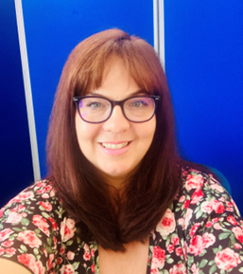
Introducing Mrs O’Donnell
First point of contact for ASN queries
Provide support both in and outside classrooms.
Help pupils to build confidence and foster independence.
Has a support team built up of:
  Secondary Sector Teachers
  Primary Sector Teachers
  Key Workers
  Additional Support Needs Assistants
“People will forget what you said, people will forget what you did, but people will never forget how you made them feel”
Maya Angelou

Slide 14
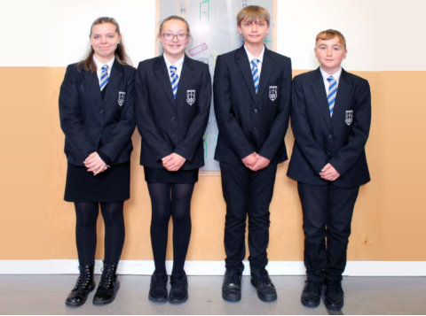
Footwear | Smart all-black footwear
White shirt | Formal white shirt must be worn tucked in
School tie | All pupils must wear a school tie (ties can be purchased from the school office)
Black trousers/skirt | Formal or tailored skirt or trousers should be worn
School blazer | Should be worn by all S5 & 6 and we encourage all S1- S4 pupils to do the same
Outerwear | Dark, plain jackets can be worn, jackets must be removed in class
PE Kit | White/Blue t-shirt with shorts/leggings/tracksuit bottoms and trainers
Uniform
https://parkmains.com/our-school/uniform/

Slide 15



Items Not Allowed
Jeans
Tracksuit Trousers
Leggings without a skirt
Hoodies
Coloured Tops
Coloured or black and white footwear
https://parkmains.com/our-school/uniform/

Slide 16


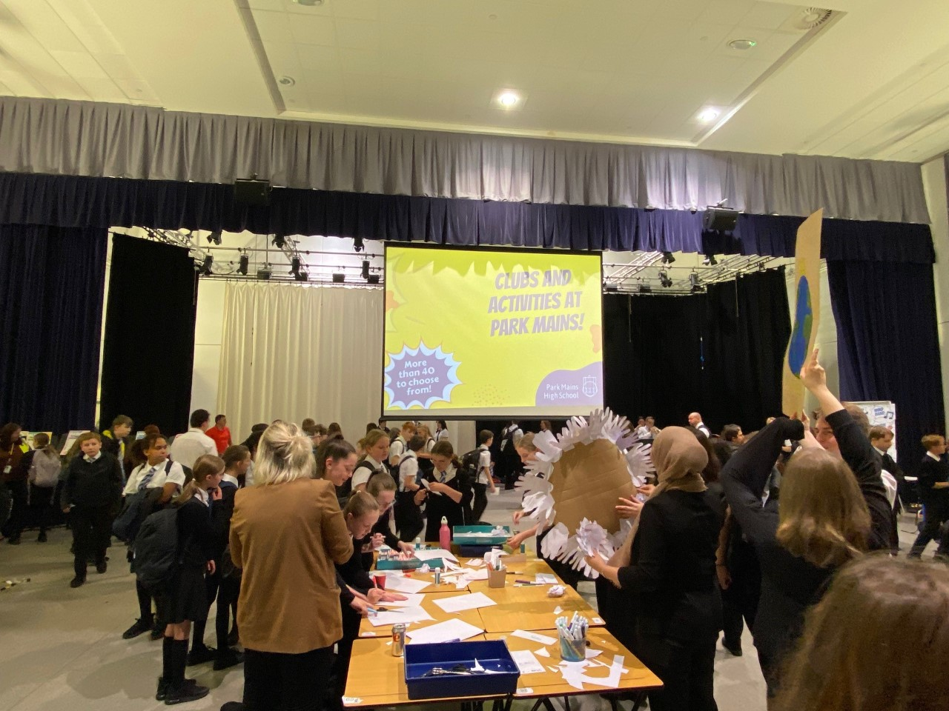
Extra Curricular Activities

Slide 17


Our ASPIRE approach recognises excellence in:
Attitude
School Uniform
Punctuality
Involved
Respect
Effort

Slide 18
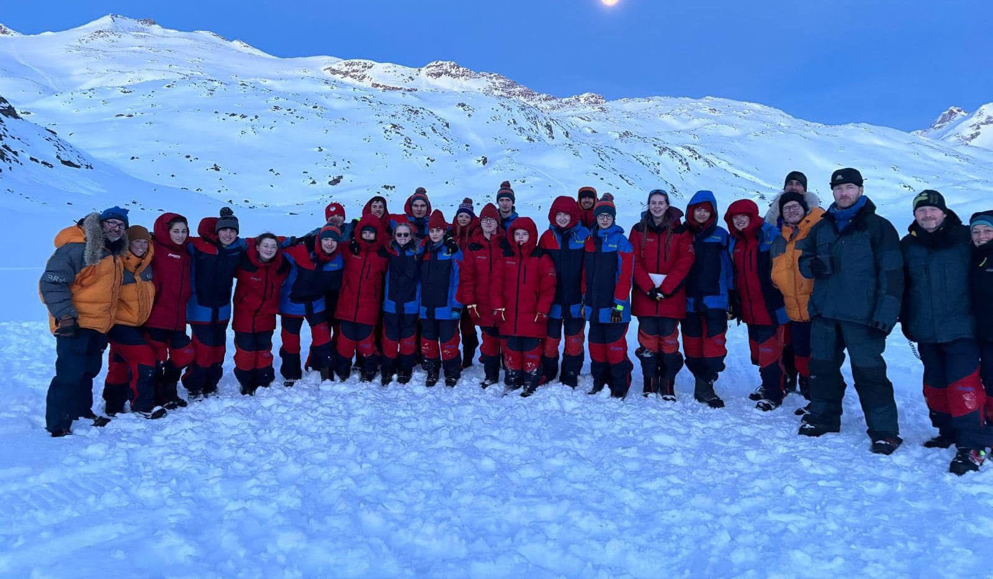
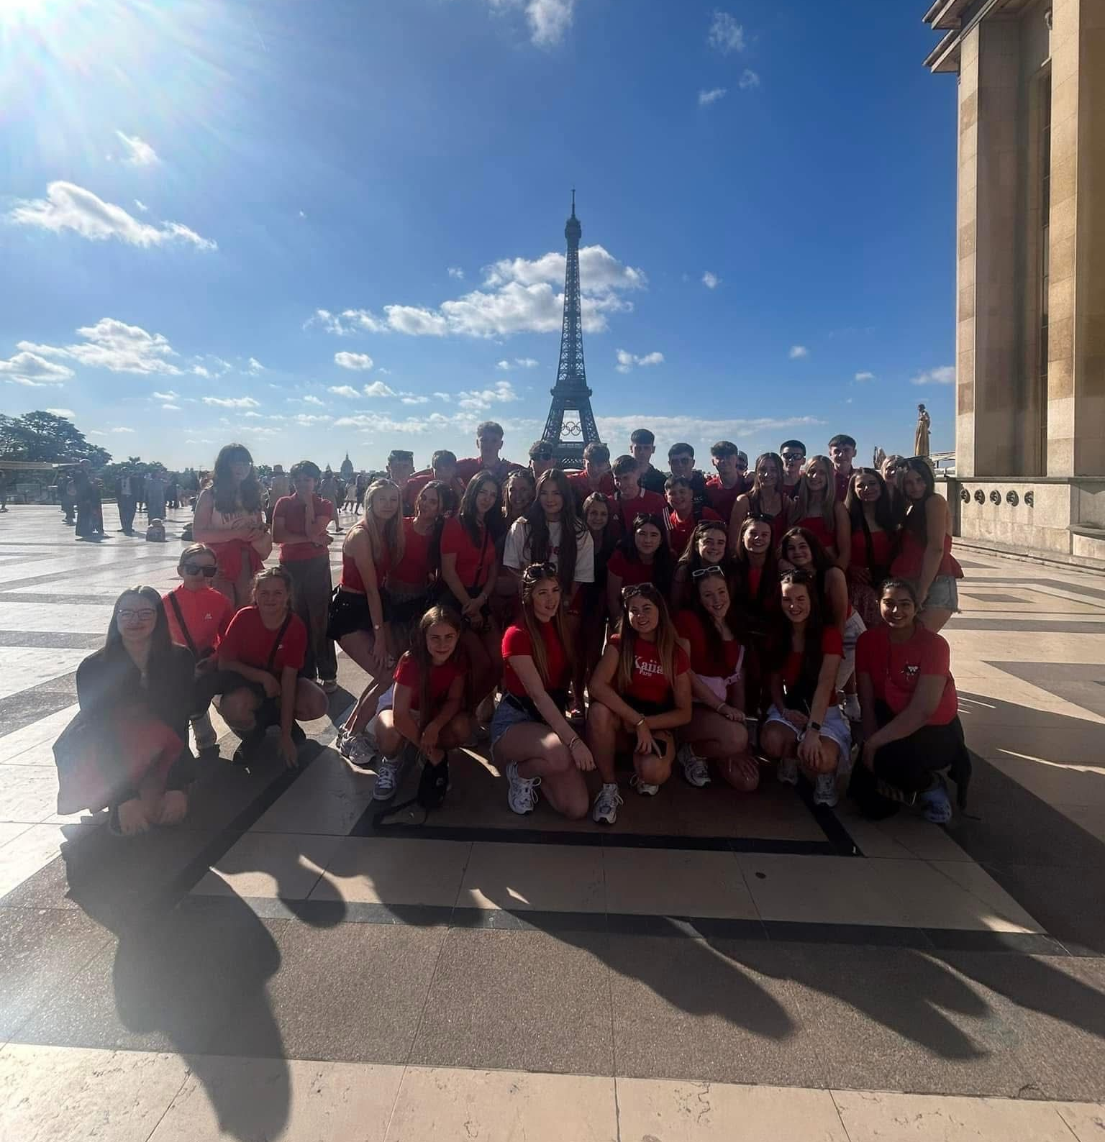
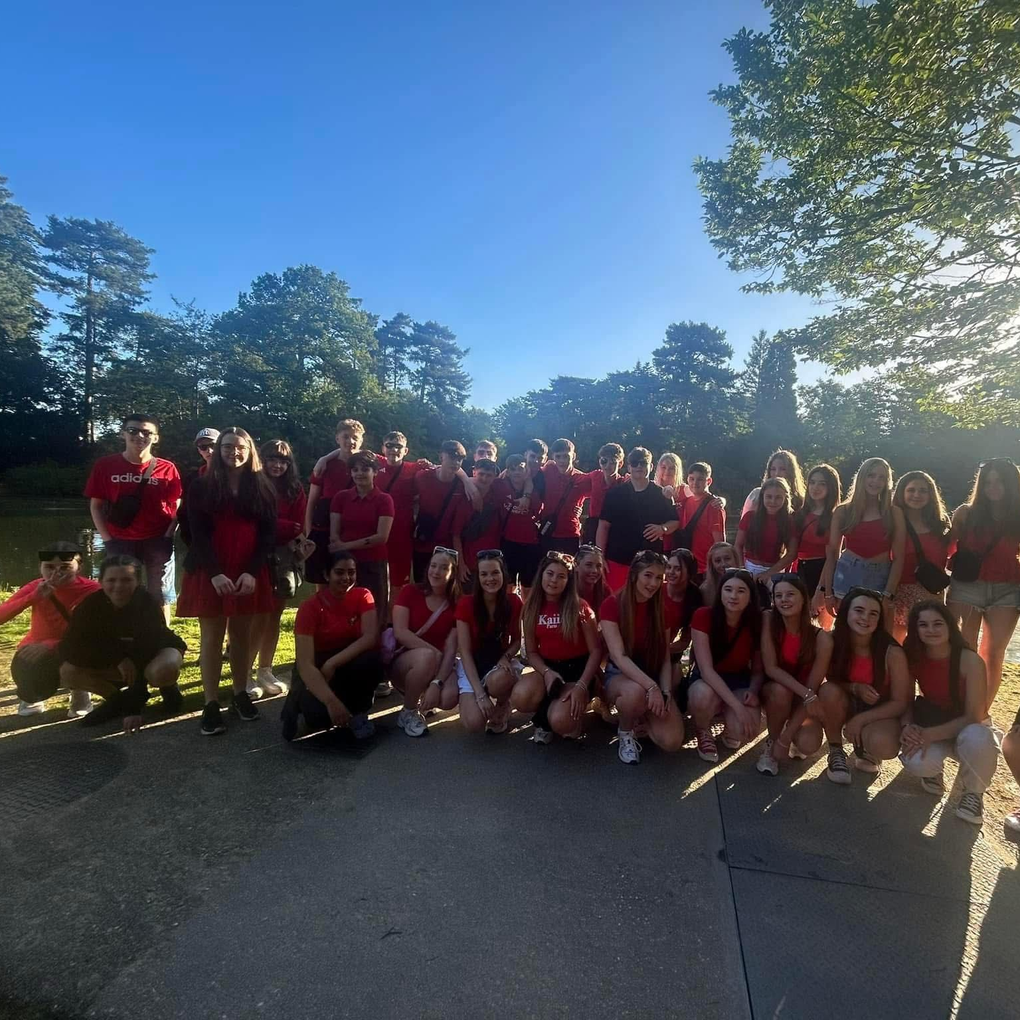
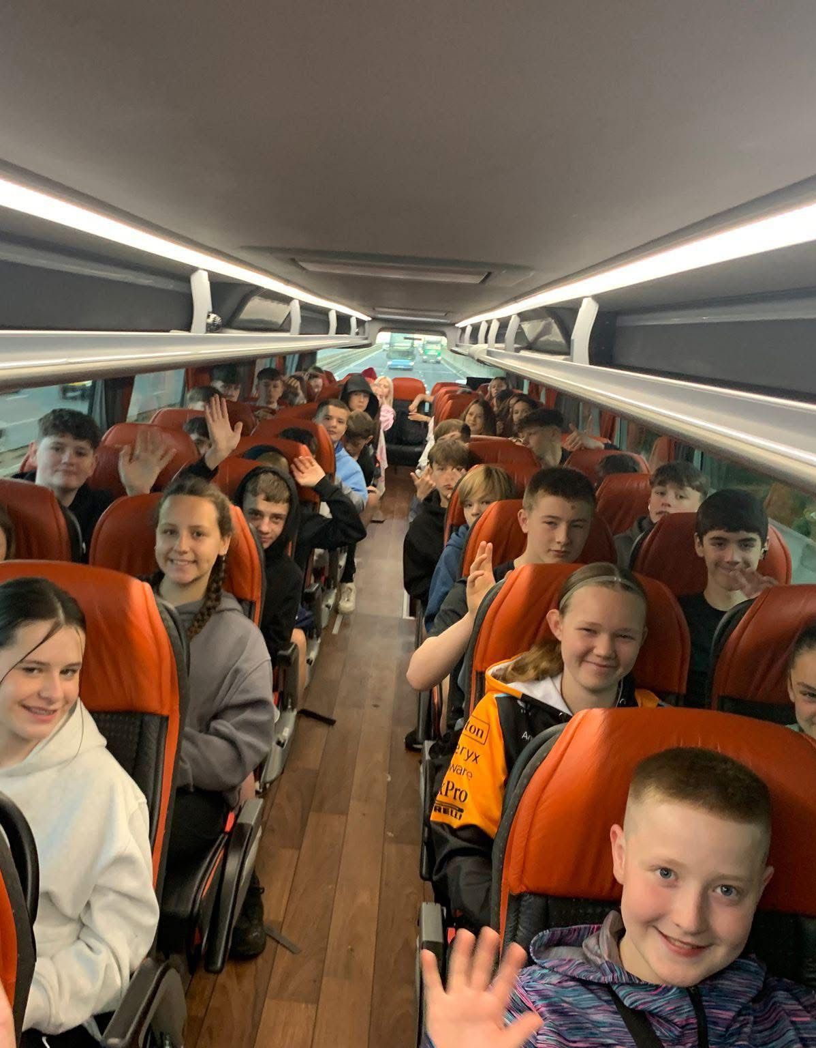
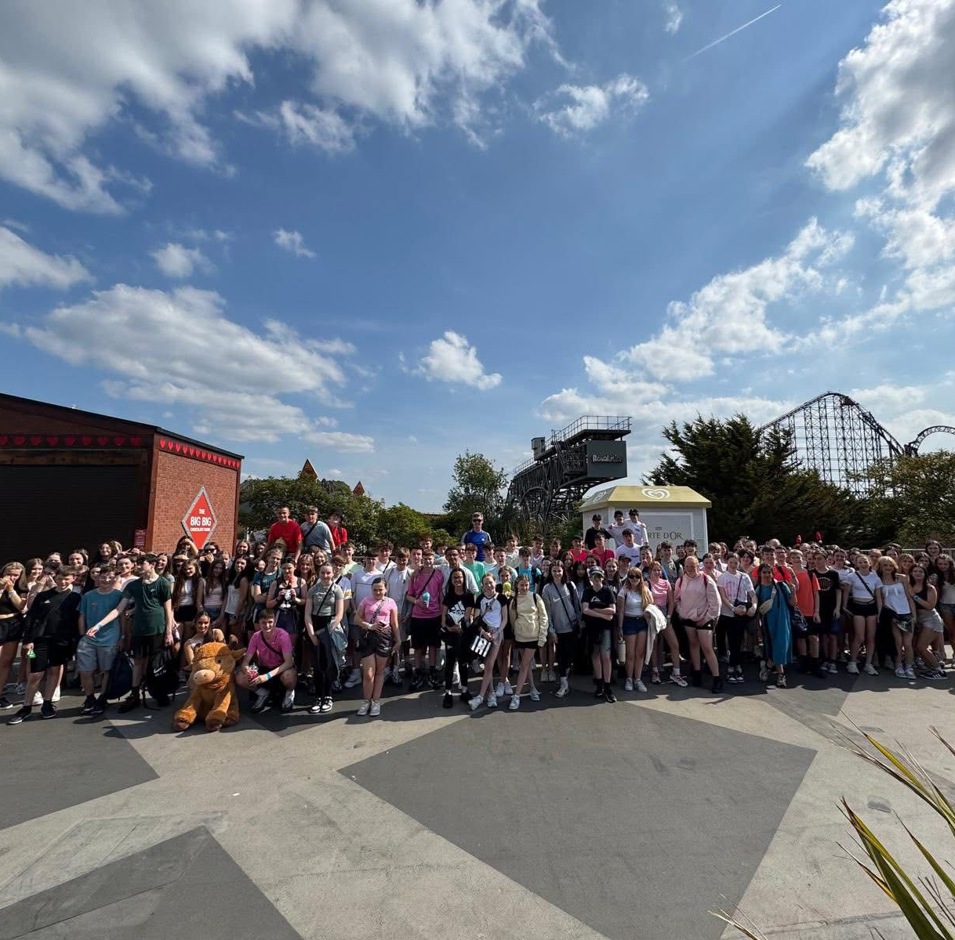
Rewards Trips

Slide 19
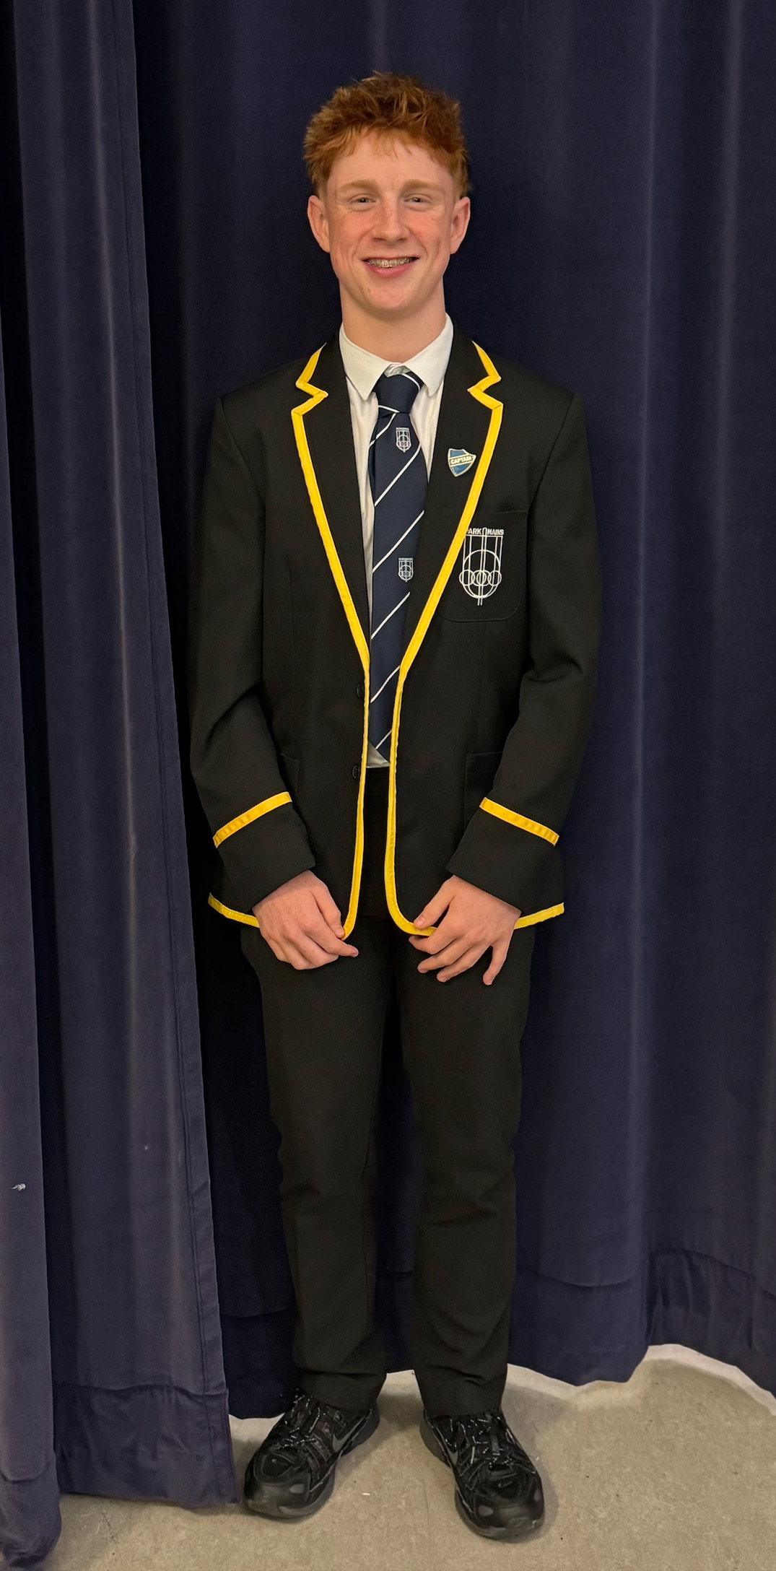
S6 School Captain
"After the first day, those nerves melted away because of the help from the teachers, support staff and older pupils in the school"

Slide 20
Key Dates
P7 Information Evening | Thursday 23rd October
Primary Visit Meeting 1 | 23rd October – 4th December
Primary Visit Meeting 2 | 8th January – 19th February
Primary Visit Meeting 3 | 26th February – 23rd April
Transition Day 1 | 5 May – 11th May (pupils attend in school groups)
Transition Day 2 Health and Wellbeing Afternoon | 20th May (All schools)
Transition Days 3/4 | Thursday 11th June and Friday 12th June
P7 Information Evening | Thursday 11th June

Slide 21








“We must prepare our children for the tests of life, not a life of tests.”
Maurice J. Elias​

Slide 22
Key Messages
Secondary School will be different, but it is a continuation of your learning – You're not starting again
Primary 7 will be an exciting year for you and you will be ready for secondary school by next August.
Our Transition programme is will let us get to know you and let you get to know the fantastic school you will be joining.

