Slide 1

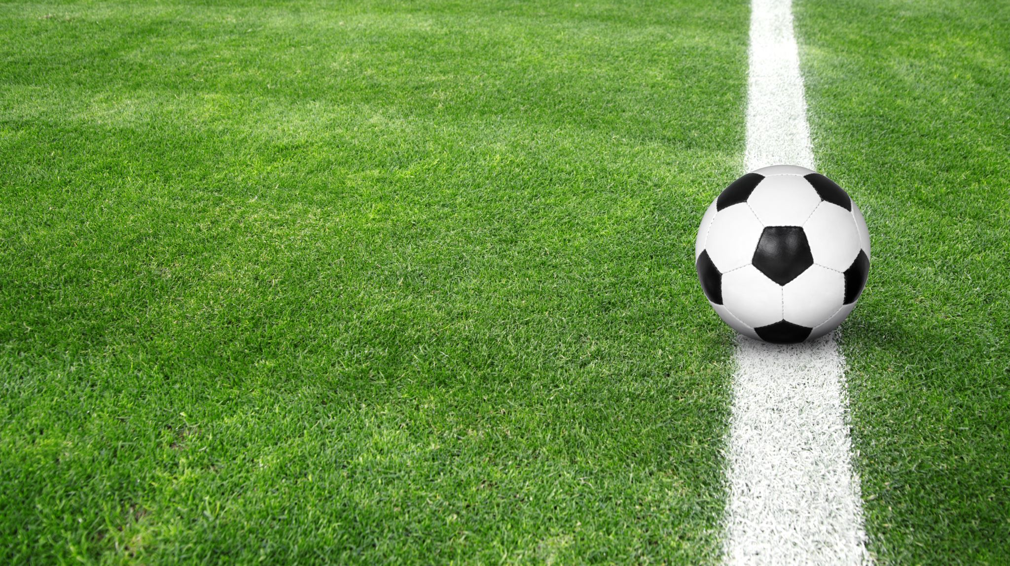

Goals for growth parents and carers information evening
Park Mains High School in partnership with St Mirren FC

Slide 2

What is the purpose of the Goals for Growth Programme?
Develop young people's social and academic skills during their first of high school.
Develop transferable skills from a football environment into schoolwork and social situations.
Capture the imagination of Young People through football to enhance engagement in school and healthy life choices.
Foster meaningful and sustainable community partnerships.

Slide 3
Key Areas of Focus – 5 C’s
Commitment – to the programme, to the development of the whole person, to each other,
Confidence – Self-esteem, confidence in own ability to lead and be part of a team
Concentration – focus on task at hand, carry role effectively, ‘staying in the moment’ (in play and in school)
Control (of emotions) – self-regulation, making the right choices, remaining calm
Communication – verbal and non-verbal, ability to listen and learn, talking on front of others

Slide 4

How will it work?
Student athletes take part in a high-quality programme of training spread across a school week/year.
A combination of extra-curricular and timetabled sessions
Pupils apply for a place (and may need to ‘trial’) before entering into a ‘contract of expectations’
Sessions delivered through a partnership with St Mirren Academy coaches, school staff, Senior Pupils and Active Schools.
Parents made aware of progress through key tracking data and pupil progress evenings in line with the rest of S1

Slide 5
Selection process
- Group discussions with staff – what do the young people want to get out of the programme?
- Technical selection days (playing ability) – participants must have a competency in football but this is not the key focus of the programme
- Teacher Recommendations – which pupils would benefit most with regards the 5 C’s

Slide 6
Content of sessions
All content will align with Curriculum for Excellence experiences and outcomes and will follow with PE Dept’s ‘Head, Heart and Hands’ BGE curricular model
Head - Tactical knowledge (Concentration, decision making when defending, attacking, 4v4 etc)
Heart – Social Skills (Commitment, Communication, Control of Emotions leading to high resilience, better teamwork, etc)
Hands - Technical skills (passing, shooting, control, finishing etc)

Slide 7
Possible S1 Goals for Growth Timetable
 | 8.00-8.40 | P1 | P2 | P3 | P4 | P5 | Lunch | P6 | P7 | After School
Mon | Session | Session
Tue |  |  |  |  |  |  | Session | Session
Wed
Thu |  |  |  |  |  |  |  |  | Session | Session
Fri

Slide 8
Monitoring and Evaluating
In order to monitor the effectiveness of the programme we will use the following:
Skill tests
Player surveys and focus groups
- Parent and Carer evenings
- Report cards which reflect progress
- Late-coming, merits
-Attendance figures (both at the class and school)
The results are monitored regularly to provide support to the pupils’ development from both a playing, academic and social point of view.

Slide 9
How will we measure success?
By creating a two year programme that pupil’s find exciting and enjoyable, but physically and mentally demanding.
Developing pupils who are engaged and passionate about football and their education.
Pupils who develop have a high skill level across 3 key areas (Head, Heart & Hands)
Pupils who not only behave appropriately during coaching, meetings and across the wider school, but take on leadership roles and become role models for others.
Showcase players for the St Mirren Academy programme

Slide 10
Questions?

