Slide 1
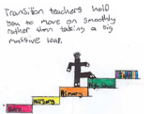
Preparing for Primary 1 Guide for parents – The world around us

Slide 2
Learning is a progression. Your child will already have many of the skills that they need to be safe, happy and to achieve well in Primary 1. The following activities will support you to continue to build your child’s confidence in their development and learning before the move to primary.

Slide 3
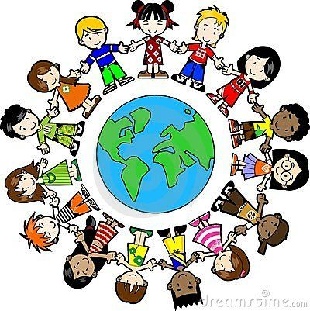
The world around us
Children find out about the world around them naturally when using their senses. Older children investigate how and why things work. They test their ideas and explore cause and effect, i.e. pouring more and more water into a container, watching as it spills over. Having an understanding of the world will help children as they learn. This will be a great skill as they move into the new environment of Primary 1.

Slide 4
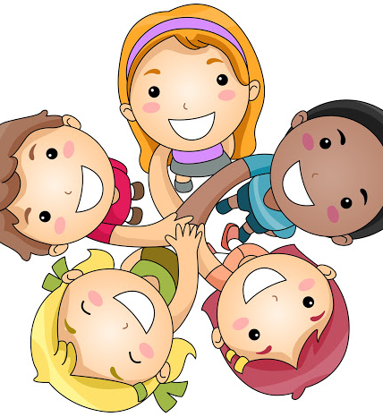
The world around us
We will look at –
People and communities
The world
Information on Coronavirus
Technology

Slide 5
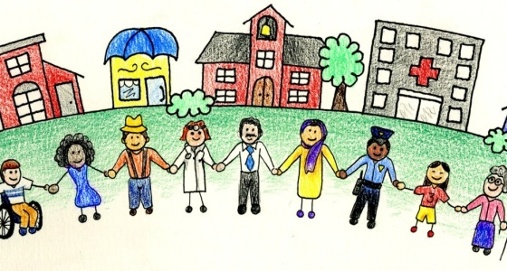
People and communities
Children learn about people around them by watching, listening and asking questions. Through talking to parents, grandparents and friends they develop an interest in their own story. This helps them to learn about how other people are different from them, yet share some of the same features and ideas. Think about how your child loves hearing stories about themselves as a baby.

Slide 6
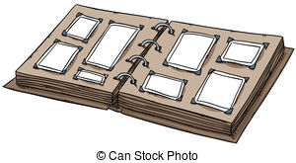
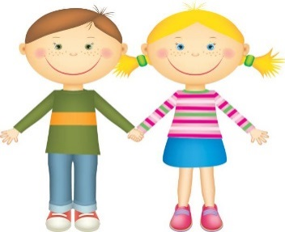
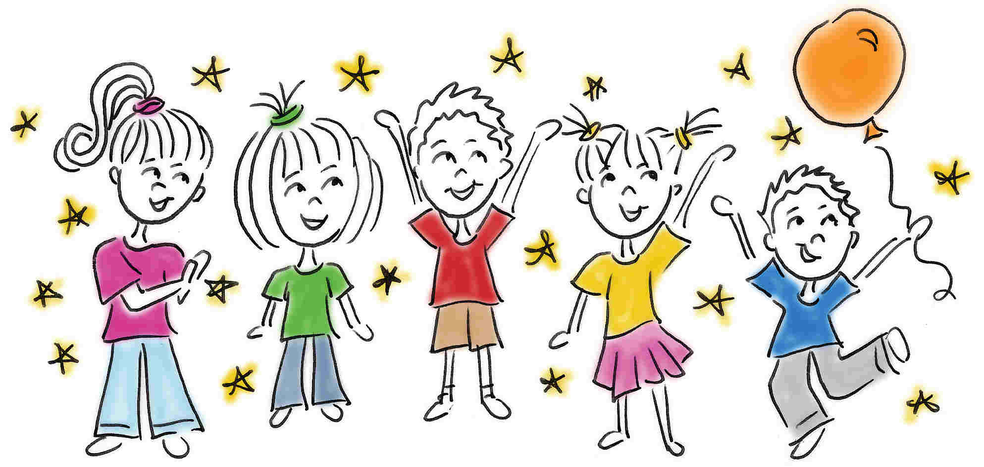
Activities and games
Make up photo albums, include grandparents if you can, talk about granny being mum’s mum! Include old baby photographs of different family members. This helps children to understand their place in the family and how important they are in it.
Encourage children to talk about what they like to do, dance, football, gymnastics, and what others like. Does everyone like to do the same? Why? What’s their favourite colour? Is it the same as everyone else? This will help your child understand that everyone has their own ideas and favourite things to do. It is important to respect other people’s ideas too.
Talk about Christmas, Diwali, Eid… festivals around the world, not every family celebrates these times. Talk about how some families celebrate these times and others may not.

Slide 7
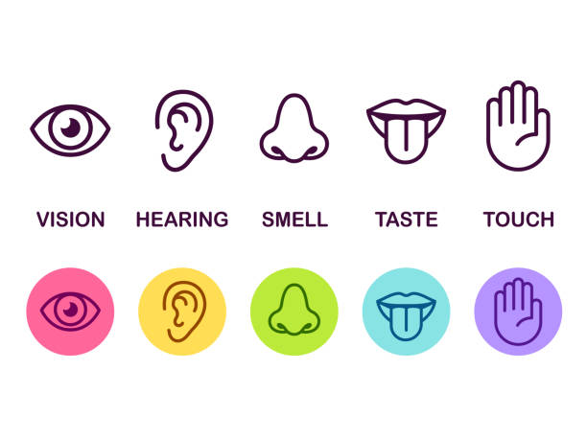
Activities and games to develop senses
Draw their attention to what food they like, Is it sweet? Savoury?
That is taste, we need our tongue for that!
Make a feely box or bag with various textures in it, ask them to feel the items and describe them, Are they soft?, Hard?, Jaggy?
We need our sense of touch for that!
Listen to sounds in the house. When it’s quiet play, “what’s that noise? Is it the washing machine? Radiator? Toilet?”
We need our sense of hearing for that!
Look at colours, grass, flowers and the sky… show lots of different colours especially if there is a rainbow in the sky.
We need our sense of sight for that!
When cooking dinner, ask them to guess what is cooking without looking at it. How do they know? What is their favourite smell? What smells do they not like?
We need our sense of smell for that!

Slide 8
The world
Children’s understanding of the world develops by noticing things around them. Finding out about places starts within their own home.
On journeys to and from home children spot signs for McDonalds, ASDA, or names on street signs, helping them recognise places around them. This understanding is helped by adults sharing their own knowledge and insights of the world.

Slide 9
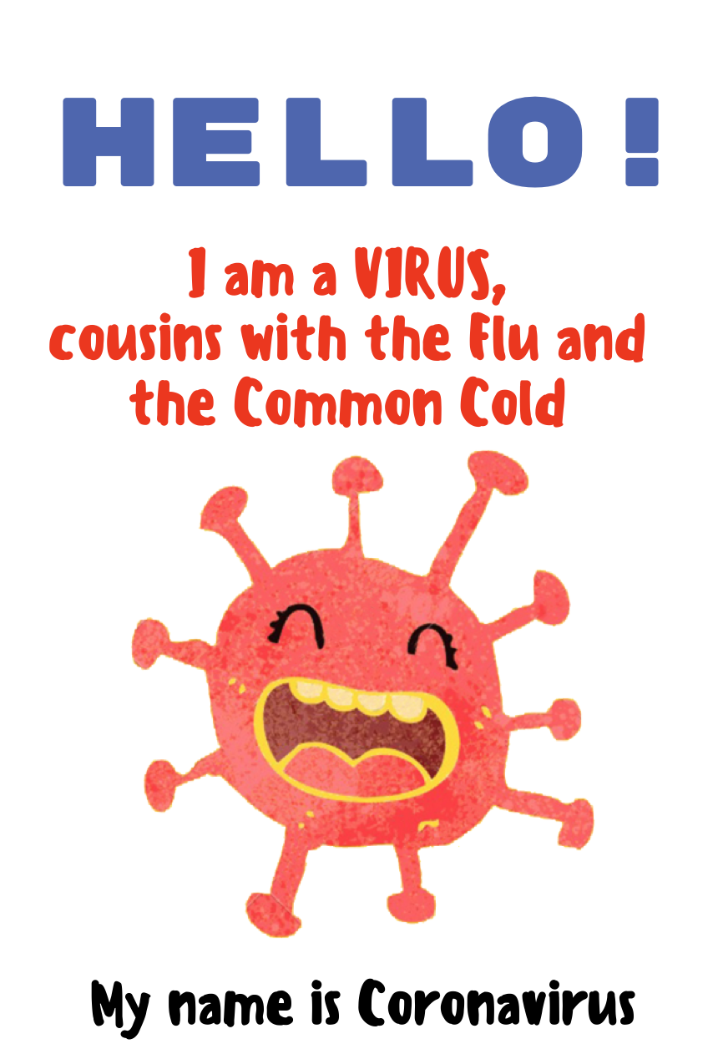
Ideas when talking about Coronavirus
Talk to your child about social distancing and why we do this. Practice with teddies and toys and spread them out pretending it’s like school for “Storytime”.
When talking about germs and keeping safe encourage frequent hand washing and drying and explain why we do this.
When out at the shops or on your daily walk if your child sees someone with a mask you can explain to them that there are germs in the world and people are keeping safe.
You can talk about keyworkers and the jobs they do: shop keepers, lorry drivers, bin men, nurses, doctors, teachers, nursery staff. Chat about their jobs and how they help us.

Slide 10
Ideas and activities about the world around us
What buildings are around your home? Schools? Shops? Who uses them? Do people work in them? Use lots of questions to promote children’s understanding of the world.
Lots of leaning takes place outdoors. How does the grass grow? What lives in the soil? How many legs does an insect have? How does a worm move? These questions and more will promote children’s thinking skills and encourage them to ask more questions to help their understanding of the world around them.
Talk about the seasons and how the weather changes throughout the year and wearing different clothes for different seasons.
Be safe in the environment. When you are out talk about the best place to cross the road, using the road crossings, waiting for the green man. Is it safe to pat dogs? Should we fear bees? Wasps? How high can we climb a tree?

Slide 11
Technology
Technology has become familiar within the home for many families and children.
Children can use it quite naturally when they play a game on a smart phone or a tablet. Understanding technology will help in Primary 1 as children use different tools each day.

Slide 12
Activities and games
Switching lights on and off, using scissors and using a mouse with a computer are all types of technology. Experimenting with these helps with understanding.
Smart phones, tablets and televisions are all widely available, children learn very quickly how to use them. Using words like delete, pause, save and screenshot will help them understand what they mean and how to use them.
Let children take digital photographs, print them if possible, its like magic to them!
Use cars and balls to roll down self-made ramps, magnets stick to metal, do they stick to wood? These activities help with understanding movement and forces within the world.

Slide 13
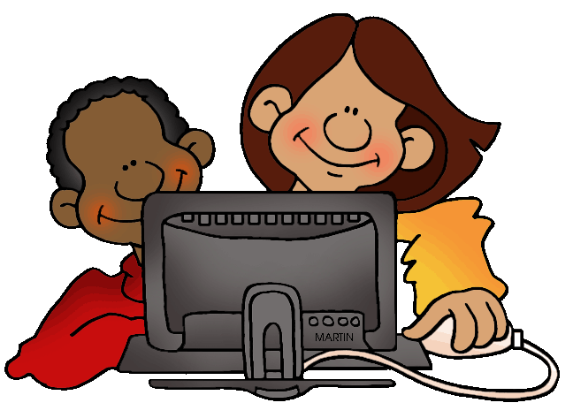
More information on Coronavirus is available here
Website links
https://www.nhsggc.org.uk/kids/supporting-children-and-young-people-during-covid-19/
These links offer more ideas when talking to your child about the world around us
http://raisingdragons.com
https://www.stem.org.uk/home-learning/family-activities
http://www.bbc.co.uk/cbeebies/grownups/understanding-the-world
https://www.bbc.co.uk/bitesize/articles/zks4kmn

