Slide 1
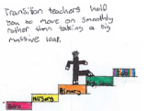
Preparing for Primary 1 Guide for parents – Social, emotional and personal skills

Slide 2
Learning is a progression. Your child will already have many of the skills that they need to be safe, happy and to achieve well in Primary 1. The following activities will support you to continue to build your child’s confidence in their development and learning before the move to primary.

Slide 3
Personal, social and emotional development
We will look at –
Building relationships
Self confidence and awareness
Emotions
Listening and understanding
Speaking

Slide 4
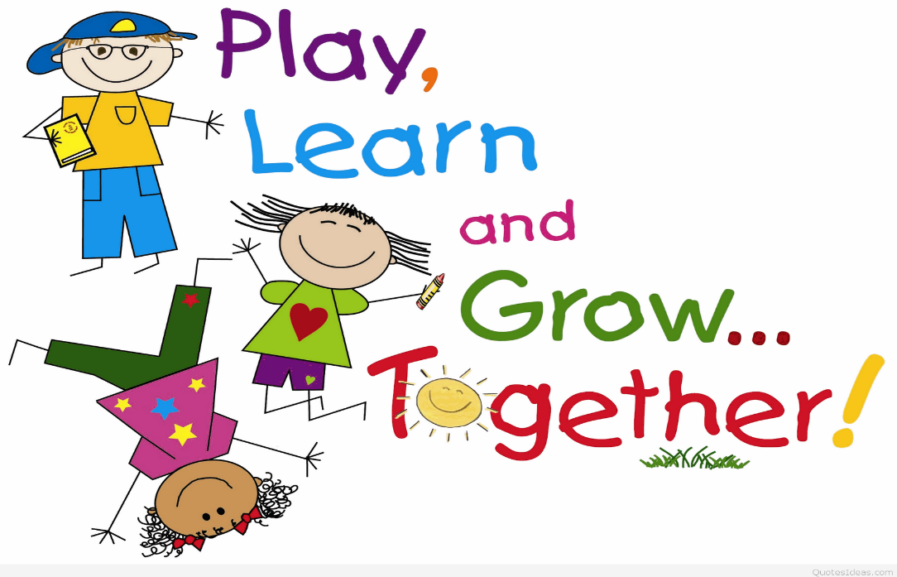
The ability to build positive relationships with others, including new friends, is something to consider as your child moves to primary. Both nursery and primary staff will continue to support children with this as they transition, so don’t worry. Opposite are six areas with ideas you can use to support your child’s growth.
Building relationships

Slide 5
1. Show them how to do it
2. Help develop a positive attitude
Your child will copy you, try to make eye contact when talking to your child lots of facial expressions- smiles, sad faces, happy etc..
3.Grow interests
Talk about their interests and let them practice something they like to do e.g. football or dancing when they meet someone new they can talk about this interest.
Children copy what they see, if they see you being kind they will copy, if they see how you chat to others they will copy this too.
Top tips for developing skills to build relationships
4. Build on communication skills
You could help by role-playing opening sentences to get the chat going i.e. Hello I'm mum what's your name? They can try to continue the chat.
5.Practice manners
Manners are key so it is important to teach your child to say ‘Please’ and ‘Thank you’. Show them how to greet adults and other children in different situations.
6. Boost confidence
Try and have as much social interaction as possible with you, family and friends. You could use social media or facetime to help your child build relationships.

Slide 6
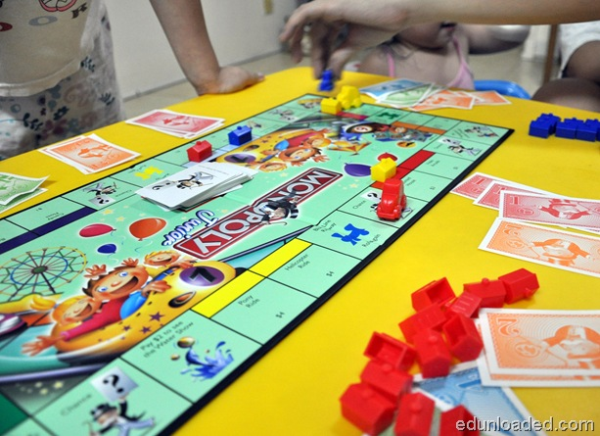
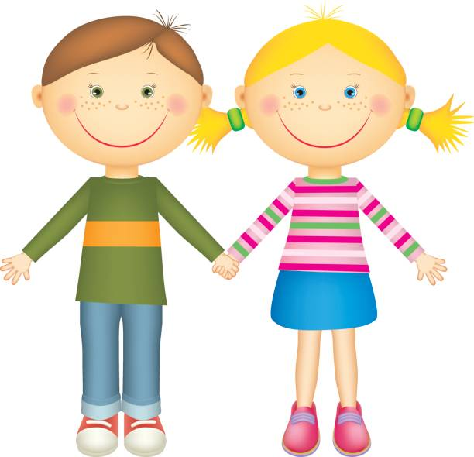
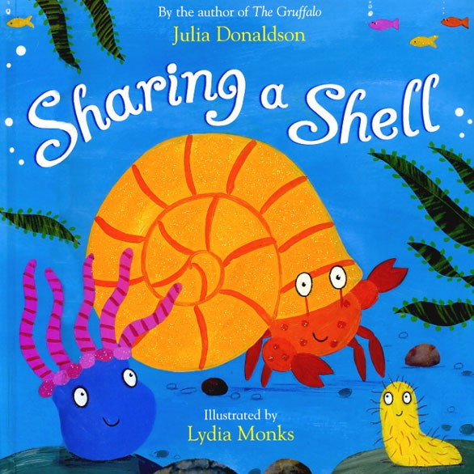
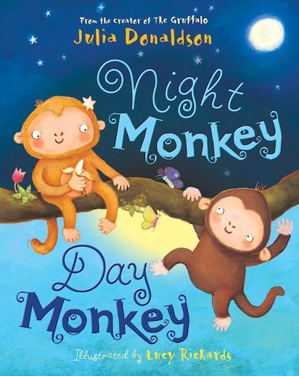
Activity ideas
Games:
Dominoes, Snap, Monopoly, Frustration, Jenga –these games promote turn taking which will help in school.
Reading stories:
Reading stories can help children’s understanding/reaction in different situations.
Some good stories for this are:

Slide 7
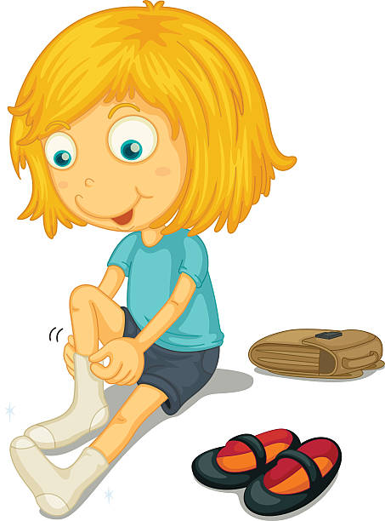
Building self- awareness and self- confidence
From taking their first steps to learning how to read, children gain self-confidence and self-awareness as they learn new skills.
This gives them the courage to continue building their skills and abilities.
Helping them to talk about frustrations and fears will help them to be more confident in lots of situations, including moving to their new school.

Slide 8
How you can help
Start Small
Notice when your child is showing an interest in getting ready or “being big” and use it to help them try things by themselves. .
Practice, Practice, Practice
Step back and let them try. They might get it wrong the first 5 times, but if they keep trying and with a little help in the right direction they will get there.
Let your child do things for themselves
It’s easier to do things for them for quickness but in school there are less adults. Therefore let them practice pouring milk, tidying their plate away and changing their shoes all on their own.

Slide 9
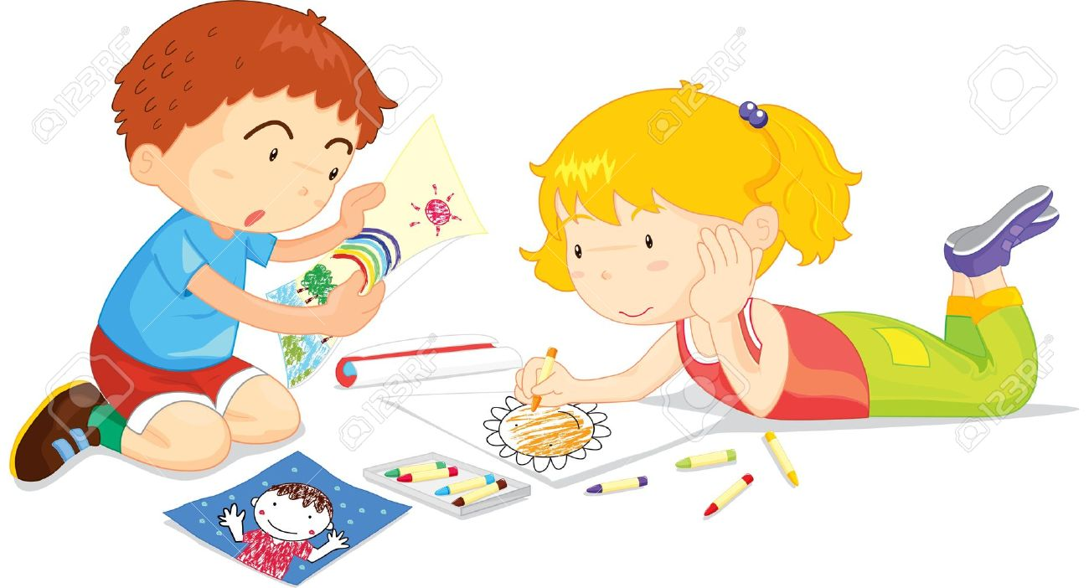
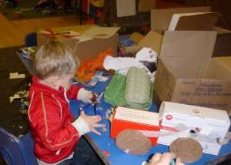
Games and activities to build self-confidence and self-awareness
Getting dressed: Encourage your child to get themselves dressed in the mornings and at bedtime. Let them get stuck and wear the top inside out, it’s okay, at least they tried and next time talk about it being inside out and how to fix it.
Drawing: Chat to your child as they draw. What are they drawing? What's happening? Who's that? Why are they doing that?
Junk Modelling: Encourage your child to play with junk that can be found within the house (as long as it is safe). Pick different things they need and let them create their own junk model.

Slide 10
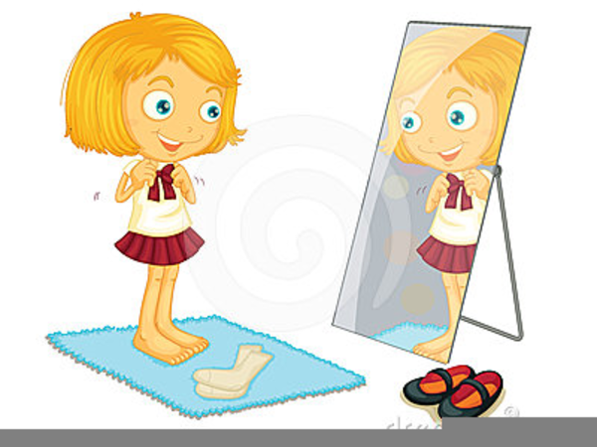
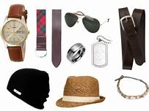
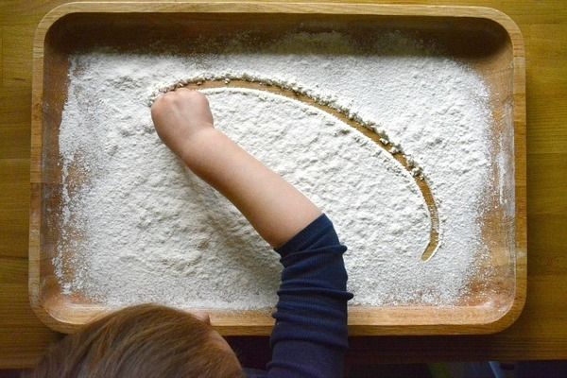
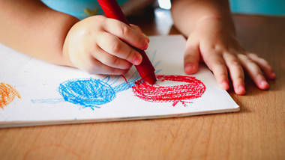
Role play and drawing to support self-confidence and self-awareness
Role play
Let your child play with lots of real clothes. Let them try to put the things on by themselves. If you have anything with zips, buttons or poppers it’s good practice for school.
Drawing- Using a range of writing tools and surfaces is good for building pencil control. Asking your child to talk about their picture is a good way to develop their confidence, listening and talking skills.
Drawing method | Writing tools | Surfaces
Painting | Pens/pencils /crayons | Paper/card /cardboard/boxes
Printing | Chalk/charcoal | Whiteboard/chalkboard
Drawing | Paintbrush/sponge | Easel/fence/pavement/ground
Rubbing | Fingers | Malleable resources, flour/shaving foam/sand
Talk to your child about their drawing
What did you use to make your picture?
What made you draw this?
What is your favourite part of the picture?

Slide 11
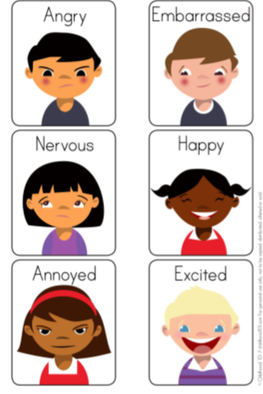
Development of feelings and emotions
Help your child to understand change and develop their awareness of how other people feel. Let them see how you react to different situations and talk more about your feelings. This is a great skill to develop as your child moves to Primary 1.

Slide 12
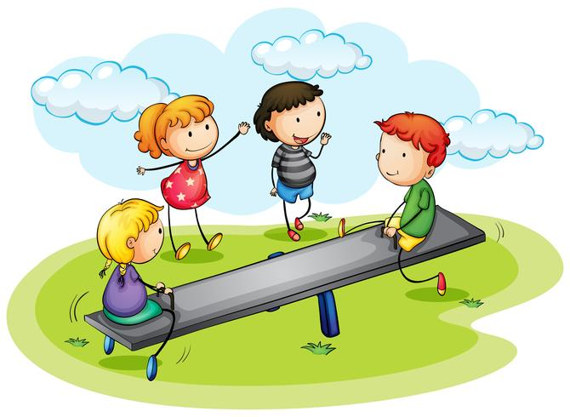
Top tips for understanding emotions and feelings
Change the language
When your child is upset, try not to ask:
“What's wrong?” Instead try:
“What's happened?” This will help them to think about why they are upset and what's made them feel this way
Change the plans
Help your child cope with this by changing plans slightly.
E.g. you always go to the park then the shop. Change this by going to the shop then the park.
If your child is upset you can reassure them that
plans change but that’s okay.
Golden rules
Rules give boundaries and this helps your child understand acceptable and unacceptable behaviour.
These five are used in school and nursery
Kind hands
Listening ears
Kind words
Quiet voices
Walking feet

Slide 13
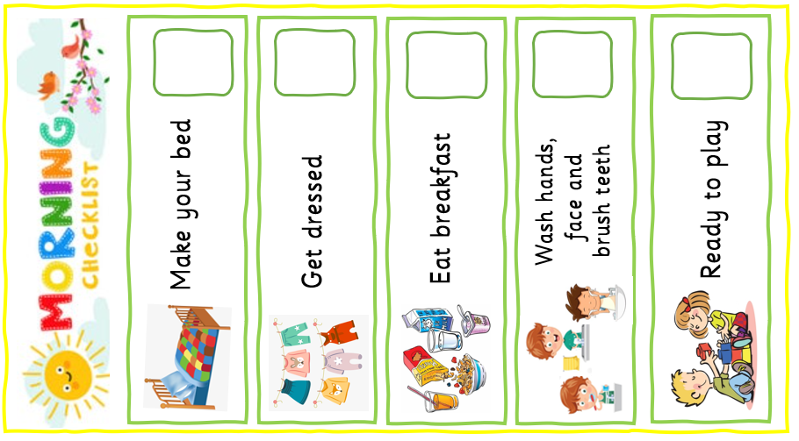
Top tips for understanding emotions and feelings
Consistency is key
Try to make sure all the adults around your child know the rules and boundaries.
This means when they go to grannies/aunties… there will be no mixed messages
A morning routine
A morning routine starts the day off nicely
E.g:
Up in the morning
Breakfast
Get washed
Brush your teeth
Get dressed
Bit of down time,
wee play with toys
Jacket & shoes on
Time to go
When learning about emotions there can be lots of confusion

Slide 14
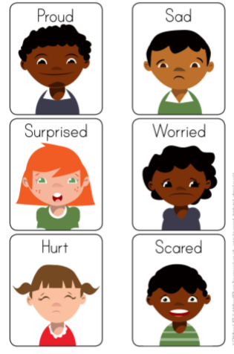
Stories and games to promote emotional understanding
Feeling scenarios- Talk about how different people feel when reading stories, watching films or when a friend or sibling is upset. You can also talk about how people are feeling using puppets or written notes or pictures that you make.
Facial expressions- Use mirrors to make different faces, ask your child if they know how you are feeling. This will help them recognise how others are feeling when they see a certain face.
No Matter What- This story discusses the bond between parents and children. It focuses upon love and loss, and helps support discussing loss and death in away that can be comforting to children.
There are many places to find information on bereavement and loss.
There are excellent resources and information on:
Child Bereavement UK

Slide 15
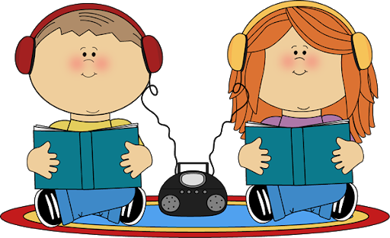
Listening, attention and understanding skills
To help your child:
Remember to praise them, it is not easy!
Sometimes your child may need to be encouraged and rewarded for gaining attention skills, you could give a “Now and Next” prompt, “If we do this NOW you can play on your chute NEXT”.
Don’t rush! If your child can only manage to stay at an activity for 1 minute just work on that. You can then move onto 2 minutes and use a timer to help keep focus if needed.
Children should be able to follow instructions involving several ideas or actions.

Slide 16
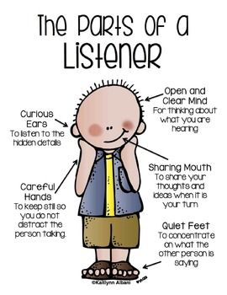
Top tips to support listening
Reduce background noise, turn off tv, radio and close windows while you are working on listening and attention skills. It will make a difference
If possible organise something for other children to do to avoid distractions
Keep it short, 5 to 10 minutes is plenty when focusing on listening and attention skills
Be face to face with your child and include eye contact during your game
Sit together in a quiet room and talk about the sounds you can hear around you e.g. cars on the road, a dog barking, birds singing
Find a noisy toy or object e.g. a loudly ticking clock and hide it around the house, go find it

Slide 17
Listening skills for younger children
Bricks and boxes
Build a wall of bricks and a wall of boxes, say ready steady boxes, (knock boxes over) or ready steady bricks (knock bricks down).
Books
Use interactive books to gain interest in books, lifting flaps, sound buttons or puppets inside. Look at pictures talk about what is happening in them. Read the story gradually.
Sing action songs
‘Wheels on the Bus’, ‘Head, Shoulders’, ‘Wind the bobbin up’,
‘Incy Wincey spider’, etc.
Use whatever they are interested in to help keep them engaged, let them choose! If they love unicorns, choose a unicorn book to look at and read or play hide the unicorn. Can they listen to and follow instructions to find it? How many instructions can they follow?
Take turns to keep interest going.

Slide 18
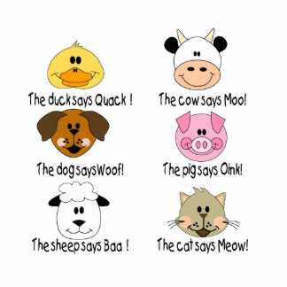
Games and activities to promote listening and attention skills
Jack-in-the-box – Child stays crouched down until they hear the alarm/clap/bang then jump up.
Musical Bumps/ Statues - Play music and children must sit down/ stand still when the music stops.
Animal sounds - If you have 2 identical sets of farm animal toys, hide one of the animals under a box and imitate the noise it makes. Encourage the child to listen and find the animal that makes the same noise then check if it matches the animal under the box.
Hide and Seek- Hide two or three objects, letting your child watch you as you do it. Let them go and find each object as you ask for it.

Slide 19
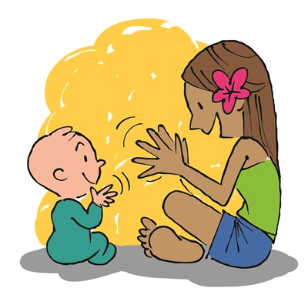
Games and activities to promote listening and attention skills
Kim’s game- Start with 5 different items on a tray/table and a tea towel to cover it up e.g. Pencil, fork, hairbrush, keys, sock. Ask child to really look at what is there and then cover up and take one item away. Can they guess what one is missing?
If you are wearing- Child listens and pays attention to instructions from you.
“If you are wearing red touch your head”. “If you are wearing blue, point to your shoe”. They have to pay close attention to what they are wearing and what to do!
Can you copy me- Follow a clapping pattern, you clap a pattern, the child copies it.
Are you listening- When reading a story with your child, stop before turning the page at some points of the story. Ask “What do you think will happen?” “How would you feel?”.

Slide 20
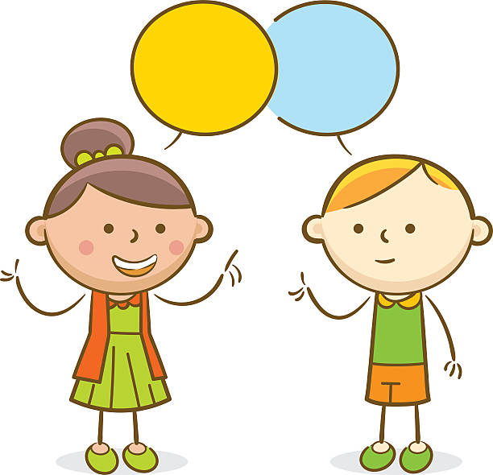
Developing Speaking Skills
Hello, my name is
Sarah
Hi, I am Tom
Children are surrounded by words and sounds during their daily life, they soon pick up that print in books, on buses and paper can ‘say’ something too. Adults and older siblings can encourage children to become confident and fluent speakers by being role models and promoting an interest in the ‘stories’ they tell.

Slide 21
Top tips to support speech
Read and discuss lots of stories, make up your own stories with your child as the “star”. Encourage them to make up their part in the story and then retell it
Use puppets and dolls to retell the story and have a pretend audience to encourage confidence in expressing themselves
Have a family meeting encourage your child to be part of it. What would they like for dinner? Where could the family go for a walk? Ask them about their wishes, then have a vote
Explain how important it is to listen to others, set examples of this throughout your day, look at peoples faces. Do they look happy/ sad…? How do you know?
When talking encourage the use of “yesterday”, “tomorrow”, “last week” in your conversation. If they say “the other day” repeat the sentence they have said with the correct terminology
The main thing you can do is allow your child the time to chat. Make sure you listen and hear their stories
My name is…
I feel happy today!
How are you today?
Hello
Hiya!
Me too!

Slide 22
Games and activities to promote a positive speaker
Name three things
Name 3 things you can…
Eat with… put in a school bag… put in a lunch bag... put in a cup… find 3 things that are red…
This game can continue anywhere you go, it encourages children to think, use and discuss descriptive words, all while having fun, they can take turns asking the questions.
You can change the amounts of items being asked for e.g. 5 things or 10 things.
Who am I?
Print or write cards with pictures on them, or just make it up!
Red Riding Hood, Goldilocks, Gruffalo, unicorn, mouse, dog.
Take turns guessing who/what they are
e.g. “I have 4 legs” “I have a tail” “I can fly”
I went to the shop one day…
“I went to the shop and bought”- you and your child take turns to shop
1st person says “I went to the shop and bought milk”
2nd person says “I went to the shop and bought milk and bread”
3rd person says “I went to the shop and bought milk, bread and jam”
This game helps children to listen, extend their memory, and build their vocabulary.

Slide 23
Examples of activities and online resources

Slide 24
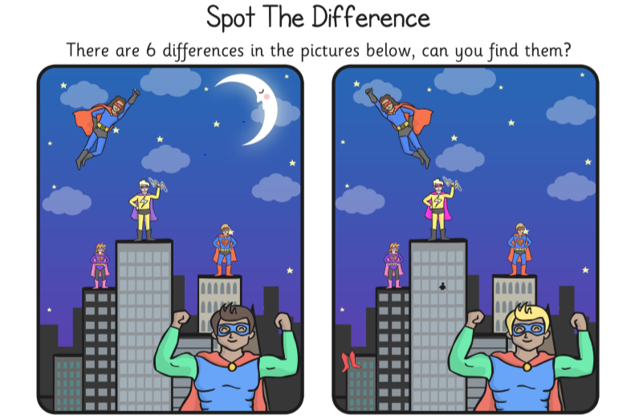
Encourage your child to talk about the differences in the pictures.

Slide 25
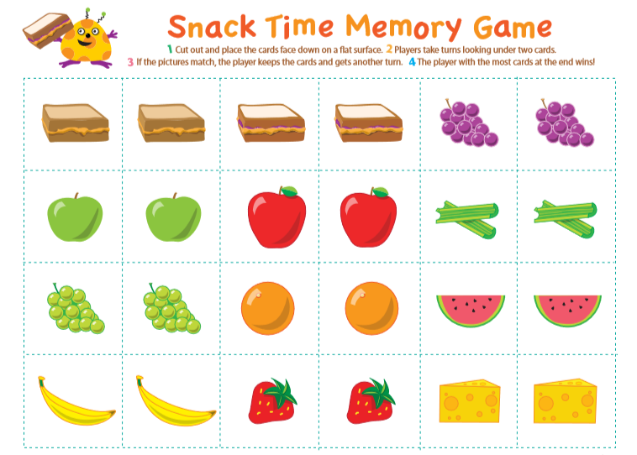

Slide 26
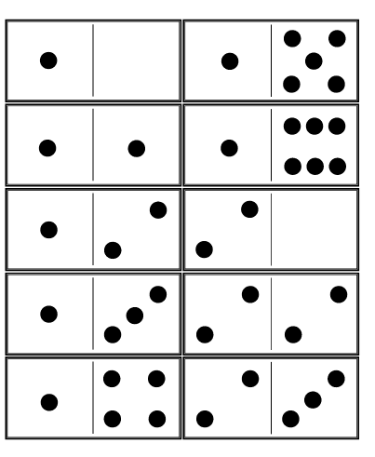
Dominoes

Slide 28
Online stories:
Being Kind – https://www.youtube.com/watch?v=kAo4-2UzgPo
Selfish Crocodile- https://www.youtube.com/watch?v=0-NhjfJ_RZI
The Hare and the Tortoise - https://www.youtube.com/watch?v=01WM87zeIzY
The Little Red Hen - https://www.youtube.com/watch?v=2E72TZy0LNo
The Lion and the Mouse -https://www.youtube.com/watch?v=0F2dNzIf4jo
It’s My Turn https://www.youtube.com/watch?v=xJBk9mJwkeI
No Matter What- https://www.youtube.com/watch?v=tD6e3rxL9Is
Online resources:
Managing feelings- https://www.bbc.co.uk/bitesize/articles/zmmgrj6
Questions when drawing - https://minds-in-bloom.com/8-questions-to-ask-children-about-their/
Tips with drawing - https://www.booktrust.org.uk/news-and-features/features/2017/july/tips-for-talking-about-drawing-with-children/
Starting school- https://www.bbc.co.uk/teach/starting-primary-school/zvbthbk
Big hopes big future - https://www.home-start.org.uk/Pages/Category/big-hopes-big-future
Starting school- https://www.parentingacrossscotland.org/news-events/posts/how-well-do-we-prepare-young-children-for-the-move-to-primary-school/
Go explore app- mindfulness- https://www.bbc.co.uk/mediacentre/latestnews/2020/cbeebies-mindulness-app

