Slide 1
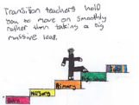

Preparing for Primary 1
Guide for parents – Starting school

Slide 2
Learning is a progression. Your child will already have many of the skills that they need to be safe, happy and to achieve well in Primary 1.
The following activities will support you to continue to build your child’s confidence in their development and learning before the move to primary.

Slide 3

Starting school
We will look at –
Top tips for starting school
Countdown to starting school
Greg starts school

Slide 4

There are many different ways you can help your child to prepare for Primary 1. You may be familiar with some of the suggestions in this booklet. However, we have tried to create some new ideas you can try. Encourage your child to do things independently, showing patience if they make mistakes.

Slide 5

Top tips for starting school
• Do up their own buttons and zips
Change shoes by themselves
• Take off their coat/gloves/hat and hang them up
• Tidy and clear away their toys
• Use a tissue to wipe their nose
• Recognise their own clothing and name label
• Share their toys and be prepared to take turns
Is confident going to the toilet, wiping bottom and washing hands properly
Children who try to practice these skills settle in better at school.

Slide 6

During the summer
Practice opening snacks, lunchbox and school bag. Try to encourage using cutlery
Try and read a book every day
Try and count your steps everywhere you go forwards and backwards
Point out numbers and letters around you
Establish a bedtime routine that will work for school
Practice going to the toilet on their own and wiping bottom, washing hands
Play sharing games and talk about kindness and making friends at school

Slide 7

The week before school
Practice putting on uniform by themselves
Practice changing into gym clothes by themselves and changing shoes
Write their name on bits of paper and send them on a hunt to find it
Label all uniform and all items that could get lost water bottle, shoes, pencil case…
Have a trial morning, get up, have breakfast, uniform on, walk/drive to school have a look through the gates at the playground and talk about playtime, lunchtime and new friends

Slide 8

Day before school
Have a relaxing, fun filled day if you can
Talk to them about what to expect and the plan for the morning
Lay out uniform and school bag ready for the morning, jacket and shoes at the door
Have a final look at Greg starts school in this booklet
Have a big sleep all ready for a fun day at school

Slide 9
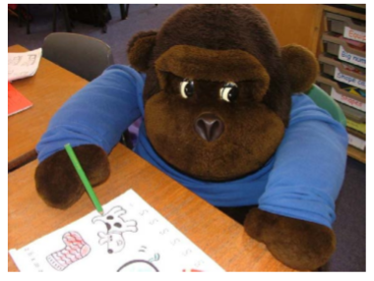
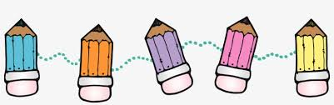
Starting school
We would like you to meet Greg the Gorilla, he’s going to be starting his first day in Primary 1. We thought you would like a little story about what happens at school and what he gets up to.

Slide 10
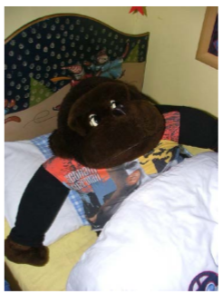
Greg was so excited he woke up early thinking about his first day at school.

Slide 11
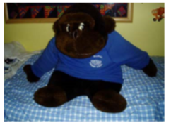
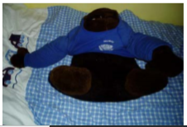
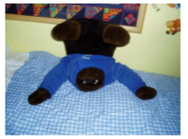
Keep trying !
Got it !!!
Almost !
He went and had some breakfast with his family and started to get ready. Greg had a real struggle getting his new school sweatshirt on – they were really meant for little boys and girls and not little gorillas. He took his time, kept trying and he did it, all by himself!

Slide 12
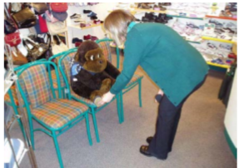
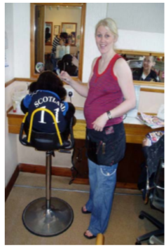
Greg had been looking forward to starting school, he told everyone he met that he was really excited!

Slide 13
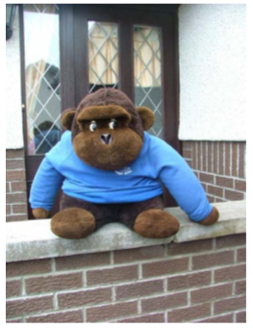
With his uniform on he was ready to go! He had packed his bag the night before and loved his new pencil case.
On the way out the door mummy said
“STOP!! I need to take a picture of you on your first day of school”
“Okay” said Greg and he showed his mum his biggest smile.

Slide 14
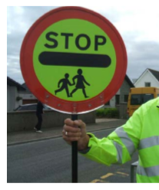
When Greg arrived at school, it was quite busy with grown ups dropping their children off.
The lollipop man guided the children safely across the road holding up the big lollipop stick to say STOP!
Greg said thank you to the lollipop man and crossed the road safely to school.

Slide 15
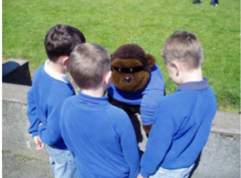
When Greg went into the playground he spotted some children he knew from nursery and his street.
They talked about how excited they were but Greg felt a little nervous, he wanted to go into his classroom and meet his teacher!

Slide 16
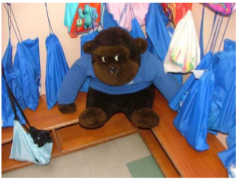
Greg was so excited when he finally got into the cloakroom and found his special peg. He hung up his jacket and his bag.
Greg was a little worried he would lose his things but it was okay because his name was on all of his belongings! He had practiced finding his things around the house so he knew what they looked like.

Slide 17
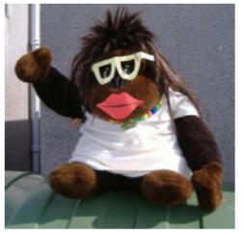
It was time for the grown ups to leave.
Greg waved bye bye and went in to start his first day in Primary 1.

Slide 18
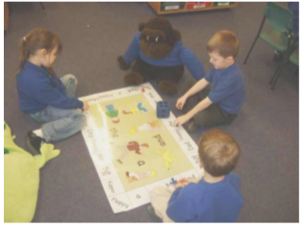
Greg played with his friends in the classroom.
His teacher was really pleased with how well they played together, Greg was being a kind friend.

Slide 19
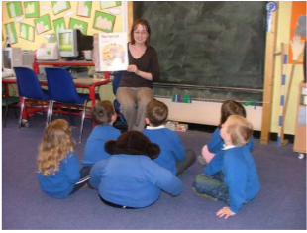
The teacher read a story to the class. Greg sat quietly with his friends and listened to the story. It was one of his favourite stories from home! The bell went and it was time for snack time.

Slide 20
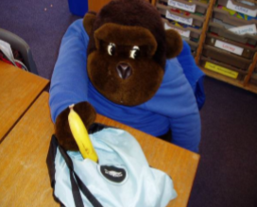
Greg took his snack out to play with him.
He was so excited it was his favourite snack…
A BANANA!!
His P7 buddy helped him to get ready to go out and showed him around the playground.

Slide 21
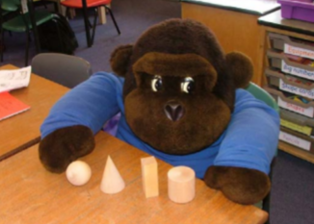
Soon it was lunch time, Greg ate up his lunch in the lunch hall, played outside for a little while and then went back into his classroom.
The teacher had made lots of learning challenges for the children to try.
Greg picked the 3D shapes, he liked learning about different shapes.
Greg had so much fun, that before he knew it, it was time to go home!

Slide 22
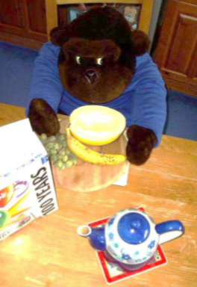
Greg was so excited to see the adults at the gate and tell his family about his first day at school.
He told them all about his buddy, playing in the classroom and outside.
After dinner Greg listened to a bedtime story and was soon fast asleep. He was tired after a busy day at school.
The next morning Greg woke up and had a big healthy breakfast.
He couldn’t wait to go to school and do it all again!

Slide 23

We hope you have a lovely first day at school!
Thank you to Hillhead Primary for the pictures of Greg and his friends.

Slide 24

Websites for more information
Some reading for parents with children starting school in August.
https://education.gov.scot/parentzone/my-child/transitions/starting-school/
Learning ideas from parent club
https://www.parentclub.scot/topics/play-learn?age=4
Bookbug for songs and rhymes
https://www.scottishbooktrust.com/songs-and-rhymes
Top tips for parents with children starting primary school
https://www.parentingacrossscotland.org/publications/top-ten-tips/starting-primary-school/
The following link has a variety of information on learning
https://www.bbc.co.uk/bitesize/articles/zks4kmn

