Slide 1
Early Level Transition Support for Families

Slide 2
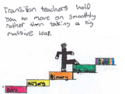
The Early Level Curricular Transition team has created 4 flipbooks for families to access via the links below. The books were created following an audit of parental thoughts and concerns around transition. They include information, top tips and activities on preparing for primary:
Learning at home
Personal, social and emotional skills
The world around us
Starting school

Slide 3
Learning at home -
https://www.flipsnack.com/Goingtoschool/guide-for-parents-preparing-for-p1-learning-at-home-fdu5635jd.html
Social, emotional, and personal -
https://www.flipsnack.com/goingtoschool1/guide-for-parents-preparing-for-p1-emotion-social-and-person.html
The world around us -
https://www.flipsnack.com/goingtoschool1/guide-for-parents-preparing-for-p1-the-world-around-us-fv1p0cpt4.html
Starting school -
https://www.flipsnack.com/Goingtoschool/guide-for-parents-preparing-for-p1-starting-school-fhcfb5fmz.html

Slide 4
Preparing for Primary 1 Guide for parents – Learning at home

Slide 5
Learning is a progression. Your child will already have many of the skills that they need to be safe, happy and to achieve well in Primary 1. The following activities will support you to continue to build your child’s confidence in their development and learning before the move to primary.

Slide 6
Learning at home
We will look at –
Reading
Writing
Numeracy
Shape, position, movement and measure

Slide 7
The importance of reading is something to consider as your child moves to Primary 1. They are listening and learning new things, by reading to them you are creating opportunities as they grow in life. Reading sparks curiosity and explains how things work in the world around us.
Early reading skills

Slide 8
Top tips for reading
Read as much as you can - Bedtime is great as it helps your child to relax and creates a good routine
Talk about what's going on - Asking questions like “Who? What? When? Where? Why?” helps your child understand what is happening in the story
Repeating or rhyming books - The Three Little Pigs, Room On A Broom etc. These books allow children to fill-in words, phrases and character’s names, as the book becomes more familiar
Try and spot words around you - Help your child recognise their name, you could point out the capital letter at the beginning
Direction of words - Use your finger to point out words as you say them going from left to right
I spy - Talking about words that start with the same sound, a game like “I spy with my little eye”

Slide 9
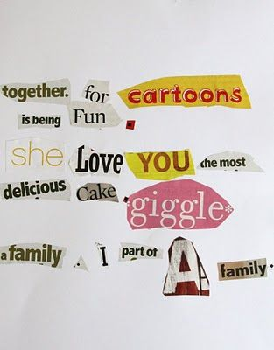
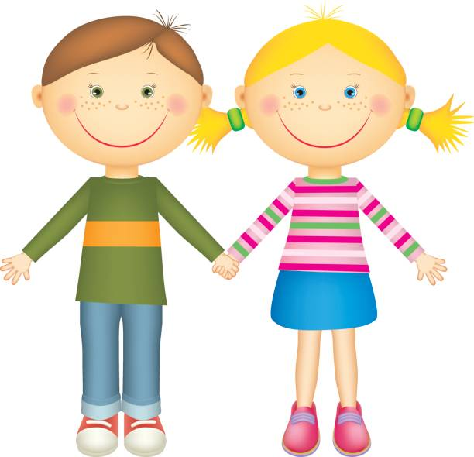
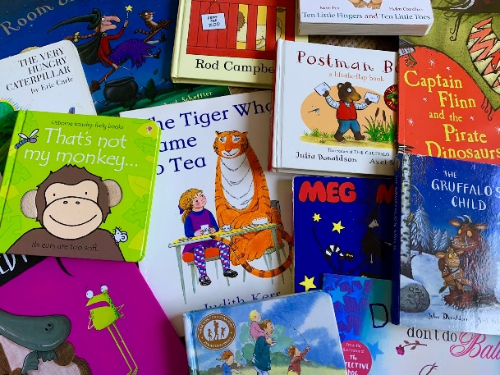
Activity ideas for reading
Look at words in old papers/magazines and cut out letters to make their name or other familiar words.
Use a variety of books, magazines, newspapers, packaging, leaflets, posters etc. Sound out some words and help to spot familiar words, letters and numbers.

Slide 10
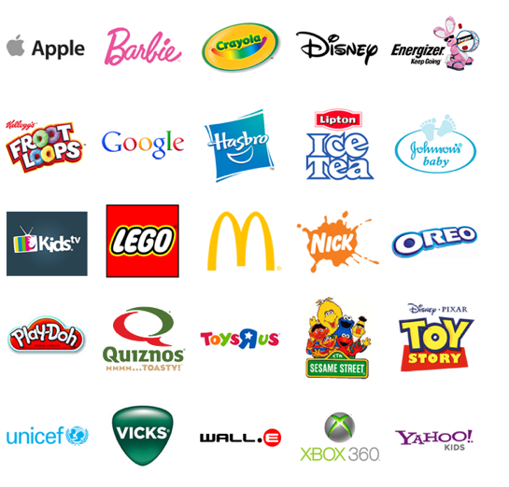
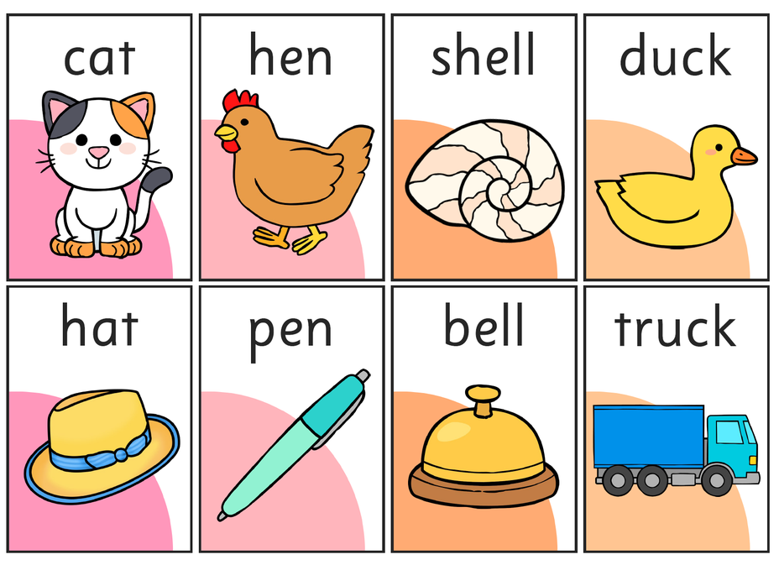
Activity ideas for reading
Point out letters and words on familiar items and signs your child may know like McDonalds, Kellogg’s, Asda etc.
Talk about rhyme and words that sound the same at the end e.g. doll – ball, cat- hat, stone – phone etc.
Put out 3 objects, 2 that rhyme and one that doesn’t and ask you child if they can hear the rhyming words, match them with the objects.

Slide 11
Early writing skills
Always allow your child to go at their own pace and praise them for trying hard.
Talking and reading as much as possible will support your child’s writing skills.
The more often children draw, the more confident they will become.

Slide 12
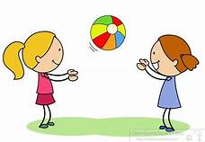
Top tips for writing
Have lots of little objects to explore, this helps develop little muscles…buttons, pegs… are perfect
Big movements with their arms and shoulders will help their pencil control as they write…try catch, yoga poses or skipping ropes
When your child is interested in writing show them their name and let them try to copy it
Talk about the sounds of the letters at the start of their name and in other words. Slow down your speech i.e. c-aaa-t
When starting Primary 1 children will learn lowercase letters first. It would be helpful to show them these letters when practicing writing
Children learn through copying. Let them see you writing things like shopping lists and cards

Slide 13
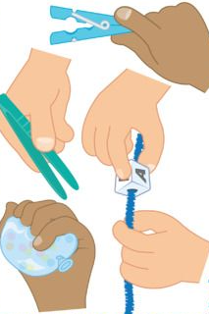
Funky finger ideas
Roll playdough with hands or a rolling pin, roll into long "snakes" then use those to form letters.
Scissor activities could involve cutting out letters, shapes numbers from papers or magazines.
Tongs or tweezers to pick up small, difficult objects.
Practice specific finger movements such as Incy Wincy Spider. "Baby Shark”, action can help children remember how to grasp their pencil.
Make letters using cardboard, punch holes around them and let your child lace in and out using different sizes of lace, thread, rope etc.

Slide 14
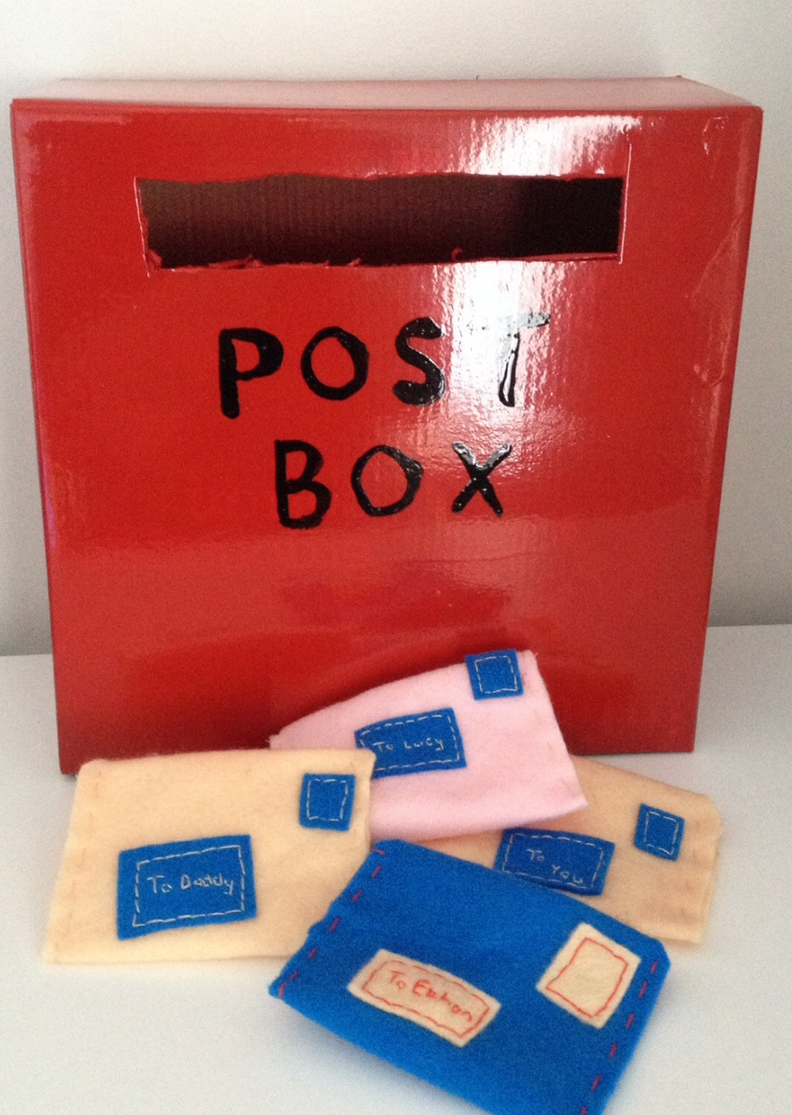
Encouraging writing through pretend play-
Shopping lists - Name items you need out loud, let your child watch as you write it down. Encourage them to write/ draw their lists. Say each sound slowly e.g. m-i-l-k.
Post Office - Make a post box, use a variety of spare or old envelopes, paper etc. let your child write a card or letter to someone, then post it.
Café - Gather several pieces of paper to make a pad to take orders.
Signs - Make signs or posters for something your child is interest in.

Slide 15
Numbers are something your child has explored as they have grown and something that they will continue to learn about as they start Primary 1. We have gathered some top tips to help your little one develop their “number sense”.
Numeracy

Slide 16
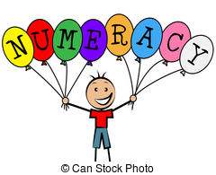
Top tips for numeracy
Numbers are all around us, you can help your child by pointing them out on doors, signs and buses
In school we use language like more, less before and after. You can help your child with this language through day to day activities i.e. Can I have more carrots? If you are 3 now what age will you be after your birthday?
Count as you go up and down the stairs this will help with adding and subtracting later on
You can help your child with maths language when talking about their height- tall, taller, tallest or with weight-heavy, heavier, heaviest

Slide 17
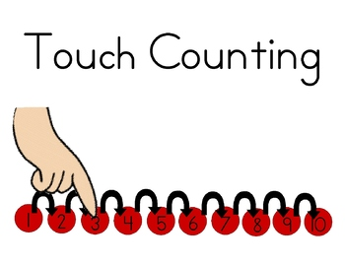
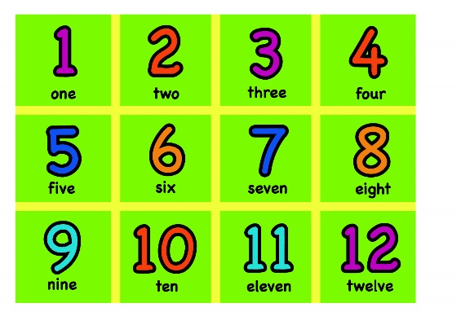
What does that mean?
It is important when children first start exploring numbers to encourage them to ‘touch count’. Meaning they should put their finger on each item as they are counting
Number recognition is a child being able to recognise the actual numeral and not the quantity that it represents
Number lines help children with the order of numbers and their recognition you can make your own by writing the numbers on the ground outside

Slide 18
Numeracy experiences at home
Go on number hunts around your home and outside, look for numbers on clocks, remote controls…
Playdough can be used in lots of ways to support numeracy. Roll it into balls then put bits of spaghetti into it to make candles on a birthday cake or put a piece of spaghetti in and use cheerios to thread on and count.
Put numbers on toy cars, up to the number your child is familiar with, put the same numbers on bits of paper on the floor to make parking spaces, or draw numbers outside with chalk. Encourage your child to park their numbered cars in the matching spaces.

Slide 19
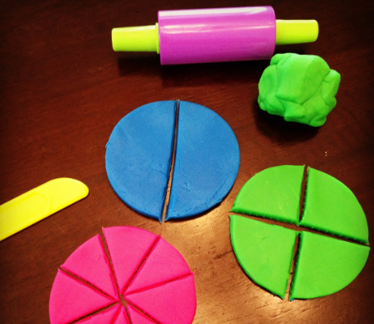
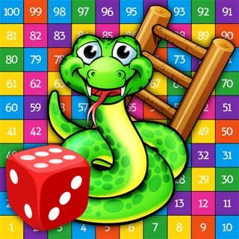
Numeracy activity ideas
Point out the time on the clock at certain times like breakfast, lunch, bedtime to help them become familiar with time and routines.
Allow children to explore money, let them look at coins and talk about their value.
When tidying up, encourage children to arrange books and toys in order of size.
When preparing meals or snacks, allow children to help cut up fruit and vegetables to develop their sense of equal amounts and sharing.
Play games involving a dice to allow them to explore and count the dot patterns.

Slide 20
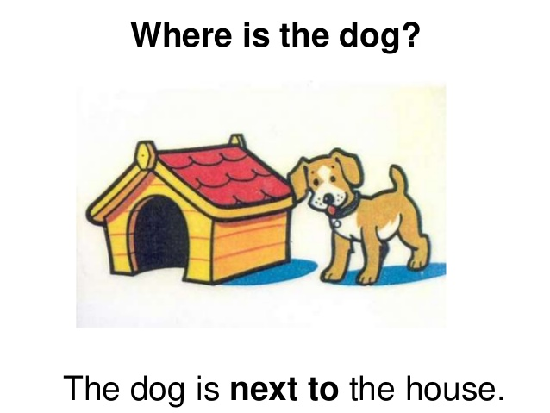
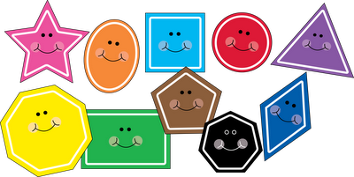
Shape, position, movement and measure
Exploring shape, position, movement and measure enables children to develop thinking, speaking and listening skills, which prepares them for interaction with others throughout life.
Children learn to make sense of the world around them, using all of their senses.
Real life or imaginary play are the best ways of offering these experiences.

Slide 21
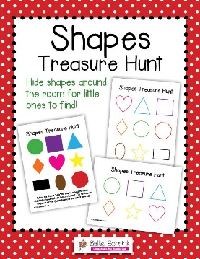
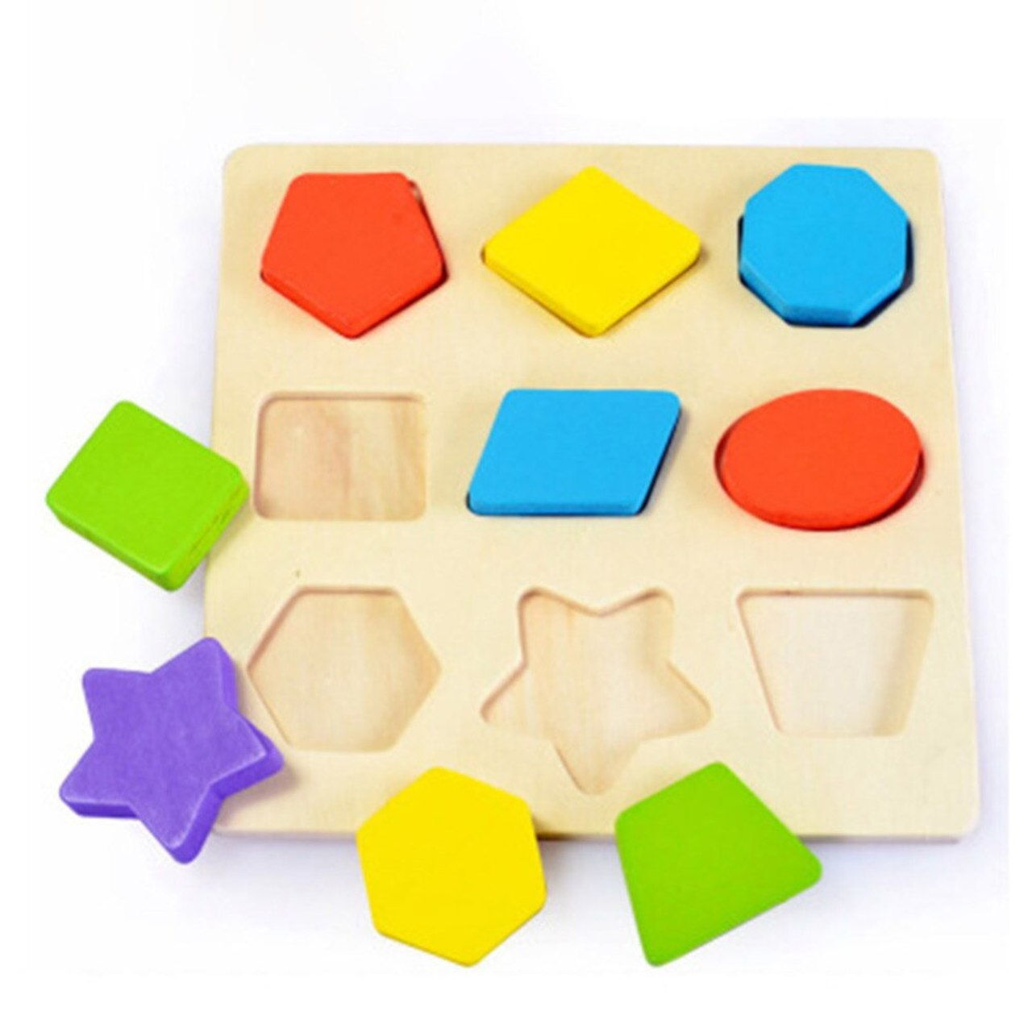
Activities to support shape, position, movement and measure
Use a variety of junk to create 3D models. It will encourage discussions about length, breadth, height, shape…
Matching/sorting into size, colour, shape. This can be done using a variety of items i.e. stones, pencils, cutlery, socks. Discussing and categorising them into size, weight and colour.
Jigsaws help your child problem solve, learn positioning, logic and encourages them to finish a task.
Construction blocks, Lego etc. helps your child to learn about solving problems. Talk about what they have made and discuss shapes and size.
Go on a shape hunt around your local area on your daily walk or around your house.

Slide 22
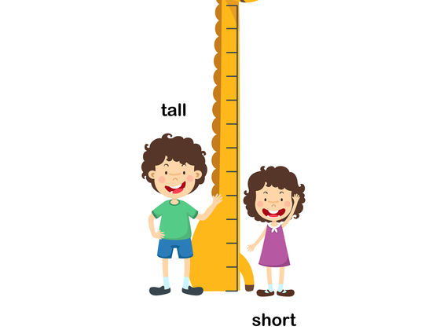
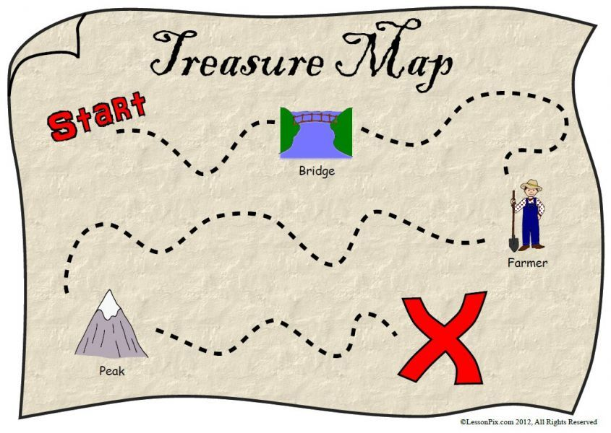
Activities to support shape, position, movement and measure
Help your child learn about patterns by pointing them out in the world around you and at home e.g. number patterns 1,2,3,1,2,3..….2,4,6,2,4,6
shape patterns
Talk about measurement in play. How tall is something? How small is it? Can you find something bigger? Who is the tallest? What one is the longest?
Talk about measure in amounts e.g. 3 cups of flour in playdough. Are the cups full? Is that more or less? Is that heavier or lighter?
Go on a treasure hunt around the garden for objects, shapes, numbers etc. Talk about the position of objects i.e. in, on, under, beside…

Slide 23
Online activity ideas
Bud’s Number Garden – includes number ordering, counting and more than and less than games.
https://www.bbc.co.uk/bitesize/topics/zjkphbk/articles/zd4b382?xtor=CS8-1000-[Discovery_Cards]-[Multi_Site]-[SL09]-[PS_BITESIZE~C~~P_NumberGame]
Teddy numbers game – counting different amounts.
https://www.topmarks.co.uk/learning-to-count/teddy-numbers
Shape monsters – Introduction to 2D shapes for children.
https://www.topmarks.co.uk/early-years/shape-monsters
Dough disco
https://www.youtube.com/watch?v=DrBsNhwxzgc
Finger gym
https://www.youtube.com/watch?v=3K-CQrjI0uY
Parentzone
Some reading for parents with children starting school in August.
https://education.gov.scot/parentzone/my-child/transitions/starting-school/
BBC Bitesize
https://www.bbc.co.uk/bitesize/articles/zks4kmn
Parents in Scotland
https://www.parentingacrossscotland.org/publications/top-ten-tips/starting-primary-school/

