Slide 1
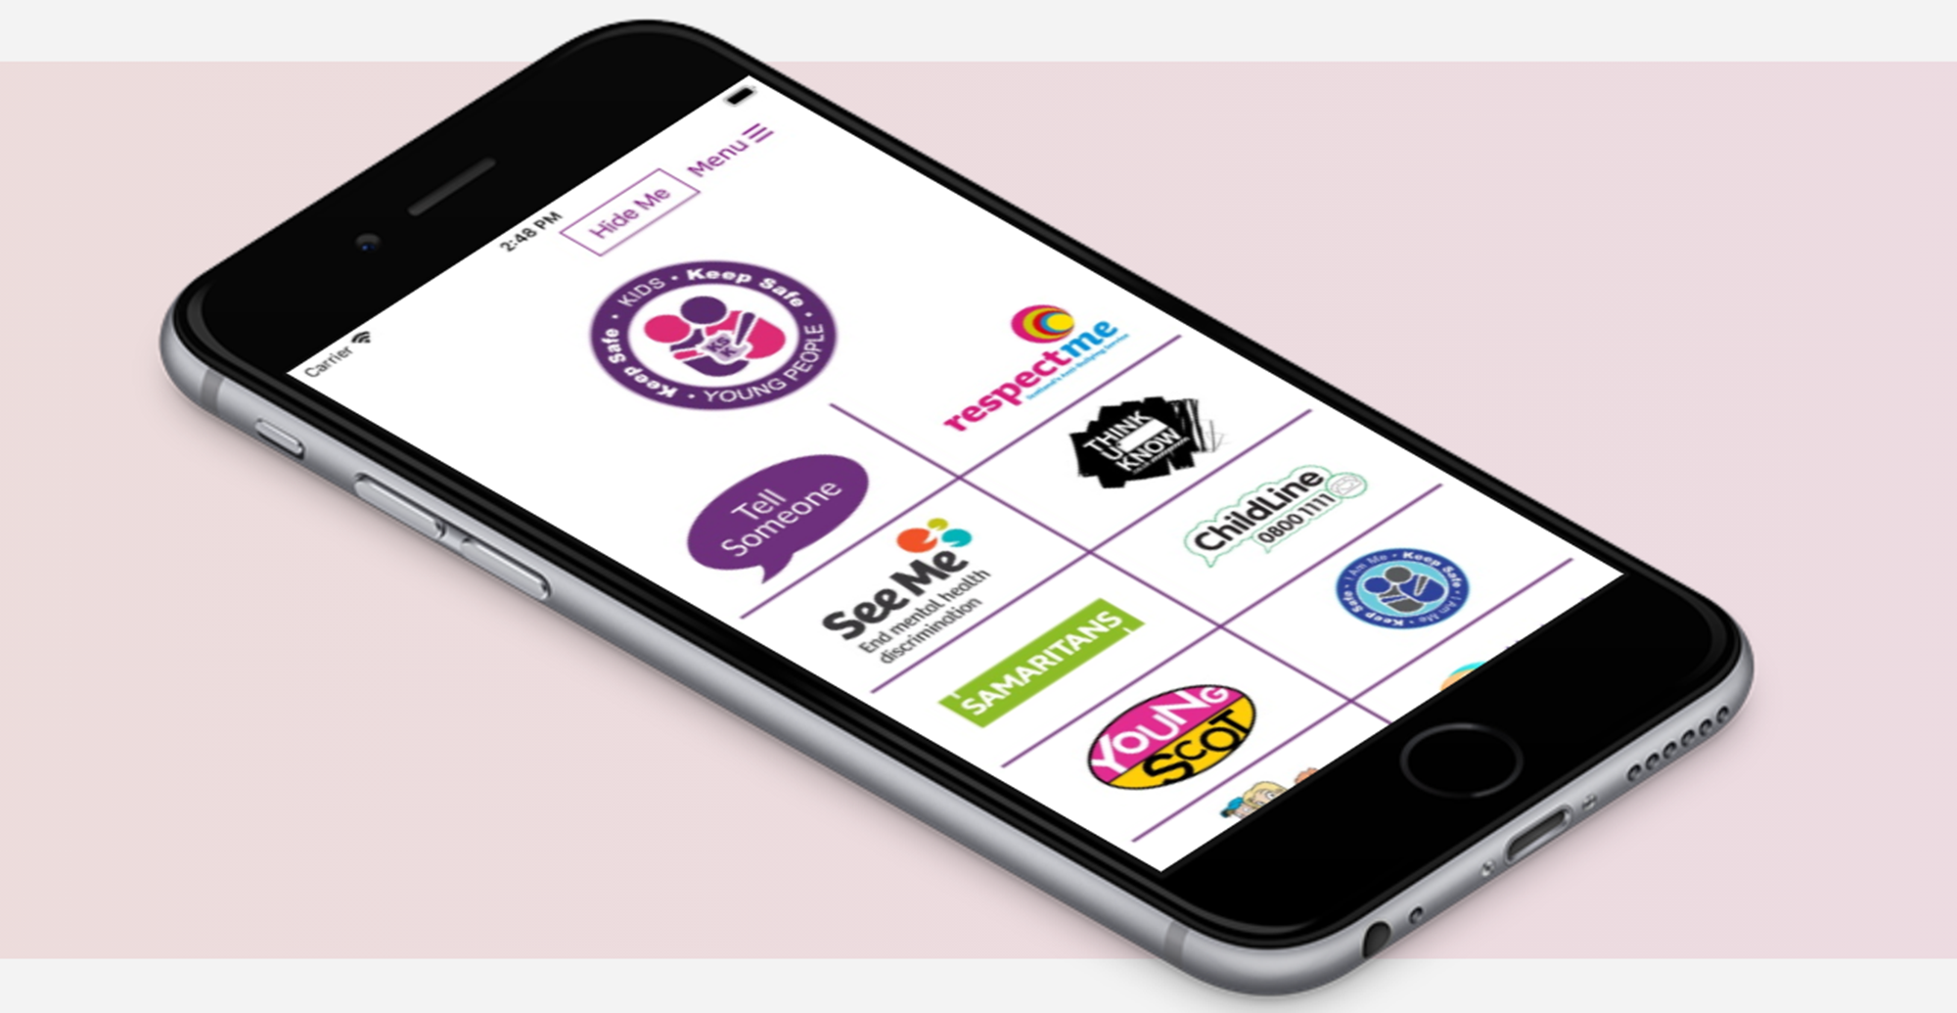

Keep Safe Kids App
Made in Renfrewshire

Slide 2
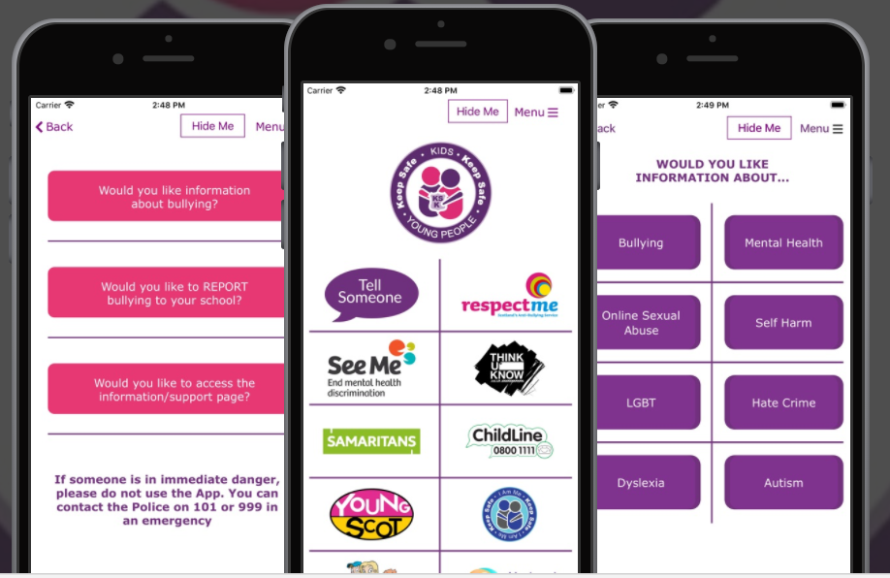
A new Support & Report App designed by young people for young people.

Slide 3
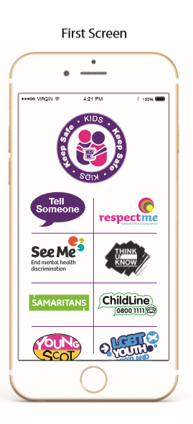
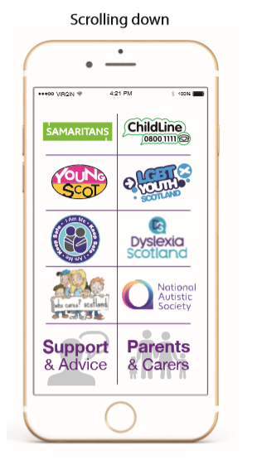
Front screen has a list of national and local organisations who can provide support and guidance on a range of topics.
When selecting a logo, the user will be directed to the organisations website (away from the App)

Slide 4
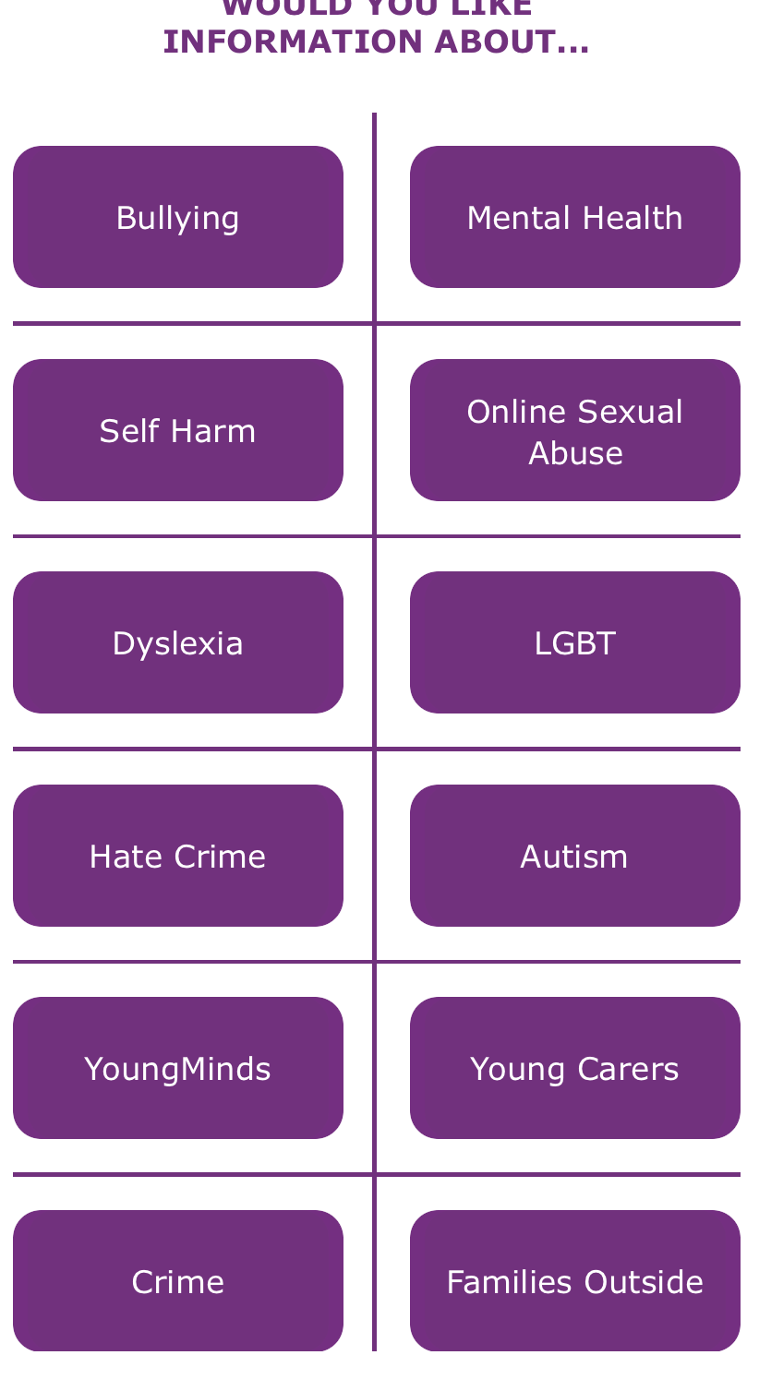
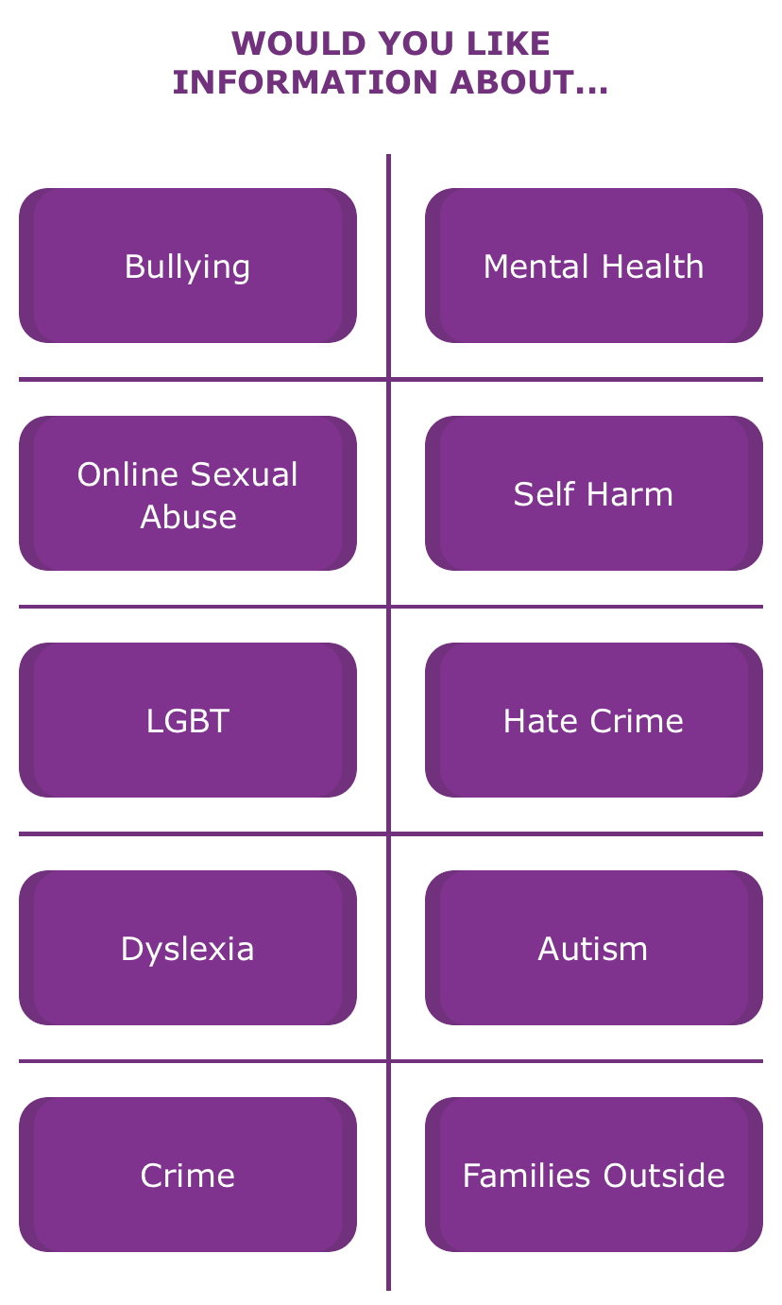
Support Pages for:
Children / Young People
and a separate one for Parents/Carers

Slide 5
Support
Links to national and local organisations
Information for children and young people on a range of topics
Advice, guidance and support available
Parents/Carers page for information for adults
All verified and approved websites

Slide 6

To report bullying – click the Tell Someone button

Slide 7
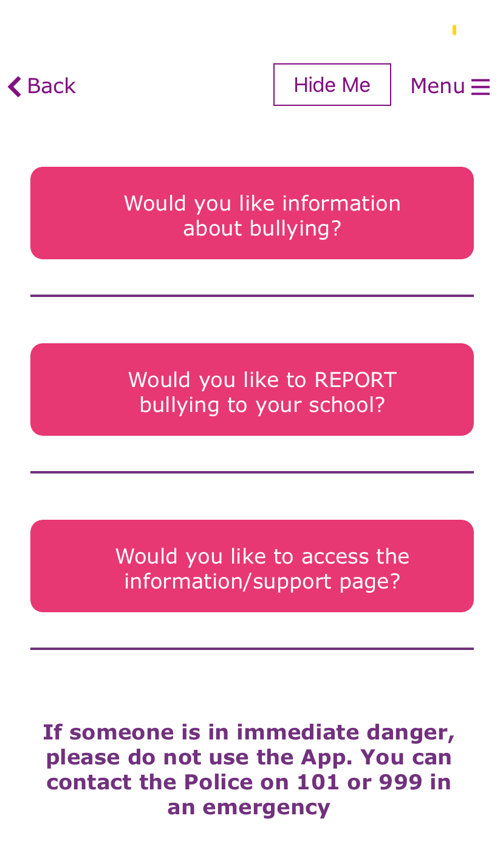
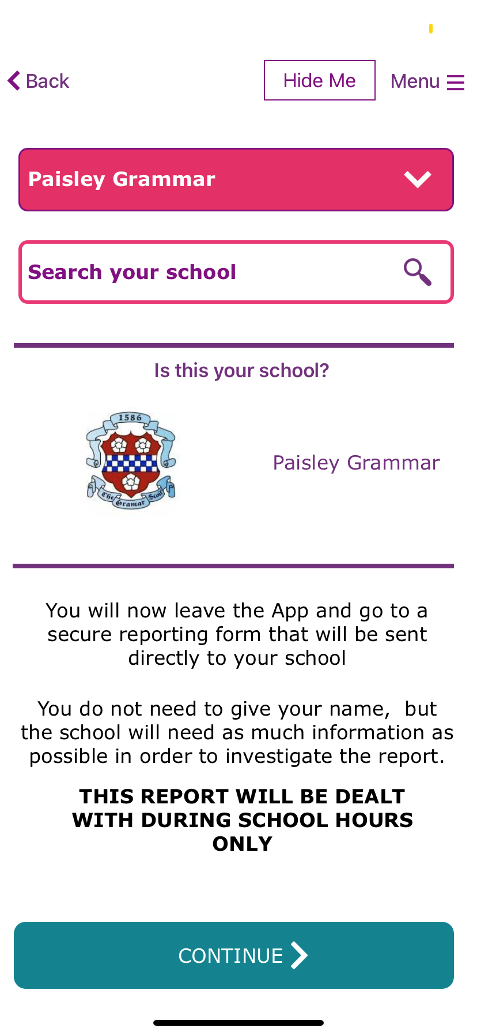
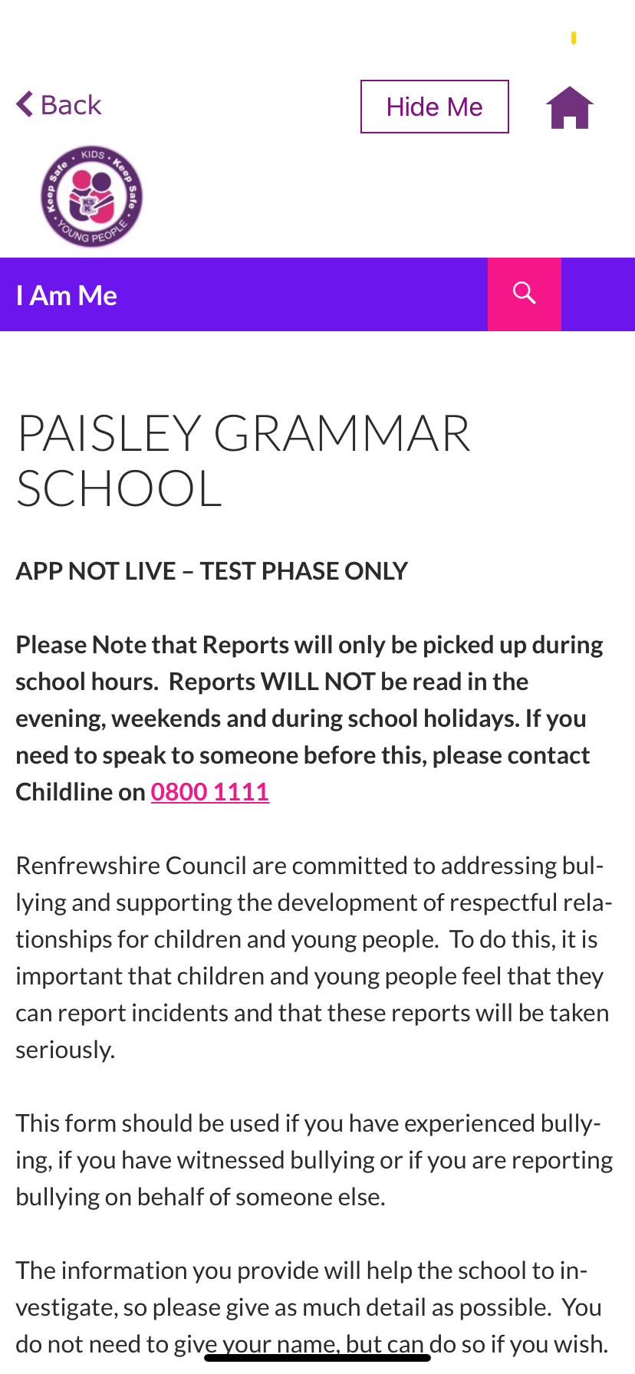
This will give you the option to choose your school and will open a reporting form.
The form will be sent directly to your school

Slide 8
How it works
The App provides a new accessible way to make reports of bullying.
Reports are sent directly to the school
Schools will only receive the reports during school hours – These will not be picked up in the evening, weekends or during the school holidays.
The school will action the report in the same way they will action any other report that they receive.
The App does not change the Anti-Bullying policy or process, it just provides a new way to make a report.

Slide 9




More information available from iamme@renfrewshire.gov.uk
In partnership with I Am Me Scotland & Renfrewshire Council

