Slide 1


Ferguslie Early Learning
& Childcare Centre
Standards & Quality Report
June 2026
​This report will inform you of our progress and achievements in the last session and let you know about our plans for 2025-2026. I hope that you find it helpful and informative.
Audrey Copland
Head of Centre

Slide 2
Our Centre Ferguslie Early Learning and Childcare Centre is located in a purpose- built facility, which is part of the Tannahill Community Centre that lies in the heart of Ferguslie Park in Paisley servicing a strong and diverse community. The majority of our children live within the Ferguslie Park area with a small percentage attending from other areas within Renfrewshire. The setting provides Early Learning and Child Care for 77 (full time equivalent) children aged between 0-6 years. Our rich learning environment, helps to stimulate the innate learning of all our children both indoors and outdoors. Impact of this work is as a result of our play-based pedagogy supporting skills for learning, work and life, and building relationships within the community, as well as providing children with the opportunity to learn problem solving skills, risk taking as well as developing creative and logical thinking. The centre has established close links with the community partners to ensure that the needs of individual children and their families are met effectively and together we offer support to families to engage with agencies through building strong partnerships working and adopting a multi- agency approach within the community.
Our staffing currently consists of:
Head of Centre
Depute Head of Centre
2 Senior Early Learning and Childcare Officers
1 Graduate
10 Full time Early Learning and Childcare Officers
3 Part time Early Learning and Childcare Officers
3 Term Time Early Leaning & Childcare Officers
5 Support Workers
1 Clerical Worker
3 Facilities Management staff

Slide 3
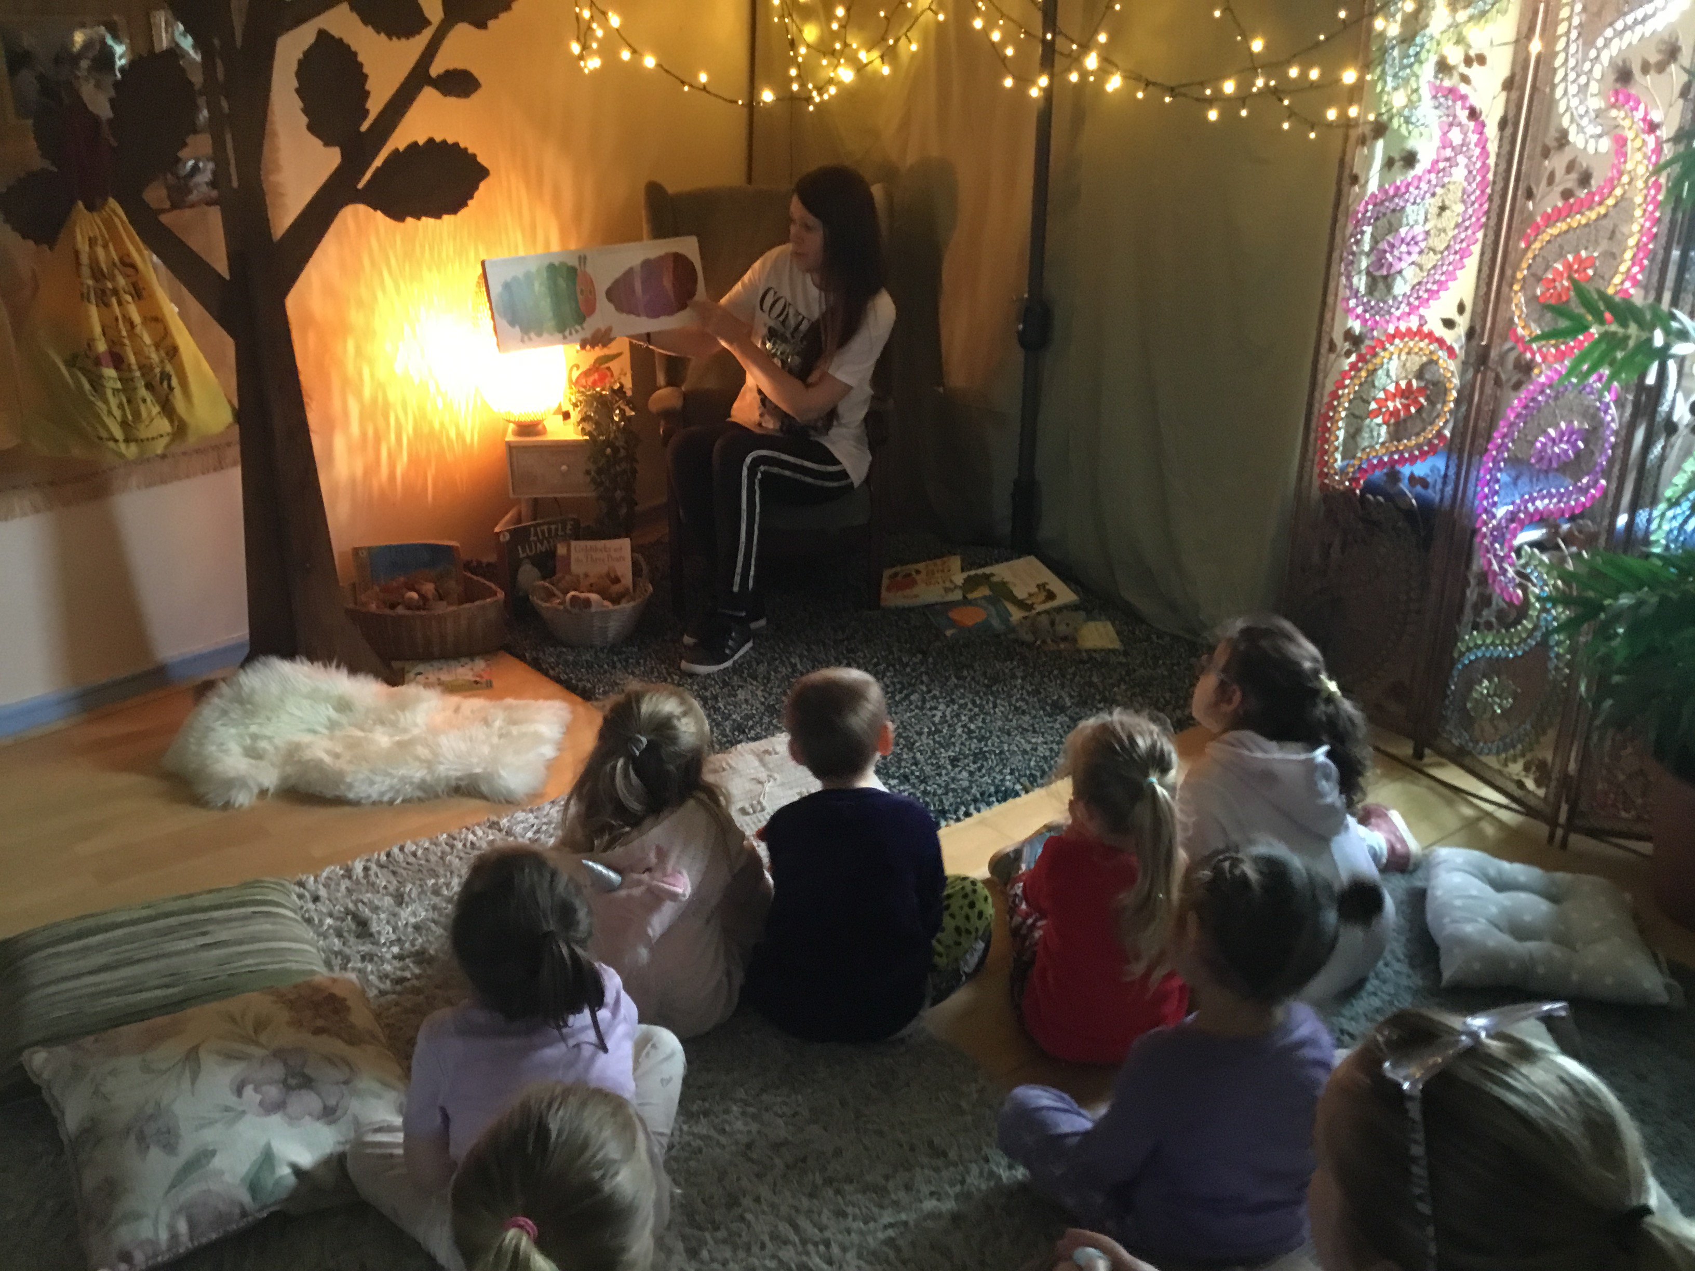
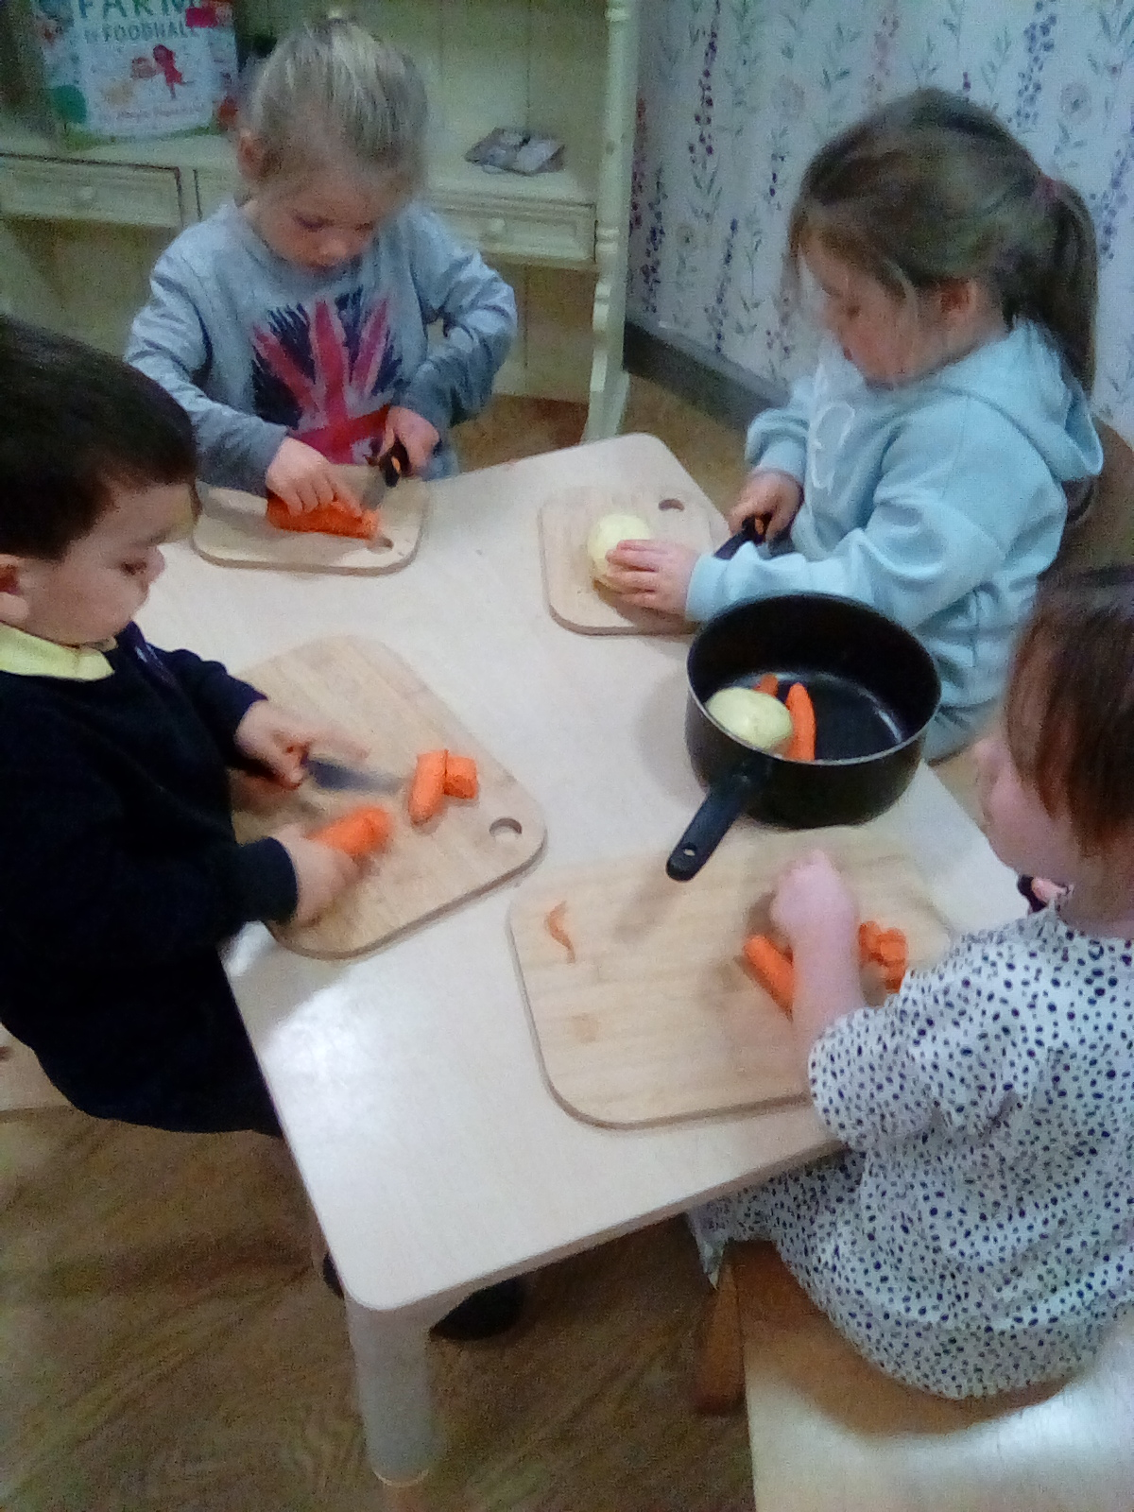
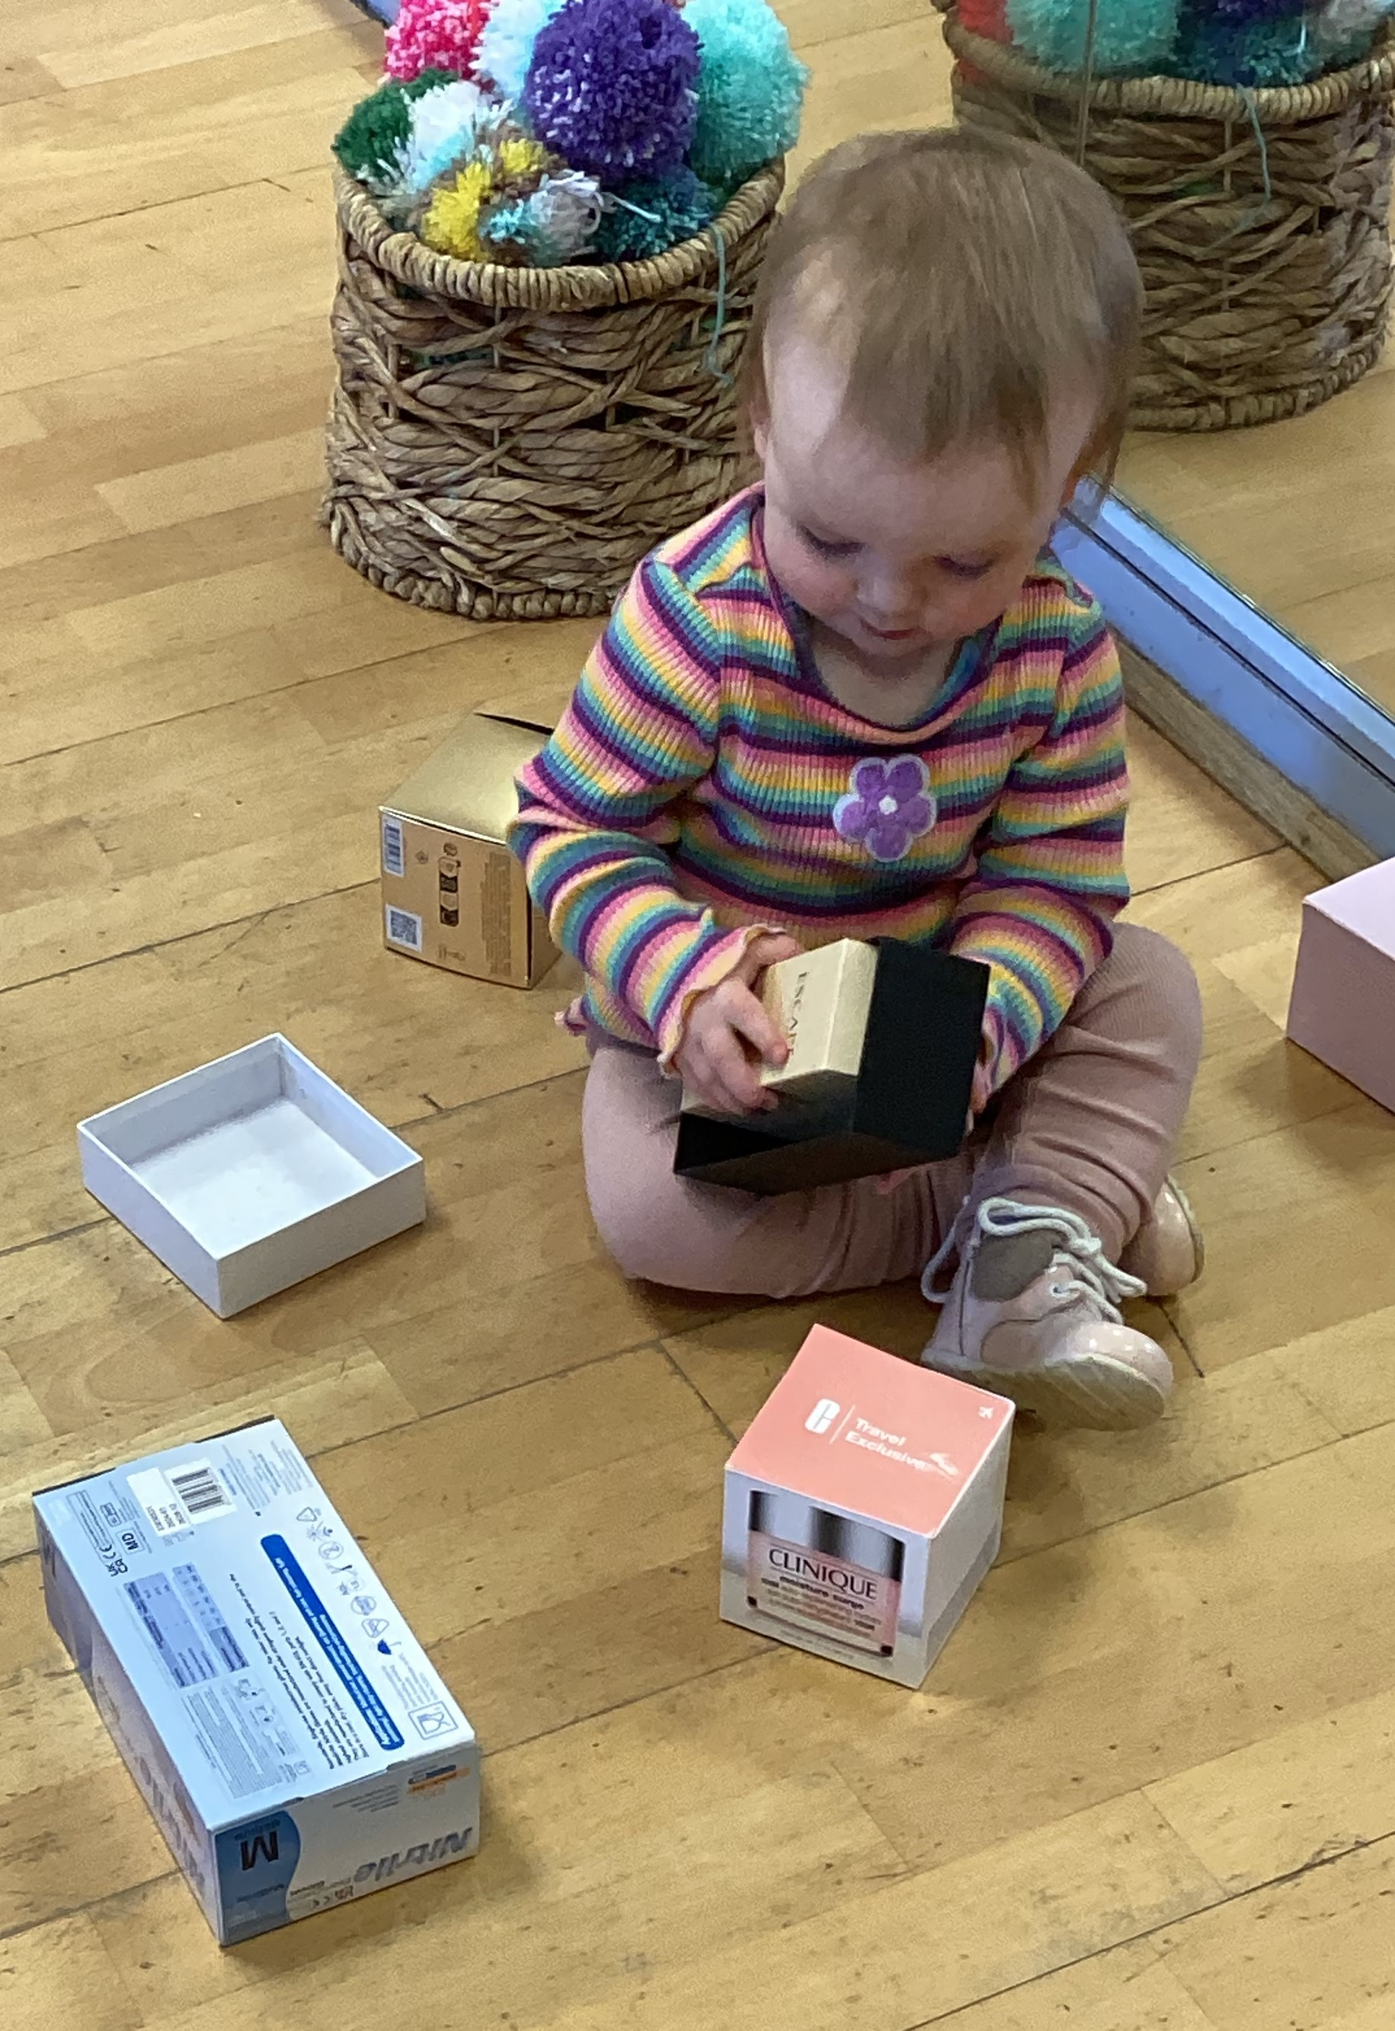
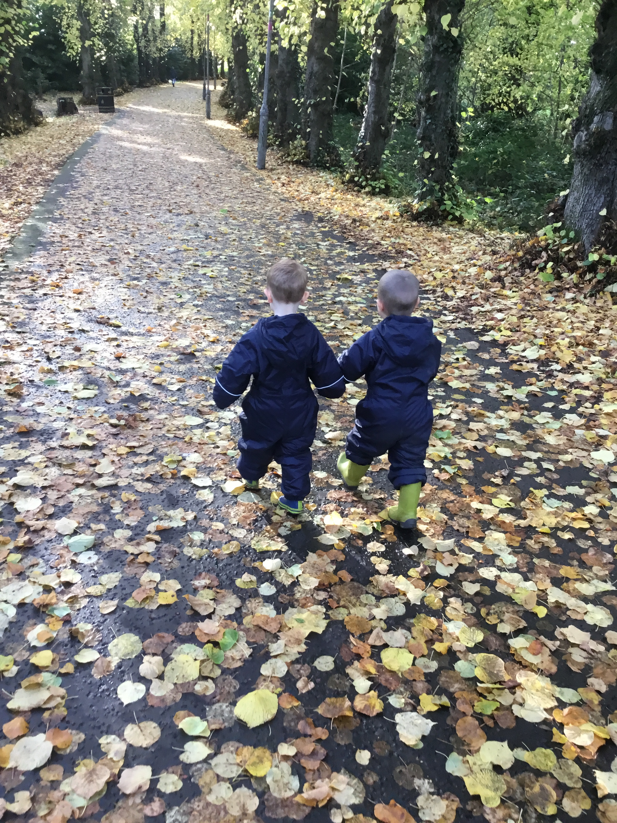
In Ferguslie Early Learning and Childcare Centre we aim to: Create a calm, peaceful and homely atmosphere where children feel happy, secure, nurtured, respected and loved so that they blossom and grow, building a strong sense of confidence and self-esteem. Allow children to achieve by providing stimulating play experiences that will allow them to develop and learn at their own pace in a way that suits their learning style. Provide a learning space where children can be curious, creative and inspired by the caring, interested adults around them. Value and respect each child and their family as unique and individual. Recognise and understand other’s cultures and beliefs, and through consultation with children and families ensuring that we listen and make changes that improves our practise.
Encourage children’s confidence and independence to take forward their ideas and thoughts that ignite new interests and learning and share these with home. Ensure that effort and achievement is recognised and celebrated and that children have ownership of their journey. Appreciate the importance of family and community partnership working through making connections with home to give support to families when they need it. Develop children’s awareness of nature through opportunities to explore outdoors and in the forest, where they will learn about caring for the natural world and living things.

Slide 4
Successes & Achievements
Froebelian principles are embedded within practice, resulting in high-quality interactions that value play, relationships, creativity and children's voices. As a result, children feel secure and confident to express themselves and make choices, take risks in learning, revisit and deepen their thinking, and demonstrate increasing independence and ownership of their learning | We are delighted with the progress our preschool children have made this year. By the end of the March, 85% of children were achieving expected literacy milestones, 81% expected numeracy milestones and 94% expected health and wellbeing milestones, reflecting the positive impact of our learning experiences and support. | Staff confidence and expertise is recognised beyond the centre, with several practitioners presenting both inhouse and at the Nurture Conference, sharing effective practice with colleagues across other settings. This reflects the high quality of practice within Ferguslie and contributes to wider professional learning and improvement. Through this ongoing sharing of expertise, children benefit from innovative, evidence-informed approaches that enhance their wellbeing, engagement and learning experiences.
Children at the Heart of Learning
Building Strong Foundations for Learning
Showcasing Excellence Across Settings

Slide 5
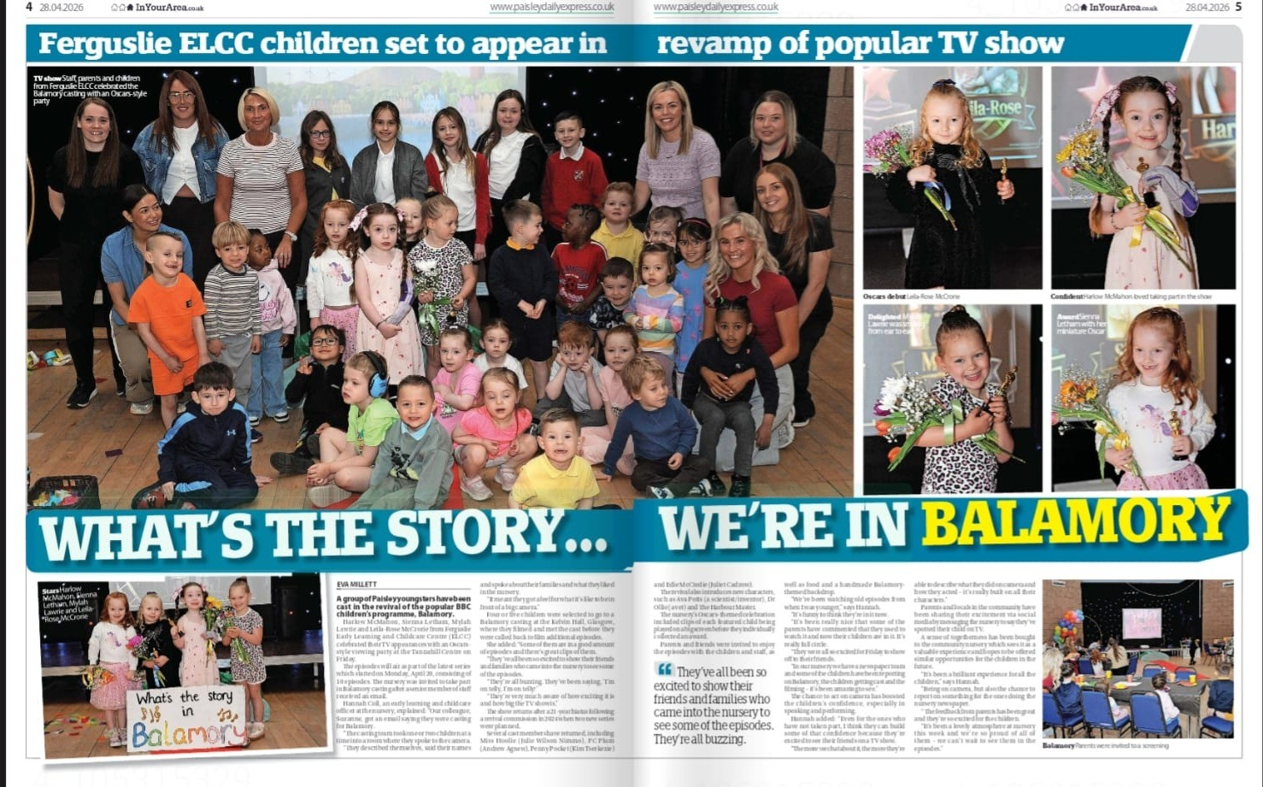
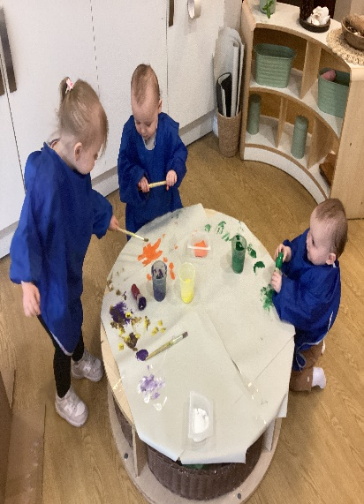
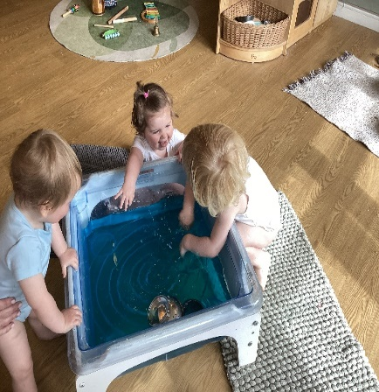
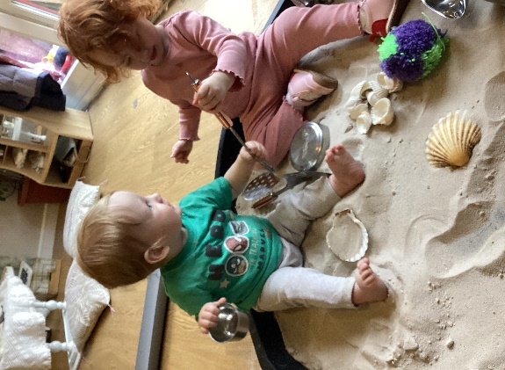
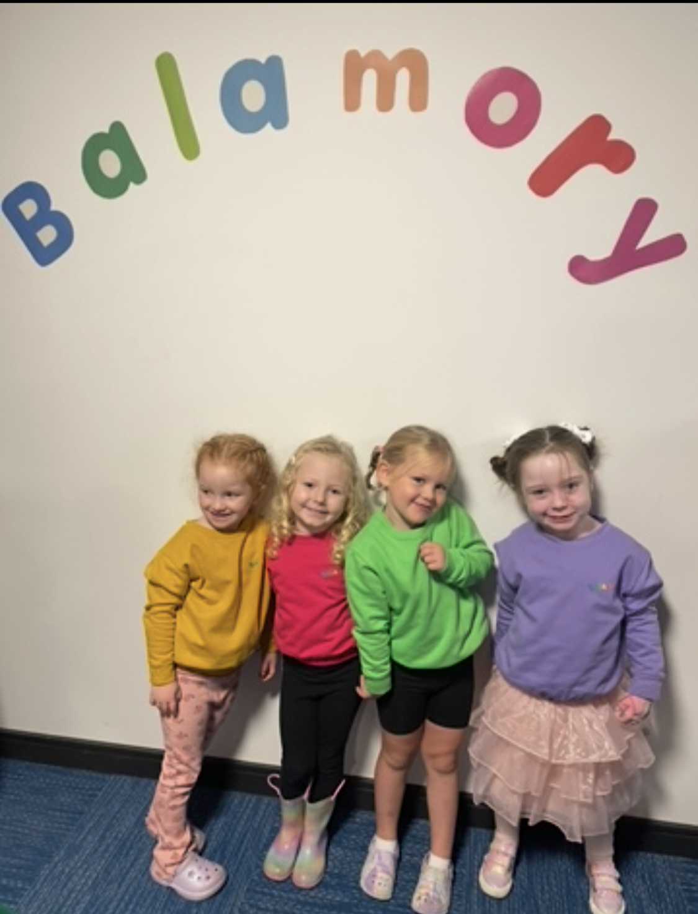
Successes & Achievements
Our Baby Playroom offers a caring and engaging environment where children feel happy and secure. Through play, exploration and meaningful interactions with practitioners, children develop their confidence, curiosity and early learning.
This year, we were incredibly proud to celebrate the success of a group of our children who were selected to star in the new series of Balamory. Their participation has been a fantastic achievement for both the children and our centre, showcasing their confidence, creativity and ability to embrace exciting new experiences
By responding to each child's individual needs and interests, we ensure they have the best possible start to their learning journey.
Through ongoing observation and reflection, the environment is adapted to provide appropriate challenge, support and accessibility, ensuring all children can participate fully and engage meaningfully in their learning experiences.
Positive, nurturing relationships with staff help our children to feel safe, valued and supported.
Being involved in filming provided children with valuable opportunities to develop a wide range of skills. They enhanced their communication and language skills by listening to and following instructions, expressing their ideas, and interacting with a variety of adults. The experience also helped to build their confidence, independence and self-esteem as they took part in a professional filming environment.
Our children are thriving and show growing confidence, curiosity and engagement in their play and learning.

Slide 6
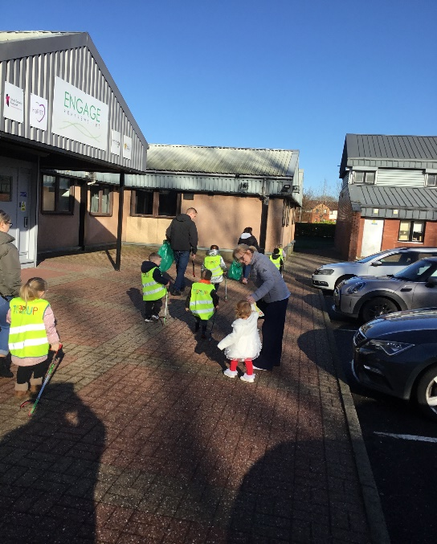
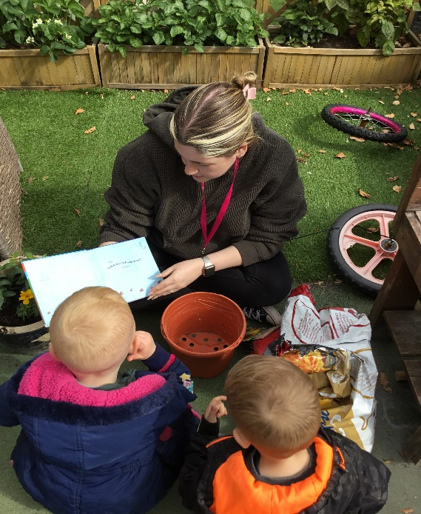
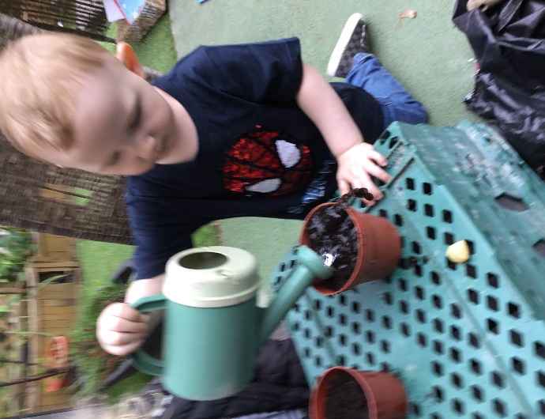
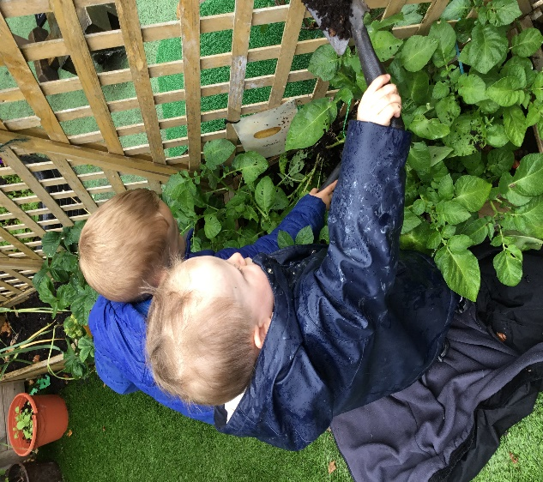
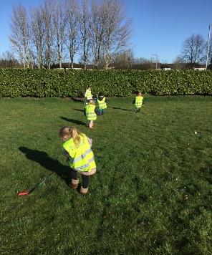
Successes & Achievements
Children in our 2–3 playroom have been actively engaged in the nursery garden, showing enthusiasm and commitment as they plant and care for herbs and vegetables such as garlic, potatoes and strawberries. Through these experiences, they are developing important skills including responsibility, patience and teamwork as they water, observe and nurture their plants The children have enjoyed watching their seeds grow, building curiosity and an early understanding of the natural world. They take pride in harvesting their produce and using it to prepare healthy snacks, helping them learn where food comes from. This hands-on experience supports their health and wellbeing by encouraging positive eating habits, introducing nutritious foods and building independence and confidence as they take part in the process from seed to plate.
Our younger children have been working alongside older children to care for their community through simple litter-picking experiences. With support, they have explored their outdoor environment, noticing and collecting litter, which is helping them develop awareness of the world around them and an early sense of responsibility.
This hands-on learning is helping children develop respect for their environment and positive attitudes towards caring for their community. They are building important skills such as teamwork, communication and cooperation as they work together, as well as developing their physical coordination and fine motor skills through using litter pickers.

Slide 7
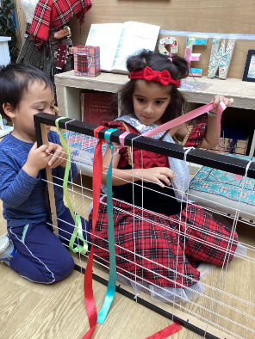
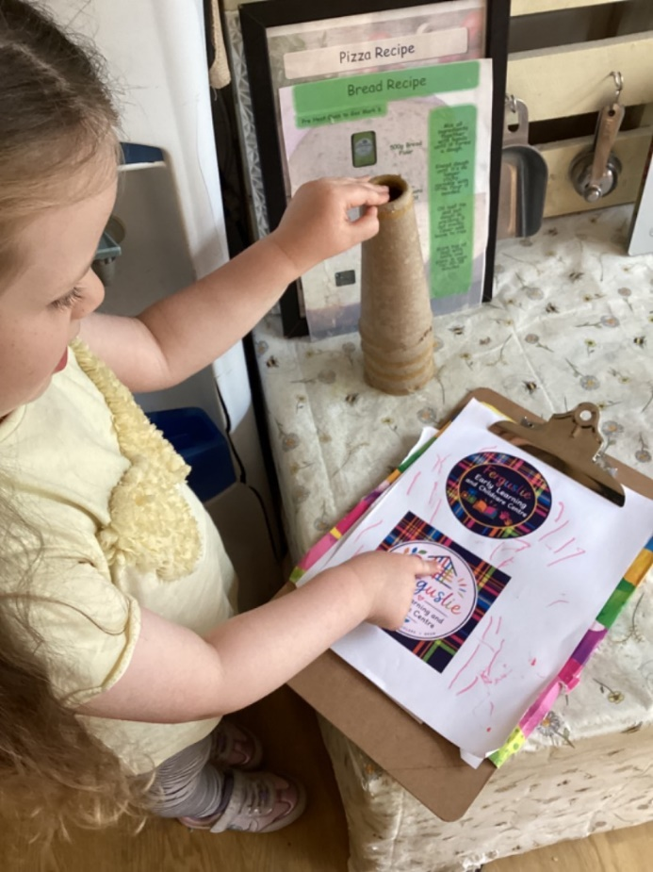
Successes & Achievements
Within Ferguslie Early Learning and Childcare Centre we value the opportunities and experiences we provide for our children. The learning and teaching that they take part in is influenced by a philosophy based on the work of Friedrich Froebel, an educational pioneer from the nineteenth century. Family and community were of central importance to Froebel, a value that we share within our service, he stated that, "family and community are at the heart of education".
The children in the 3–5 playroom have been exploring tartan as a way of representing identity, heritage and personal meaning. Through their learning, they developed an understanding of how colours and patterns can be used to communicate ideas about themselves, their families and their community. As children designed their own tartans, they carefully chose colours and explained what these represented about themselves, showing an understanding of identity and belonging. They then explored tapestries and other visual images, discussing the stories and meanings they shared. This encouraged children to think about their own nursery community and what makes it special, inspiring them to consider how they could represent their experiences, friendships and sense of belonging within the nursery.
When designing a new nursery logo, children reflected on their experiences and shared what the nursery means to them.
Using their learning about symbols, the children chose to include the nursery tartan in their logo design as a representation of their shared identity and community. They shaped the tartan into a house, showing that they see the nursery as a safe, welcoming and nurturing place.

Slide 8
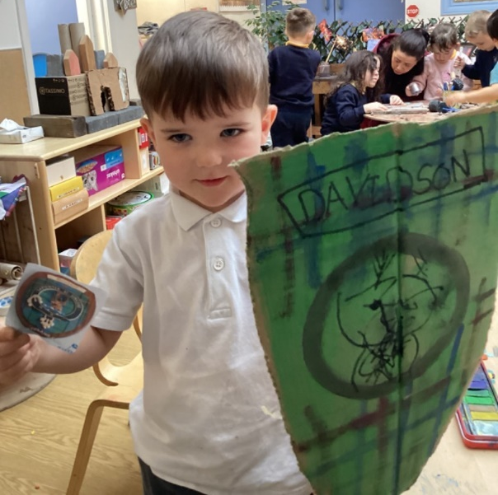
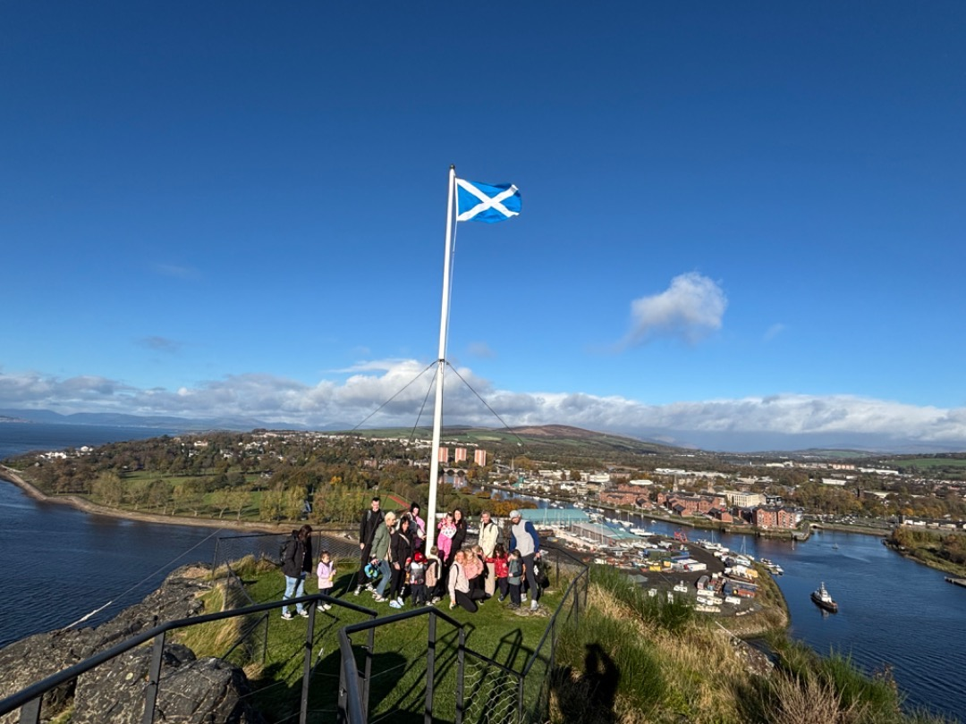
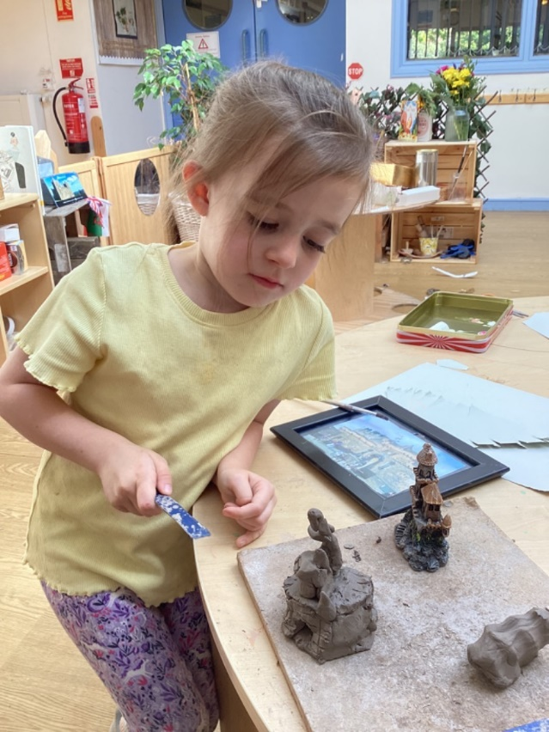
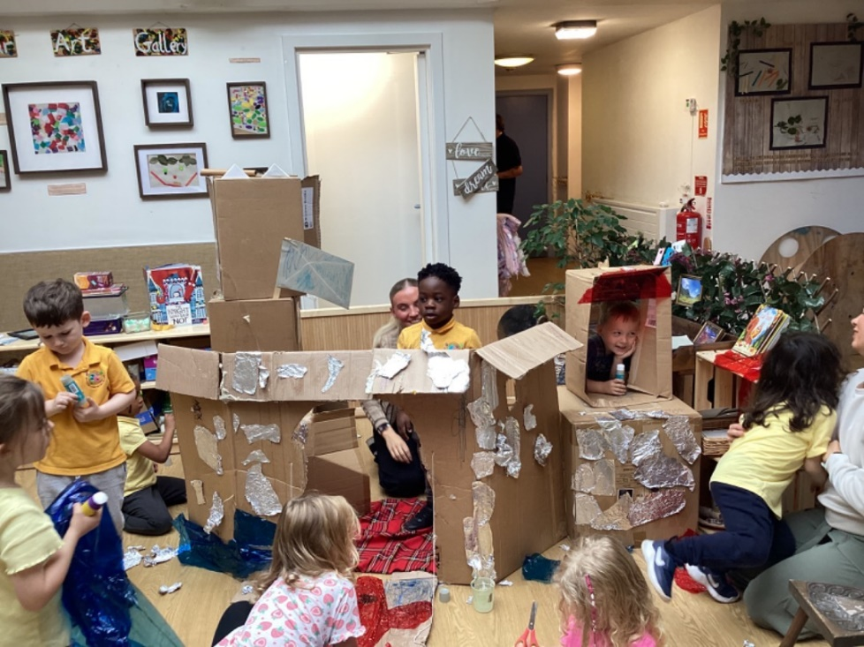
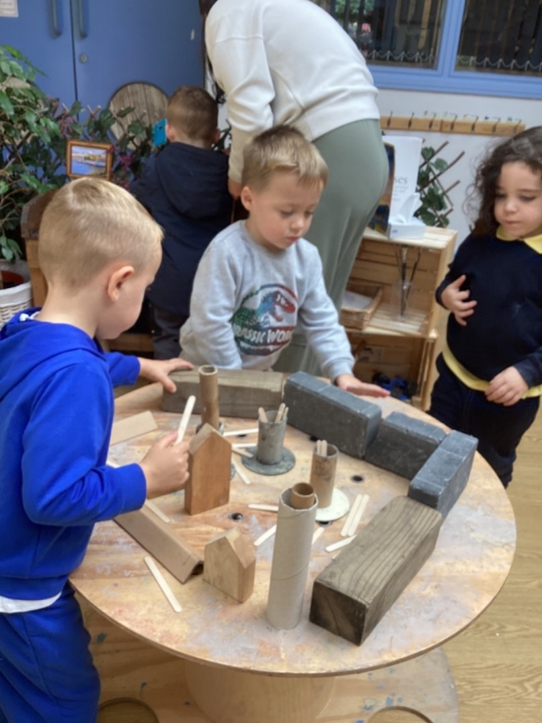
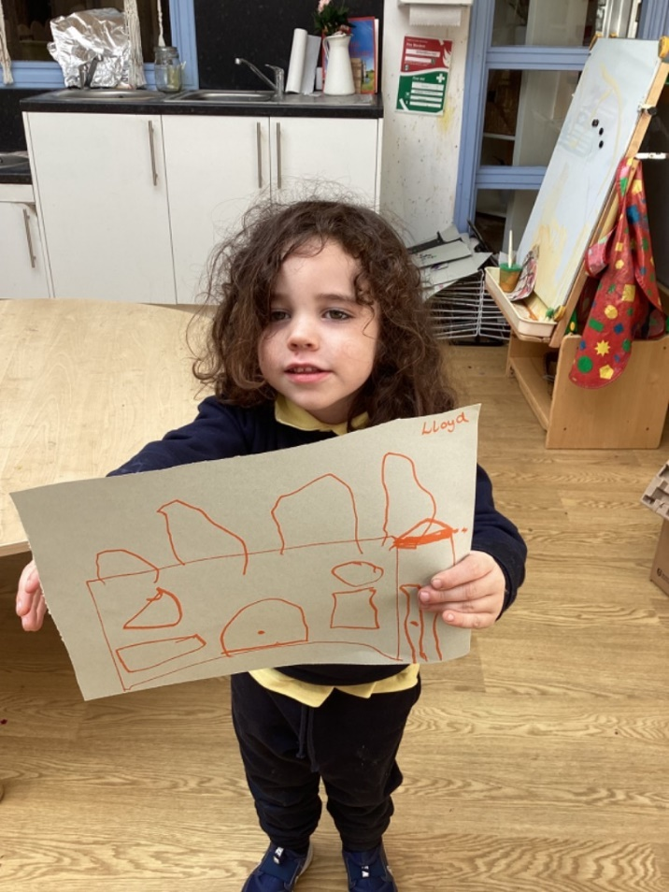
Successes & Achievements
Following children’s interest in building castles through junk modelling, they explored different types of castles and how they were built, including how materials changed from wood to stone to make them stronger. Using loose parts, children created their own castles and learned the names of features such as towers, bridges and turrets. Their learning was extended through a visit to Dumbarton Castle, where they experienced a real castle and began to think about what life may have been like there. This led to further interest in castle defence and knights, with children creating their own cannons and designing family crests and symbols to represent their ideas.
Children developed an interest in kings, queens and the Royal Family, learning about royal clothing, crowns and the symbols of the UK nations. They created their own coronation capes using flower-printing techniques and made jester costumes, developing early sewing skills. | Their learning was extended through a visit to Stirling Castle, where they explored royal clothing, castle defences and Scottish history, including William Wallace and Robert the Bruce. Children also recognised the Scottish flag, the Saltire, and identified its colours.
Through these experiences, the children brought their learning to life, developing their understanding of castles, Scottish culture and heritage.

Slide 9
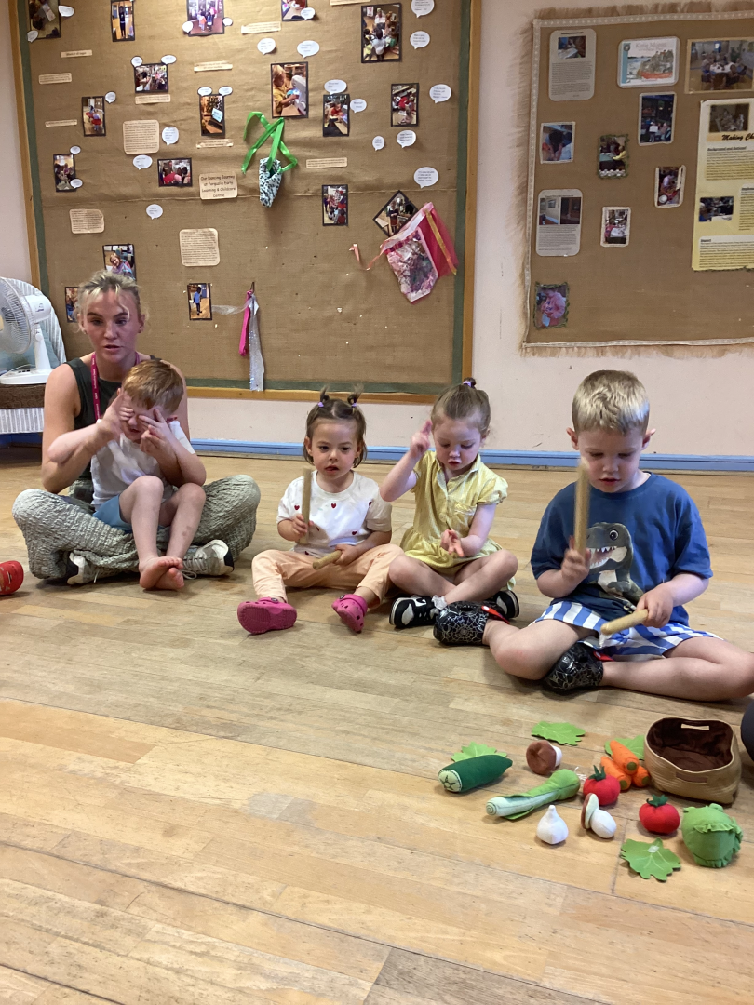
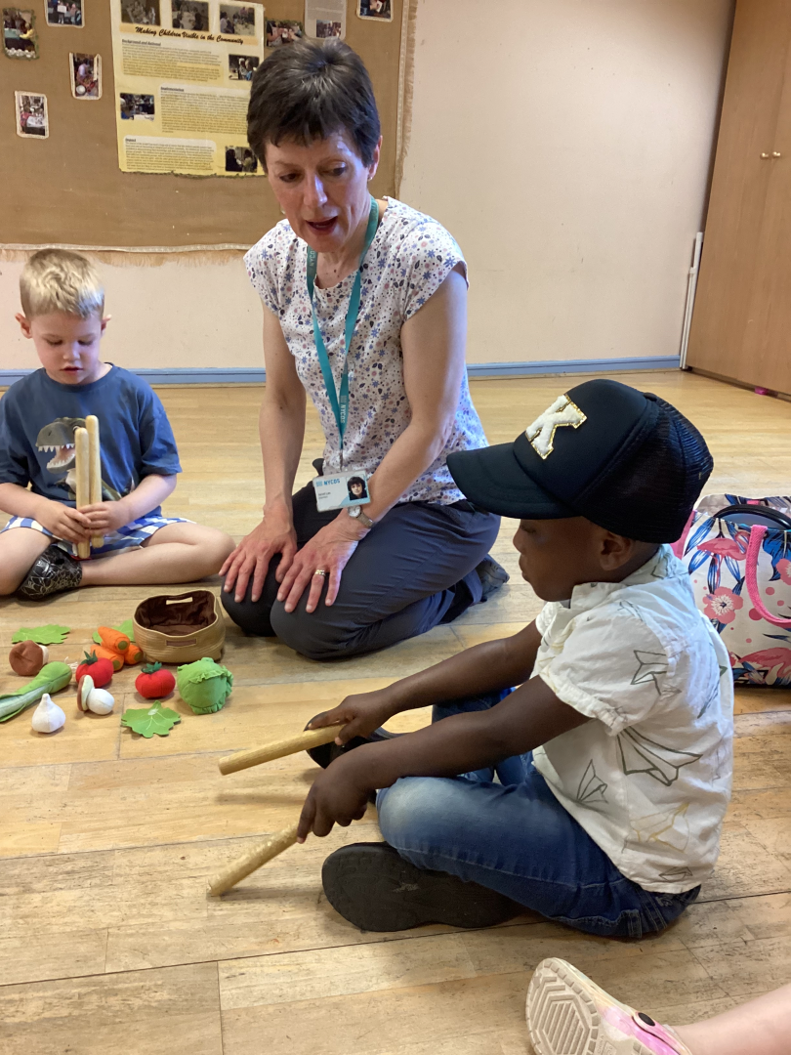
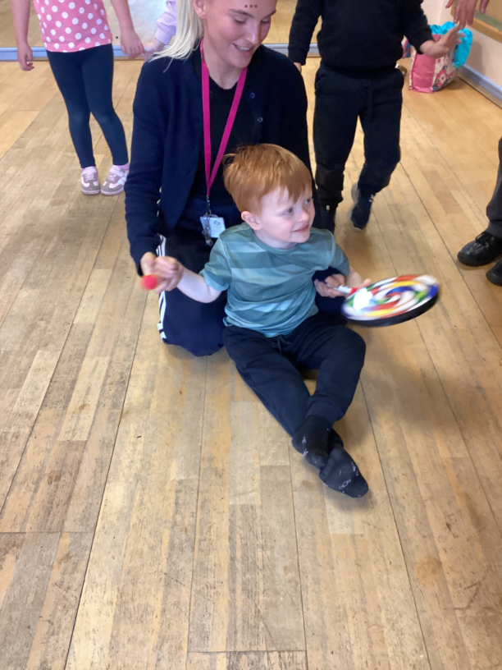
Successes & Achievements
This year, children have enjoyed music sessions delivered by Janet from NYCOS Music. Through interactive songs, games and musical exploration, they have developed their understanding of key musical concepts such as rhythm, tempo and beat. Using familiar nursery rhymes and songs, children explored how music can be fast or slow and learned to recognise and respond to changes in tempo. They clapped, tapped, marched and moved to the beat, helping them develop a sense of rhythm and steady timing.
Children explored a range of musical instruments, particularly percussion, experimenting with sound, rhythm and pattern. They are growing in confidence using instruments appropriately and learning to play together as part of a group, developing coordination and listening skills.
These musical experiences have provided an engaging and enjoyable context for learning. Children have developed creativity, communication and social skills while building confidence and a growing appreciation of music that supports learning across different areas of development.

Slide 10
“
HOW SUCCESSFUL HAVE WE BEEN IN IMPROVING OUR CENTRE?
”

Slide 11
Improvement Priority 1: To enhance our partnerships with parents/carers enabling them to feel more confident to engage and be involved in their children’s learning.
Professional learning has increased staff confidence and skills in engaging parents and carers in their child's learning. As a result, most families are actively involved in supporting learning at home and in the setting, strengthening partnerships and contributing to positive outcomes for children. Strong partnerships with parents and carers have been established, allowing effective information sharing about children's development, wellbeing, and home experiences. This has supported consistent approaches between home and the setting, contributing to improved wellbeing, engagement, and progress in learning. | Evaluation data shows that our co-designed family engagement opportunities, including Stay and Play sessions, cultural cooking, outdoor learning and Book Bug, have had a significant positive impact. Partnership working has strengthened by 85%, with 23 parents and carers regularly participating in learning experiences, extracurricular activities and outings. As a result, families feel more connected to the setting, have a greater understanding of their child's learning and are more confident in supporting learning at home. | Contributions by parents and carers to children's online learning journals have increased by 79.45%, demonstrating significantly improved engagement with their child's learning. This has strengthened partnerships between home and nursery, enhanced the sharing of learning, and enabled more responsive and personalised learning experiences that reflect children's interests, experiences and next steps. Family feedback, participation and increased engagement across a wider range of opportunities demonstrate strong collaborative relationships and a shared commitment to supporting all children's wellbeing, progress and achievement

Slide 12
Improvement Priority 2: To introduce the Mosaic Approach into the setting to better understand children’s perspectives and increase learner participation.
By using The Mosaic Approach, our practitioners have developed a better understanding of the many ways children communicate, including through talking, gestures, play, behaviour, drawing and interactions with others. This helps us respond to each child's individual needs, interests and ideas, ensuring every child feels heard, valued and included. Through conversations, thoughtful questions and shared play experiences, practitioners support and extend children's learning in ways that are meaningful and enjoyable. As a result, children are becoming more engaged, curious and confident learners. They are increasingly able to think for themselves, solve problems, make choices and use their skills in different situations. | Children are demonstrating increasing independence, curiosity and problem-solving skills, confidently applying previous learning and sharing their ideas through conversations and play. By providing meaningful opportunities for all children, regardless of language ability or developmental stage, to express their views and experiences, we are strengthening children’s voice and agency. As a result, children feel listened to, respected and valued, leading to deeper engagement, understanding and ownership of their learning. Children are now contributing more to shaping child-centred spaces, helping to create an enhanced learning environment that reflects their ideas, interests and needs. By seeing their contributions valued and represented within the setting, almost all children feel more empowered to participate in their learning. As a result, they demonstrate increased curiosity, active exploration, independent thinking and deeper levels of engagement. | Feedback from children and families, gathered through the Mosaic Approach, Stay and Play sessions and other opportunities to share views, shows that their ideas help shape improvements to the learning environment and experiences. As a result, children feel a stronger sense of belonging and inclusion, take an active part in their learning, and grow in confidence when sharing their thoughts and ideas while developing respect for others. Feedback from the majority of families shows that children are becoming more confident and are increasingly keen to talk about their learning at home, demonstrating greater engagement and ownership of their learning.

Slide 13
Improvement Priority 3: To embed RNRA’s Nurture Principle – All behaviour is communication.
All staff have been trained in R.N.R.A.’s Nurture Principle – ‘” All behaviour is communication” ensuring an appropriate and individualised methodology is embedded within our pedagogical approach. Leuven observations show high levels of wellbeing and engagement across the setting. Children feel secure, curious and involved in their learning, helping them to explore new experiences, persevere with challenges and make good progress.. Recent observations found that 91% of children in the 0–3 room and 95% of children in the 3–5 room demonstrated high levels of wellbeing and engagement. | Feedback from families and children shows that our inclusive and nurturing approaches, including deregulation strategies and language used within the book “Colour Monster” is helping children to feel safe, valued and supported. Children have developed positive relationships and a strong sense of belonging, while learning experiences reflect their interests, identities and backgrounds. This has supported their wellbeing, confidence and enthusiasm for learning. Using Strathclyde’s 3 Domain Model has helped staff to have a better understanding of each child and their family, strengthening partnerships with parents and carers. This supports more personalised learning and wellbeing experiences and ensures children’s voices are heard and valued. | Multi-agency records, support plans and professional feedback demonstrate effective partnership working, resulting in coordinated support that is positively impacting individual children's wellbeing, engagement and progress The consistent use of nurturing and trauma-informed approaches is having a positive impact on children’s wellbeing and engagement. Almost all children benefit from caring, responsive relationships that help them feel safe, valued and included. As a result, children are increasingly able to regulate their emotions and engage positively in their learning and play.

Slide 14
Key Strengths: Highly motivated, enthusiastic children who enjoy learning and make excellent progress. A dedicated and caring staff team who share the centre’s vision and values and know children well, enabling them to provide personalised support and learning experiences that help every child thrive. An extensive range of challenging and rich learning experiences which meet children’s individual needs. Strong meaningful relationships with parents and carers. Effective partnerships with other professionals. The strong, united and compassionate leadership of the Head and Depute Head of Centre
OUR NEXT STEPS – PRIORITIES FOR 2026-2027 We have made very good progress during session 2024-25 and we will use the improvement priorities listed below to build on this progress moving forward. To strengthen our curriculum rationale and design, ensuring a shared understanding of what children need to learn, why it matters, and how learning progresses across the setting. To close the gender attainment gap by shifting focus from the physical environment to the quality of adult interactions and assessment accuracy. We will embed high-level communication and observation methods into boys' natural play zones; to ensure every child's cognitive ability is accurately captured and developed." To further develop through our Gold RNRA submission the Nurture Principle – All behaviour is communication. Full details of the improvement priorities and actions are detailed on the establishment improvement plan which can be accessed via: www.Ferguslie-elcc.co.uk

Slide 15
Thank you
Establishment Name: Ferguslie Early Learning and Childcare Centre Address;: 76 Blackstoun Road, Paisley, PA3 1NT Phone 0300 300 1464 Website: www.Ferguslie-elcc.co.uk Facebook: Ferguslie Early Learning Childcare Centre
HAVE YOUR SAY! Please take the opportunity to share your thoughts with us as we use feedback to help us make improvements to the centre. You can do this by speaking to staff, participating in parent/carer meetings, responding to questionnaires/surveys and by completing evaluations at events.

