Slide 1

Ferguslie Early Learning & Childcare Centre Standards & Quality Report June 2025
​This report will inform you of our progress and achievements in the last session and let you know about our plans for 2025-2026. I hope that you find it helpful and informative.
Audrey Copland
Head of Centre

Slide 2
Our Centre Ferguslie Early Learning and Childcare Centre is located in a purpose- built facility, which is part of the Tannahill Community Centre that lies in the heart of Ferguslie Park in Paisley servicing a strong and diverse community. The majority of our children live within the Ferguslie Park area with a small percentage attending from other areas within Renfrewshire. The setting provides Early Learning and Child Care for 77 (full time equivalent) children aged between 0-6 years. Our rich learning environment, helps to stimulate the innate learning of all our children both indoors and outdoors. Impact of this work is as a result of our play-based pedagogy supporting skills for learning, work and life, and building relationships within the community, as well as providing children with the opportunity to learn problem solving skills, risk taking as well as developing creative and logical thinking. The centre has established close links with the community partners to ensure that the needs of individual children and their families are met effectively and together we offer support to families to engage with agencies through building strong partnerships working and adopting a multi- agency approach within the community.
Our staffing currently consists of:
Head of Centre
Depute Head of Centre
2 Senior Early Learning and Childcare Officers
1 Graduate
11 Full time Early Learning and Childcare Officers
3 Part time Early Learning and Childcare Officers
3 Term Time Early Leaning & Childcare Officers
5 Support Workers
1 Clerical Worker
3 Facilities Management staff

Slide 3
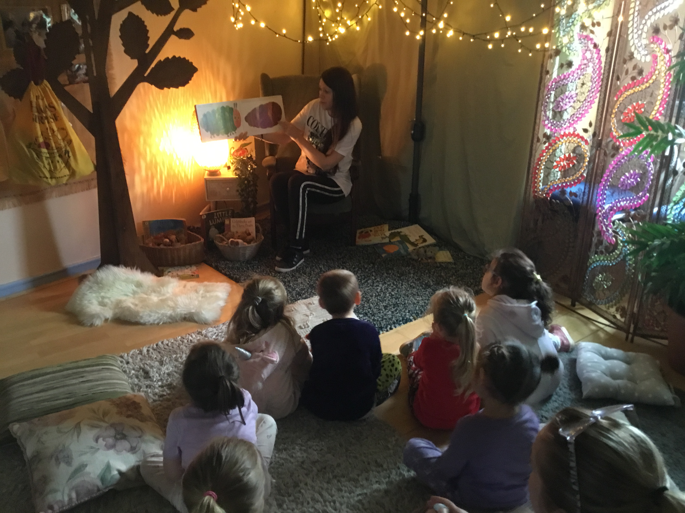
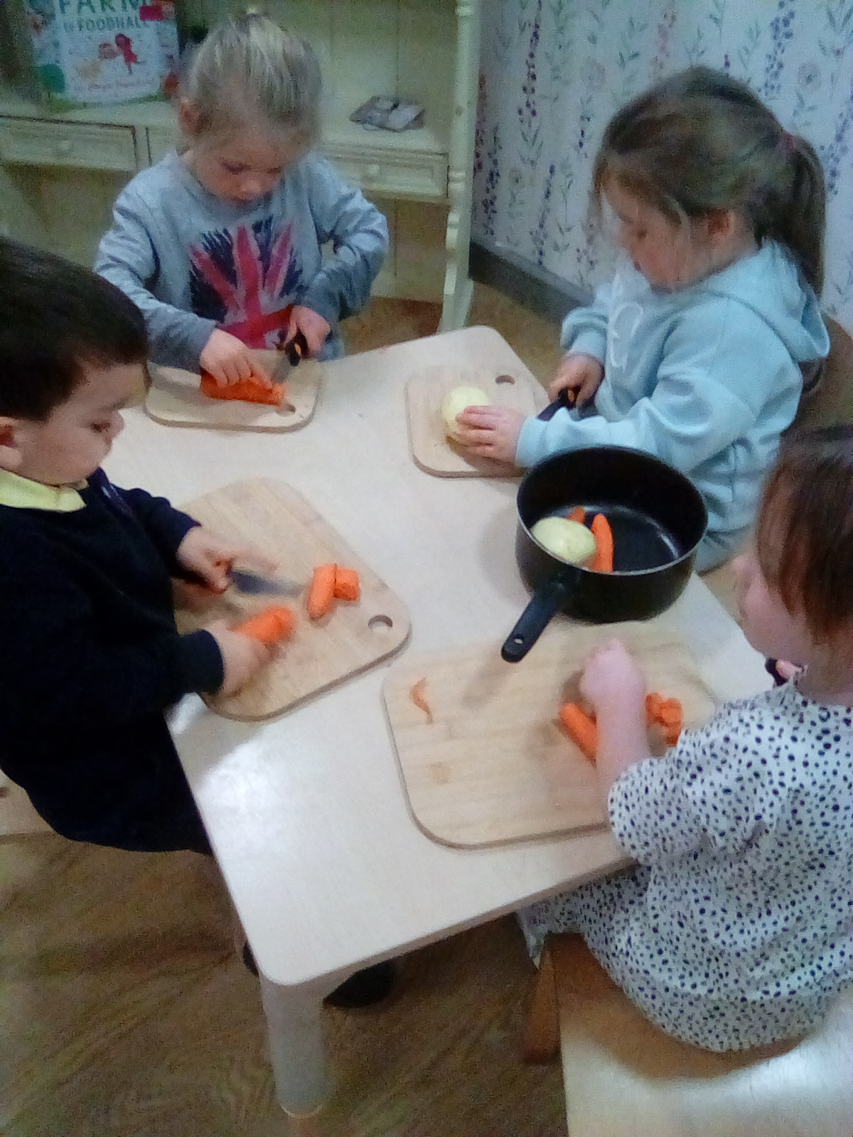
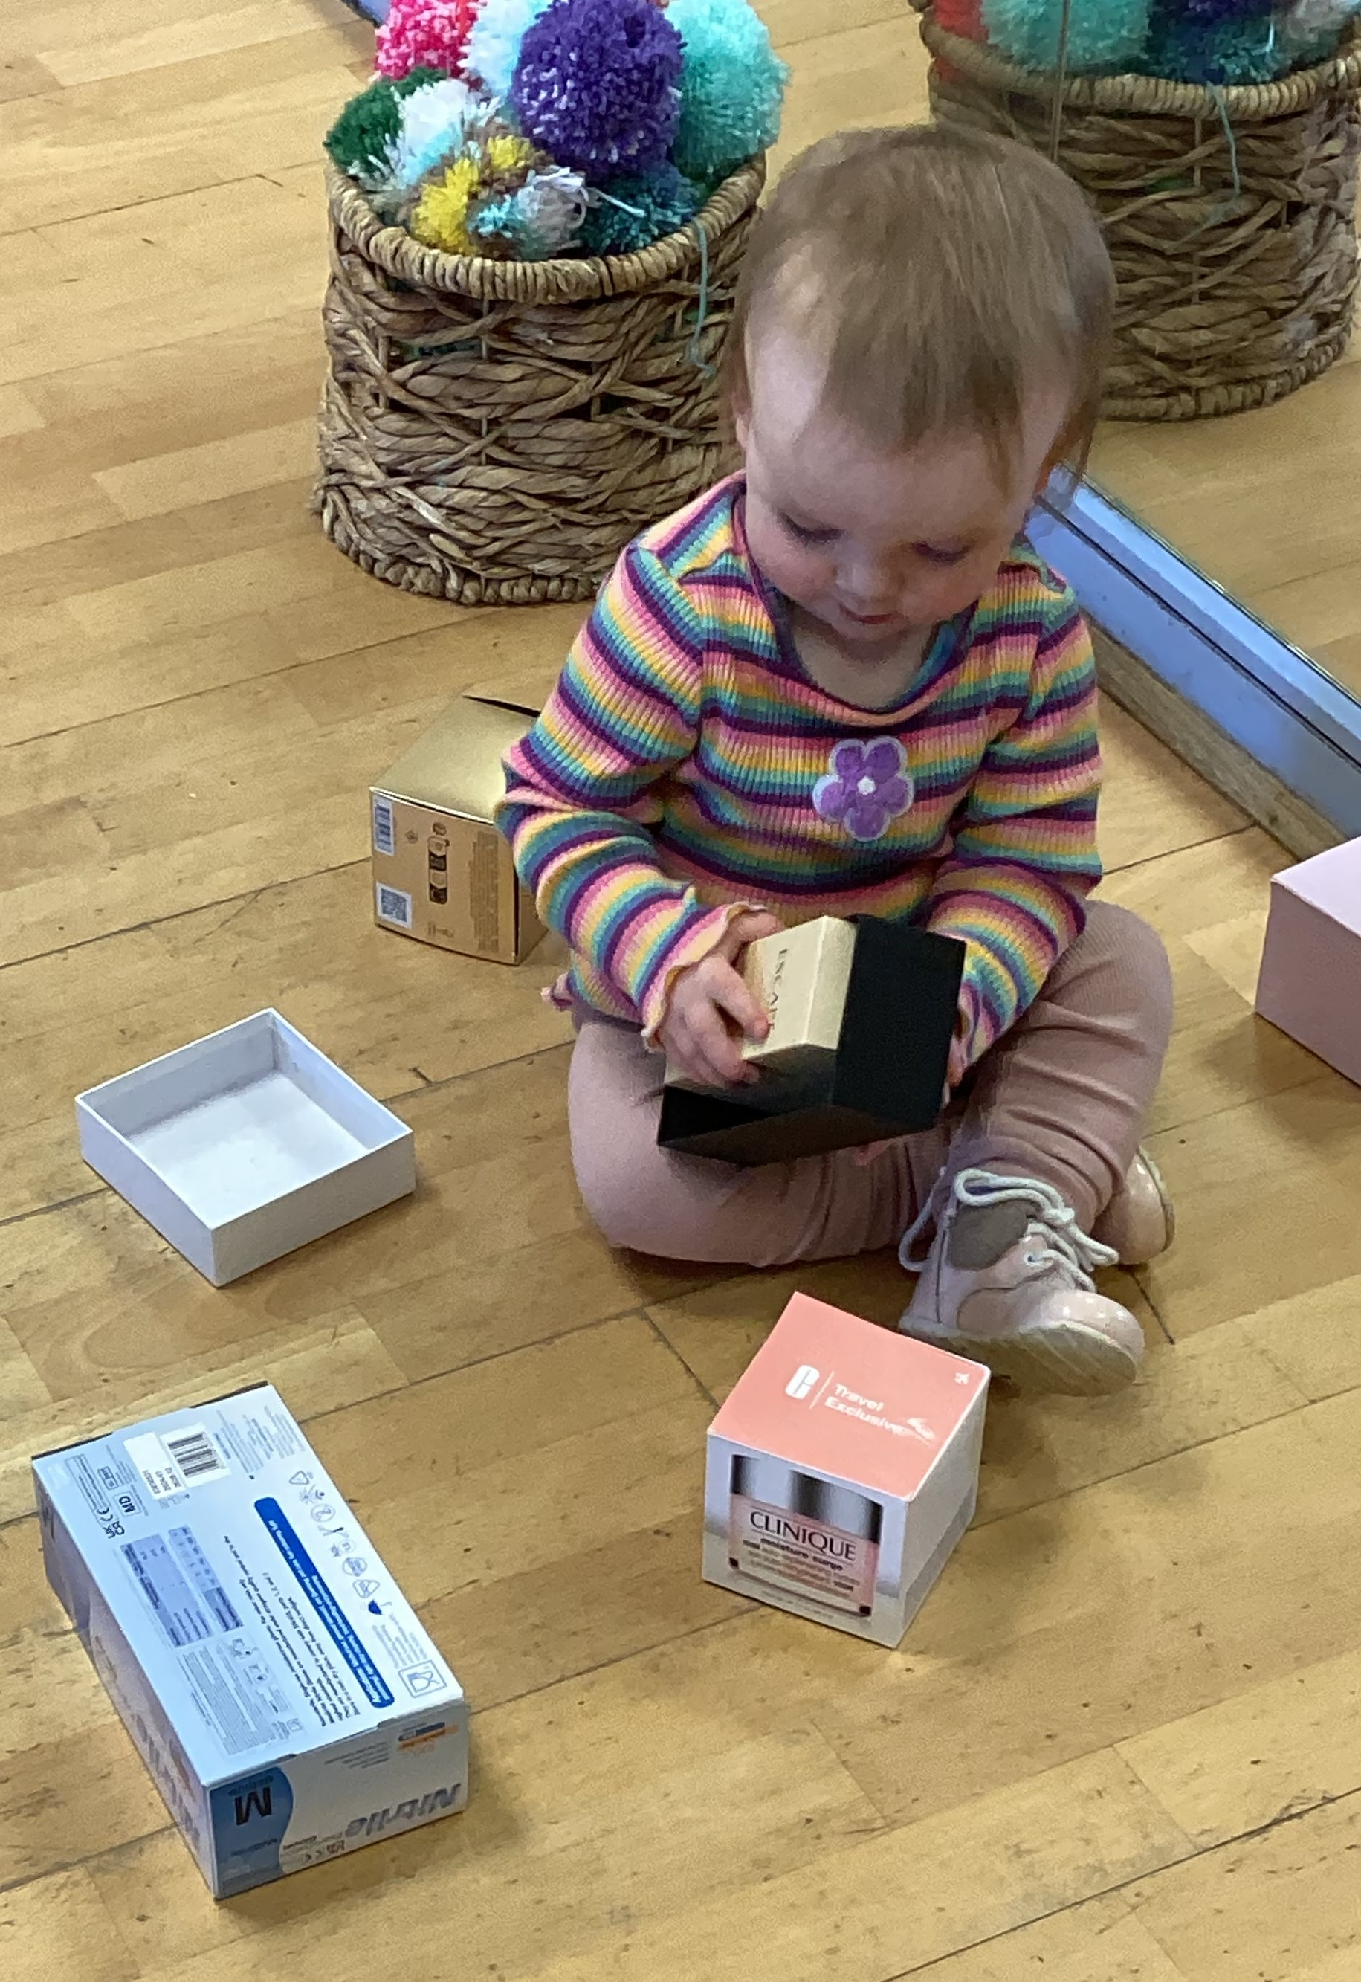
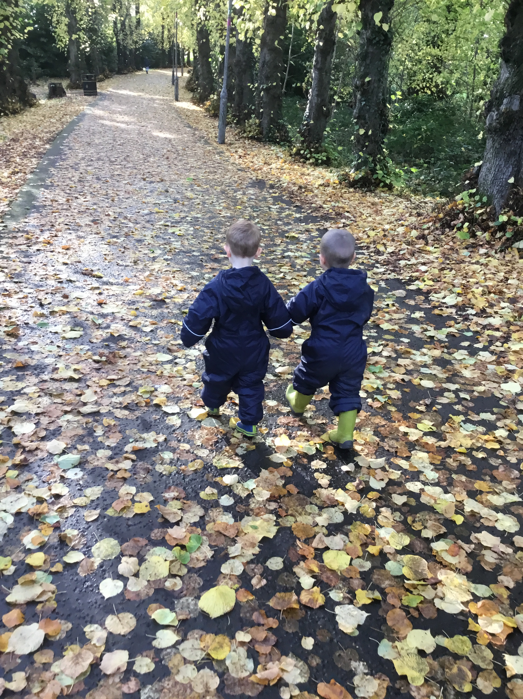
In Ferguslie Early Learning and Childcare Centre we aim to: Create a calm, peaceful and homely atmosphere where children feel happy, secure, nurtured, respected and loved so that they blossom and grow, building a strong sense of confidence and self-esteem. Allow children to achieve by providing stimulating play experiences that will allow them to develop and learn at their own pace in a way that suits their learning style. Provide a learning space where children can be curious, creative and inspired by the caring, interested adults around them. Value and respect each child and their family as unique and individual. Recognise and understand other’s cultures and beliefs, and through consultation with children and families ensuring that we listen and make changes that improves our practise.
Encourage children’s confidence and independence to take forward their ideas and thoughts that ignite new interests and learning and share these with home. Ensure that effort and achievement is recognised and celebrated and that children have ownership of their journey. Appreciate the importance of family and community partnership working through making connections with home to give support to families when they need it. Develop children’s awareness of nature through opportunities to explore outdoors and in the forest, where they will learn about caring for the natural world and living things.

Slide 4
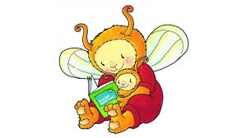
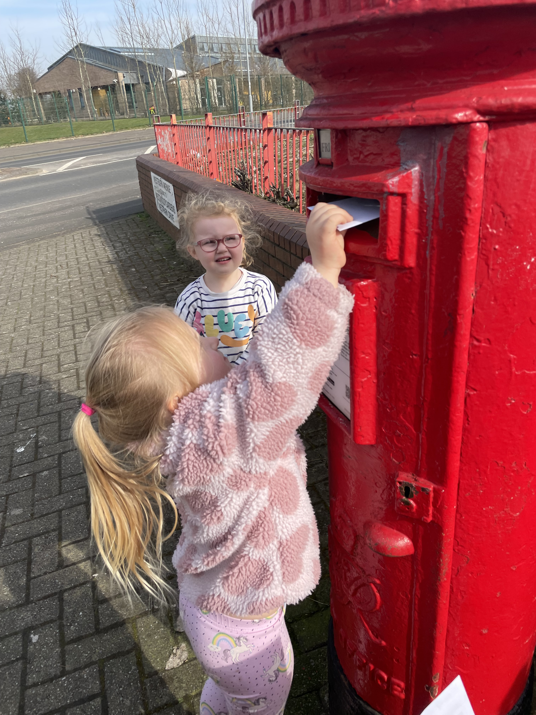
Successes & Achievements
Within Ferguslie Early Learning and Childcare Centre we value the opportunities and experiences we provide for our children. The learning and teaching that they take part in is influenced by a philosophy based on the work of Friedrich Froebel, an educational pioneer from the nineteenth century. Family and community were of central importance to Froebel, a value that we share within our service, he stated that, "family and community are at the heart of education".
The books ‘Dear Dinosaur’ and ‘Katie Morag Delivers the Mail’ have sparked the children’s interest of letter writing with the children in the 3-5 playroom. Using “I wonder” questions the practitioners encouraged children to explore the purpose of sending and receiving letters, how long delivery takes, and how distance and postage affect delivery, linking this to real life experiences such as buying stamps in the local post office. Children now regularly write letters to their ‘pen pals’— family, friends, other nurseries, and even contacts in Australia—sharing their thoughts, feelings, and nursery learning. The excitement when they receive a letter addressed to them is wonderful and sparks rich discussions, helping shape the next steps in their learning journey. | Our Bookbug programme has expanded to include twilight sessions, welcomed by both working and non-working parents. These sessions encourage families to share stories and rhymes, supporting children’s language, social, and overall development. Families from the centre and wider community report a better understanding of the benefits and the positive impact on their child’s learning.
“Fun for all the family”
“Great to be able to attend.

Slide 5
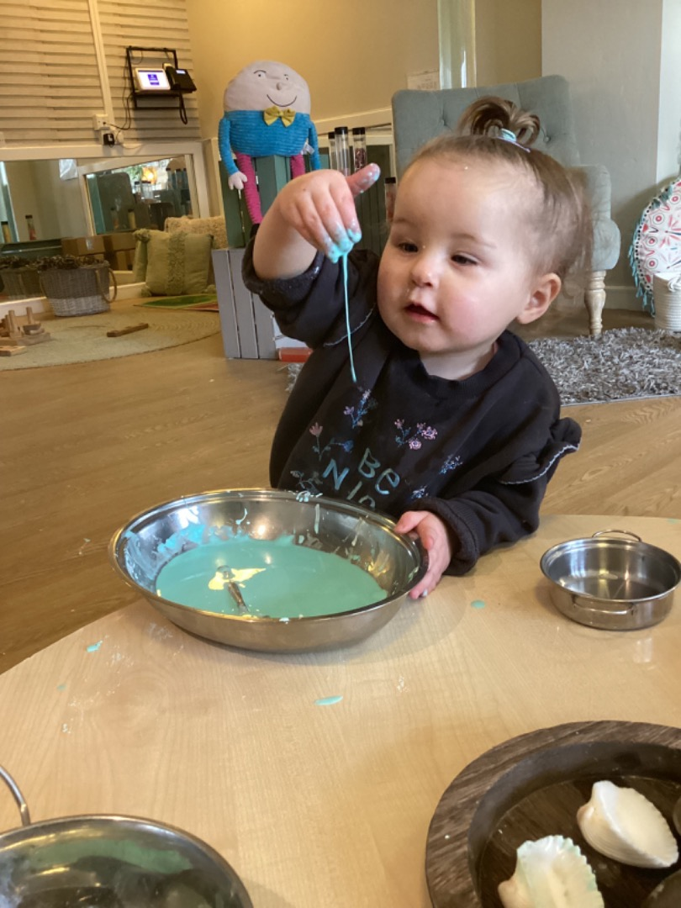
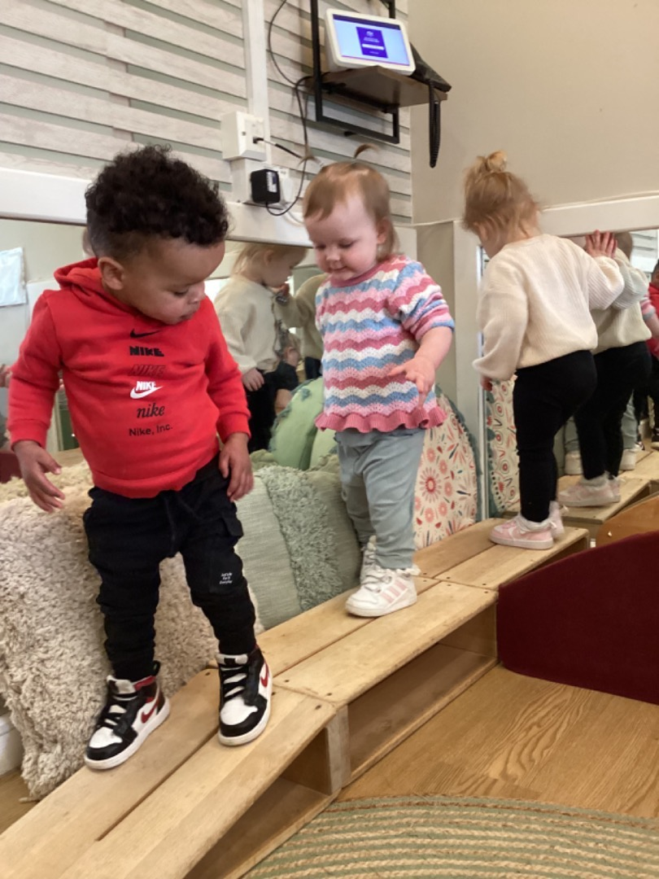
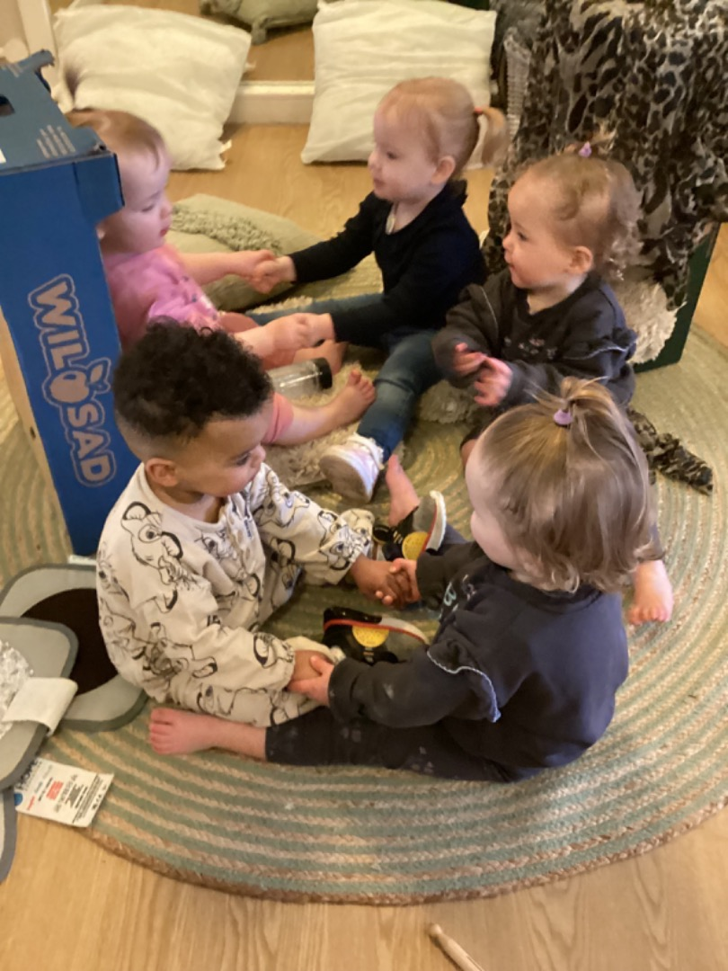
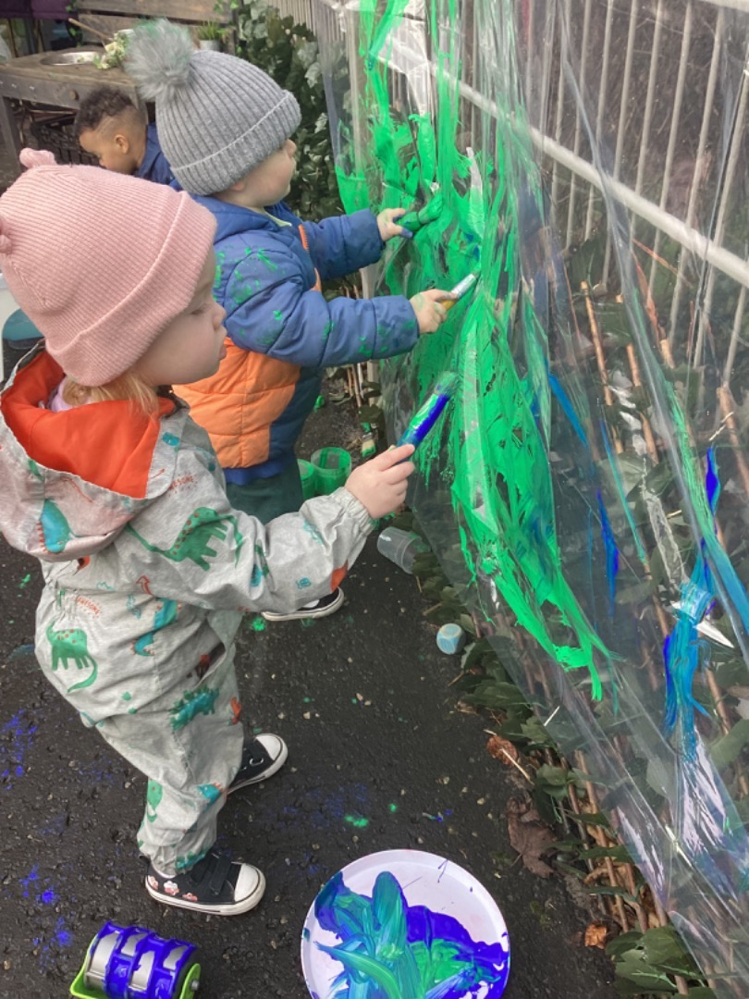
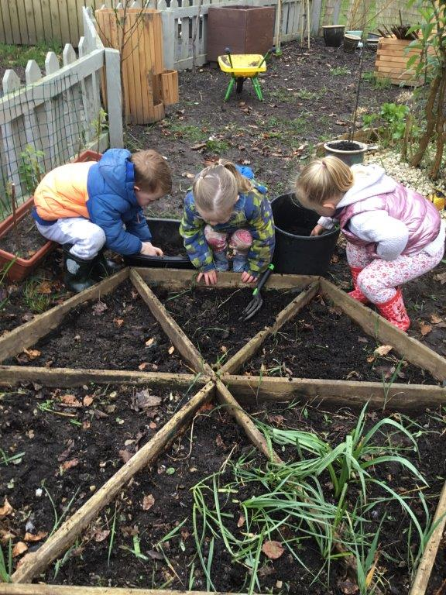
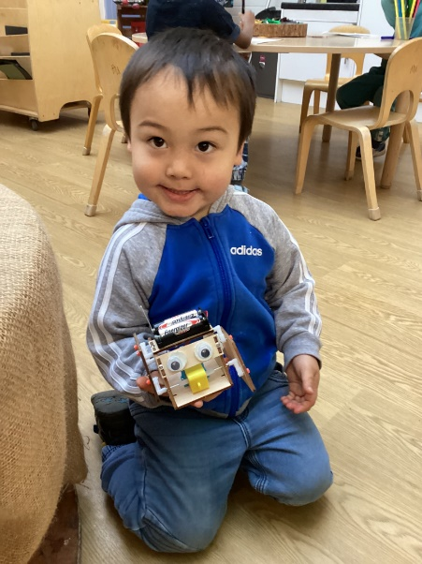
Successes & Achievements
Our baby room offers a calm, nurturing space where our youngest children thrive—encouraging curiosity, creativity, and the development of confident, happy individuals." Skills for Learning Life & Work Following the children’s interest in junk modelling robots, we expanded the experience by exploring construction with materials like metal, cardboard, and recycled plastic. Using real tools, the children deconstructed old electronics, sparking curiosity about electricity. They investigated circuits, batteries, and switches, learning how these work in everyday life. This led to collaborative problem-solving as they followed instructions and engineered a working robot together | Growing fruit and vegetables in our community allotment and playground greenhouse has inspired children to become enthusiastic gardeners and develop healthy eating habits. Building on last year’s visit to the pumpkin patch, they’ve chosen to grow their own pumpkins—bringing Froebel’s belief in 'rich, hands-on, real-life experiences' to life in a meaningful way.

Slide 6
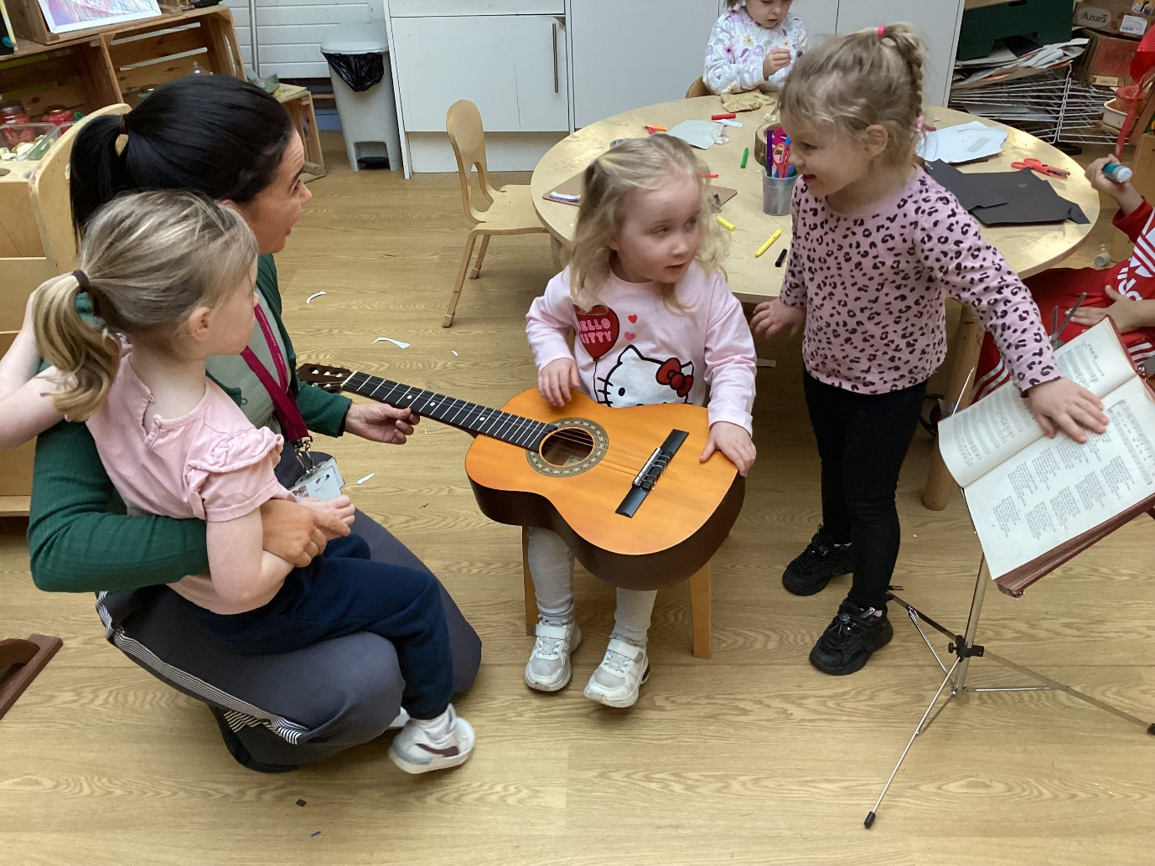
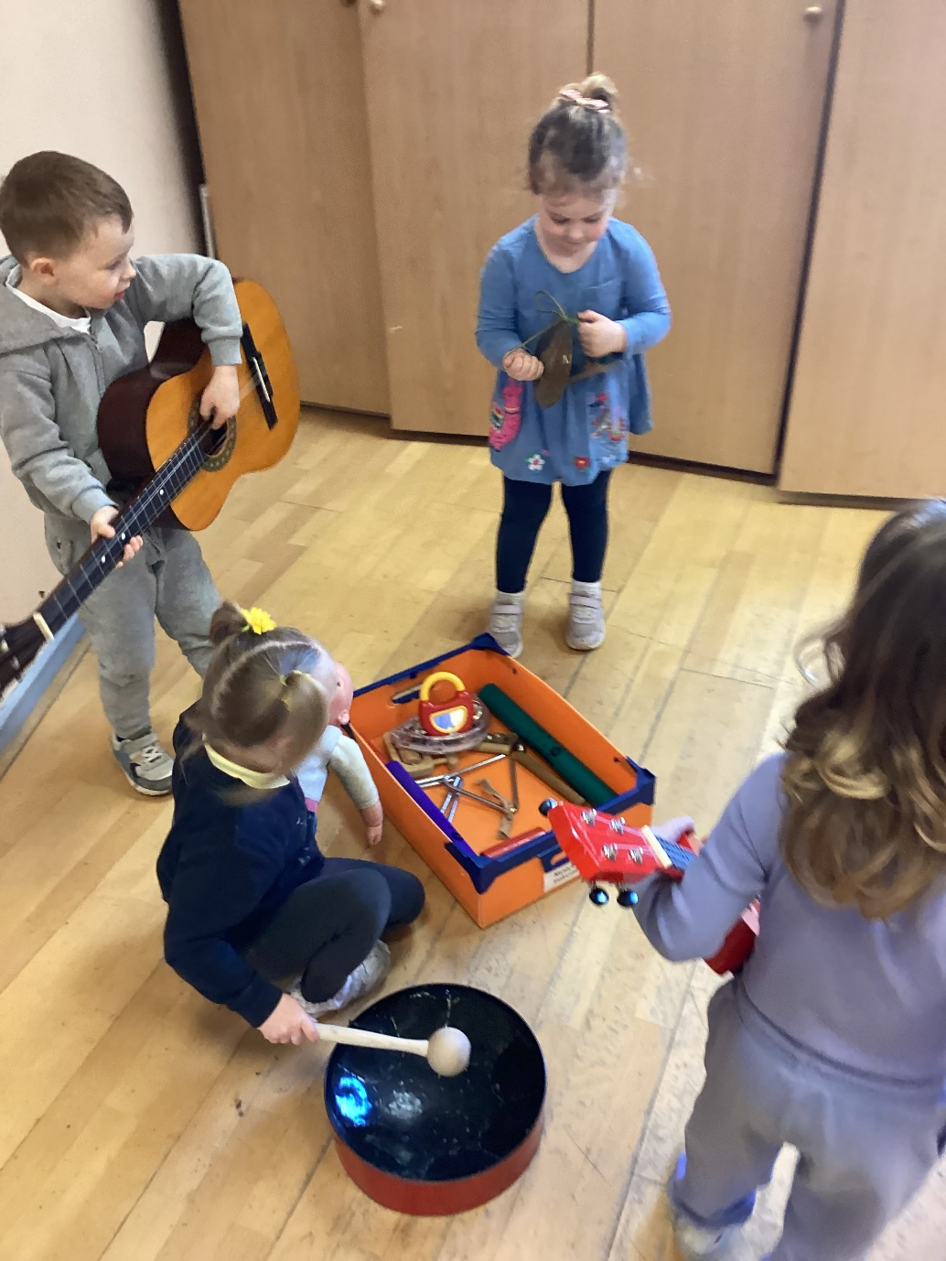
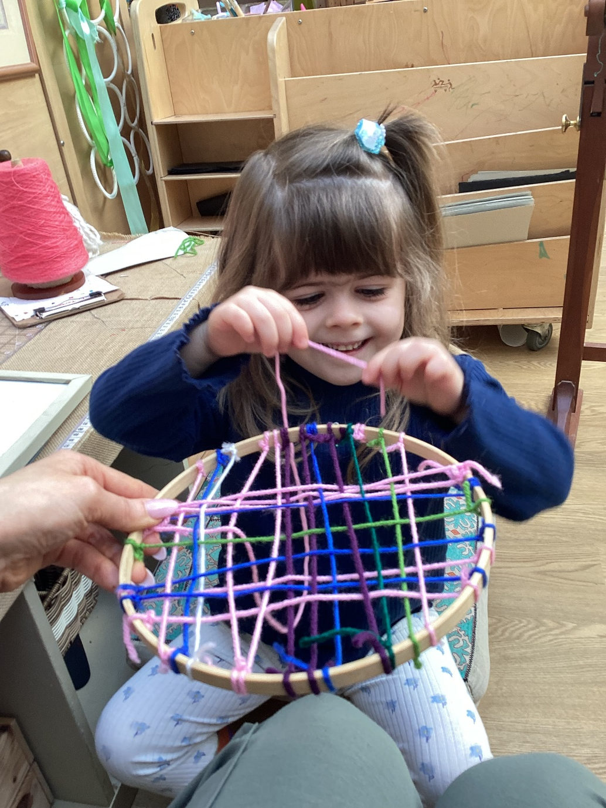
Successes & Achievements
The children have been researching Scottish music and dance and learning the Highland fling. Children have been exploring musical instruments such as the guitar, ukulele, drums, and flute—investigating how they produce sound and playing along to the rhythm of familiar songs. Their interest extended to written music, where they explored symbols and learned how many beats each represents. | While exploring Highland Fling videos, the children noticed the traditional tartan kilts worn by Scottish dancers. This led to research into family tartans, where they discovered the unique colours and patterns linked to different surnames. Inspired, the children designed their own nursery tartan, demonstrating pattern-making skills by crossing vertical and horizontal lines using colours from their nursery groups. In order to create our tartan, the children demonstrated their weaving skills, following positional and directional language to weave coloured strands of wool create the pattern on an embroidery hoop. The children then discussed how we could make our nursery tartan as part of our nursery logo.

Slide 7
“
HOW SUCCESSFUL HAVE WE BEEN IN IMPROVING OUR CENTRE?
”

Slide 8
Improvement Priority 1: Practitioners will have a clear and visible understanding of Froebelian values and principals embraced within our pedagogical approach.
All staff have developed a deeper understanding and knowledge of Froebelian principles and practice, ensuring a whole centre approach is Froebelian informed and embraces our pedagogical beliefs. All staff report to feeling more confident in linking their practice to Froebelian principles, ensuring children experience a responsive and enabling environment that provides a rich variety of learning opportunities. | Our approach to children’s learning is now understood by all staff, giving children the time, space and freedom to become immersed in deeper open-ended play experiences, Our play-based learning environments are conducive to children making choices for themselves, solving problems independently and pursuing their own interests. Staff have a deeper understanding of ‘freedom with guidance’ allowing all children time to be independent and enabling them to take ownership and direction of their own learning. | A variety of rich first-hand learning experiences are encouraging almost all of our children to build connections with the wider world and their place within it. All staff are familiar and will now routinely make use of the online resources and training opportunities available on The Froebel Trust Network. All staff completed a practitioner enquiry exercise to showcase their understanding and delivery of Froebelian principles into practice within individual learning areas.

Slide 9
Improvement Priority 2: To raise attainment in literacy with a priority focus on syllables, letters: their sounds and purpose.
Four staff are now trained in Talk for Writing, and have cascaded this information within the team, ensuring there is a shared consistent approach in place; all practitioners are confident with aspects of Talk for Writing and putting storytelling into practice which align with existing practice and pedagogy. Our continuous provision is rich in resources to support purposeful learning in literacy, which has supported staff to ensure that resources in the environment challenge children in their thinking and allow them to embed and apply concepts linked to literacy in a holistic way. By using a more interactive approach to reading the majority of children are more actively engaged in storytelling and are becoming more involved in extending the initial story. | Froebelian mother songs such as Pat a Cake, and London Bridge is Falling Down are now a core part of practice and are more frequently used within the playroom; practitioner confidence is increased, and the repetition of Mother Songs is supporting all children's use of language helping them to become more familiar with phases and sounds and building stronger concepts of rhyme. Books are displayed in all areas, allowing children to make connections in their learning and allow practitioners to create opportunities to link literacy and storytelling to learning experiences. Almost all children are showing increased engagement and participation in reading though storytelling: storytelling happening in several areas across the playroom children are engaging with stories for longer periods of time children are more familiar with stories and are beginning to change aspects of stories/add more information to stories children are acting out their own stories children have been creating their own simple stories. | Evaluation of the data collected from the Progression Tool, has identified that of our pre-school children: 80% are demonstrating consistency within ‘I can identify and tap out syllables’ (75% increase from May ’25), 80% are demonstrating consistency within ‘I can explore some letters and their sounds’ Book bug sessions have increased the majority of our parents understanding with how to support their child’s learning in syllables and recognising some letters and their sounds in home learning. The majority of our pre-school children are developing concepts linked to letters and sounds (for example recognising their own first name, recognising more letters of their name in the environment around them and recognising words and other names which start with the same letter.

Slide 10
Improvement Priority 3: To embed RNRA’s Nurture Principle – Learning is understood developmentally into our practice.
All staff have been trained in R.N.R.A.’s Nurture Principle – ‘Learning is understood Developmentally,” ensuring an appropriate and individualised methodology is embedded within our pedagogical approach. Moderation of the Leuven Scale (which is used to monitor children’s emotions and engagement) has ensured a consistency between staff opinions during observations within wellbeing and involvement. Children’s personal plans are more detailed and individualised, giving a holistic view of the child and their family; ensuring all personal needs/circumstances are recorded, updated and supported in an equitable way. | A variety of approaches are used to gather information, for example Leuven Scale, Shanarri indicators, STAR analysis, Circle and Teach for Talking approaches, ensuring a complete approach to assessment is observed, and all relevant information gathered. All staff have a deeper understanding of the importance of having a more holistic approach to assessment and planning and recognise the importance of setting individual learning targets that are informed by the child's emotional age as well as their ability within curricular areas. Key workers are attuned to and consider all child’s emotional age as well as their ability within curricular areas when planning for children’s individual next steps, ensuring all children have access to a curriculum that is designed around individual learning styles and developmentally appropriate experiences. | Our pedagogical approach considers that our children may have different prior learning experiences which impacts on their ability to learn and ensure that the curriculum is adapted to reflect the needs of all children socially and emotionally as well as in their learning needs – creating an environment where all children can thrive and engage in meaningful learning. Triangulation of data has allowed staff within the 3-5 playroom to identify children for targeted support groups, such as Philosophy, and Learning to Listen, enhancing our individual approaches to learning and development and ensuring an equitable approach for all. Wellbeing meetings give time and opportunity for reflection of targeted groups encouraging a consistent approach to delivery and identification of appropriate next steps.

Slide 11
Key Strengths: Highly motivated, enthusiastic children who enjoy learning and make excellent progress. A dedicated, nurturing and motivated staff team who are embracing the shared vision, values and aims of Ferguslie Early Learning and Childcare Centre. An extensive range of challenging and rich learning experiences which meet children’s individual needs. Strong personal relationships with parents and carers. Effective partnerships with other professionals. The strong, united and compassionate leadership of the Head and Depute Head of Centre
OUR NEXT STEPS – PRIORITIES FOR 2025-2026 We have made very good progress during session 2024-25 and we will use the improvement priorities listed below to build on this progress moving forward. To enhance our partnership with parents/carers enabling them to feel more confident to engage and be involved in their children’s learning. To introduce The Mosaic Approach into the setting to better understand children’s perspectives and increase learner participation. To embed RNRA’s Nurture Principle – All behaviour is communication. Full details of the improvement priorities and actions are detailed on the establishment improvement plan which can be accessed via: www.Ferguslie-elcc.co.uk

Slide 12
Thank you
Establishment Name: Ferguslie Early Learning and Childcare Centre Address;: 76 Blackstoun Road, Paisley, PA3 1NT Phone 0300 300 1464 Website: www.Ferguslie-elcc.co.uk Facebook: Ferguslie Early Learning Childcare Centre
HAVE YOUR SAY! Please take the opportunity to share your thoughts with us as we use feedback to help us make improvements to the centre. You can do this by speaking to staff, participating in parent/carer meetings, responding to questionnaires/surveys and by completing evaluations at events.

