Slide 1
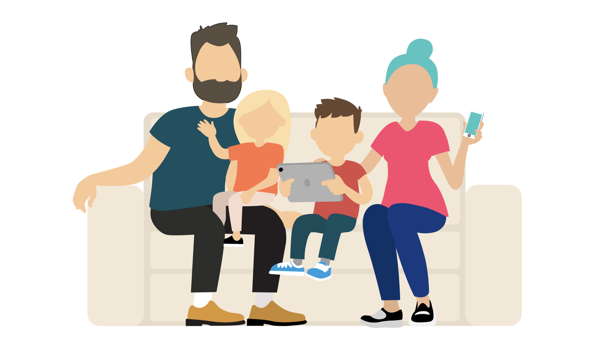
Session 3
ELC Setting Culture

Slide 2
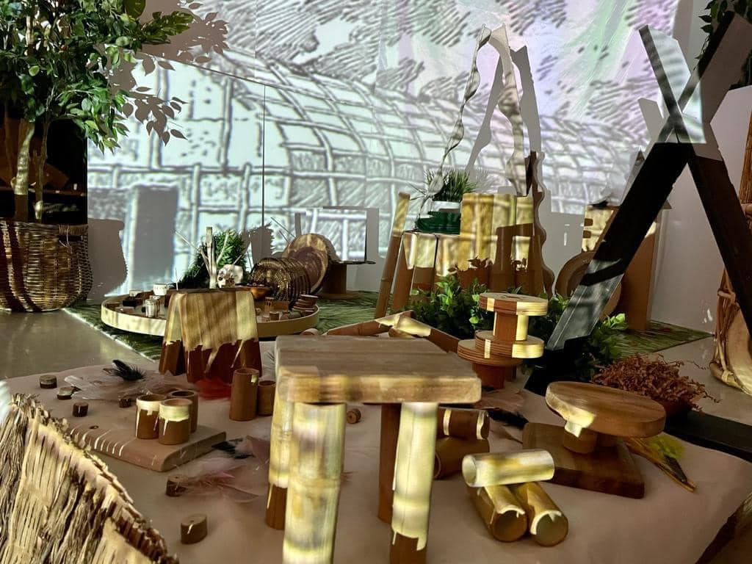
Digital technology is used throughout the ELC setting, where appropriate.
Notes:
ELC culture.
An ethos of learning together, growth mind set, problem solving. Not just within our setting but within our local community. Where can DT help us?
Considered use of technology and makes informed decisions about when to not use technology (supported by current/emerging research and the individual needs of children and families). Technology that enhances, enriches, helps us and helping families to understand why we choose what we choose to explore.
For example, why we might offer drawing apps when we have an array of art materials? What value would be added here? Would it be to record the process via screen record and capture the child’s audio description? Careful thought is given to resources/experiences in terms of continuous provision at early level, for experiences to continue and be built upon in P1 (transition).
Opportunities for parents/carers to learn about the advantages of digital technology and how to support children’s digital wellbeing and explore experiences safely and securely.
There is current research about parents’ conflicting views about screentime, we can support families to recognise DT can be screen free, digital thermometers, stop watches, torches, light projections, audio.
We can also support families with digital wellbeing/worries about screentime by inviting them to learn with us and make choices, again current research tells us parents as role models don’t always recognise learning opportunities with DT at home “should think aloud as they use technology, explaining thought processes and involving children in simple tasks, such as online shopping, which provide language rich opportunities.”
Not about the device but about how it is offered to children. We can role model this during stay and play, try at home activities etc.
How digital technology can support early language and literacy outcomes in early years

Slide 3

Setting Culture Evidence…
Strategy and improvement plan
Transition Sway collaboration
P6 Buddy feedback Sway collaboration
Outdoor area audit
Team planning meeting minutes Feb 2024re parent support to access LJs and accessibility help & parent feedback.
Newsletter Oct 23 staff and children "Learning together" digital books
Stay & Play CRIS Storytimes parent feedback
Photos of community walks "passcode treasure hunts"
Notes:
What might this look like? Evidence.

Slide 4
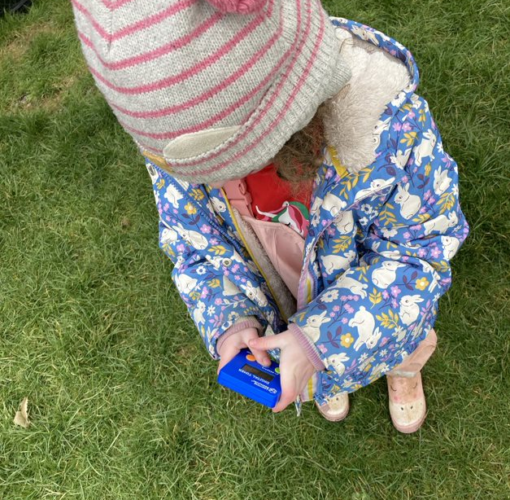
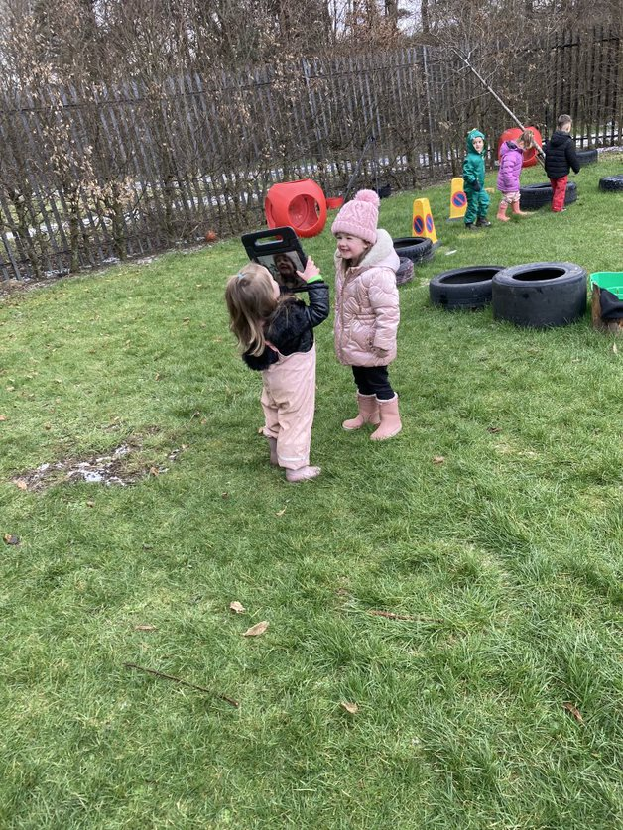
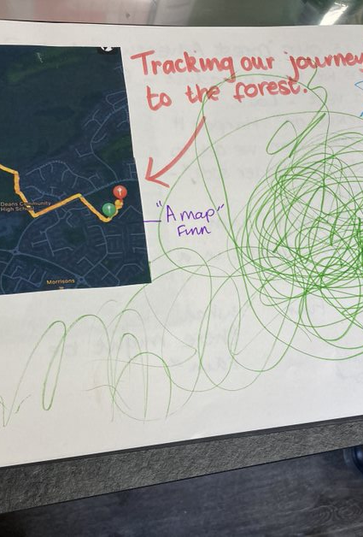
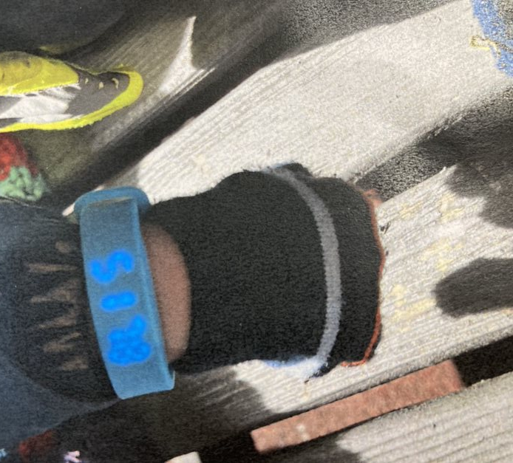
Notes:
This special recognition award has been designed to support ELC settings to integrate digital technologies into children’s experiences of learning through play, both outside and indoors. It is all about open ended opportunities to learn with and through technology in practical and creative situations, and providing children with flexibility and choice while exploring technology as solutions to solve problems.
Learning with and through technology is recognised and celebrated throughout the framework. This is the main thread.
Photo credit Carmondean and Deans South ELC settings in West Lothian.

Slide 5
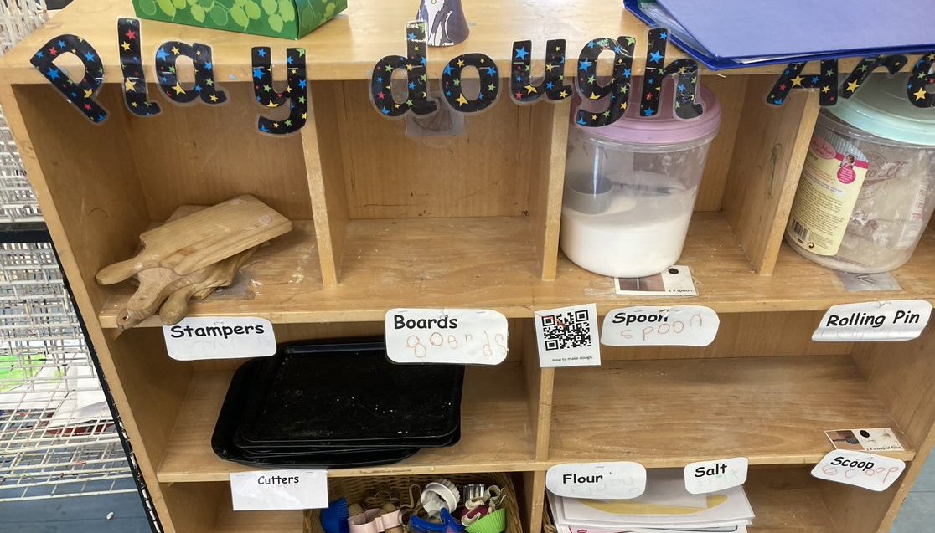
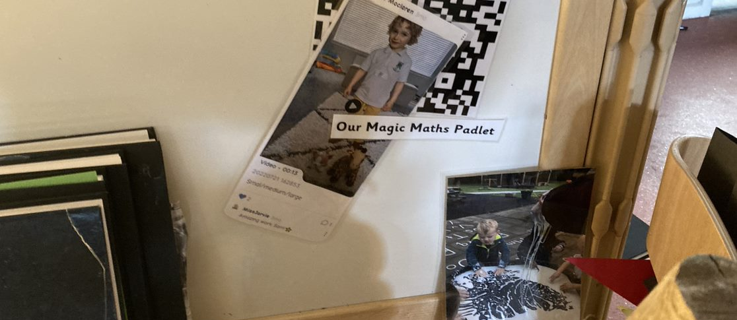
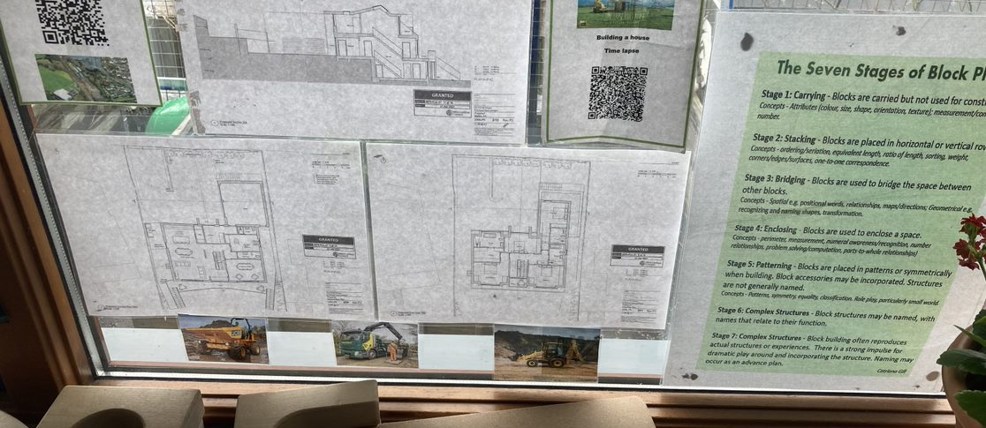
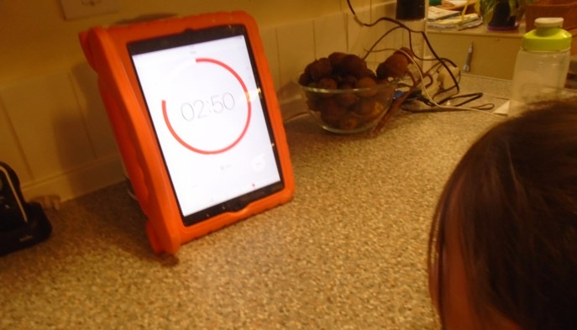
Notes:
The award values the development of a whole setting approach and is specific to Scottish ELC context, mainly (Realising the Ambition:Being me, and also Curriculum for Excellence early level Technologies Experiences and Outcomes, the National Digital Learning and Teaching Strategy for Scotland and current national self-evaluation framework for ELC).
Independent learning vi QR codes, revisit learning via instant access of children's prior experiences recorded on video.
Photo credit BEYC, Carmondean and Deans North ELC settings in West Lothian.

Slide 6
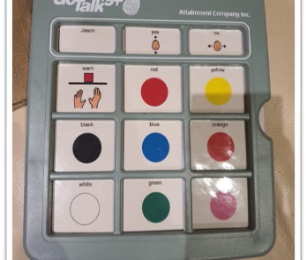
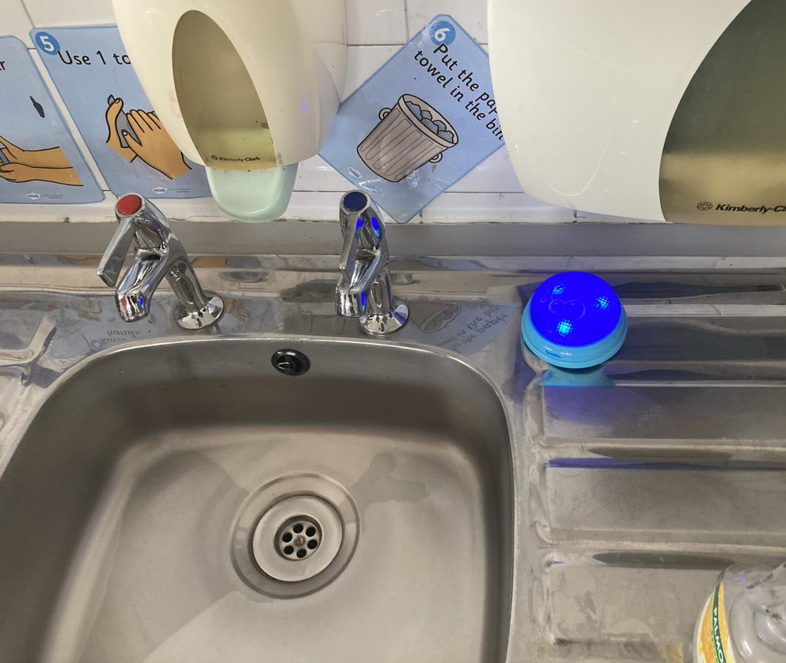
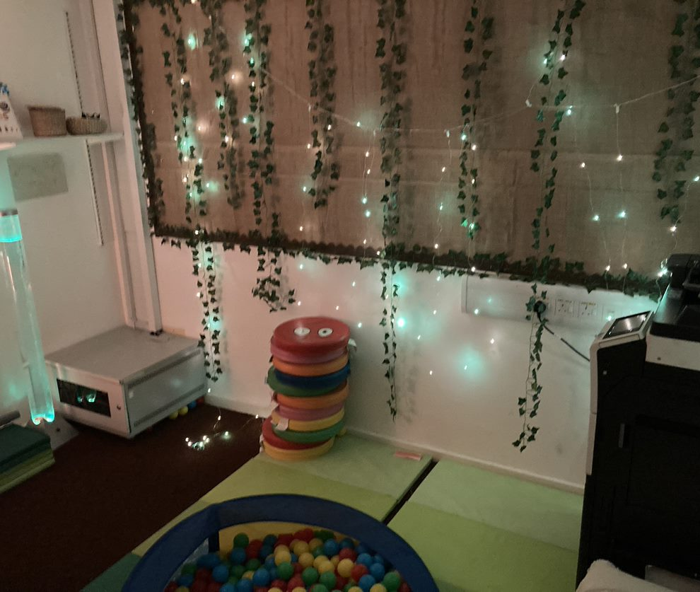
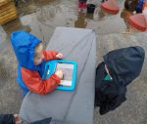
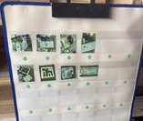
Notes:
This award also aims to support sustainable change, underpinned by CLPL and leadership at all levels. Think small, every day, manageable, achievable goals. Developing confidence and skills of everyone in our setting.
Photo credit BEYC, Carmondean and Deans North ELC settings in West Lothian.

Slide 7
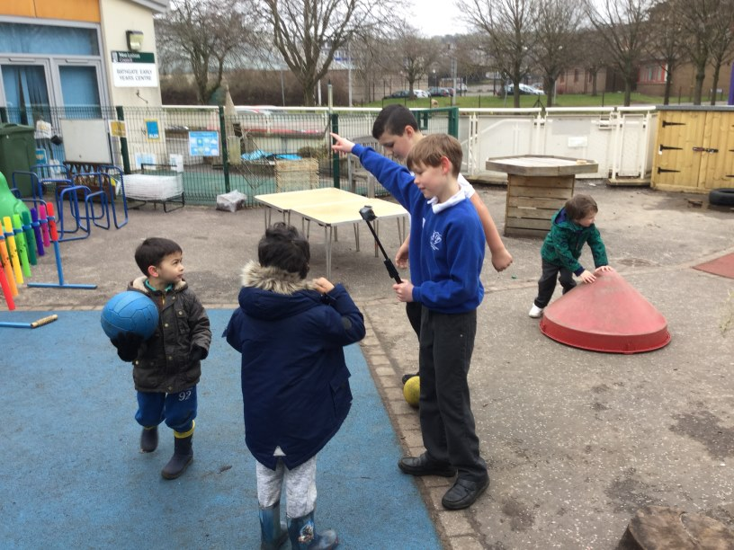
Notes:
Get help where we can!
Transition, vlog co creating/working together.
Very much an ethos of learning from one another.
Photo credit BEYC West Lothian.

Slide 8

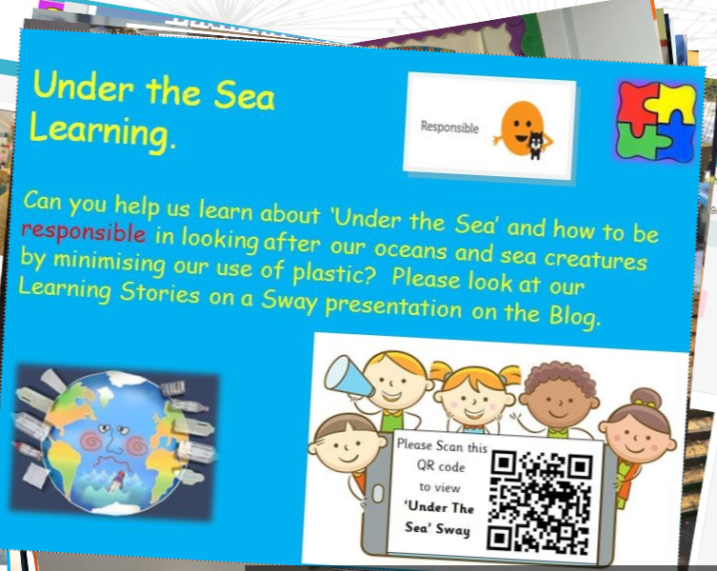
Notes:
And ensuring families/carers are invited to learn with us and support learning too.
That is a huge benefit of DT – supporting and enabling communication and collaboration.
#DigiLearning @BathgateEYC (cloud.microsoft)

Slide 9
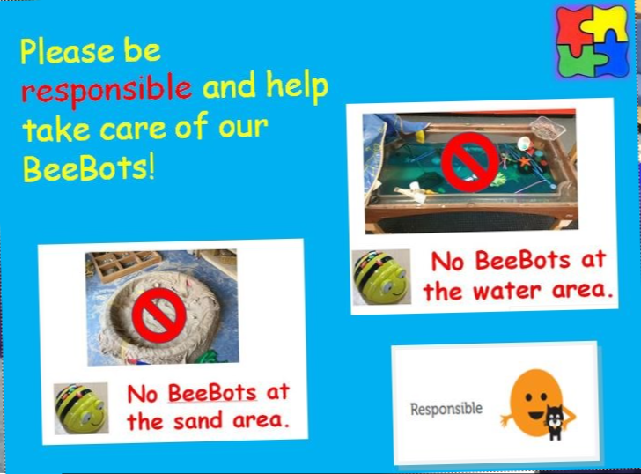
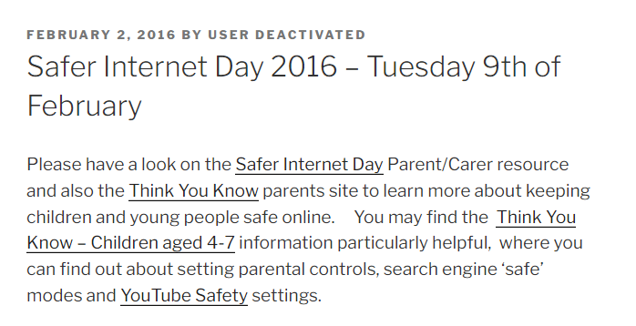
Notes:
As long as we are actively encouraging safe and responsible use for all at the same time.

Slide 10


Notes:
Early & First Level Internet Safety Resources Signposting Webinar. – DigiLearn
https://youtu.be/fRcFtR5O4U8?si=O3eVXFli4YpUnEpn
SID 2025 theme is 'too good to be true', protecting yourself and others from online scams. 11th Feb 2025.
Safer Internet Day 2025 - UK Safer Internet Centre
Education resources - UK Safer Internet Centre
Personally feel it is more suitable for first level. See Detective Digiduck | Childnet

Slide 11

Notes:
Cyber Scotland Week 2025 – DigiLearn
For early level the Bongles is the focus, including GME and ASN sessions.
Cyber Scotland Week - 24 February to 2 March 2025
This year’s theme, Can’t hack it!?, highlights everyday actions everyone can take to improve their cyber resilience. CyberScotland Week - Cyber Scotland
Click
For our youngest of learners this is about raising awareness of cyber security by using secure passwords. (three random words) The Crafty Crows | bongles (thebongles.com)

Slide 12

Evidence example (2023/24) Quarry View Nursery Dundee

Slide 13
Children use technology in their daily play. There is a range of devices in the 3-5 playroom and stage appropriate resources in the younger play areas. Practitioners report that the introduction of the devices for recording learning in e-portfolios has increase both their own and children's interest in technology. Children ask to record and review their own learning on a daily basis as they see the devices being used. The setting has both an up to date website and a private Twitter account. The website provides information about the centre as well as links to relevant web sites such as Parentzone Scotland and the Twitter account. The Twitter account shows regular posts about learning experiences, events in the centre, signposting parents to local and national support and children's achievements both in the setting and from home. There are clear guidelines on how the Twitter account will be used which includes acknowledging children's right to privacy. This year, the centre introduced the presentation of their learning information for parents in the form of a SWAY document. While the movement towards more on-line information fits well with the improvement plan, the centre recognises the needs of a small number of parents/carers and facilitates access to the information by providing the use of one of the centre's devices or issuing a hard copy.
Notes:
Report highlights
Glenbrae Children's Centre, Inverclyde (2022)

Slide 14
Glenwood Family Centre clearly demonstrates that it has a strong digital presence throughout the school. Staff and children are completely at ease with the digital technologies available to them and key practitioners and the pupil Digtal Working Party, ensure that the centre keeps up to date with new developments. In discussions with staff it was clear that a well formulated digital culture had been fully embedded across the whole centre. Through their website and Twitter feed parents/carers are kept fully up to date with the life and work of the centre. Both the website and Twitter are current, vibrant and lively and help to convey all the wonderful learning and teaching that is going on in there. Parents/carers are also able to engage with the centre using, for example, Google Meet to share World Book Day with their children and review meetings are conducted using Teams. There is a paperless ethos in school, with communication with parents/ carers done through email, blogs and QR codes, including the centre's newsletter being created and distributed through Sway. 'Family Fun Bags' are also sent home and parents/carers are able to use QR codes to access relevant videos that they can watch and share with their children.
Notes:
Report highlights
Glenwood Family Centre, Glasgow (2022)

Slide 15
The use of technology helps to instil a sense of community and is part of the nursery culture. Digital technologies are deployed in ways that help children improve their resilience, motivation and self-esteem and to be inclusive, diverse and equal. The ELC has done lots of work on internet safety with children and parents. It's been a big topic. The use of Showbie encourages the children to communicate, share and discuss their work with their peers and parents at home. Across the ELC there is a huge passion and enthusiasm to use technology for teaching and learning - technology is utilised for children to work together. There is no top-down dictatorship on how technology should be utilised, but a collaborative and inclusive approach with both staff and children. The ELC demonstrates how they have not forced new technology into old pedagogy. There has been a paradigm shift. It is about a new pedagogy, different skills
for practitioners and engaged and empowered children supported by digital infrastructure accessible to all children. The centre demonstrates a strong culture of trust and communication between parents / guardians / carers and their children. Practitioners use a variety of digital technologies in their planning and administration. The centre has supported parents in understanding the benefits of using digital technology for learning and provided support in responding to their concerns and helped build their knowledge and confidence.
Notes:
Report highlights
Burgh ELC, Scottish Borders (2024)

Slide 16
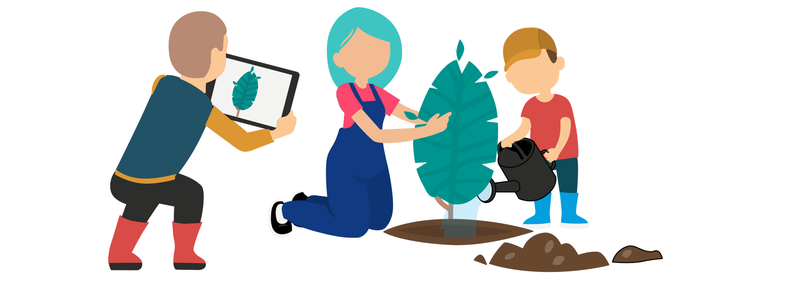
Discussion time

