Slide 1

Leadership & Awards in ELC
DSAS Digital Learning Through Play
in ELC Award
Professional Learning Network
Notes:
Guided by Education Scotland’s Digital Team, you will work together to make quality improvements in digital learning in your ELC settings (maximum 30 settings).
Collectively, the group will explore each area of the DSAS Framework for ELC and investigate where digital technologies provide opportunities to design unique learning spaces outside and indoors, (enabling children to play and learn with and through technology) and be guided on how to evidence this.
At the end of the program settings will apply for award validation.
https://newsroom.east-ayrshire.gov.uk/news/catrine-early-childhood-centre-becomes-first-ecc-in-scotland-to-earn-digital-schools-award

Slide 2
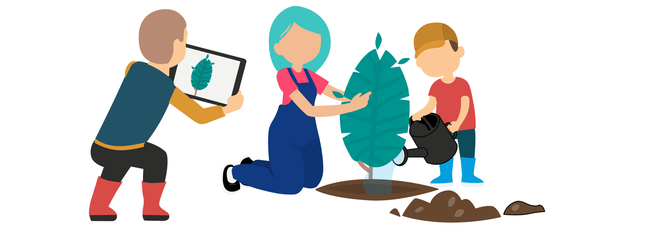
Session 2
Use of DT within your curriculum

Slide 3
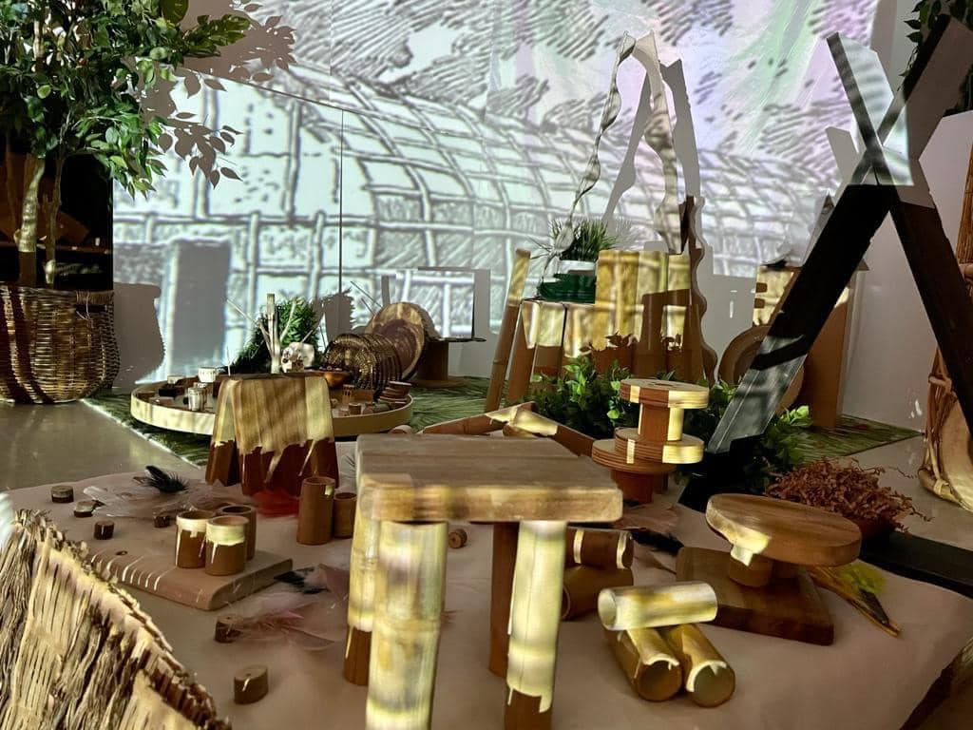
Practitioners integrate digital technology through child centred pedagogy, outdoors and inside.
Notes:
Technologies within the curriculum.
The use of digital technologies to bring meaningful experiences virtually to the setting e.g. through sound/visual media/projections.
Considered developmentally appropriate technology that works for your learners. Practical uses to solve problems such as exploring a digital timer when baking, using a step counter when walking, slo-motion camera when jumping, and creative uses to communicate a message/thoughts/feeling such as making an audio recording the bird song in the garden, or various sounds to create your own listening lotto type game.
This is our focus session for Session 2.

Slide 4
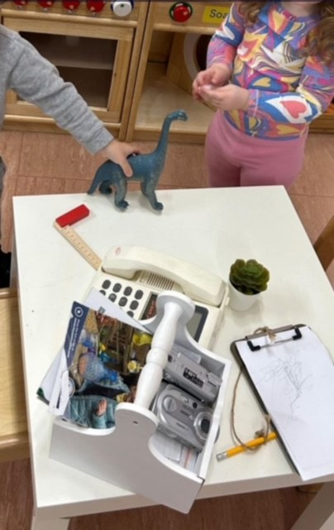
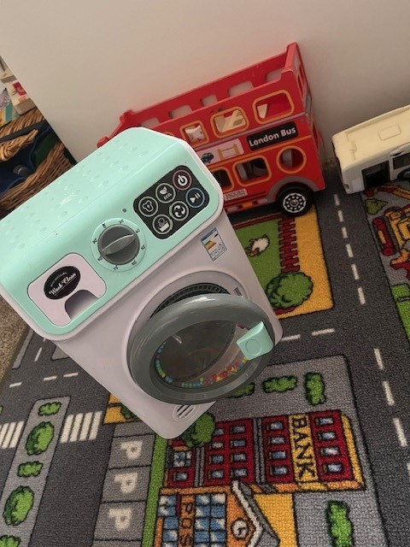
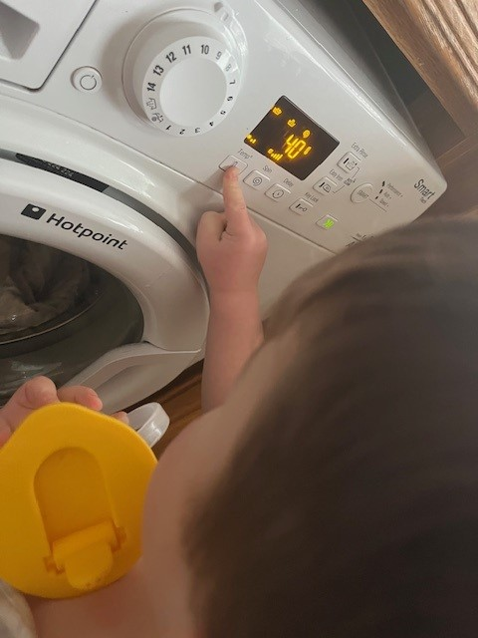

Slide 5

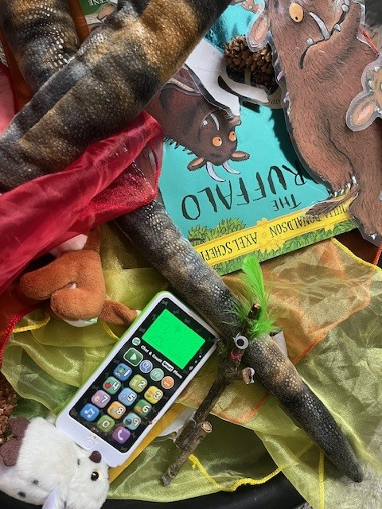
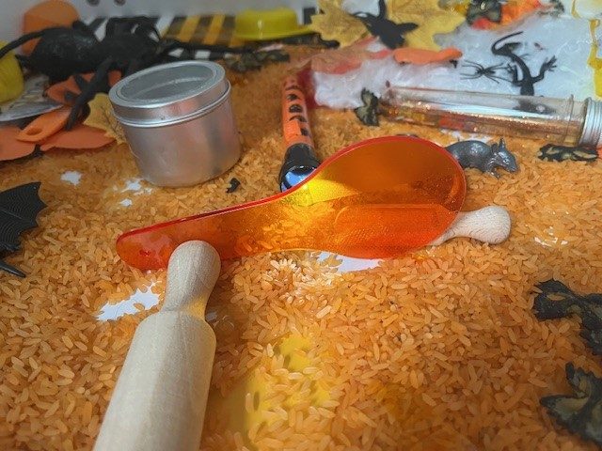

Slide 6
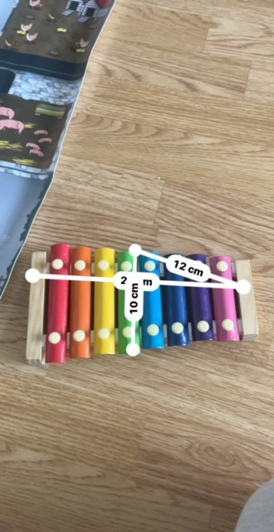
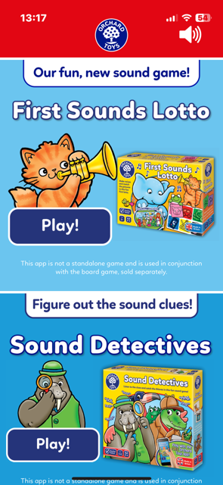
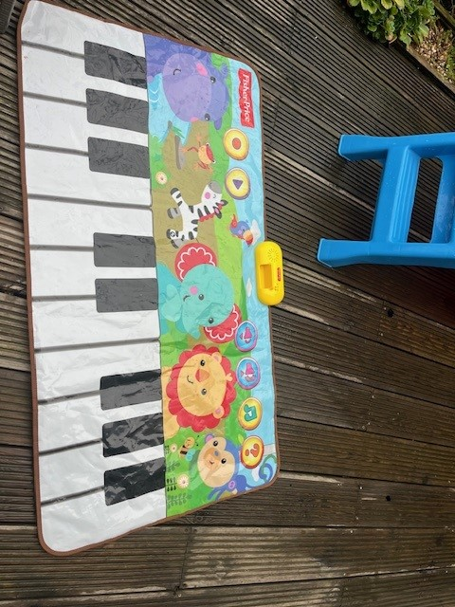

Slide 7

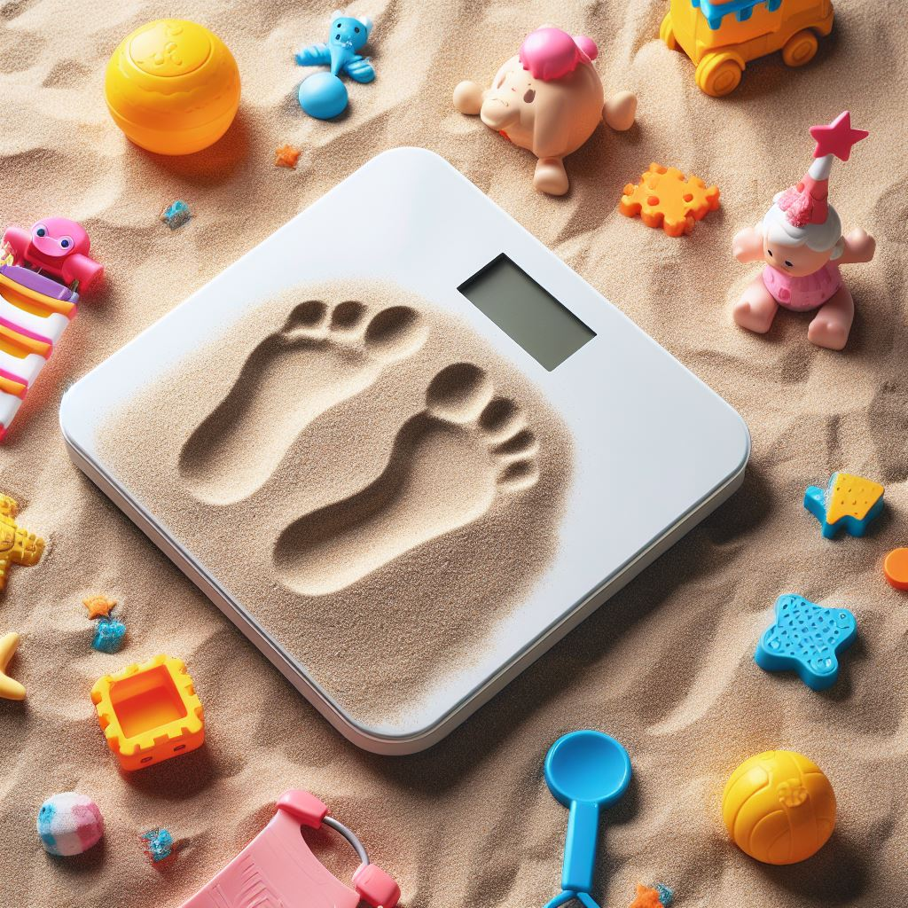

Slide 8
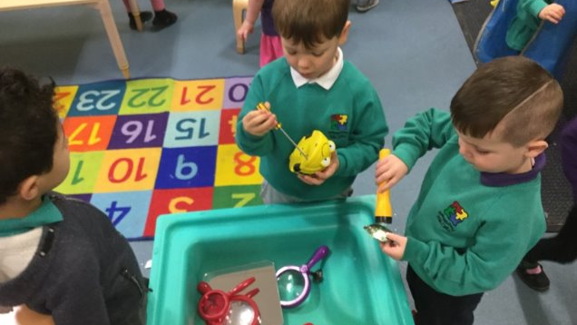

Slide 9
Loose parts
There is s evidence that all children love to interact with variable materials and shapes; smells and other physical phenomena, such as electricity, magnetism and gravity; media such as gases and fluids; sounds, music, motion; chemical interactions, cooking and fire; and other humans, and animals, plants, words, concepts and ideas. With all these things all children love to play, experiment, discover and invent and have fun.
Nicholson, S. 1971:30-34
Notes:
Light and sound.
Loose parts play theory was devised by architect Simon Nicholson in the 1970s, developing the idea that moveable materials that can be constructed and taken apart create limitless possibilities for creativity. In his theory of Loose Parts Play, he cites playing with forces as an integral part of enriched play environments.
Nicholson described loose parts as ‘variables’ and provided examples such as....
Nicholson, S. (1971). How NOT to Cheat Children: The Theory of Loose Parts. Landscape Architecture, 62(1), 30–34. http://www.jstor.org/stable/44663886
Loose-Parts-Play-Toolkit-2019-web.pdf (inspiringscotland.org.uk)

Slide 10
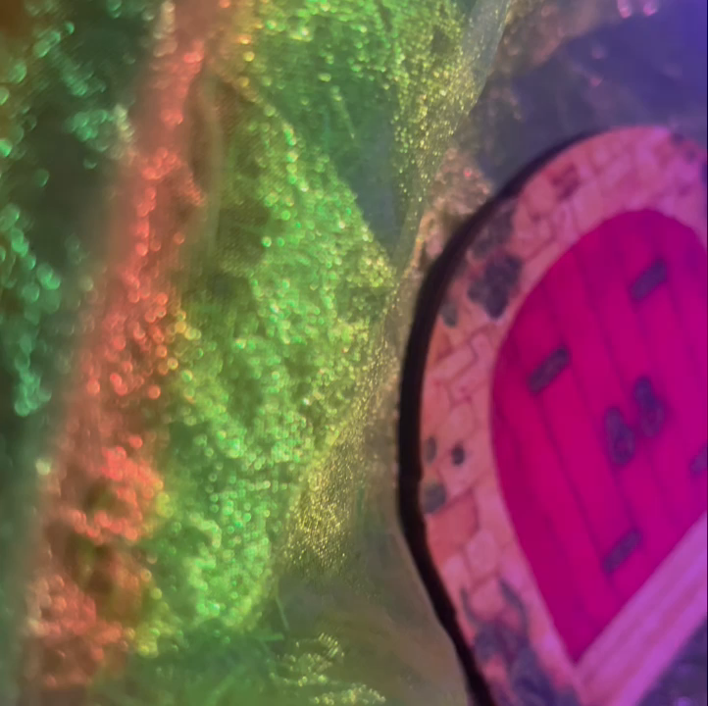
Notes:
Example.
Metallic material, sheer material, battery colour changing light, little doors, wooden fairy silhouettes.
The simple light opens up many more possibilities. Reflection, shadow, opacity, transparency, translucency and colour can be linked to feeling/emotion in imaginative play.
What about the sound?
Talking button/postcard with a recording from https://sound-effects.bbcrewind.co.uk/

Slide 11
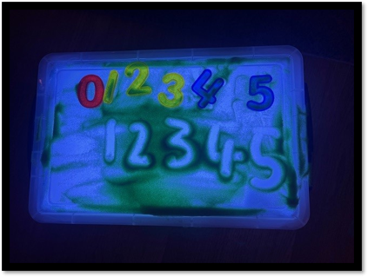
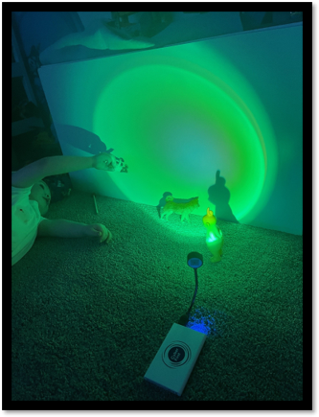
Notes:
Power of light.. Interesting spaces.
Facts/evidence/research info.
Light is a form of energy that reflects, refracts, scatters or creates shadows on surfaces.
On smooth surfaces light passes through uninterrupted and is transparent. Think of a glass window.
On rough surfaces the passage of light is interrupted and appears translucent. Think of frosted glass. https://www.bbc.co.uk/bitesize/articles/z92k239#zht4jfr
Bringing digital and non-digital together tools together to explore how they connect and interact, how they are inviting, interesting, and you can literally be immersed in your explorations and investigations in a wonder filled environment.
Interesting reading:
Exploring Natural Connections with Light, Reflection and Sha - Treveton, Natashja, Halton, Nicole, Buchan, Niki | 9781925145106 | Amazon.com.au | Books
Halton, Nicole & Treveton, Natashja & Buchan, Niki. 2016, Exploring natural connections with light, reflection and shadow / Nicole Halton, Natashja Treveton & Niki Buchan. Teaching Solutions Blairgowrie, Victoria
The interplay of light and materials and how light interacts with different objects creating various visual and stimulation sensory experiences is not only creating intriguing invitations, but also enables scientific investigation, which led by curiosity, in turn promotes higher level thinking.
This light can give the illusion of sun light shining through a prism, separating the colours out into the 7 colours of the rainbow.
Visible light and additive mixing of light guide for KS3 physics students - BBC Bitesize
Unique learning spaces.
Laptops, projectors, digital microscopes, cameras, screen mirroring, talking buttons, postcards, voice recorders.
Good opportunity to discuss copyright, permission/consent.
Interest in space, solar system "back drop" providing an immersive experience for children gluing and sticking their space craft cardboard boxes together. Sound and visual inspiration.
Bringing experiences virtually, the beach? Have all children been to the ocean, heard the waves crashing while they have their feet in the sand?
Multi sensory experiences create strong connections see - (Shin,2019)
Shin, M. (2019) ‘Exploring multisensory experiences in infants’ learning and development in the child care classrooms’, Early Child Development and Care, 191(13), pp. 2116–2127. doi: 10.1080/03004430.2019.1695127.
Nava, E. et al. (2024) 'The emergence of the multisensory brain: From the womb to the first steps', iScience, 27(1), p. 108758. Available at: https://www.tandfonline.com/doi/full/10.1080/03004430.2019.1695127 .
Multisensory integration and neuroplasticity in the human cerebral cortex (degruyter.com)
Unravelling the multisensory learning advantage: Different patterns of within and across frequency-specific interactions drive uni- and multisensory neuroplasticity - ScienceDirect

Slide 12

DT in Curriculum Evidence…
Music selection & audio recordings observations
Stay and Play photos & feedback forms
Our Body Floor book pages - Thermometers & scales indoors & outside
"Safe" CRIS observations
Journey planning/risk assessing records, weather, maps
Recordings from talking buttons lunch & snack evaluations
Communication symbols for all
Strategy and improvement plan
Videos of Tinker Tray
Notes:
What might this look like? Evidence.
Children's exposure to different types of DT, working, not working, real, toy, symbolic

Slide 13

Evidence example (2023/24) Quarry View Nursery Dundee

Slide 14
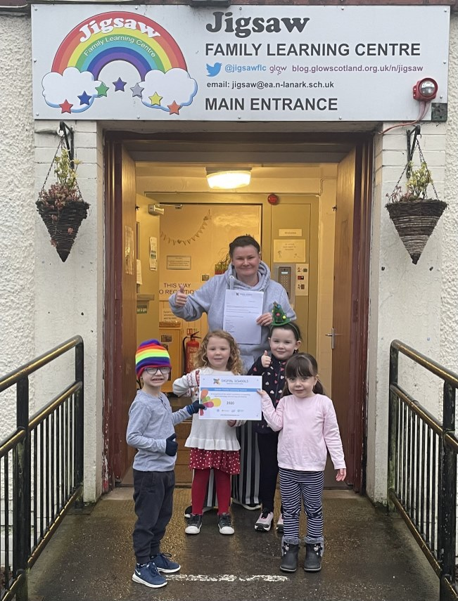
Evidence example (2020) Jigsaw Family Learning Centre North Lanarkshire
Notes:
Report highlights

Slide 15
The validation visit included visits to classes. While this only gave me a snapshot of their ongoing work it was clear from discussions with learners and staff that digital technologies were part and parcel of their everyday work. I didn’t see any evidence of digital technologies being used to support additional needs, but staff were able to tell me about software and websites they used to target specific needs. I was particularly impressed by the use of software to support sign language Given the limited access staff and pupils have to technology staff were using their own iPads to support learners while they waited for an increased provision from the Local Authority.
Notes:
Report highlights
Castlemilk Family Learning Centre, Glasgow (2019)

Slide 16
…. Across the centre there is a huge passion and enthusiasm to use technology for teaching and learning technology is utilised for children to work together, for example, the children were learning about Police Officers and the centre had their very own "crime" happen in the ECC. The children used lots of technology to try and find clues to find out who committed the "crime." The children were really engaged in this activity and had lots of fun working with the wide range of technology. The whole centre staff team were involved: depute manager, senior, 7 practitioners, 2 support assistants, clerical and janitorial staff all supported to provide the best quality learning experience. The children worked as a team to figure out where the clues might be and might lead us. The depute manager dressed up as the thief and the crime was recorded by another member of staff. The video was then shown to the children by the Janitor who acted as though this had been retrieved from the CCTV cameras, creating realism to the crime. This then led the children to the scene of the crime (the office) where they found a clerical worker hiding under her desk eating all the managements biscuits. This provided the children with the opportunity to develop a wide range of skills such as problem solving, teamwork, communication, leadership and so much more. It also shows how involved and dedicated to providing quality learning experience everyone who works in Catrine ECC is. The culture is very much inclusive…
Notes:
Report highlights
Catrine Early Childhood Centre, East Ayrshire (2024)

Slide 17
The staff at Tulliallan Nursery are very much a team. I felt they had a wealth of experience and were beginning to develop more ideas for harnessing the potential of learning through digital technology. They were skilled, highly motivated and able to deliver the Early Level experiences and outcomes by ‘intentionally promoting’ them within the play-based setting. As their pupils were gaining success and enjoyment with their creative skills, their enthusiasm was growing, and they were choosing to explore digital technologies further. The pupils themselves were driving this forward. By sharing learning on Twitter, parents could see the children were not just having ‘screen time’ but were being offered opportunities to work collaboratively, think critically and be creative, and parents were very supportive of the school’s endeavours. The nursery is fully inclusive and caters for the needs of all learners. A range of software and devices allowed all pupils to make use of technology. Guidance on the use of assistive technologies was provided by the Local Authority and staff were aware of who to contact should they require technology for pupils with more complex ASN. There are Acceptable Use Policies for staff and pupils of the school and very simple pictorial representation of the AUP and Housekeeping Rules for pupils in the nursery. This was on display......
Notes:
Report highlights
Tulliallan Nursery, Fife (2019)

Slide 18
… Staff are very aware, through audits and discussions with pupils and parents, of the amount of time children were online at home, and they felt that often one-to-one drip feed of e-safety issues, is appropriate, as this can be tailored to the child’s individual understanding at this level. I think this is a very sensible and responsive approach for this age group. Parental advice on internet safety was given on the school’s website, along with appropriate links to external sites.
Notes:
Report highlights
Tulliallan Nursery, Fife (2019)

Slide 19
Discussion time
Notes:
Nursery World - 'Why we should be embracing screen time'
We need to move beyond the fear of technology and instead focus on its potential to enhance learning. Early years settings are perfectly positioned to introduce children to the world of technology in a way that is playful, exploratory, and developmentally appropriate.
Whether children are pressing buttons, exploring light and shadows or engaging with a screen, technology can be a valuable aspect of children’s learning and development. Think ‘activity first, technology second’ to ensure that the child, and their needs, is always the priority.

Slide 20
Smart APP 16 Million Color Sunset Lamp Led Projector Home Decoration Photography Background Night Light (1 PCS): Amazon.co.uk: Lighting | 5.99
Pup Go Dinosaur Torch and Projector with 3 Discs 24 Images, Dinosaur Toys for Boys, Cool Kids Torch, Dinasour Gifts Ideas Present for Toddler and Age 3 4 5 6 7 Year Old Children(Dino) : Amazon.co.uk: Toys & Games | 9.99
Digital Easy-Read Talking Scales | Weight & Measuremen | TTS (tts-group.co.uk) | 82.79
10 Mini Talk-Time Recordable Cards 30 Seconds | Talk-Time | TTS (tts-group.co.uk) | 55.19
200x Zoom Kids Portable Microscope Pocket Handheld Mini Microscope with LED Light | 11.98
Mini Projector, VISSPL 1080P Full HD Portable Projector, Outdoor | 59.99
AsperX 2-Pack Power Bank Portable Charger Fast Charging (used with Sunset lamp) | 11.19
Talking Food Thermometer : Amazon.co.uk: Home & Kitchen | 26.94
Digital Display Roller Ruler, Long Battery Life Digital Measuring Tape | 19.49
Walking Step Counter for Men Women,Smart Bracelet Watch, | 7.99
6 Recordable Talking Pegs Assorted Colours | TTS (tts-group.co.uk) | 59.99
TuoTu Fairy Lights, Battery Operated Christmas String Lights with 8 Flashing Modes and 8-16 Hours Timer，5M/16ft 50 LED Copper Wire Light (Multi-Colored) : Amazon.co.uk: Lighting | 5.99
2 Pcs Submersible LED Lights Remote Control Battery Powered, RGB Multi Color Changing Waterproof Light for Pool, Vase Base, Spa, Aquarium, Pond, Hot Tub, Decoration, Party : Amazon.co.uk: Lighting | 9.99
DIY lightbox box | 6.59
DIY lightbox box lights | 9.99
Tinfoil on inside of box base/sides & white baking paper/tissue paper on inside of lid
Notes:
Resources.
These are links to the various bits and pieces of DT (or similar) I have gathered over the last couple of years (as a parent and for demo purposes in workshops with practitioners). These are not recommendations or endorsements but simply a selection of items that you may find useful to consider.

